Slide 1
6clicks Startup & Growth Edition
Extended Version

Slide 2
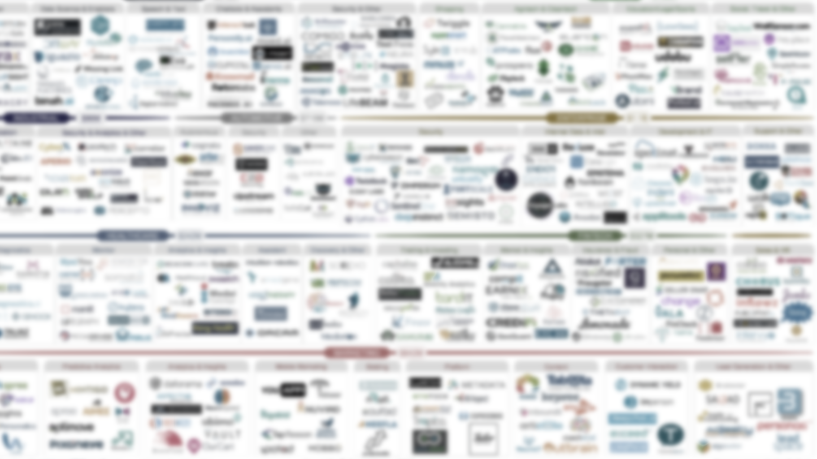
Wanting to mature your risk and compliance capability?
Good news.
You’ve got plenty of tools to choose from.

Slide 3
With spreadsheets and software options, getting started has never been easier.
… but getting started right is tougher than ever.

Slide 4
Where do you even begin?

Slide 5
You know you need to check suppliers compliance… | So you send them a due-diligence spreadsheet…
You know the board expects an updated risk register this week… | So you email the last spreadsheet and ask if there are any updates…
You see companies getting hit by ransomware… | So you send out an email to all start to ‘watch out’…
You know you need to follow up on the recent internal audit findings… | So you review the report, pull together a spreadsheet and email it to the team…
You receive complaints over email you need to action... | You setup a shared email account and create various folders to sort the inbox to work out where things are at…
You need to make sure people follow policies and do what they have been assigned… | You upload the latest policy to your intranet and send a follow-up email to everyone to review it again….
You need to check controls are effective and people have done what they said they would… | You create a spreadsheet and setup a meeting to talk through where things are at with all control owners…

Slide 6
The problem with that approach: More spreadsheets means more time spent managing your spreadsheets. A lot more.

Slide 7
Your to-do list goes from this:
I need to create a risk register for the divisions across my business

Slide 8
Set up spreadsheet to manage risk registers for the divisions in the company and our board
Setup and process and notifications for management when we have a high-priority incident
Create a form on our website for people to log complaints
Identify new risks that might impact our business
Download the latest regulations and see how these relate to our current obligations
Work out what’s in scope for our next audit
Send out a questionnaires to our suppliers to check their compliance
Check with our advisors if they have a template for a new business continuity policy we need
Create a spreadsheet with the steps we should take if there’s a ransomware attack
Send an email to our board of directors asking them rate our top 20 risks
Pull together a slide for the next management meeting
Pull together a plan for pending ISO 27001 audit
Create a list of remediation actions from the recent privacy impact assessment
Send a list of recent assessment results to our external auditors that need evidence of where things are at
Update our obligations register based on new legislation that’s just passed
Create a report to show management what needs to be done following our last audit
Draft and document and send it out to the owners of our key controls and highest risks for attestations
Review the 122 privacy regulations now around the world and work out which controls we then need to have in place
To this:

Slide 9
All of a sudden, you realize you’re spending more time managing spreadsheets than improving risk management maturity and managing compliance.

Slide 10
But it’s not just you.
When your company depends on spreadsheets and disjointed manual processes, your stakeholders and customers notice.
And not for the right reasons.

Slide 11
The worst part?
As your business grows, you’ll outgrow spreadsheets and manual processes… and have to start again but with an even bigger mess.
Back to where you started.

Slide 12
Set up spreadsheet to manage risk registers for the divisions in the company and our board
Setup and process and notifications for management when we have a high-priority incident
Create a form on our website for people to log complaints
Identify new risks that might impact our business
Download the latest regulations and see how these relate to our current obligations
Work out what’s in scope for our next audit
Send out a questionnaires to our suppliers to check their compliance
Check with our advisors if they have a template for a new business continuity policy we need
Create a spreadsheet with the steps we should take if there’s a ransomware attack
Send an email to our board of directors asking them rate our top 20 risks
Pull together a slide for the next management meeting
Pull together a plan for pending ISO 27001 audit
Create a list of remediation actions from the recent privacy impact assessment
Send a list of recent assessment results to our external auditors that need evidence of where things are at
Update our obligations register based on new legislation that’s just passed
Create a report to show management what needs to be done following our last audit
Draft and document and send it out to the owners of our key controls and highest risks for attestations
Review the 122 privacy regulations now around the world and work out which controls we then need to have in place
Stop wasting your time. Stop wasting your energy. Stop wasting your stakeholders’ goodwill.

Slide 13
Set up spreadsheet to manage risk registers for the divisions in the company and our board
Setup and process and notifications for management when we have a high-priority incident
Create a form on our website for people to log complaints
Identify new risks that might impact our business
Download the latest regulations and see how these relate to our current obligations
Work out what’s in scope for our next audit
Send out a questionnaires to our suppliers to check their compliance
Check with our advisors if they have a template for a new business continuity policy we need
Create a spreadsheet with the steps we should take if there’s a ransomware attack
Send an email to our board of directors asking them rate our top 20 risks
Pull together a slide for the next management meeting
Pull together a plan for pending ISO 27001 audit
Create a list of remediation actions from the recent privacy impact assessment
Send a list of recent assessment results to our external auditors that need evidence of where things are at
Update our obligations register based on new legislation that’s just passed
Create a report to show management what needs to be done following our last audit
Draft and document and send it out to the owners of our key controls and highest risks for attestations
Review the 122 privacy regulations now around the world and work out which controls we then need to have in place
Stop managing spreadsheets. Start risk and compliance right.

Slide 14
Cool story, 6clicks.
If only it were so easy.

Slide 15
If I wanted to do that, I’d need a big software suite.
And big software suites are expensive and complicated.

Slide 16
Yeah. They are.
But what if they weren’t?

Slide 17
What if all the tools you needed to start risk and compliance right lived in one system?

Slide 18
And buying that system didn’t break your budget?

Slide 19
Set up spreadsheet to manage risk registers for the divisions in the company and our board
Setup and process and notifications for management when we have a high-priority incident
Create a form on our website for people to log complaints
Identify new risks that might impact our business
Download the latest regulations and see how these relate to our current obligations
Work out what’s in scope for our next audit
Send out a questionnaires to our suppliers to check their compliance
Check with our advisors if they have a template for a new business continuity policy we need
Create a spreadsheet with the steps we should take if there’s a ransomware attack
Send an email to our board of directors asking them rate our top 20 risks
Pull together a slide for the next management meeting
Pull together a plan for pending ISO 27001 audit
Create a list of remediation actions from the recent privacy impact assessment
Send a list of recent assessment results to our external auditors that need evidence of where things are at
Update our obligations register based on new legislation that’s just passed
Create a report to show management what needs to be done following our last audit
Draft and document and send it out to the owners of our key controls and highest risks for attestations
Review the 122 privacy regulations now around the world and work out which controls we then need to have in place
What if, instead of this…

Slide 20
… scaling your risk and compliance activity looked more like this?
Sign up for 6clicks
Run audits, assessments, manage risks, issues, incidents and more
Integrate 6clicks with 1,000’s of apps you already use and love
Make every part of your company risk savvy and get compliance under control
Get more in control.

Slide 21
How much time would that save you?

Slide 22
And how much better would it be for your stakeholders?

Slide 23
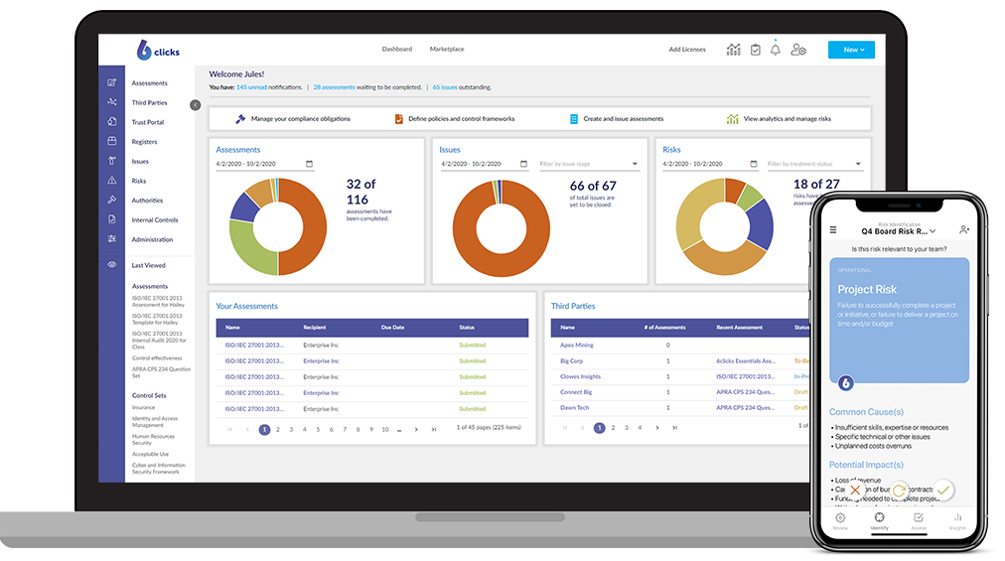
Introducing 6clicks
All the tools you need to start risk and compliance right. Run audits, assessments, manage risks, issues, incidents and actions, define policies and control sets, manage supply chain risk, establish incident management playbooks and run attestations.
Stay organized in the #1 GRC platform for businesses.
All from $4,800 per year.

Slide 24
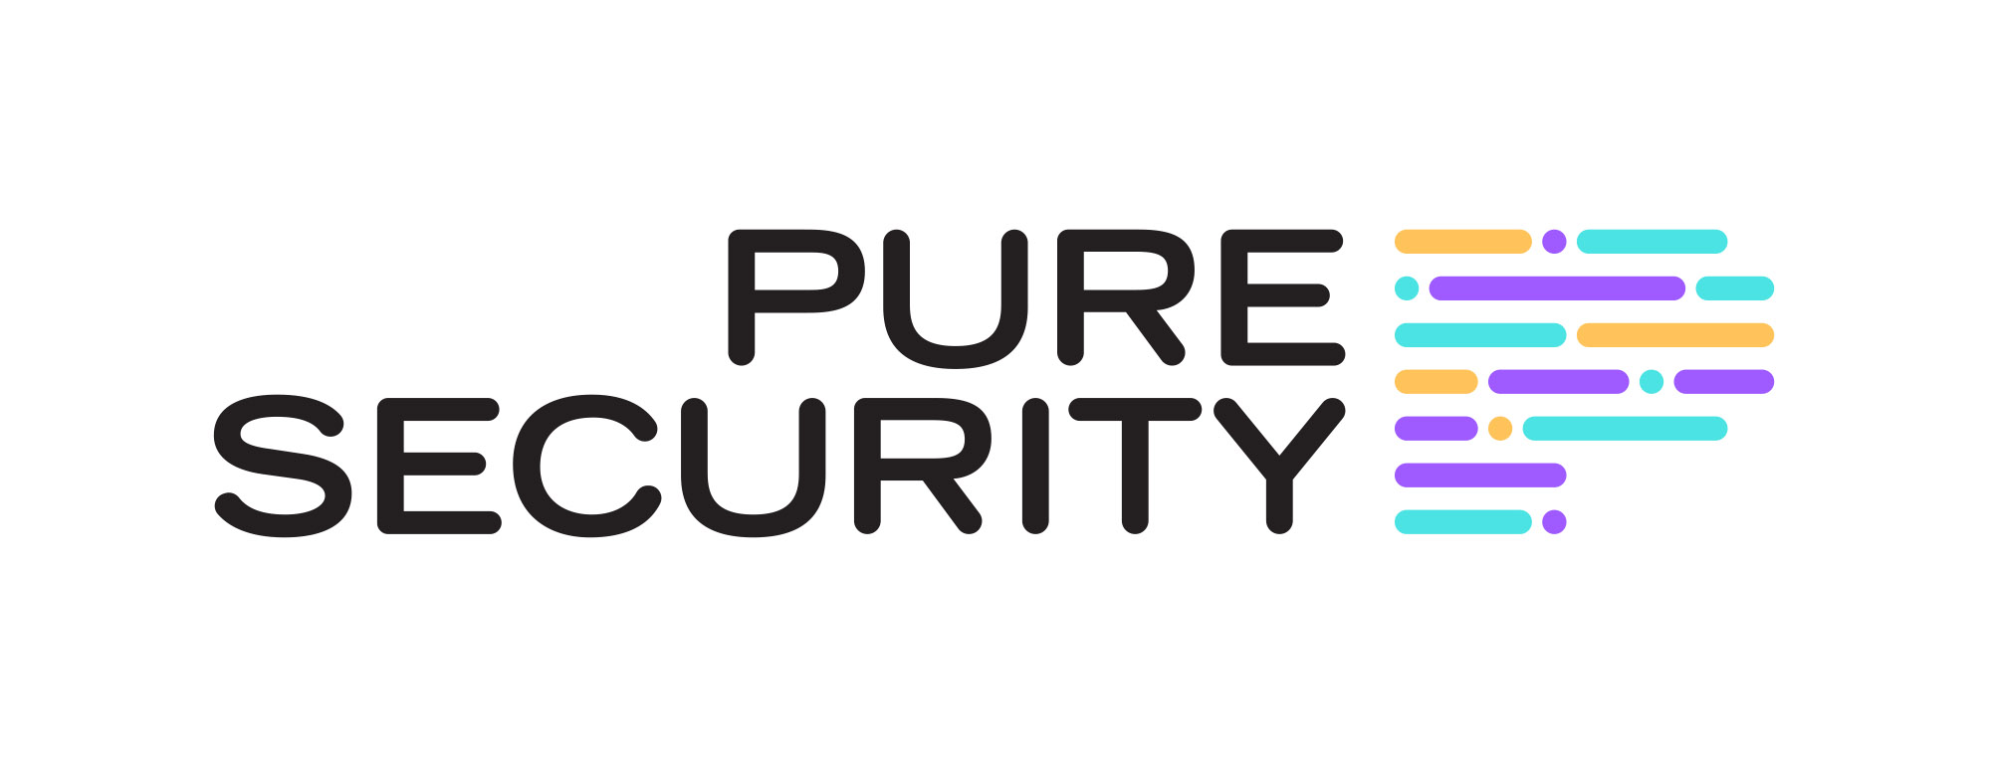
Trusted by some of the biggest brands in the world

Slide 25
With 6clicks…

Slide 26
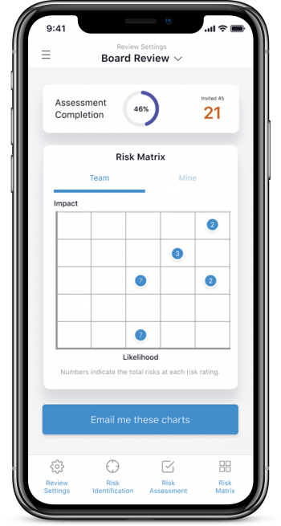
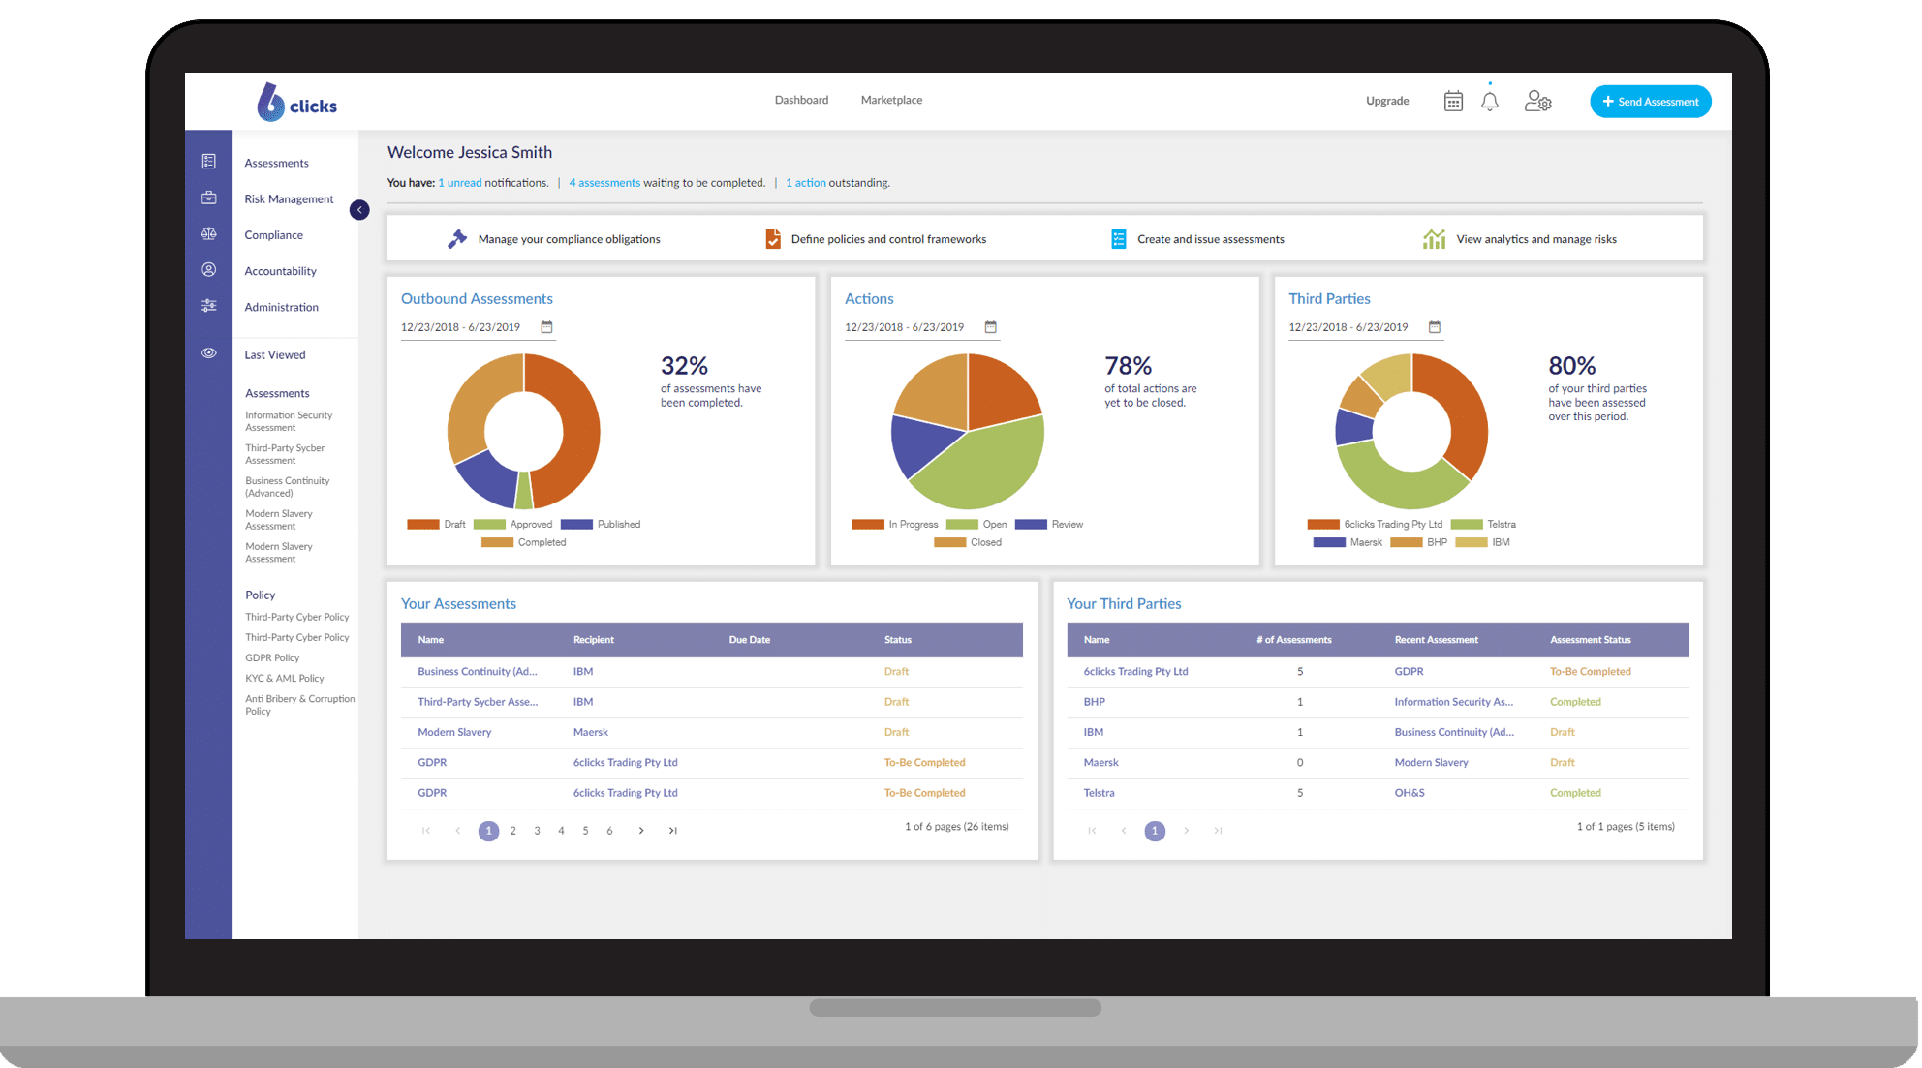
… you have everything you need and more.
EXPERIENCE
Mobile App
Web App
FUNCTIONALITY
Hailey artificial intelligence engine baked in across the platform
6clicks Pulse ® to support risk-based news and events and employee engagement
Breakthrough mobile app for team-based risk reviews
Unique parent-child architecture
Microsoft Power BI connector for advanced analytics
Controls & Policies
Risk-Based News & Events
Attestations
External
Integrations
Assessment & Audit
Risk Management
Attestations
Asset Management
Vendor Management
Compliance Management
Employee Social Engagement
Analytics & Custom Reporting
Partner
Benchmarking
CONTENT
Standards, Laws & Regulations
Policies & Control Sets
Assessments
Risk Libraries
Projects & Playbooks

Slide 27
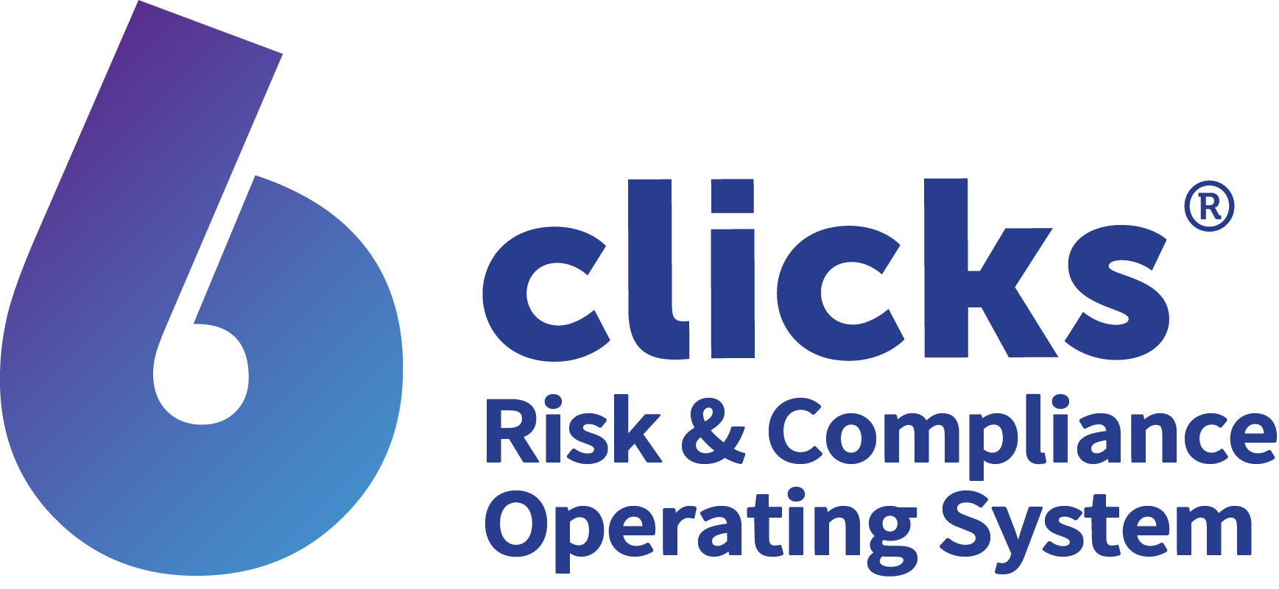
.. and the 1,000’s of integration possibilities
Input & Forms
Training & Courses
Teachable
Gravity Forms
Thinkific
Pingdom
Podia
Teachery
Survey Monkey
Twitter
New Relic
TalentLMS
Protonmail
Typeform
Freshping
Tennable
JotForm
Udemy
Pushover
StatusCake
Qualys
Google Gmail
Now Push
SiteDocs
Security & Monitoring Tools
Email, Phone, SMS
and Notifications
Site24x7
Detectify
Intruder
Microsoft Office365
Twillio
Task & Project
Management
Todoist
Monday
ClickUp
Google Data Studio
Google Sheets
Analytics and
Dashboards
Any.do
Microsoft Excel
Klipfolio
Trello
ZenDesk
Slack
Databox
All supercharged with capability to:
Schedule and delay actions
Define workflow logic and paths
Receive and parse email
Looping and filtering logic
Google Tasks
Google Docs
Help Scout
Microsoft Teams
Microsoft To-Do
Jira Service Desk
Google Groups
ServiceNow
Zoho Desk
Support & IT Operations
Team Collaboration

Slide 28
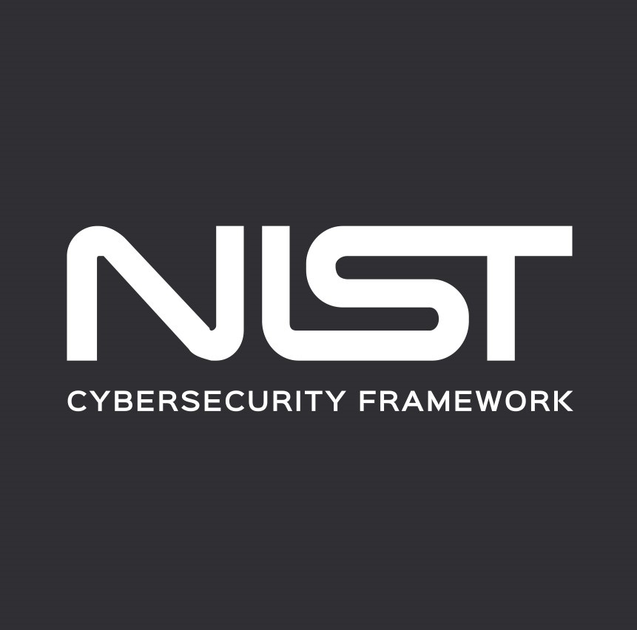
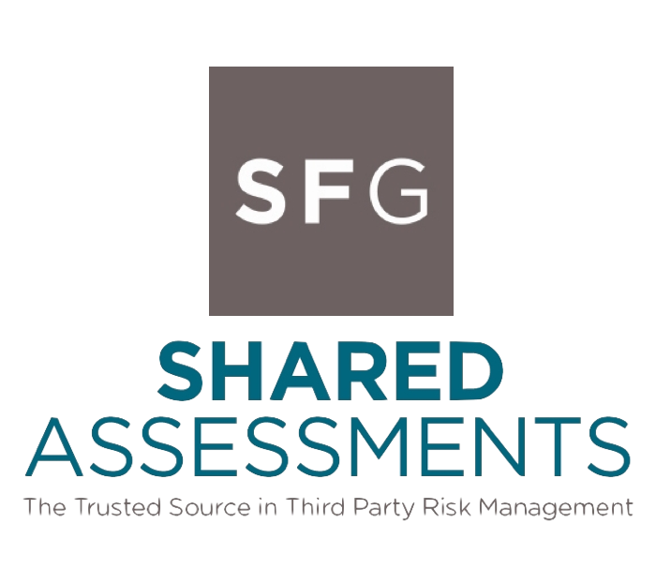
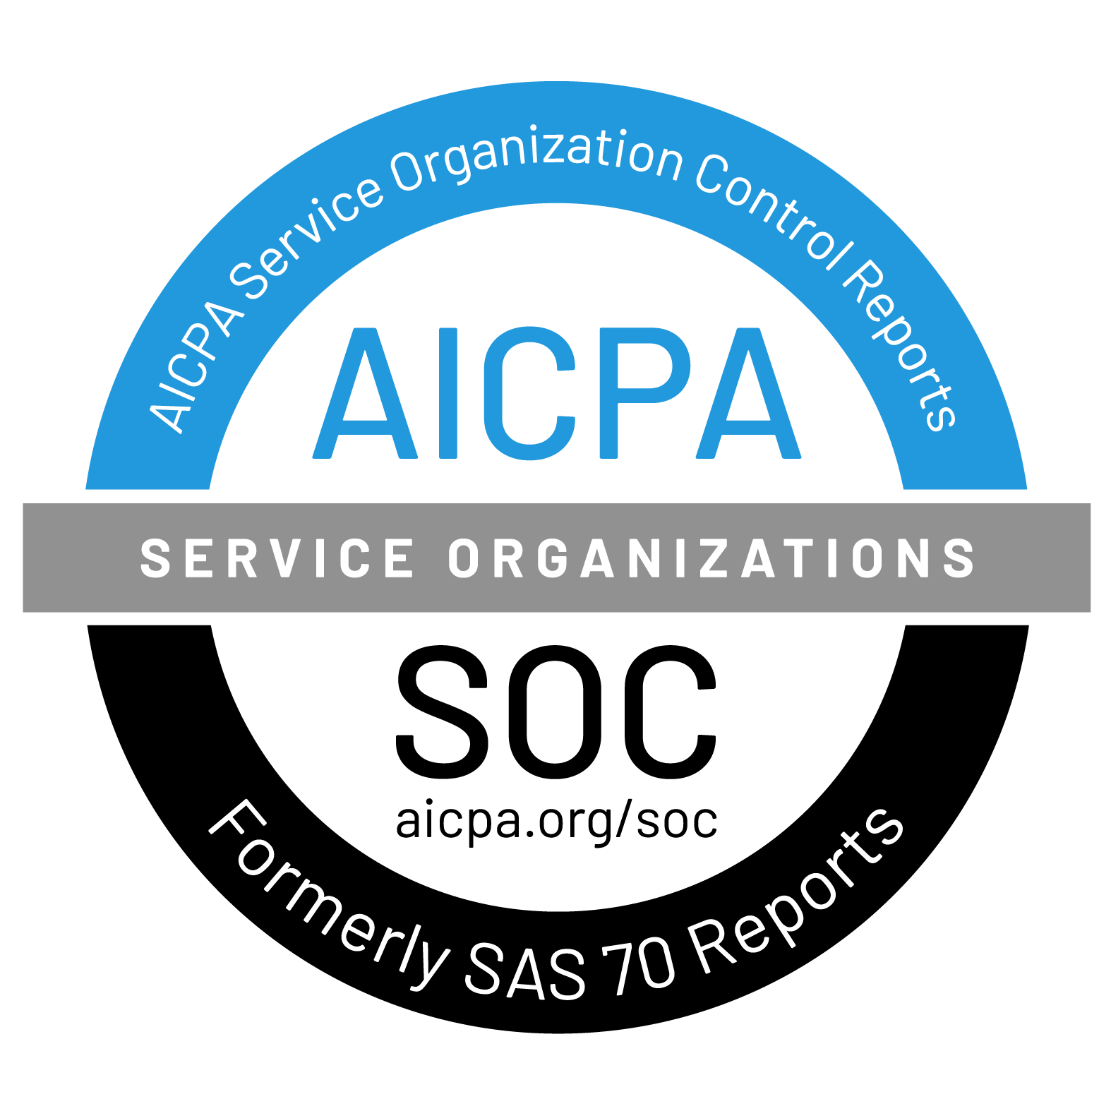
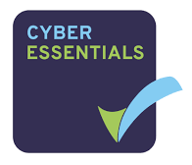
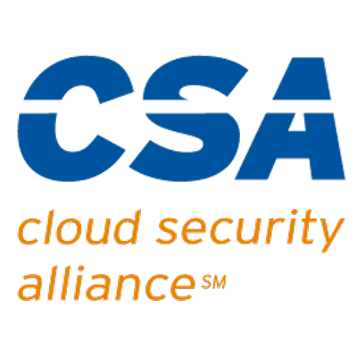
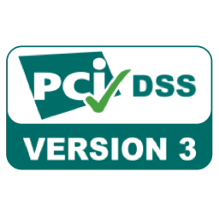
… and with the biggest library of content baked in.
For a complete listing of content in 6clicks visit https://www.6clicks.io/content.
Notes:
Ref ASD ISM (monthly updates), NIST CSF, NIST 800-53, NIST 800-171 and NIST 800-161.

Slide 29
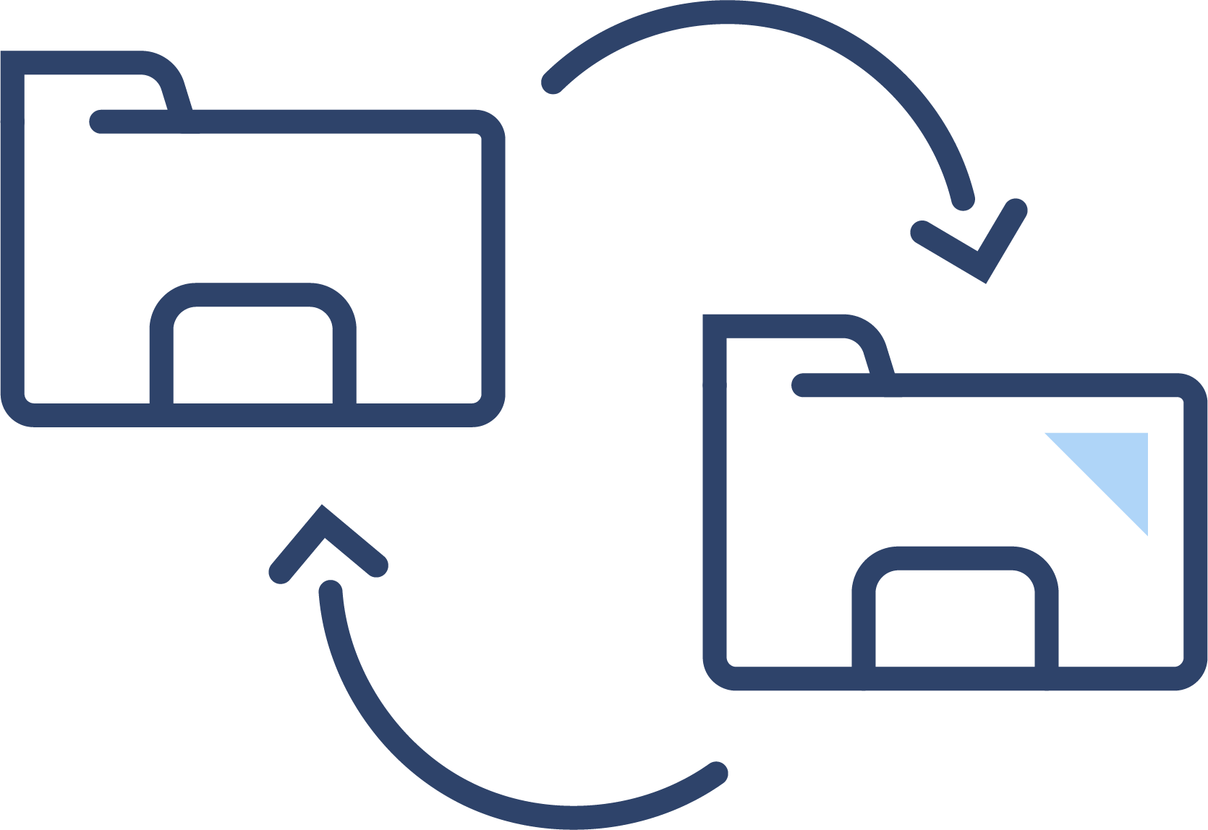
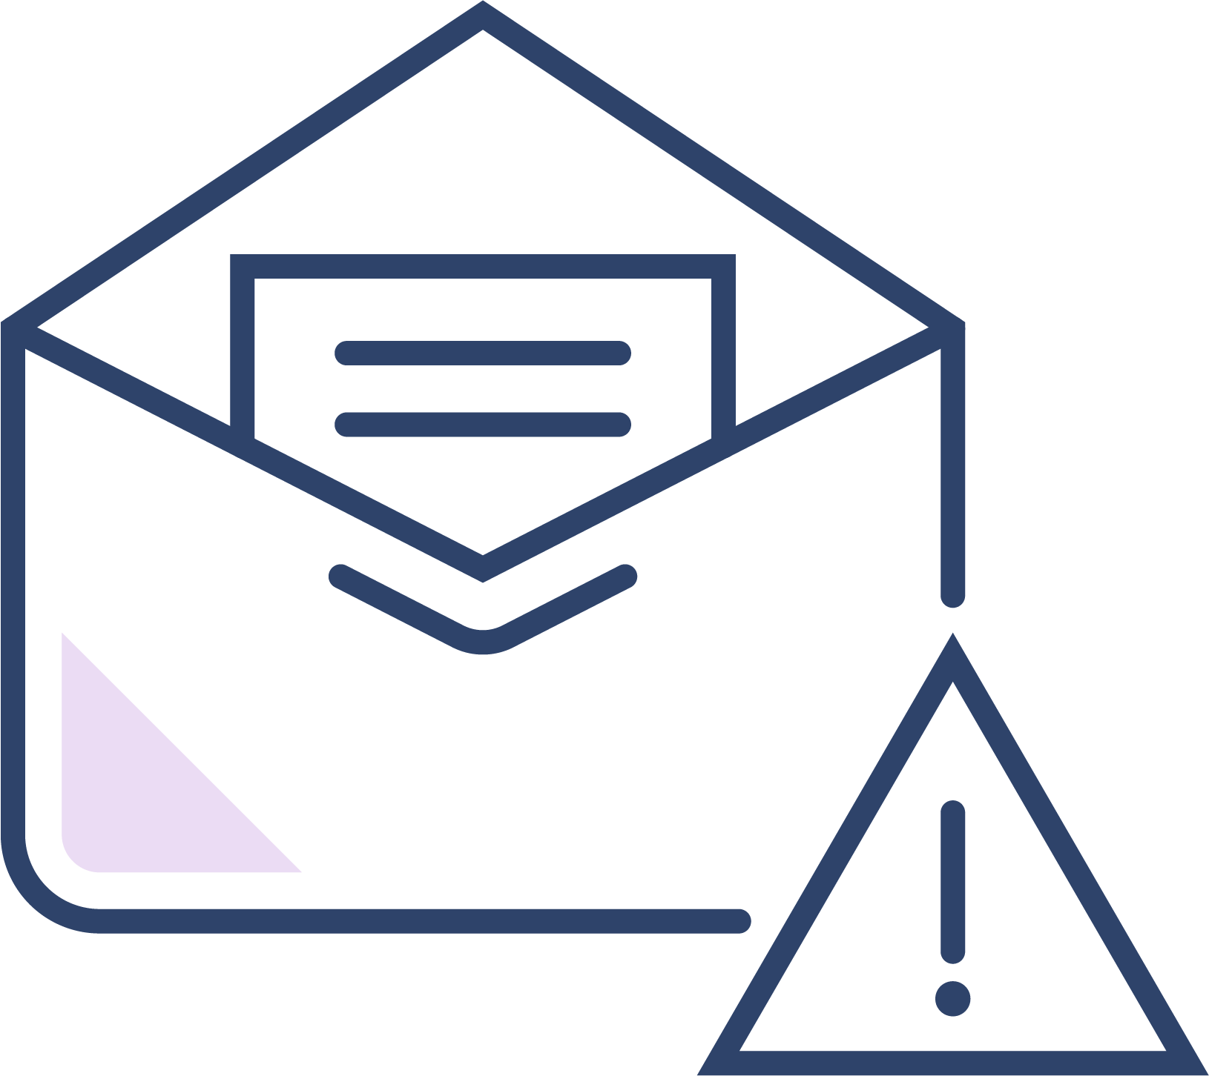
… and 6clicks takes you beyond ‘GRC’…
A faster and better way with 6clicks
Information security management system
Enterprise-wide governance, risk and compliance
Compliance mapping, similarity identification and gap assessments
Enterprise and operational risk from top to bottom
Staying abreast of relevant risk-based news and events
Improving employee engagement and awareness of risk
Compliance assessments against a standards, laws or regulations

