Slide 1
5G Security:
A Shared Responsibility

Slide 2
Our Agenda Today
5G Security: The Scope of the Challenge
How 5G Changes the Security Equation
What’s Needed
How Best to Get There
Critical Success Factors: Standards and Testing
The Future: How Best to Prepare
Summary/Conclusions
Q&A

Slide 3


Our Featured Speakers
Andy Purdy
Chief Security Officer (CSO)
Huawei Technologies USA
Paul Scanlan
Chief Technology Officer (CTO)
Huawei Technologies

Slide 4
5G Security: The Scope Of The Challenge
Threats can come from anyone, anywhere, anytime
  “Malware as a Service”
  Disgruntled former employees
  Disgruntled current employees
  Malevolent nation-states
  Etc….
The real challenge: effective risk management

Slide 5
How 5G Changes the Security Equation
For good: more/better internal security features
For bad: larger threat surfaces
  IoT
  More connected devices, services, and people

Slide 6





5G is more secure than 4G – or any network technology
4G
Identity Integrity Protection
E2E Security
Authentication
128-bit Encryption
Encrypted Subscribers’ ID
E2E security
between Networks
Unified Authentication
256-bit Encryption
This Slide is Animated
LTE
e.g.
5G
L=256
5G
CN
L=256
Wi-Fi
L=128
Better
Privacy Protection
Enhanced
Interconnection Security
Effective
Authentication framework
Stronger
Security Algorithm
Years of common contributions by dozens of vendors/operators/regulators…

Slide 7
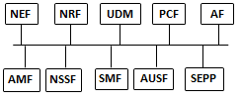

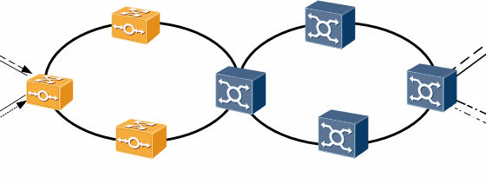
5G Networks: Threats Landscape
O&M
Firewall
SecGW
UPF
gNB
UPF
Firewall
MEC
Firewall
1: UE
mMTC
uRRLC
eMBB
2: Air interface
mMTC
uRRLC
eMBB
3: gNB assets
New Radio
CU/DU Split
eCPRI
4: Transport
Optical
Microwave
SDN
5: MEC assets
UPF
NFV
COTS
6: 5G Core
User data
OS/Software
O&M data
7: O&M
Hardware
OS&EMS software
O&M data
1: UE threats
Malware
Cloning
Bots Hijacking
Rough BTS
Protocol Downgrade
FW/HW/SW (Supply Chain) Poisoning
IMSI Catching
2: Air interface threats
Eavesdroping
Impersonation
Data Tampering
Jamming
Rough BTS
SON Attacks
3: gNB threats
Tampered SW/HW
Unauthorized access
Data Leakage
RAN DDoS (From UE)
4: Backhaul threats
Tampering
Eavesdropping
Protocol Modification
Protocol downgrade
SDN Threats
5: MEC threats
Untrusted 3rd APP
DDoS UPF
Malware
Virtualization attacks
App layer attacks
API Attacks
6: 5GC threats
NFV-based attacks
Roaming (Fraud, Abuse)
Roaming Protocol attacks ( SS7-like attacks)
Malicious AF/VNF
Unauthorized Access
Data Tempering
Eavesdropping
DDOS
OSS/5GC Attacks
7: O&M threats
Unauthorized access
Data Leakage
Malware
API attacks.
OSS Services Integration.

Slide 8
5G Network Evolution Challenges
Cloudification
Machine-2-Machine & IoT
Distributed Architecture
Safety/Privacy Critical Scenarios
Multi-Tenancy (B2B Network Sharing e.g., MVNO)
5G & Legacy Technologies
Introduces new threats and increases the attack surface (e.g., CSA/ENISA/NIST Top Threats)
MEC, SBA increase complexity due to the decompiling of network services/functions.
eHealth, Autonomous Driving, Smart Factory, … , compromised networks may result in loss of life.
Slicing end to end chunks of the networks for MVNO and large enterprises, increases the risk for unauthorized access, abuse and data leaks.
2G/3G/4G technologies will co-exist with 5G networks ~5-10 years, exposing downgrade, bypass attack vectors.
IoT devices offer only weak identity/security capabilities, Hard to govern/ control and often include vulnerabilities which allow them to be used as DDoS / Bot networks.

Slide 9
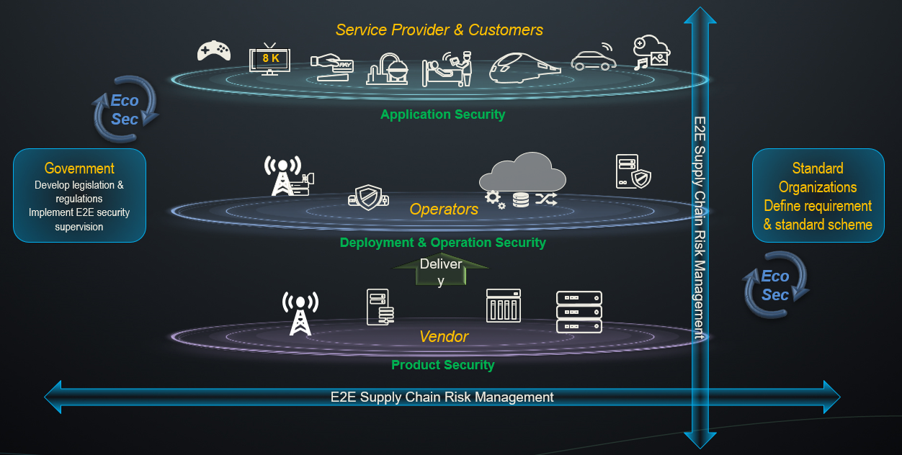
Security is a Shared Responsibility…
Security Improvements in 5G
Access Network | Enhanced Air Interface and Transport Security on 5G
 | Split Architecture supported
 | Encryption schemes for privacy
 | mMTC (IoT) standards defined in 3GPP R17
 | Base Station identification / control of DDOS attack
Core Network | Enhancements to key, roaming, and transport security
 | Cloud Security
 | Industry standards
 | End-to-end Service Isolation
 | Mobile Edge Computing security features
 | Slicing security
Deployment & Operation | Security by design principles
 | Utilize NIST CSF to control key risks in live operations
 | Identify, Protect, Detect, Respond, Recover
 | Support monitoring, auditing and traceability
 | Boot/file/code integrity verification
Service Provider & Customers
Eco
Sec
8K
Application Security
Government
Develop legislation and regulations
Implement E2E security supervision
Standard Organizations
Define requirement & standard scheme
This Slide is Animated
Operators
E2E Supply Chain Risk Management
Delivery
Deployment & Operation Security
Eco
Sec
Vendor
Product Security
E2E Supply Chain Risk Management
Notes:
Security is a Shared Responsibility
Vendor – Secure and security enabled products via security and privacy by design concepts
Operator – Leverage all tools available to secure Deployment and Operational Security
Service Providers and Customers/Consumers – Ensure Application security, where possible End Point security, Cyber Hygiene
Collaboration on standards, requirements and verification mechanisms is imperative.
Across the public and private sector we need to establish standards based security models for our critical infrastructure.
Exclusion ≠ Security → weakens the ecosystem and sharing, disclosure, collaboration.
We see quite a bit of collaboration between industry and government in Europe already but we need more here.
Risk-Based approaches to security of our critical infrastructure.
Utilize resources (NIST) already available to evaluate organization and technical risk within your businesses.
Establish comprehensive requirements for security and privacy in ICT.
Apply to all of Supply Chain with Zero Trust → Assume nothing, Believe no one, Check everything
Trust Through Verification.
Globally Integrated Supply Chains must be verified regardless of past “trust” relationships.
Expanded supply chains need more in-depth scrutiny and verification at delivery.
Continual Verification is imperative.
Implementation and Operationalized Security
Quotes from USG → “ Everyone should face the same rules”, “trusted vendors”, “Frameworks for understanding risk”

Slide 10
What’s Needed
Effective protections must be consistent, pervasive, and seamless
Across geographies
Across networks
Across products

Slide 11
How Best to Get There
The Past: “Trust, but verify.”
The Present and Future: “trust through verification.”
How? As simple as “ABC”
  Assume nothing
  Believe no one
  Confirm everything

Slide 12
Critical Success Factors: Standards and Testing
Standards: developed and validated by experts; shared with everyone
Testing: internal and external
Regular, comprehensive review and revision of processes as technologies evolve

Slide 13


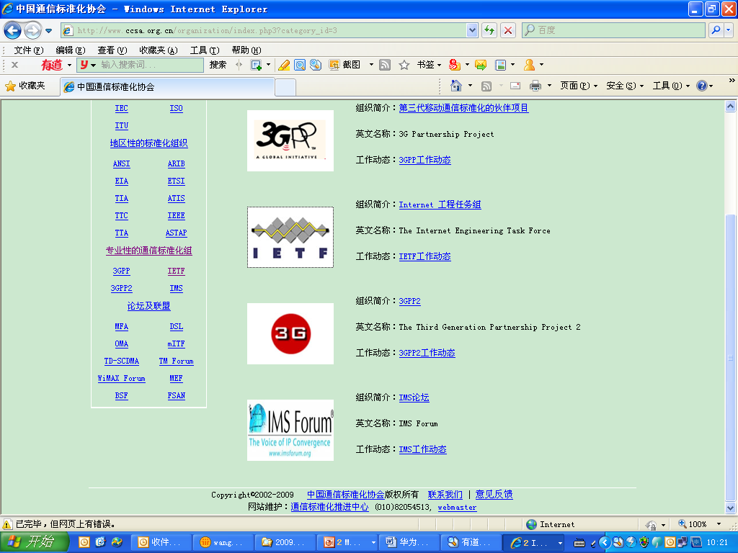












A Cyber Security Ecosystem Based on Standards
Multiple Cross-industry Alliances & Standardization Organization, Promoting Security In New Business Domains
Top Contributor to NFV Security Group
Major contributor to SA3, driving 5G security standardization
Board member
Board member
Leads proposal drafting of 4 working groups; chairs DOTS and I2NSF working group
Executive corporate member

Slide 14


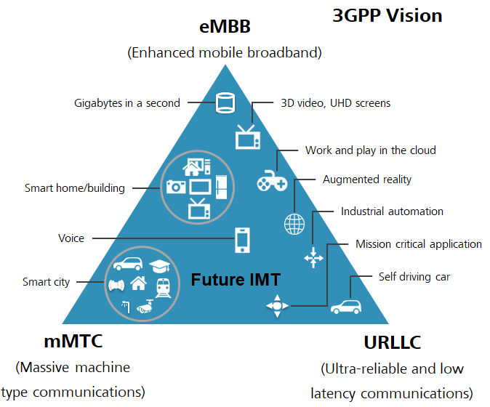
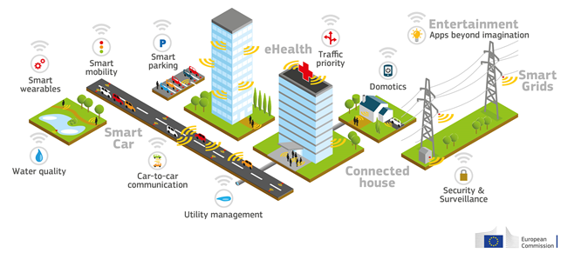
A Global Vision for 5G Technology
EU Commission 5G Action Plan
3rd Generation Partnership Project

Slide 15
The Future: How Best to Get There
Things to do and think about now
Huawei’s approach

Slide 16
Security is a Shared Responsibility…
Security Improvements in 5G
Access Network | Enhanced Air Interface and Transport Security on 5G
 | Split Architecture supported
 | Encryption schemes for privacy
 | mMTC (IoT) standards defined in 3GPP R17
 | Base Station identification / control of DDOS attack
Core Network | Enhancements to key, roaming, and transport security
 | Cloud Security
 | Industry standards
 | End-to-end Service Isolation
 | Mobile Edge Computing security features
 | Slicing security
Deployment & Operation | Security by design principles
 | Utilize NIST CSF to control key risks in live operations
 | Identify, Protect, Detect, Respond, Recover
 | Support monitoring, auditing and traceability
 | Boot/file/code integrity verification
Service Provider & Customers
Eco
Sec
8K
Application Security
Government
Develop legislation and regulations
Implement E2E security supervision
Standard Organizations
Define requirement & standard scheme
This Slide is Animated
Operators
E2E Supply Chain Risk Management
Delivery
Deployment & Operation Security
Eco
Sec
Vendor
Product Security
E2E Supply Chain Risk Management
Notes:
Security is a Shared Responsibility
Vendor – Secure and security enabled products via security and privacy by design concepts
Operator – Leverage all tools available to secure Deployment and Operational Security
Service Providers and Customers/Consumers – Ensure Application security, where possible End Point security, Cyber Hygiene
Collaboration on standards, requirements and verification mechanisms is imperative.
Across the public and private sector we need to establish standards based security models for our critical infrastructure.
Exclusion ≠ Security → weakens the ecosystem and sharing, disclosure, collaboration.
We see quite a bit of collaboration between industry and government in Europe already but we need more here.
Risk-Based approaches to security of our critical infrastructure.
Utilize resources (NIST) already available to evaluate organization and technical risk within your businesses.
Establish comprehensive requirements for security and privacy in ICT.
Apply to all of Supply Chain with Zero Trust → Assume nothing, Believe no one, Check everything
Trust Through Verification.
Globally Integrated Supply Chains must be verified regardless of past “trust” relationships.
Expanded supply chains need more in-depth scrutiny and verification at delivery.
Continual Verification is imperative.
Implementation and Operationalized Security
Quotes from USG → “ Everyone should face the same rules”, “trusted vendors”, “Frameworks for understanding risk”

Slide 17
Shared Risk Management Responsibility for Telcos and Vendors
Emmanuel Delpon, Orange Group CTO:
  being secure means taking a full set of actions to maximize the confidentiality, integrity, and availability of our networks;
  being secure is a shared responsibility between 3rd party service providers, telcos, and vendors;
  security by design is critical;
  security concerns of virtualized networks require a “test and learn” approach.
5G Network security solution coverage:
  security in standards,
  security in equipment, and
  security in deployment security.

Slide 18
Shared Risk Management Responsibility for Telcos and Vendors (continued)
TELCOS | VENDORS
Formally obtain control of the network for operations Operations of the network Request support from Huawei through traceable channels Implement various security measures such as: Operational: systematic management of network and information systems, Operational: physical and environmental security Operational: The security of supplies (Supply Chain Security Process) Operational & Technological: access controls to network and information systems restricted based on business and security requirements Operational & Technological: incident handling, anomaly detection capabilities. Operational: identifying weaknesses and vulnerabilities in the Information system Operational: Business continuity management establishment and the use of contingency plans disaster recovery capabilities Operational & Technical: monitoring, auditing and testing policies Operational & Technological: Verify compliance with the security elements | Manufacturing of Products Verification of Security of Products Installation of devices into the network (no access to user data) Handover the network to the operator after acceptance. (Clear handover process with guidance to reset all accounts and access rights) Provide local / remote support based on explicit request and authorization of operator All remote access and actions are being tracked and traced by Huawei.

Slide 19
Mobile Network Security Standardisation, Audit, Test, Certification
  GSMA&3GPP
Other Government Cyber Security Authorities | Country
BSI Bundesamt Fur Sicherheit in der informationstechnik | Germany
NCSC UK’s independent authority on Cyber Security | UK
Instytut Lacznosci (March 2020) | Poland
Members | Country
Orange | France
DT | Germany
NTT DCM | Japan
CMCC | China
Vodafone | UK
Telefonica | Spain
BT | UK
Telenor | Norway
Etisalat | UAE
MTN | Africa
Manufacturers | Country
Ericsson | Sweden
Huawei | China
Nokia | Finland
ZTE | China
Samsung | Korea
NEC | Japan
Accredited Companies | Country
ATSEC (Auditor) | Germany
NCC Group (Auditor) | UK
Epoche (Test Lab) | Spain
Stakeholders closely work with each other in security standards, verification system, and security technology innovations to improve NESAS & SCAS and strive to establish a trust system based on facts and verification.

Slide 20


Comparison between Mobile and IT Industries
SCAS/NESAS provides security baseline & audit for mobile network equipment, cloud, digitization, and software-defined everything. It includes product development and lifecycle processes, threat analysis and modeling.
CC/PP is intended for the IT industry as a whole. It covers the general R&D process and lifecycle management audit.
Test
Methodology
Equipment
Test
Specifications
Security Accreditation
Accreditation / Evaluation System | NESAS/SCAS | CC/PP
Standards organization | GSMA/3GPP | Common Criteria (CCRA)
Standards scope & completeness | 0 Evaluation Assurance Levels | 7 Evaluation Assurance Levels
Standards progress | 5G SCAS specifications | Protection Profiles are mature
Number of accredited labs & auditing companies | Only one lab 2 auditing companies | 77 labs globally
Regulators' recognition | Low | High - 30 countries
Process & TTM | Simple processes & 3-6 months | Complex processes & 12-18 months
PP: Protection Profile; CC: Common Criteria

Slide 21



















Establish uniform & objective global cyber security accreditation / evaluation
NESAS / SCAS are authoritative security standards built by 3GPP / GSMA for the communication industry
Common Criteria (CC) is an international standards (ISO 15408) for computer Security Certification
Drive NESAS/SCAS to a become mature international standard
Operators have rich experience in mobile network O&M and technical advantages
Jointly improve 5G SCAS specifications to keep pace with 5G rollout
Increase number of regulators & greater government recognition
Strengthen dialogues with regulators, get legislative support & promote unified standards
Ensure security of critical infrastructure through unified security standards to facilitate competition & innovation
Engage more industry partners including labs/auditing companies
Promote CC lab evolution to GSMA NESAS lab
Easy for partners to obtain accreditation as only requires understanding of 5G
GSMA 5G training facilitate accreditation
Certified Authorizing Members
Certified Consuming Members

Slide 22
In 2018 Huawei initiated the TSECT: Trustworthiness and Software Engineering Capability Transformation
Industry Trends
As cloud, digitization, and software-defined everything become more and more prevalent, cyber attacks and threats have become commonplace.
Customer Requirements
Product trustworthiness and cyber resilience are therefore increasingly essential, and customers will preferentially seek out trustworthy products rather than new functions and features.
Oversight Board
Software engineering capabilities are the cornerstone of building trustworthy, high-quality products. OB points out that Huawei needs improvements on software engineering.
The view of the Board of Directors is that Huawei must implement corporate-level transformation immediately to enhance its software engineering capabilities to build trustworthy, high-quality products^{[1]}.
[1] Huawei BOD NT. No. [2018] 001 Notice of Resolution on Initiating Thorough Transformation for Enhancing Software Engineering Capabilities to Build Trustworthy, Quality Products

Slide 23
Huawei Transformation Objectives
To demonstrate to our customers and industry experts that: Huawei is executing the Huawei Board directive (October 2018), a transformation program to Enhance Software Engineering and to Build Trustworthy, Quality Products Huawei took the findings of the UK NCSC OB report seriously and is addressing them through the TSECT program Concerns from industry partners have been and are being addressed To increase our partners awareness and confidence that Huawei is building trustworthy, high-quality products & solutions To build trustworthiness into the management systems and corporate culture To build high-quality products with trustworthy processes and results
Goal: |  | To build trustworthiness into Huawei culture | Management systems | Processes | Organizations | Tools | Appraisal incentives

Slide 24

Trustworthiness Framework Development Process
Industry Standards & Best Practices Analysis
Over 250
Outputs
Synergies
Gaps
Overlaps
Conflicts
Shortcomings
Huawei Trustworthy Framework
Huawei IPD Processes & Best Practices

Slide 25
Example Engineering Capability Programs
Topic | Value/Purpose | Content
End-to-end integrity | Prevents injection of malicious code and secures customer assets. | Including traceability from requirements to code, trustworthy build management and software binary, digital signature and trusted boot.
Security & Resilience | Deliver more secure and resilient products to customers and ensure the security and stability of customer network equipment. | Including security features (anti-DDoS, protection against rogue base stations, etc.), resilience architecture, and security hardening of products.
Product & Contract Lifecycle | Support the lifecycle policy and timely update of products and versions on customers' live networks. | E2E product lifecycle management rules, component lifecycle management (including third-party and open-source components), relationship between vulnerabilities & lifecycles, etc.

Slide 26
Summary/Conclusions
Cyber threats have no single home country.
Cyber threats respect no borders or boundaries.
Effective cyber security must be consistent, pervasive, and seamless.
Standards must be developed and managed by experts and uniformly enforced.
Every element of every connection must be subject to rigorous, credible internal and external testing.
Everyone in the connected value chain can help improve cyber security.

Slide 27
Questions and Open Discussion

