Slide 1
Open Blend Talent Launch Training

Slide 2

Agenda
Why we’ve invested in Open Blend and the benefits to you
Working with Wellbeing
Working with Blend
Maintaining boundaries
Working with GROW
Objectives
Next steps and ongoing actions
Notes:
Talk through the agenda points

Slide 3
Reasons to engage with Open Blend
  Insert company reasons to engage
Notes:
Bring to life each element in more detail

Slide 4



Open Blend
Puts you at the centre of more meaningful performance conversations with your manager
Support you in all aspects of your development and wellbeing to help you perform at your best
Develop your skills, confidence and performance in pursuit of your goals
Notes:
This is an investment in you
PUTS YOU IN CONTROL – this is a PEOPLE UP approach to culture transformation
YOU ARE ONE PERSON WORK AND HOME – SUPPORTS YOU AS A WHOLE PERSON IN TERMS OF YOUR LIFE BLEND AND WELLBEING, NOT JUST PERF
Our users report
More confidence
More logical steps and tangible output from 121 towards goals
Increased self awareness and ability to focus and improve in growth areas

Slide 5

Since using Open Blend
89%
are more engaged with their job
82%
feel more connected to their manager
97%
say Open Blend has had a positive impact on their wellbeing
Open Blend’s
impact on
talent
Open Blend’s
impact on
talent
Notes:
Interesting data to help highlight the benefit to their talent of engaging and using Open Blend effectively.
This is data worth using in the comms to their talent.

Slide 6
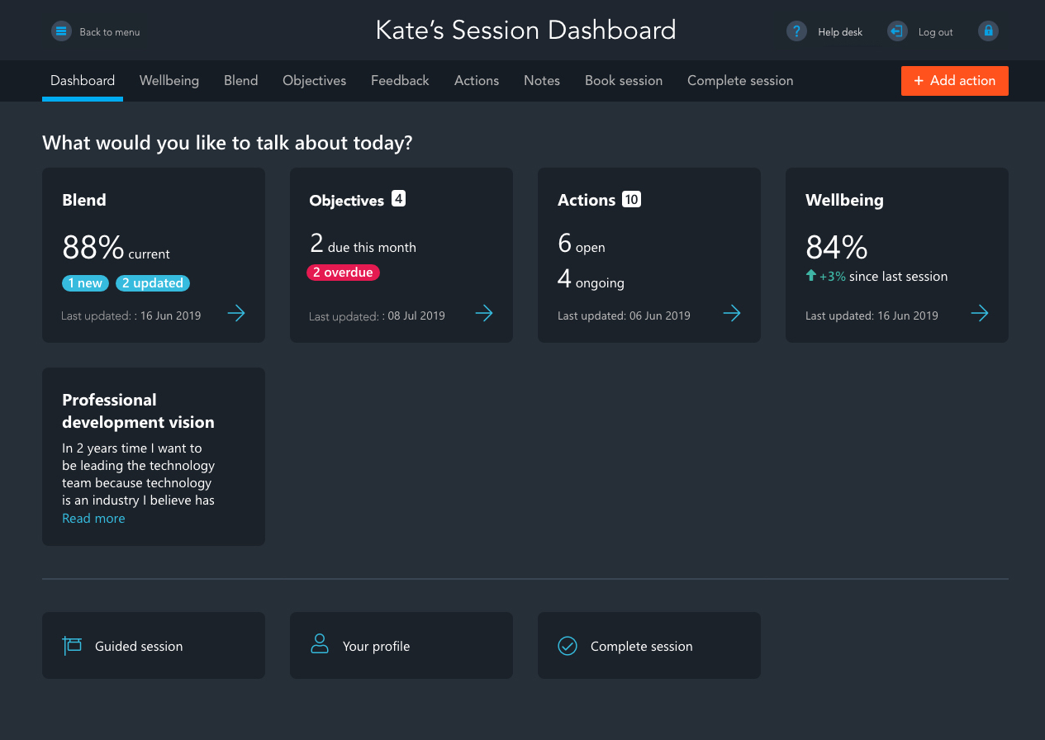
How we enable coaching-led one-to-ones
How you use it is unique to you and your needs
Instant access to areas that need attention
All of the modules complement each other
All underpinned by coaching methodologies
Notes:
Familiarise them with layout
Enables 5/6 types of conversations
Each area highlights where there is action required, when elements were last discussed, colour coding highlights improvements or declines
Enables you to go straight to what you need to talk about
Focus on accountability for completing actions
Overview – 4 main areas – Work life drivers, objectives, actions, wellbeing
Navigates managers through structured conversations but also enables easy access to areas that need attention
MENTION GUIDED SESSION – only use first few times

Slide 7
Wellbeing
There are 3 wellbeing metrics:
How happy are you?
How confident are you?
How capable do you feel to manage stress?

Slide 8
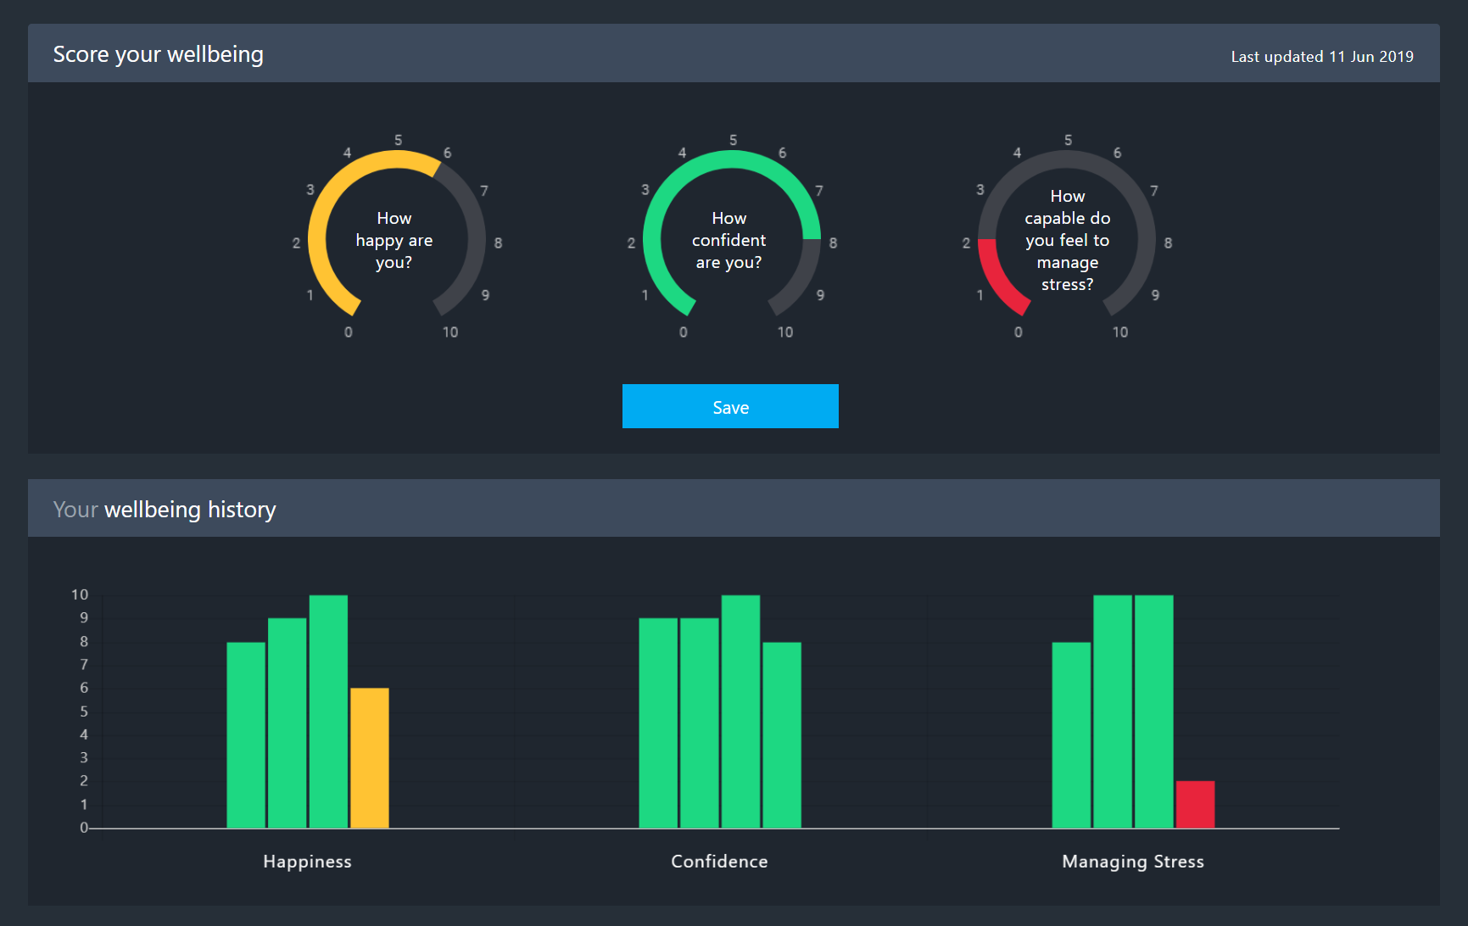
Working with the wellbeing module
You decide as to how you use this
Opportunity for you to talk things through and access support
You drive the conversation
Notes:
20 mins in
5 mins for whole wellbeing section
Might want to just cover work context
Up to you how you use it
Capability to manage stress – you wont be judged
Brokers more meaningful and intimate conversations

Slide 9
Blend
Creates self-awareness of your drivers
Enables you to share them with your manager
Work together to improve your overall Blend and enable you to perform at your best

Slide 10

Working with your Blend
Clear career goals and direction
Effective team
9
8
6
Exercise &
health
My
partner
5
Your current
Blend is 63%
7
Your target
Blend is 82%
5
4
9
7
8
Manageable
workload
Fulfillment
At work
7
8
9
A
My children
Progression
at work
B
Where are
you now?
Where do
you want to be?
Notes:
30 mins in
10 mins
ANY SELECTION – COMPLETELY UNIQUE TO YOU
JUST WORK
ALL PERSONAL
BLEND
SOME YOU DON’T DISCUSS – USE AS SELF COCHING
ALL TO DISCUSS
SUPPORTIVE LEADER EXAMPLE
KEEP AN EYE OR WORK ON ACTIVELY
MAY FIND YOU WANT TO REFRESH – NOT KEY DRIVERS BUT NEXT LAYER
MANAGER SHOULD BE ASKING ‘WHAT WOULD YOU LIKE TO TALK ABOUT’
DON’T HAVE TO COVER ALL
ALLOWS FOR DIFFERENCES IN HOW PEOPLE COMPLETE
EXAMPLE OF WEIGHTING FOR MUM
ITS ABOUT THE GAP
COACHING – NOW – WANT – HOW – NOT A COUNSELLING CONVO
BOOK YOUR SESSIONS IN – CO CREATIVE PROCESS – PEOPLE UP – NOT FOR YOUR MANAGER TO HAVE ANSWERS ON YOUR FULFILLMENT

Slide 11
Layers of conversation
Layer 1 - Awareness of the element via Blend wheel
Minimum
requirement
Layer 2 – Work-related
actions
Layer 3 – Life-related
actions
NOT required
Notes:
5 mins
YOU ARE IN CONTROL
DON’T HAVE TO TALK ABOUT EVERYTHING
IF YOU BRING IT UP, IT’S BECAUSE YOU THINK A COACHING CONVERSATION WITH YOUR MANAGER CAN HELP
YOU MANAGE THE BOUNDARIES
Level 1 – enables your manager to be aware of what is important to you – don’t have to talk about everything
MY PARTNER EXAMPLE
Level 2 – looks out how changes in the work environment by you or others can help and how manager can support
Level 3 – don’t have to go there. You can if you feel comfortable and want to use the coaching skills – and manager is OK with it
Your managers are NOT QUALIFIED COACHES so manage your boundaries and allow them permission to manage them
Your conversation will stay CONFIDENTIAL unless they believe you are a danger to yourself or others
They will CONTRACT WITH YOU AS TO WHEN THEY FEEL THEY CANNOT HELP and you can do the same if the conversation is going somewhere you don’t want it

Slide 12
GROW
Notes:
35 mins in

Slide 13
How we goal set in Open Blend
Way forward
What will you/we do? What is the action plan ?
Options
What could you/we do to moving towards the goal?
Reality
Where are you now?
(Current score & meaning )
Goal
What do you want?
(Target score & meaning )
Notes:
10 mins
GROW
ESTABLISHED
SIMPLE PATHWAY TO ACTION
FRAMEWORK FOR CONVERSATION
DRIVE FORWARD – CREATE NEW THINKING
BLUE BUBBLES – PERMISSION TO ASK MANAGER TO USE
G – what does it look like, what would change, how would it feel, benefits, nail it down, how will you know, what will it mean
So often people say – I want to buy a house and then move on but it doesn’t unlock the excitement create sticky goals
Spend Longer in G than feels comfortable, really understand the goal, create a massive magnet
R – current reality, how it happened, what's good and what's not, obstacles, costs of it, benefits of it, what done in the past
G AND R GIVE US OUR SCORE
O – explore, open it up, always a solution, how could you look at this differently, what would your hero do, what creative ideas could you come up with, how have you overcome similar in past, what resources or support do you need
W – What are we going to do , first step, smallest step, how can I support you, when start, when finish, 1-10 commitment, how will we know achieved
Benefit for the other person

Slide 14
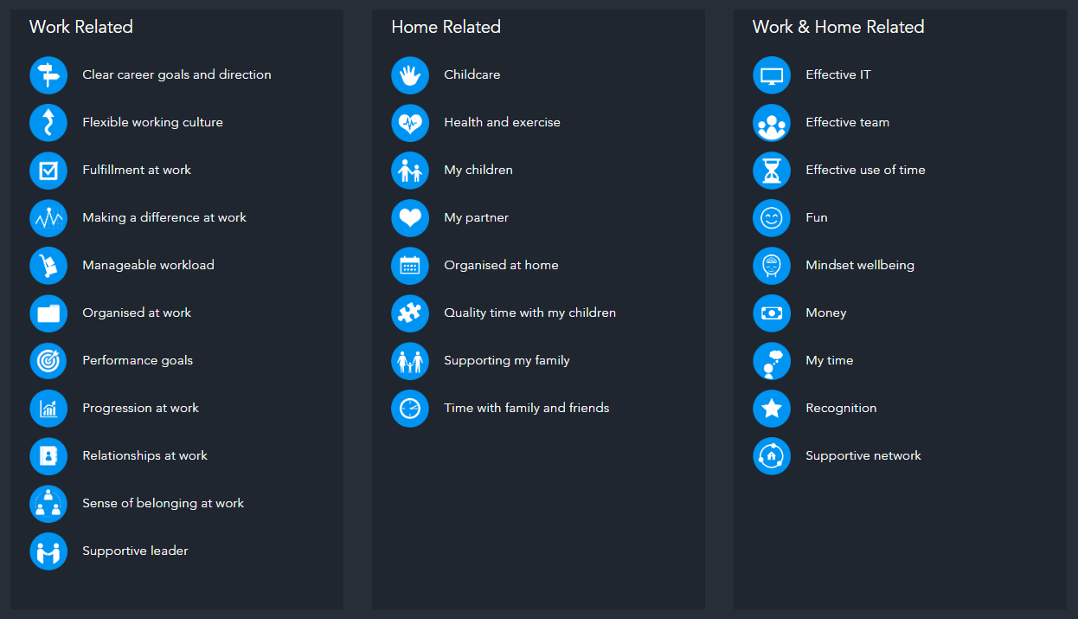

Slide 15

GROW in action
Choose one element from your Blend, an aspect of your wellbeing or one of your objective
Define it
Score it - Current vs. Target
Answer these questions
Write down the answers
No need to discuss
Notes:
10 mins
G(oals)
What will be happening when you reach your target score – what do you see, hear, smell?
What would be the benefits to you and others once you’ve achieved this goal?
R(eality)
What does the current situation cost you?
What is stopping you from achieving your target score?
O(ptions)
What are your options?
What resources do you need?
W(ay Forward)
What's the first step you could take?
When will you start?
DISCUSS AFTER:
BLIND QUESTIONS HELPFUL
POWER OF BEING ASKED QUESTION AND GIVEN TIME TO THINK (SILENCE)
I DIDN’T NEED TO KNOW ANYTHING OR BUY IN TO YOUR GOAL TO HELP YOU - ENCOURAGES ACCOUNTABILITY AND OWNERSHIP

Slide 16
Objectives
Notes:
10 mins for this section

Slide 17
Objectives

Slide 18
What do we mean by an Objective?
Personal
Career / company related
Not directly linked to work but contribute to your wellbeing and performance
Business and Performance
Company – Department – Team – Individual
Individual performance related set by manager
SMART
Specific – Measurable – Achievable –
Realistic – Time Stamped
DEVELOPMENT AREAS
See – Hear – Feel
Notes:
SYSTEM CATERS FOR ALL
ADAPT TO SUIT CLIENT

Slide 19

The benefits of Objectives to you
Provide strategic direction and your place in future plans
Creates focus on what’s important rather than urgent
Nurture and hone the skills you need to develop in to future roles
Ensure you get the support you need in your development
Notes:
WHO HAS OBJECTIVES?
You are missing out if you don’t have them

Slide 20
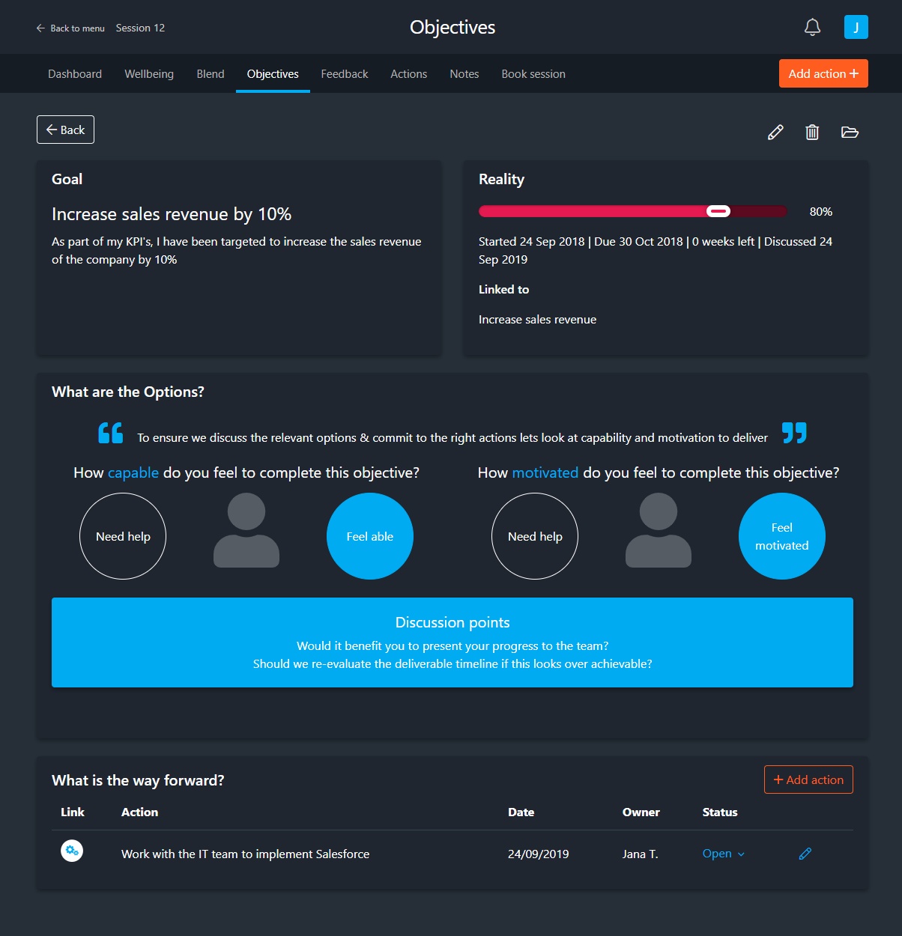
Objectives in Open Blend
Understand the Goal
Use the progress bar to define the Reality
of where you are now
Link to company values
Discussion points around capability and
motivation will help the you discuss the right
Options to get to the goal.
Adding actions is the Way forward to
meeting the objective
Note – Objectives linked to Company values will
show on Company Administrator dashboard
Notes:
USE GROW MODEL
Think about what you want ahead of time
Come together and discuss with your manager for the first time

Slide 21
Usage guidance
  An OpenBlend session should take place once a month
  Add in objectives after your first session
  You may want to have shorter, more regular check-ins about objectives and actions
Examples of what you might cover:
Action only (5-10 mins) | Objective only (15-20 mins) | Whole person (30-60 mins)
Weekly | Monthly | Monthly/Quarterly
Quick check in Sign off completed actions and check in on outstanding Drives objective completion and Blend progress | Sign off completed objectives and update progress on ongoing objectives Add new actions to drive on-time completion | Discuss Blend, wellbeing, and objectives Add in objectives for the upcoming quarter

Slide 22

Next steps
Don’t miss this opportunity to rocket boost your development
Get a session scheduled in if you don’t already have one
Consider the following rotation, as a guide:
  Blend every 4-8 weeks covering priority elements, at least once a quarter
    May want deeper dives at key milestones
  Objectives at least month
  ‘Blend in 10’ as needed on any area
  Check in on wellbeing every month
If you need support:
  Insert PEL
  Open Blend team
  Peers
Notes:
This is a People led, people up approach
Permission to book in sessions
Don’t need to cover all elements or wait for manager
Everyone should have at least 1 per quarter – we track and record this as one of our company metrics.

Slide 23
ADDITIONAL CONTENT – DELETE AS APPROPRIATE

Slide 24
Goal setting
Notes:
15 mins in – 9.45

Slide 25
Fulfil your potential
Creates focus on what’s important
Chunk down achievable plans
Holds you accountable
Enables measurement of success
Understand your why
Make the most of your time
Power of goal setting
“
If you
don’t know
where you are going,
you’ll end up somewhere else.
- Yogi Berra
Notes:
5 mins
ACHIEVE YOUR POTENTIAL – VISUALISING IS KEY
CREATE FOCUS – IMPORTANT NOT URGENT – BREAK FREE FROM DAY TO DAY AND WORK TOWARDS FUTURE
GOAL SETTING – BREAK DOWN, ACHEIEVEABLE TASKS – FROM BIG DREAM TO TANGIABLE TASKS AND GOALS
ACCOUNTABLE – WRITING IT, SHARING IT, LEAVES ACTION WITH YOU TO BE MASTER OF DETSINY AND HELPS WITH PROCRASTINATION
WHY – OFTEN WE WORK TOWARD GOALD WE DON’T WANT, THINK WE SHOULD, GOAL SETTING HELPS YOU UNDERSTAND WHY AND HOW MUCH YOU WANG IT, WHATS DRIVING YOU
MAKE MOST OF TIME – TAKE CONTROL, DEADLINES AND MILESTONES, SUPPORT AND RESOURCES, MOVE FORWARD – DEFINITION OF INSANITY
MEASURE SUCCESS – CELEBRATE WHAT ACHIEVE TO HELP FUEL MORE CHANGE AND GROWTH

Slide 26
Feedback
Notes:
1 hr 30 mins in – 11am

Slide 27






What is continual feedback?
Continual feedback in Open Blend is a process where feedback is easily gathered from your Talent’s peers,
colleagues and manager as well as themselves.
It further supports your development by providing a simple way of collecting feedback and then having an action-led, coaching based discussion about it within your Blend sessions.

Slide 28
How feedback sits in the Open Blend family
Meaningful, coaching led conversations
Tools to help you grow, taking in to account all aspects of you and your performance
Capitalise on strengths
Help your manager understand how they can best support you
Not anonymous so continues to be transparency, collaboration and trust
Blend
Wellbeing
Continual
Feedback
Performance
Notes:
In our heartland of meaningful conversations
BUILT ON TRUST AND FOCUSSED ON PERFORMANCE
BRINGING A NEW DIMENSION AND SOURCE OF DATA IN TO THE SESSIONS
Game changing tool in your toolkit for growing and developing your people to the best you can be

Slide 29
Why is it important?
More than 75% of employees say feedback is valuable…yet less than 30% say they ever receive it
Recruiter.com
Companies that implement regular employee feedback are have 14.9% lower turnover rates
Gallup
68% of employees have changed jobs because of a lack of learning and development
onrec.com
Notes:
DONE IN THE RIGHT WAY, this is why its important – READ SLIDE
We interviewed over 50 people when researching feedback
people NERVOUS of feedback, but majority WANT it, and RARELY received it
INFORMAL VERBAL BASIS - rarely logged to revisit and follow up on
Employees REALISE THEY NEED IT TO DEVELOP
46% of workforce are millennial who value this!!!

Slide 30
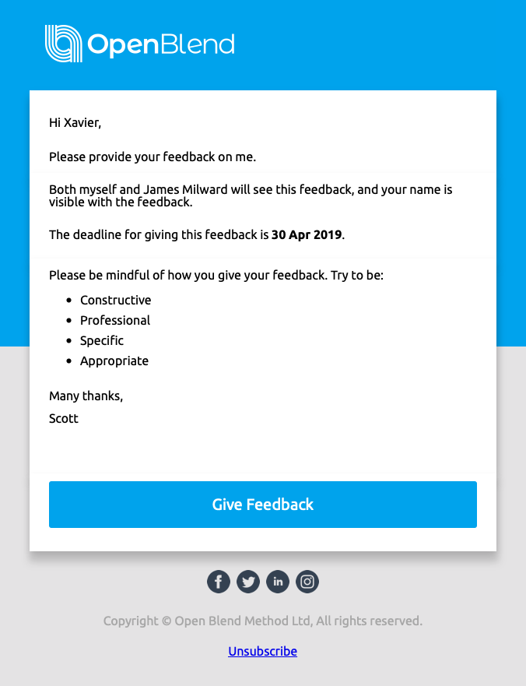
What are respondents asked?
Two simple questions:
What is the individual doing well?
Where does the individual need support?
Notes:
If nervous about feeding back up, reassures that this is about identifying support areas, not critiquing
DOING WELL
RECOGNITION BUILDS TEAMS AND CONFIDENCE
78% of employees say being recognized in their job motivated them.
SKILLS TO UTILISE IN OTHER AREAS
NEEDS SUPPORT
IDENTIFY WHERE NEEDS SUPPORT ENABLES DEVELOPMENT – GETS THEM TO WHERE THEY WANT TO GROW QUICKER
BETTER SUPPORT FROM MANAGER TO DO THAT

Slide 31
Benefits to you
Identify and leverage skills (not just praise)
Recognition for your achievements and what makes you special
Gives you a platform to give feedback
Address support areas in real time
Gives your manager pointers on how best to support you
Gifts you information to help you achieve your goals quicker

Slide 32

Viewing feedback before a session
Feedback released to both you and your manager on the feedback deadline for you both to review
Make sure you schedule an Open Blend session for an appropriate time post the feedback deadline
The Blend session creates a coaching, action led environment to discuss together

Slide 33
Working through your feedback
Notes:
1hr 40 in

Slide 34
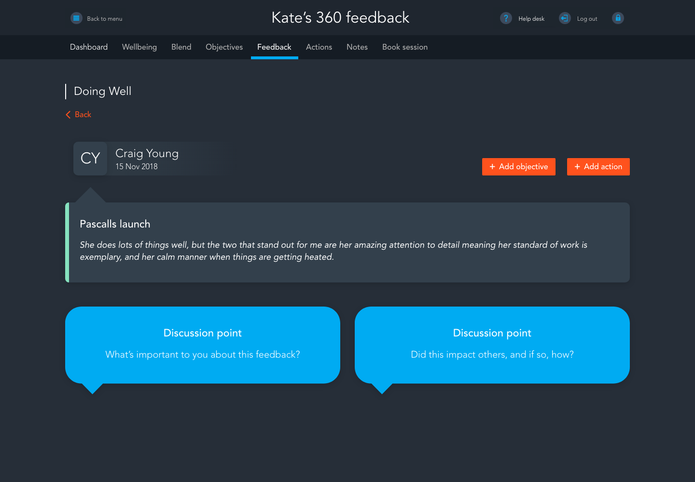


Navigating Doing Well feedback
What?
Reactions and observations
Patterns and dynamics
Context
So what?
What have we learned
Now what?
Planning for effective use of the learning
Notes:
WE WILL ALWAYS REVIEW DOING WELL FEEDBACK FIRST
What?
what happened?
What patterns have you observed?
What have you heard?
So what?
What does this mean?
What is implied?
What have you learned?
Now what?
What will you do differently? – LINKING TO ACTION
May decide nothing because of context – but make sure gone through process
ALWAYS DRIVING TO ACTION
WHAT ARE YOU MOST PROUD OF ABOUT THIS FEEDBACK?
WHAT IMPACT HAVE YOU MADE IN THE BUSINESS WITH THIS?
WHAT SKILLS IS THIS HIGHLIGHTING?
WHAT HAVE YOU LEARNED FROM THIS FEEDBACK?
HOW WILL YOU BUILD ON THIS SKILL IN FUTURE?
WHAT PROJECT / SITUATION WILL YOU APPLY THIS SKILL TO IN THE FUTURE?

Slide 35
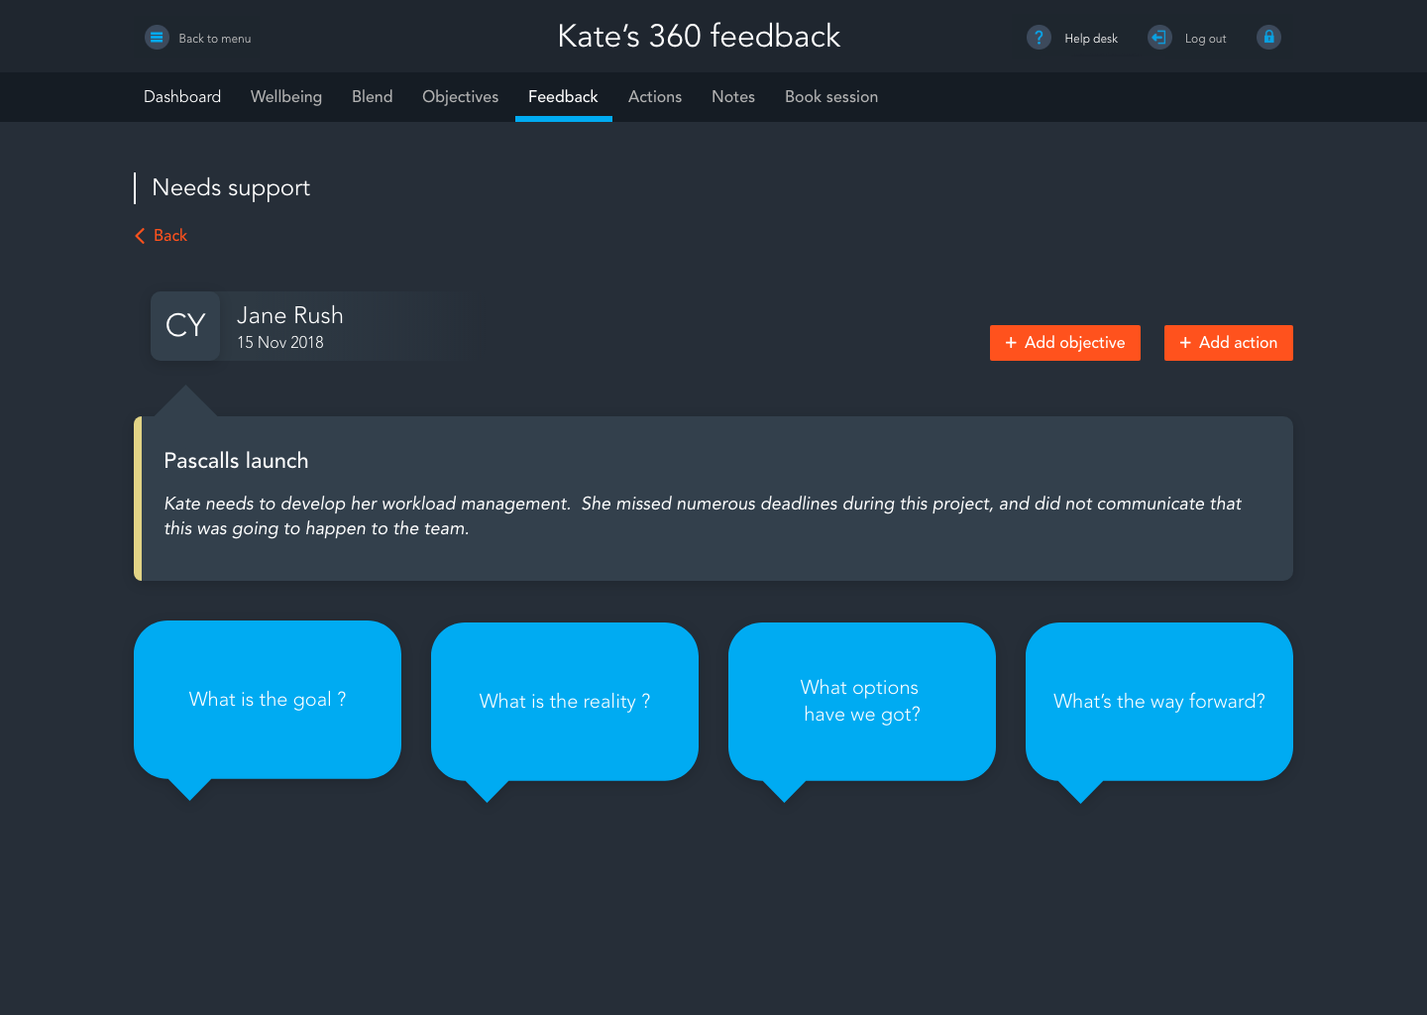
Navigating Needs support
Agree actions and way forward
Explore options
  Understand the feedback and context
What want to be different
Notes:
Feedback is one data-point
You should seek to understand this
You might not agree with the feedback
Some of the feedback might be difficult – ADAPTAD GROW TO PROCESS

Slide 36
Giving feedback
Notes:
1 hr 45 in – 11.15

Slide 37
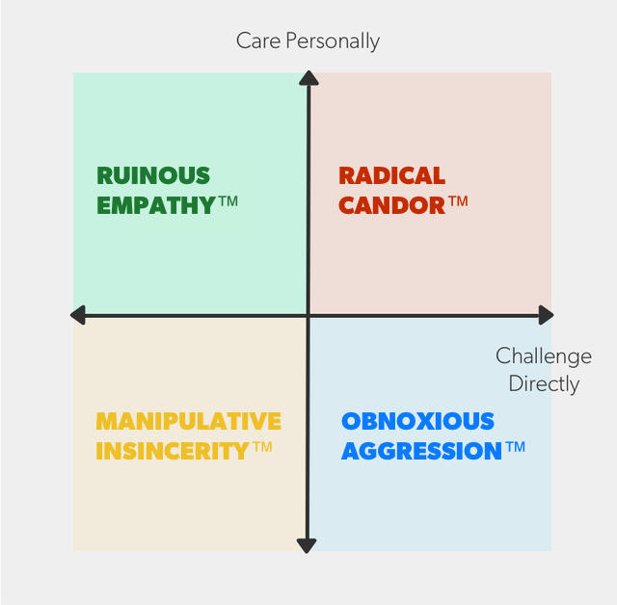
Radical candor
Care deeply about people as human beings
Challenge directly and honestly, to help
Can’t let short term feelings get in the way
We need to get comfortable in the Radical Candor quadrant
Feedback is a gift
Reference source and copyright of 2019 Radical Candor, LLC
Notes:
4 mins – slow down to replace exercise if later than 1hr 45
Recommend as a good read
Go through each quadrant and explain: HOW DO I LOOK?
Obnoxious aggression – giving feedback without care – I DON’T LIKE WHAT YOU’RE WEARING you look awful
Manipulative insincerity – didn’t mean it, protect my feelings before yours - someone who doesn't care, doesn’t want to challenge
– YOU LOOK GREAT Ruinous empathy – cant bear to hurt feelings, don’t help them improve – YOU LOOK LOVELY BECAUSE I FEEL BAD FOR HURTING YOU IF I SAY OTHERWISE - BO EXAMPLE WITH DEODERANT
Radical candour – clear, honest and to help – ITS UNFLATTERING, YOU LOOKED BETTER IN THIS

Slide 38
Giving good quality feedback
True
Kind
Helpful
SITUATION
BEHAVIOUR
IMPACT
Actionable feedback
Notes:
1 mins
1 hr 50 in
For when you are providing feedback for your talent and others
We ask that you provide feedback which is:
Constructive
Professional
Specific
Appropriate
Fact based
Bring opinions in where useful
Explain perspective for context and sign post it
WHEN WE WORKED ON THIS PROJECT WHICH WAS RUNNING LATE, I NOTICED YOU WERE QUITE SHORT WITH PEOPLE ASKING YOU QUESTIONS AND THIS SEEMED TO MAKE THEM CLOSE DOWN AND MADE ME FEEL UNCOMFORTABLE

Slide 39
Exercise
HOW I FIRST EXPERIENCED YOU
HOW I PERCEIVE YOU NOW
WHAT I PERCEIVE YOUR SUPER POWER TO BE
Walk around the room and find someone you could answer these questions about
Tell your partner:
Partner to say thank you
Then swap
Notes:
Ditch if over 1hr50 in
3.5 mins each way
7 mins total

