Slide 1
Launch comms

Slide 2
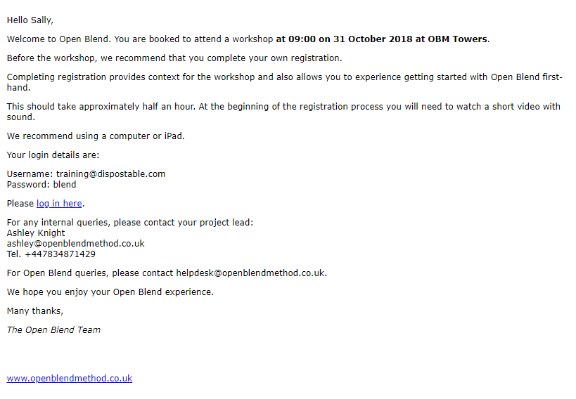
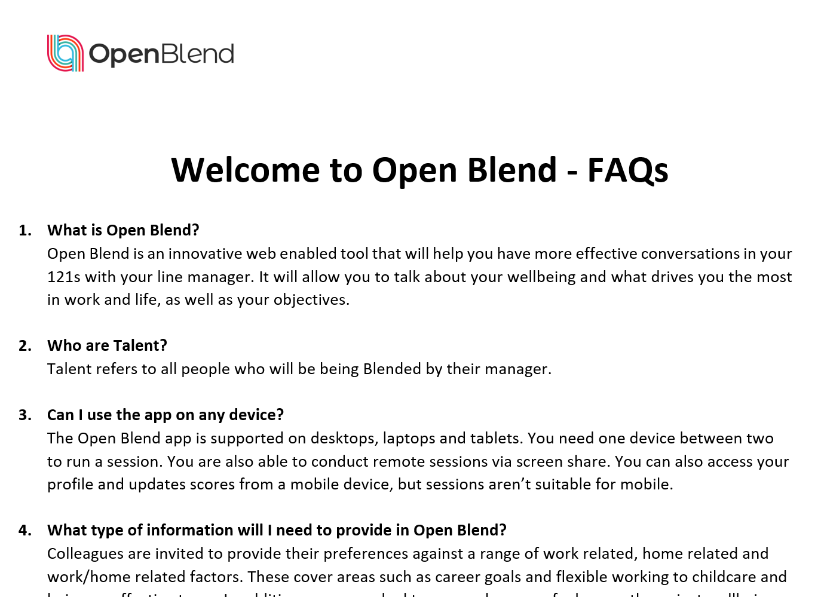
Example launch email to all
Example: Internal sponsor/PEL announcement (right) & FAQ attachment (below)
Hi All,
We are passionate about providing the best working environment possible and dedicated to helping everyone develop their careers here at <company name>.
You may have already heard that we are introducing a new tool called OpenBlend – a tool designed to help you to have more structured and positive one-to-one conversations around:
Key drivers and motivators (Blend)
Objectives
Wellbeing
It will really add value to your one-to-ones, making them more specific and actionable, and importantly, ensure you are supported to have the right conversations to thrive at work. Take a look at the attached for more information.
What happens next?
Managers will attend a workshop on XXXX to learn coaching and leadership skills, plus how to use the tool
You will all receive an email from Open Blend asking you to register and complete your personal Blend profile; what is most important to you in your work and home life
You will also receive an email asking you to answer 4 questions about your current one-to-ones; this will help us to set a benchmark on key areas before we start using Open Blend
What to expect
During registration you’ll be asked about your key drivers (Blend) and your wellbeing – happiness, confidence, and stress management
This information and how you have scored them will populate your personal dashboard and be used in your one-to-one sessions with you and your manager. Nobody else will have access to your individual data
It’s purely designed to help guide a productive conversation and support you to move towards feeling fulfilled in each area. Your manager will be trained in coaching skills to help you with this
You will be in control of what you want to talk about with your manager and if you don’t want to cover a certain area of your wellbeing or Blend, you don’t have to
Open Blend is to be used monthly at minimum, but you can check in more frequently as needed. The tool is designed to be flexible and you can talk about some or all areas of the tool during each session
What’s in it for me?
97% of users say that using OpenBlend has had a positive impact on their wellbeing
89% are more engaged with their job
83% feel more connected to their manager
We hope you’ll enjoy using OpenBlend and start seeing the benefits quickly. If you have any questions at all, please contact XXXX

Slide 3
AUTOMATED – Manager login details
Hello [first_name],
Welcome to OpenBlend. You are booked to attend a workshop at 09:00 on 12th December 2019 at OBM Towers.
Before the workshop, we strongly recommend that you register for OpenBlend by creating your own personal Blend profile.
Creating your Blend provides context for exercises you will be doing during the workshop and also allows you to experience getting started with Open Blend first-hand.
This should take half an hour at most. At the beginning of the registration process you will need to watch a short video with sound.
You can complete your registration on a computer or mobile device.
Your login details are:
Username: [user.email@address.com]
Password: Blend123!
Please log in here.
We hope you enjoy your Open Blend experience.
Many thanks,
The OpenBlend Team
For any internal queries, please contact your project lead:
Jim Smith
jim@blendPEL.com
For Open Blend queries, please contact helpdesk@openblend.com
AUTOMATED Manager login details
Sent automatically once a manager has been booked onto a training session in OpenBlend.

Slide 4
EXAMPLE – Manager email to team
Hi [line report/talent/mentee],
As you know, <company name> has invested in OpenBlend to help us to have more structured and positive conversations around:
Your wellbeing
What drives and motivates you as an individual
Your objectives for the year
You’ll shortly receive an email directly from members@openblendmethod.co.uk inviting you to register and complete your personal Blend profile.
Once you’ve completed your online registration we’ll set up a time together for our first Open Blend session.
I think the tool will really add value to our conversations, to make them more meaningful and actionable and I’m looking forward to getting started.
Do let me know if you have any questions at all.
Many thanks,
[line manager]
Example: Manager to direct report personal email
Possible email a manager can send to their team:
Once they have completed training
BUT
Before they will get their login email (48 hours after the manager training is completed)

Slide 5
AUTOMATED – Talent login details
Hello Alan,
Welcome to OpenBlend. You are now ready to arrange your first session.
We are thrilled that your business recognises the importance of supporting you to reach your potential.
Prior to your first session, you need to complete your OpenBlend registration by creating your personal Blend profile.
This should take half an hour at most. At the beginning of the registration process you will need to watch a short video with sound.
You can complete your registration on a computer or mobile device.
Your login details are:
Username: alan@blender.com
Password: blend
Please log in here.
For any internal queries, please contact your project lead:
Jim Smith
jim@blendPEL.com
Tel. 01234 56789
For Open Blend queries, please contact helpdesk@openblend.com
We hope you enjoy your Open Blend experience.
Many thanks,
The OpenBlend Team
AUTOMATED: Talent login details
Sent automatically from OpenBlend 48 hours after their manager has completed training (if scheduled in the OpenBlend training feature in PEL area)

Slide 6
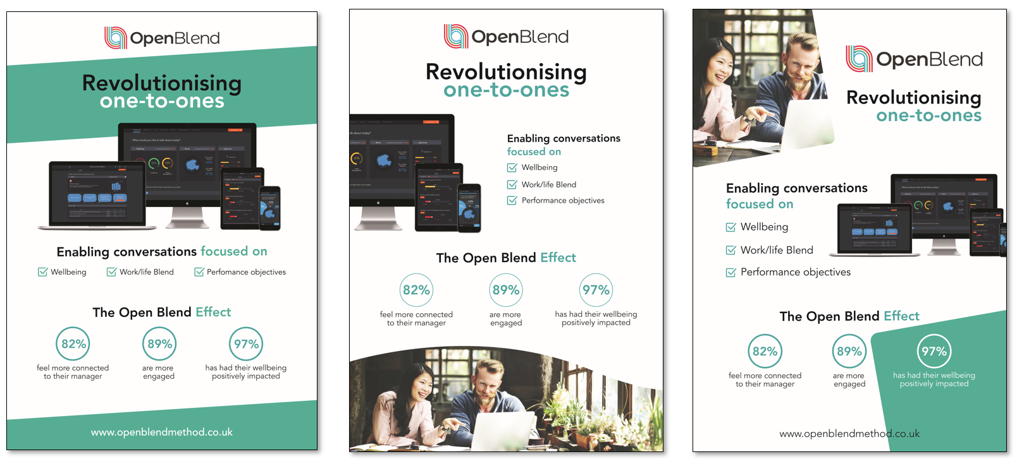
Posters – Available from OpenBlend

Slide 7
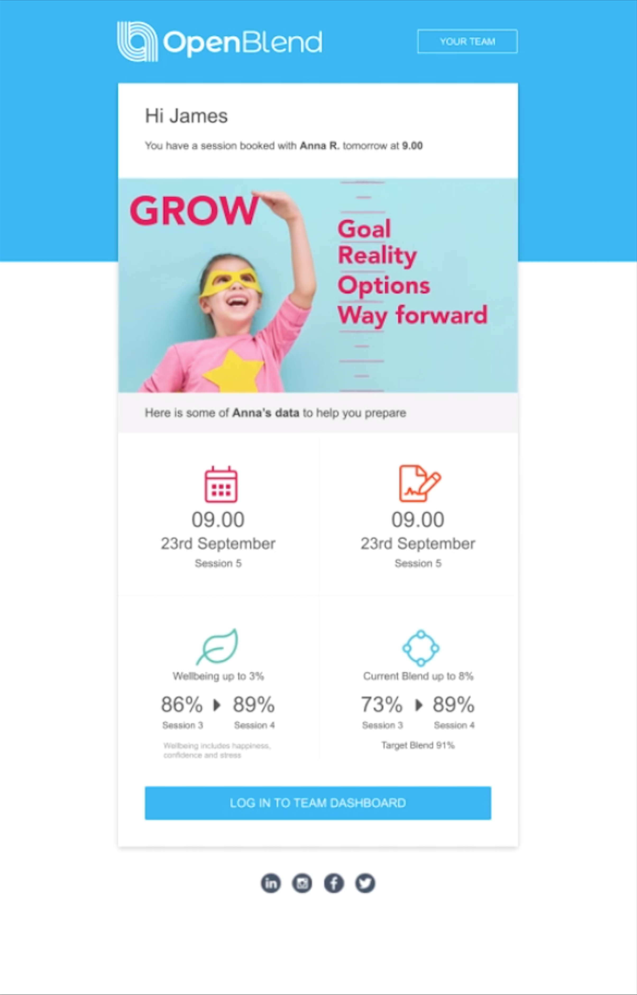
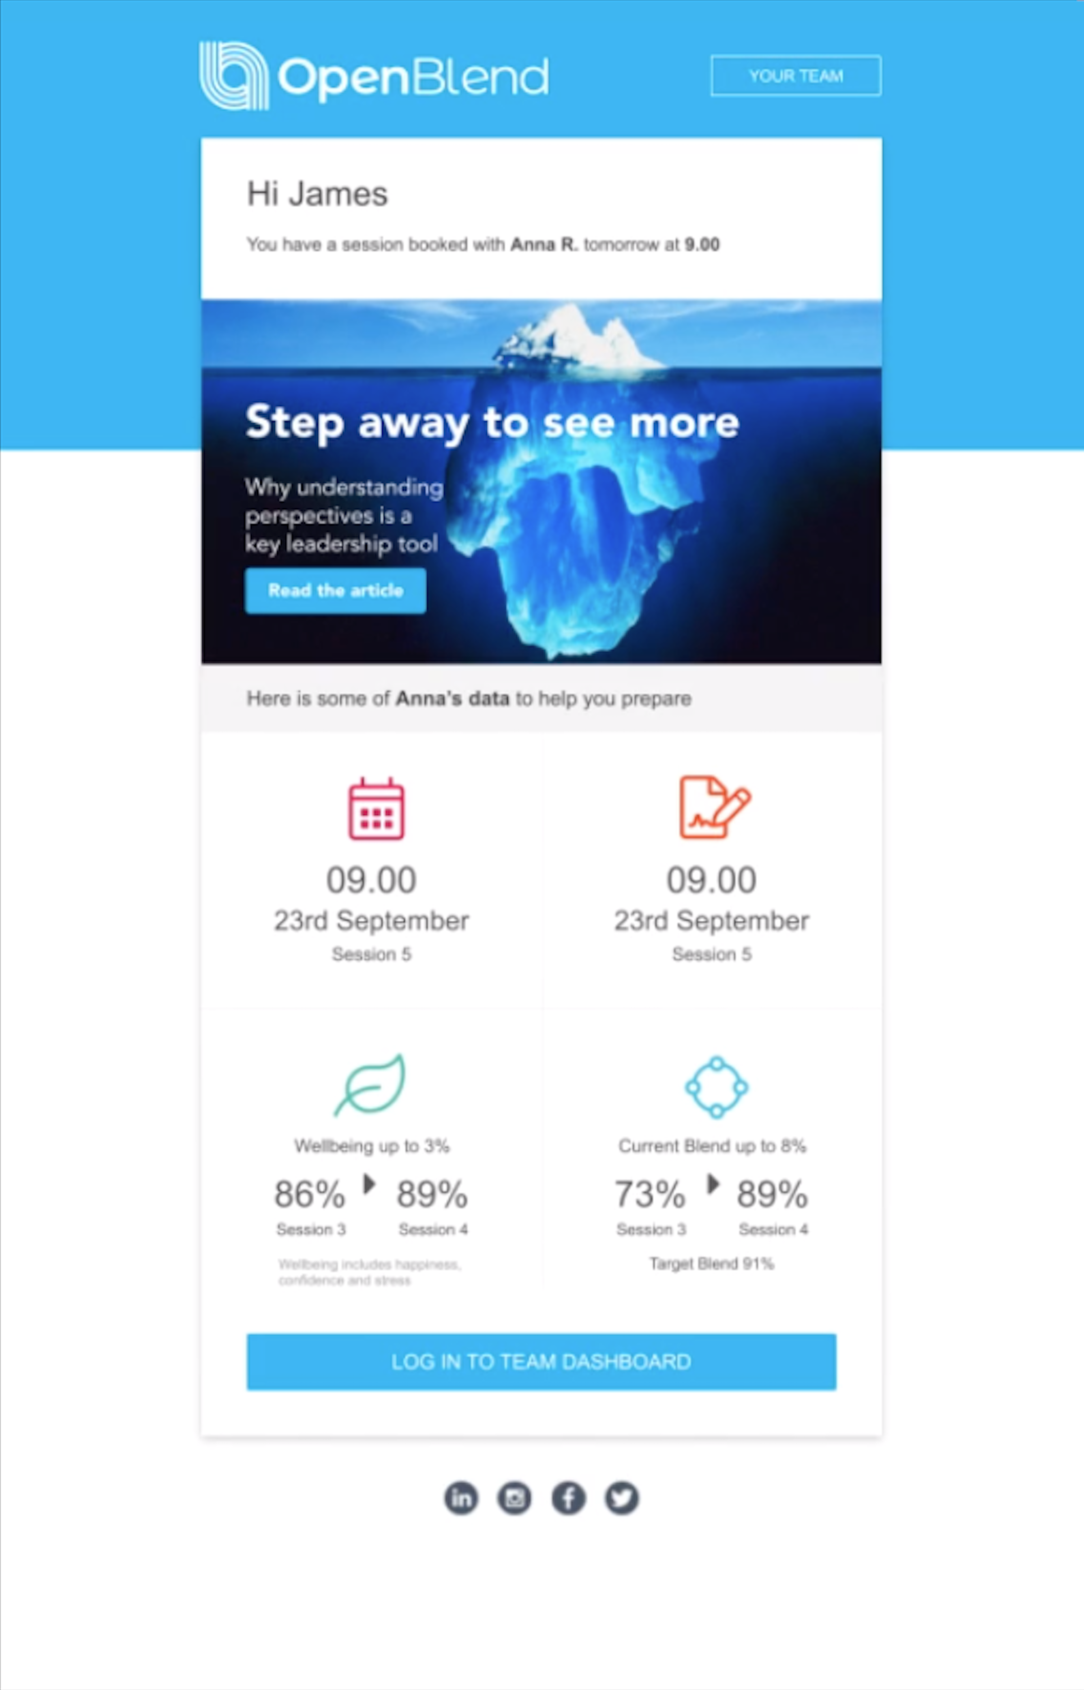
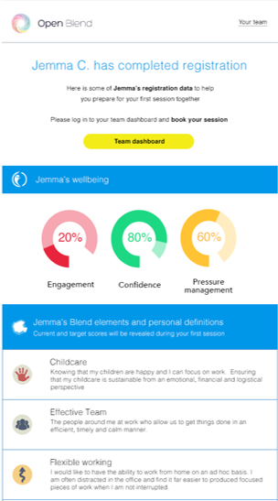
AUTOMATED – Session reminders to managers
AUTOMATED:
Session nudges to managers
Sent to help managers prepare for 1:1s.
Nudges include articles, podcasts and updates relevant to the upcoming session

Slide 8
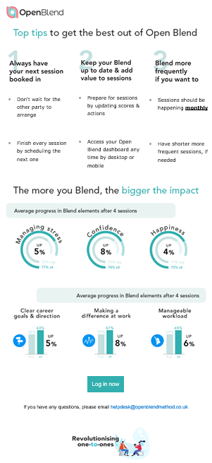
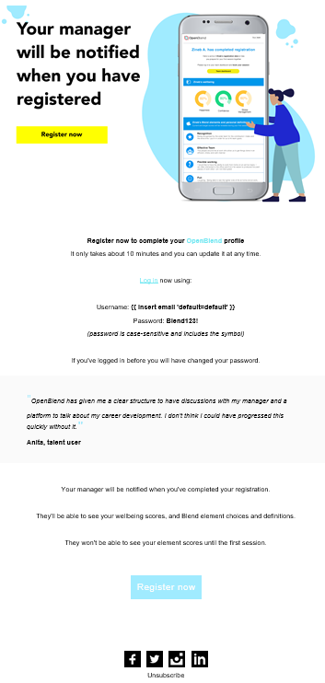
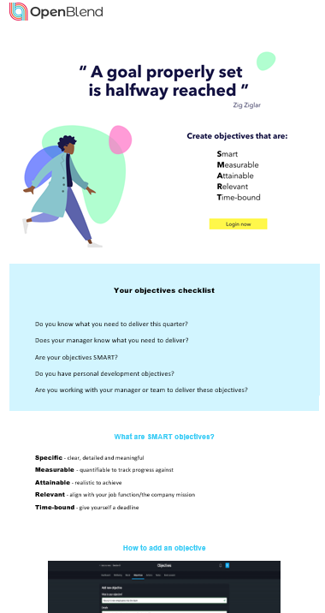
EXAMPLE – Engagement comms to users
OpenBlend has a catalogue of engagement emails, to encourage next action, including:
Registration nudges
Book session reminders
Effective objective setting
Owning your Blend
Tips to have the best 1:1

