Slide 1

Manager training
Notes:
INTRODUCE YOURSELF BRIEFLY
TIMINGS – 2 hours
BREAKS
IMMERSIVE – what you put in you get out, ask questions, chat, emojis
EMAIL OFF
TECH FAMILIARISATION

Slide 2

Agenda
What is OpenBlend?
What is people centred performance?
A coaching mindset
Product features with their coaching frameworks
  Objectives
  Blend
  Wellbeing
Homework
Notes:
Talk through the agenda points

Slide 3
What does people centred performance mean?
Notes:
Putting the person at heart of the conversation
An individual who is delivering so you need to address performance on an individual level
People up not business down

Slide 4
The modern demands of people managers
5 generations in the workforce
Self-awareness of varied motivators and drivers
Technology creates a 24/7 culture
Everyone has a Blend
Diverse
workforce
Notes:
USE ANNOTATIONS
REALITY CHANGE FACED BY MANAGERS LIKE YOU – very different work to 1970s when most management frameworks developed, managers facing very different challenges but have same tools and frameworks to use
COMPANIES NEED TO KEEP UP WITH THAT SHIFT
3 OF THE BIG CHALLENGES IN THE WORLD TODAY
1 - TECHNOLOGY – ALWAYS ON
Rife with issues,
boundaries,
Hard for a manager to measure performance and engagements
2 – EVERYONE HAS A BLEND - WORK LIFE BALANCE DOESN’T EXIST
OPPOSING SIDES OF WORK VS REST EXHAUSTING
WE ARE ONE PERSON WHO IS ALWAYS ON
Not just mums working flexible hours
Triathletes
Podcasters
Side hustles
Carers
Travelers
Everyone in workplace has a blend and demands an employer that acknowledges that
3 – DIVERSE WORKFORCE – NOT JUST SEXUALITY, GENDER, CULTURE, RELIGION, LIFESTYLE CHOICES
4 - FIRST TIME EVER 5 GENS IN WORKPLACE – education, relationship with authority, growth mindset, changes peoples relationship with their workplace and their expectations
5 – more self aware than ever, growth mindset everywhere, respect for difference and how we are motivated and driven by different things at different stages of our life and based on our character, values etc
INCREDIBLY COMPLEX SET OF CHALLENGES TO MANAGE AS A MANAGER, OFTEN WITH NO TRAINING

Slide 5




You as people managers
Demands on you as people manager greater than ever
A people centred approach
enables you to:
acknowledges each person as an individual
take time to understand their different drivers
give them the type and level of support needed to reach their potential
Notes:
As people managers there are huge demand on you to understand and support your people
Its about putting the person at heart of the conversation
An individual who is delivering so you need to address performance on an individual level
People up not business down
You need to support your people to
meet their needs and desires
ensure your retention of skilled and engaged talent?
engage in continual conversations and feedback
be agile to the changing needs of your people
We belive a coaching led conversations that work with the whole self is key to
create more meaningful and effective conversations with your staff
help you understand what drives and motivates them
idenfity blockers and challenges
work together to work through these.
WE’VE DESIGNED A TOOL TO HELP YOU DO THIS

Slide 6



OpenBlend
A unique
people-centred performance tool with coaching frameworks
Supporting all aspects of an individual to perform at their best
Develop manager coaching capability
Notes:
People up approach to performance, no broad brush top down, about giving each individual the change to tell you what they need to perform at their best
Not just about setting and measuring objectives but also understanding what is driving and motivating the individual and looking at their wellbeing – their ability to show up and perform at their best – giving opportunity for business to support in all areas
Aimed at manager, also drives coaching culture

Slide 7
Framework that gives you confidence
You no longer need all the answers
Time efficient tool – get to the nub quicker
Develop high performing achievers in your team
What you will get from OpenBlend
Notes:
Bring each point to life
Being a manager that can coach is not another role – it’s a skill set that will make conversations with your team more effective
OpenBlend gives busy managers the framework, tools, competence and confidence to have effective coaching conversations

Slide 8
A coaching mindset
Notes:
20 mins in

Slide 9
What do you see?
OPPORTUNITYISNOWHERE
Notes:
What do you see? Ask the room
Critical life skill
Key in relationships
Looking at the same thing, seeing something different

Slide 10
Different perspectives
It’s crucial to OpenBlend
Understand that an individual’s perception is their reality – i.e. Blend choices and scores
Build rapport
Notes:
First job as a coach is to understand how coachee sees the world – meet them in their world
It’s a mechanism to build rapport
It also makes sure there is no assumption – keeps you staying curious, by you exploring to understand their world you help them to
An individual’s perspective may be different to ours’ but that doesn’t mean it is wrong, if it is their Blend, we must learn to accept their reality.
Bring to life with an example

Slide 11


What are perceptions of reality?
Filters
The world is made
up of millions of events
Beliefs and feelings
input
output
Feelings and behaviours
Notes:
World made of billions of pieces of info
We take in around 7 +/- 2
We have a set of filters - like a brain sieve that filters stuff in and out.
Notice everything blue in the room, close your eyes and recall all the red stuff
Pregnant ladies, MINIs
Our sieve is made of our experiences, values, upbringing
RAS is also scanning to confirm/evidence what it knows to be true and will throw out the rest
These convert to beliefs and feelings which spit out behaviours and reactions
Train journey through London – farmer vs Londoner
Londoner – lining up exits with which train, rest not paying attention, dull
Farmer –looking at ads, buskers, conscious being packed in, excited, anxious, bewildered
Same experience for your team when presenting, writing report for CEO, client meetings
MAKE SURE THEY GET THIS BEFOR EYOU MOVE ON
STRESS IMPORTANCE

Slide 12


Coaching v mentoring
COACH
MENTOR
MENTOR
Notes:
Add a new hat to their wardrobe
WEAR the new hat by default for now and consciously swap to mentor

Slide 13
Coach
The term ‘Coach’ derives from transport and is used to describe the process of transporting people from where they are to where they want to be.
A coach uses a variety of communication skills:
Asking questions
Listening
Clarifying
Challenging
Re-clarifying
ASK/PULL
A coach asks (or pulls) questions to support the individual to discover the answers for themselves
Notes:
NOT FLUFFY
IT’S A STANCE
LESS ADVICE – COACHEE HAS BEST SOLUTIONS
I COULD COACH RICHARD BRANSON
USE WHEN WORKING ON:
Personal issues
Ambitions and goals
Relationships and politics
Where coachee is the expert – personal development, performance
Individual knows better and takes accountability

Slide 14
Mentor
Mentorship is a personal development relationship.
A more experienced or more knowledgeable person helps to guide (tell or push) a less experienced or less knowledgeable person.
A mentor guides the mentee to find the right direction and helps them to develop solutions .
TELL/PUSH
Notes:
Give advice
You are an expert
Your experience helps them more
Be careful of temporary compliance – keep telling them what to do and never gets done – they don’t own the solution
Use this in the O section of the grow model we talk about later

Slide 15
Expanding your preference
PUSH
Tells
Sells
Tests
Asks
Follows
PULL
PUSH
the solution
PULL
the solution
Notes:
There is no better or worse way to solve a problem but the coaching is all about Pull.
Pull is something that can take a little time to learn, but is a far more empowering way to lead. Your talent are more likely to come up with the solution themselves, next time.
Also, people make much more effort with their own ideas than with someone else’s. In OPENBlend Sessions, we want you to practice coaching as much as possible.
But be aware of your default style and be conscious to flex
Look out for temporary compliance
This scale shows where people may be.
Tells: Simply tells the talent what to do
Sells: Leader sells the benefits to the talent of doing it the way they suggest
Test: Leader suggests an answer and asks the talent to imagine what would happen if they did this
Asks: The leader asks the talent what they think might work best
Follows: The leader asks the talent what to do and follows their suggestion.

Slide 16
Fundamentals of coaching and mentoring
Where are you now?
How?
Where do you want to be?
Notes:
IN ITS SIMPLEST FORM
WHERE ARE YOU NOW
WHERE DO YOU WANT TO BE
WHATS THE GAP
WHAT HAVE WE GOT TO DO TO GET THERE
SOME WILL BE PUSHING AND SOME WILL BE PULLING
REMEMBER THERE WILL ALWAYS BE A SOLUTION

Slide 17
Getting started
Notes:
45 mins in

Slide 18
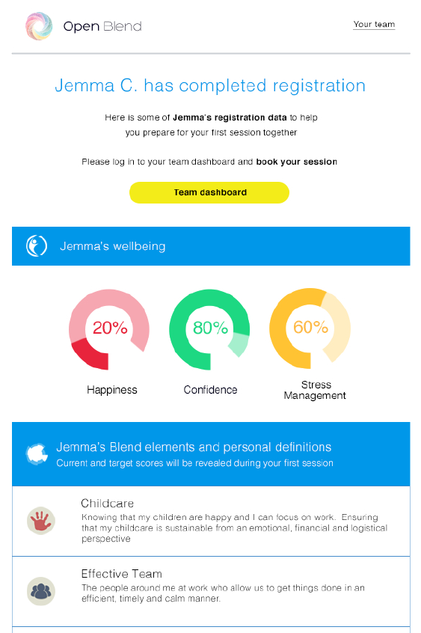
Everyone completes their registration
You will get a confirmation when you talent has completed their reg showing their:
Wellbeing
Blend elements and definitions (key drivers)
Notes:
Tell them that when their talent complete their registration they will receive a notification with an overview of their:
- blend elements & definition – tell them you will cover what this is in more depth shortly
Wellbeing

Slide 19
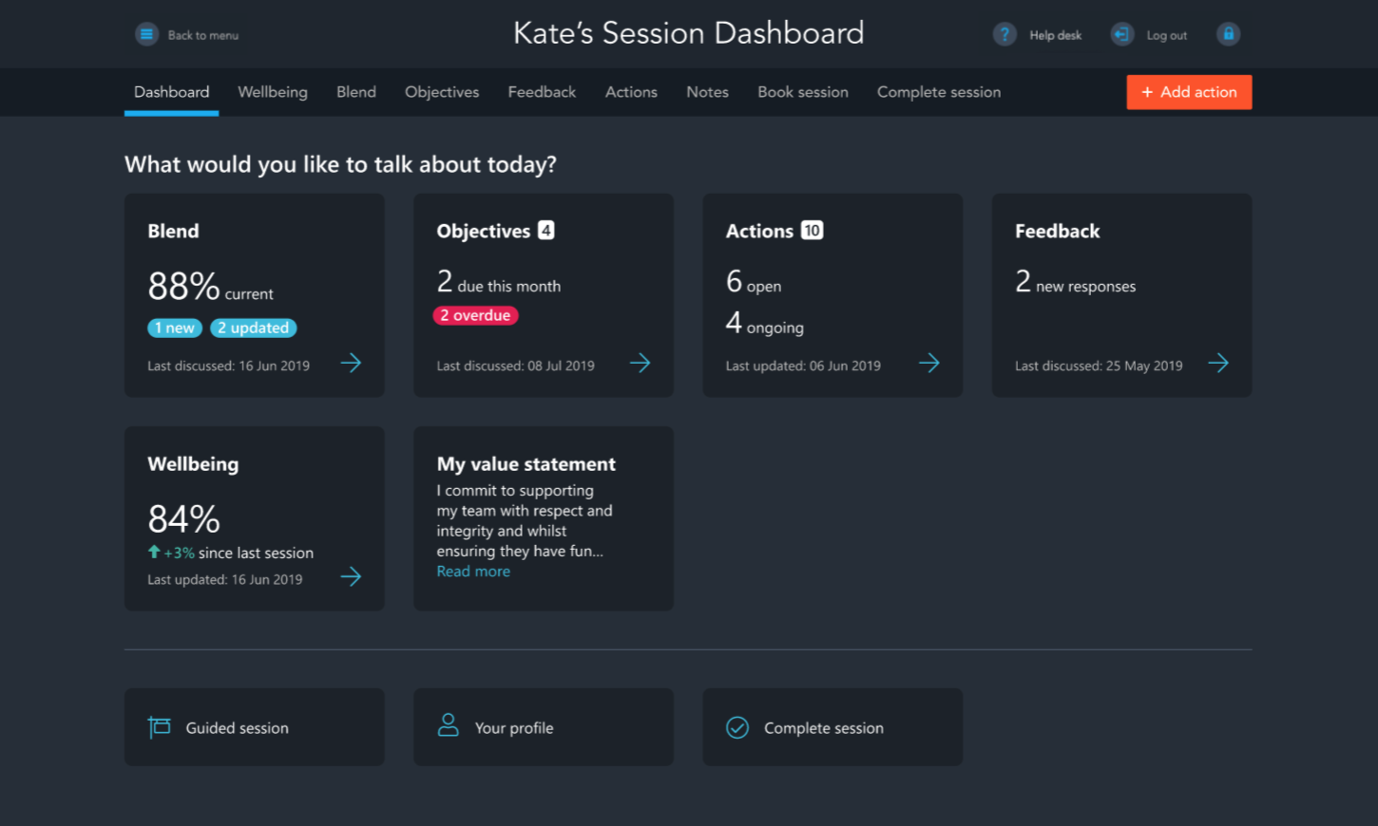
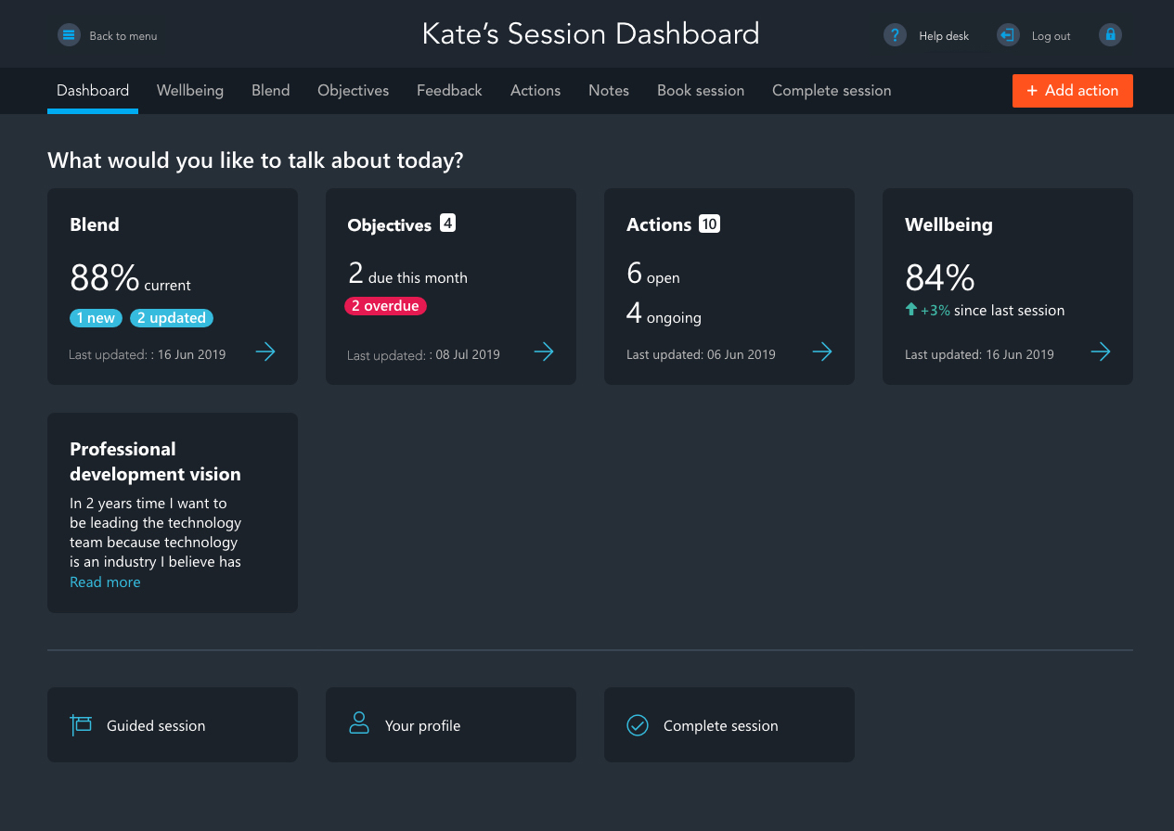
OpenBlend session dashboard
Notes:
You talents registration data will pre populate a session dashboard, and this is where the conversations will happen. Laptop used in session to triangulate
Here you can see the core areas within OpenBlend including:
- Blend
- objectives
- actions
- wellbeing
Enables 5/6 types of conversations
Each area highlights where there is action required, when elements were last discussed, colour coding highlights improvements or declines
Enables you to go straight to what you need to talk about
Focus on accountability for completing actions
Navigates managers through structured conversations but also enables easy access to areas that need attention
Mention guided session – only use first few times
As this is performance management Lets start with objectives

Slide 20
GROW
Notes:
1HR 30 MINS IN

Slide 21
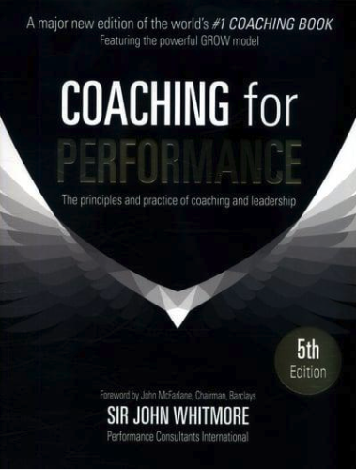
What is the GROW model
GROW is acknowledged as the most popular ‘manager as coach’ model globally
  Problem solving
  Goal setting
  Performance improvement
First published by John Whitmore
  Coaching for Performance in 1992
  Coaching bible for managers.
Notes:
First published by John Coaching for Performance in 1992, whicWhitmore in his book h was regarded as a coaching bible for managers.

Slide 22
A roadmap to action
Way forward
What will you/we do? What is the action plan ?
Options
What could you/we do to moving towards the goal?
Reality
Where are you now?
(Current score & meaning )
Goal
What do you want?
(Target score & meaning )
Notes:
SIMPLE, POWERFUL, AWARENESS, UNDERSTANDABLE, PATHWAY TO ACTION
OVERVIEW EACH STAGE
G – what does it look like, what would change, how would it feel, benefits, nail it down, how will you know, what will it mean
So often people say – I want to buy a house and then move on but it doesn’t unlock the excitement create sticky goals
Spend Longer in G than feels comfortable, really understand the goal, create a massive magnet
R – current reality, how it happened, what's good and what's not, obstacles, costs of it, benefits of it, what done in the past
G AND R GIVE US OUR SCORE
O – explore, open it up, always a solution, how could you look at this differently, what would your hero do, what creative ideas could you come up with, how have you overcome similar in past, what resources or support do you need
W – What are we going to do , first step, smallest step, how can I support you, when start, when finish, 1-10 commitment, how will we know achieved
Benefit for the other person
About them – for them – not you – for their benefit

Slide 23


Silent GROW
Select a Blend element
Note your current and target score
Answer these questions
Write down the answers
No need to discuss
Notes:
Silent GROW
You will lead the group in a silent GROW session using 3 questions from each section of GROW (see below)
Ask each person to use the objective they have just established
Mark their level of completion on this
Use the GROW model to navigate through a coaching session – the facilitator reads out the questions for each section but instead of supplying answers, the participants just write down their answers. Go through each section and emphasise how coaching, as a true PULL model, works in us not needing to supply any solutions or mentoring because we all have it in us to find the answers. This is so empowering, so that even if we are coaching talent with a problem we have never encountered, or an element we don’t relate to, we can support them by simply asking the right questions.
G(oals)
What will be different for you when you achieve this objective?
What would be the benefits to you and others once you’ve achieved this objective?
R(eality)
What does the current situation cost you?
What is stopping you from achieving this objective?
O(ptions)
What are your options?
What resources do you need?
W(ay Forward)
What's the first step you could take?
When will you start?
DISCUSS AFTER:
1st experience of blend
Power of being asked question and given time to think (silence)
I didn’t need to know anything or buy in to your goal to help you – encourages accountability and ownership

Slide 24
Objectives
Notes:
1 hr 10 mins to here - BREAK

Slide 25
Objectives in OpenBlend

Slide 26
What should be included in objectives?
TWO SKILLS (ONE SOFT, ONE HARD)
Behaviours
Communication
Skills related to role
TWO KPIS/PROJECTS
Process change
Innovation
Change projects
ONE STRETCH GOAL
Align with future career aspirations
What skills does this individual need to excel in their role?
What is holding this individual back?
What changes would make this team more successful?
What ideas does this individual have for the enhancement of the team activities?
Where does this individual want to be in five years?
Who do I need in the team in 18 months time?
Notes:
Suggest between 3 – 6
Link to company values and strategy – behaviours, change projects etc
Use coaching tools, stance and system questions to flesh out the approach
Document the key actions within the tool
Revisit progress and action completion in on-going sessions

Slide 27
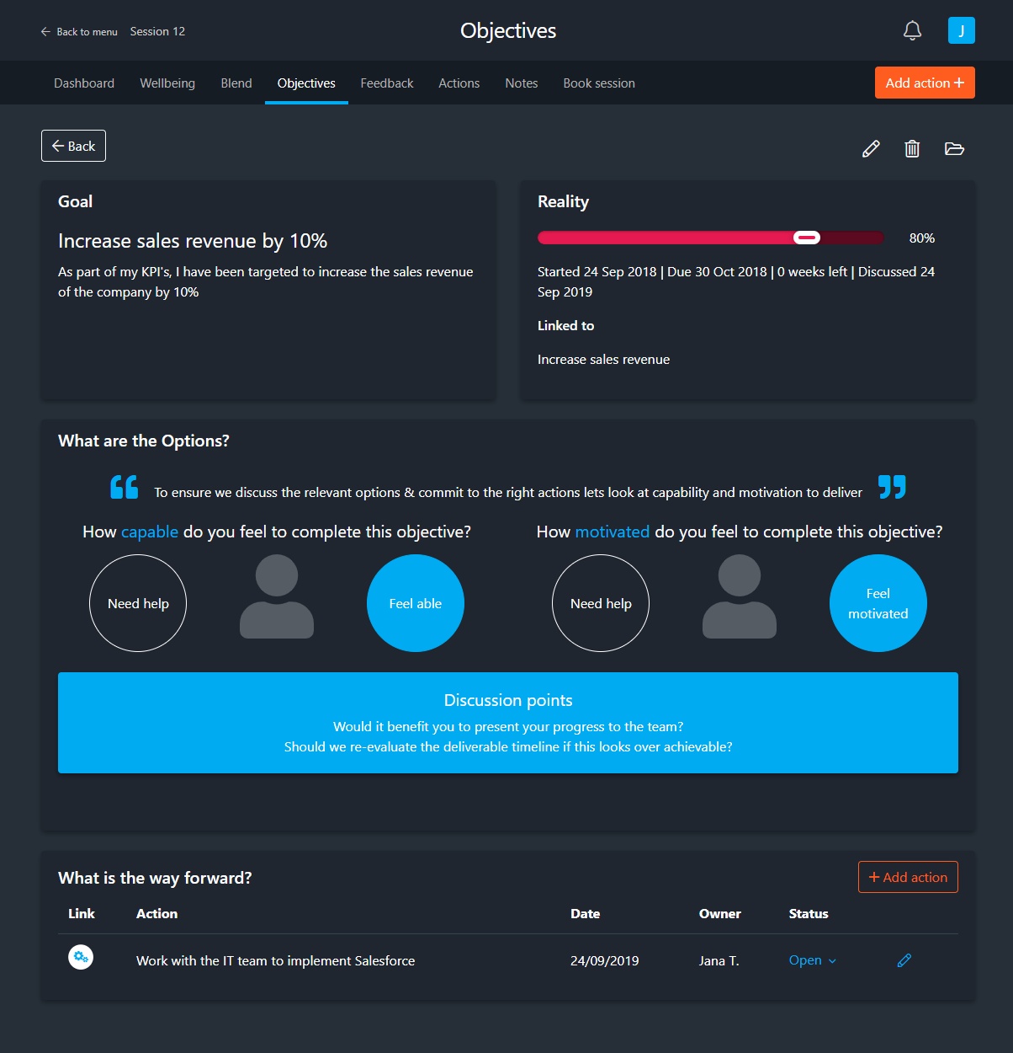
GROW in objectives
Goal.
What is the objective?
Reality
What is the reality now?
Specific – clear, detailed and meaningful
Measurable – quantifiable to track progress against
Attainable/ agreed / achievable – Realistic to achieve
Relevant – does it make sense within your job function, and align with the company mission
Time-bound – state when you'll get it done
Options
What are the option?
Way forward
What actions will we commit to?
Notes:
Talk through how to use GROW with the screen
Broker discussion about how to use the tool practically in the session

Slide 28
Blend
Notes:
1 HR 20 TO HERE

Slide 29
Blend
Notes:
HELP IDENTIFY OBJECTIVES
HELP IDENTIFY BLOCKERS TO PERFORMANCE
WE USE THIS TO DRIVE PERFORMANCE BY UNDERSTANDING WHAT IS IMPORTANT TO INDIVIDUAL

Slide 30

Blend
Part 1
Populating their Blend
8 elements
Unique to each person
Progressive via current to target
Clear career goals and direction
Effective team
My
partner
Exercise &
health
Manageable
workload
Fulfillment
At work
My children
Progression
at work
Notes:
STORY OF BLEND
Anna, 15 years leadership coach
9 years ago noticed work life balance a blocker
Own life, two opposing sides was jarring
Knew job as coach was to help look at something differently
Drew a circle, 8 segments, named each segment
Called it blend – based on wheel of life
THESE CREATED THE KEY DRIVERS, AS IDENTIFIED BY THEMSELVES THAT NEED TO BE FULFILLED IN ORDER FOR THEM TO CAHIEVE THEIR FULL POTENTIAL
Adding scoring
Shoulder drop relief moment
Realized this is what managers should be doing
USE THIS TO SET UP THE STRUCTURE AND CONTENT OF YOUR CONVERSATIONS
CONSIDER PERCEPTION, THEY CHOOSE, THEY DEFINE, THEIR BLEND
We all have different values and drivers, these also change in priority all the times
KEEPS THAT FUTURE, ACTION FOCUS BASED ON NOW, GOAL, GAP

Slide 31
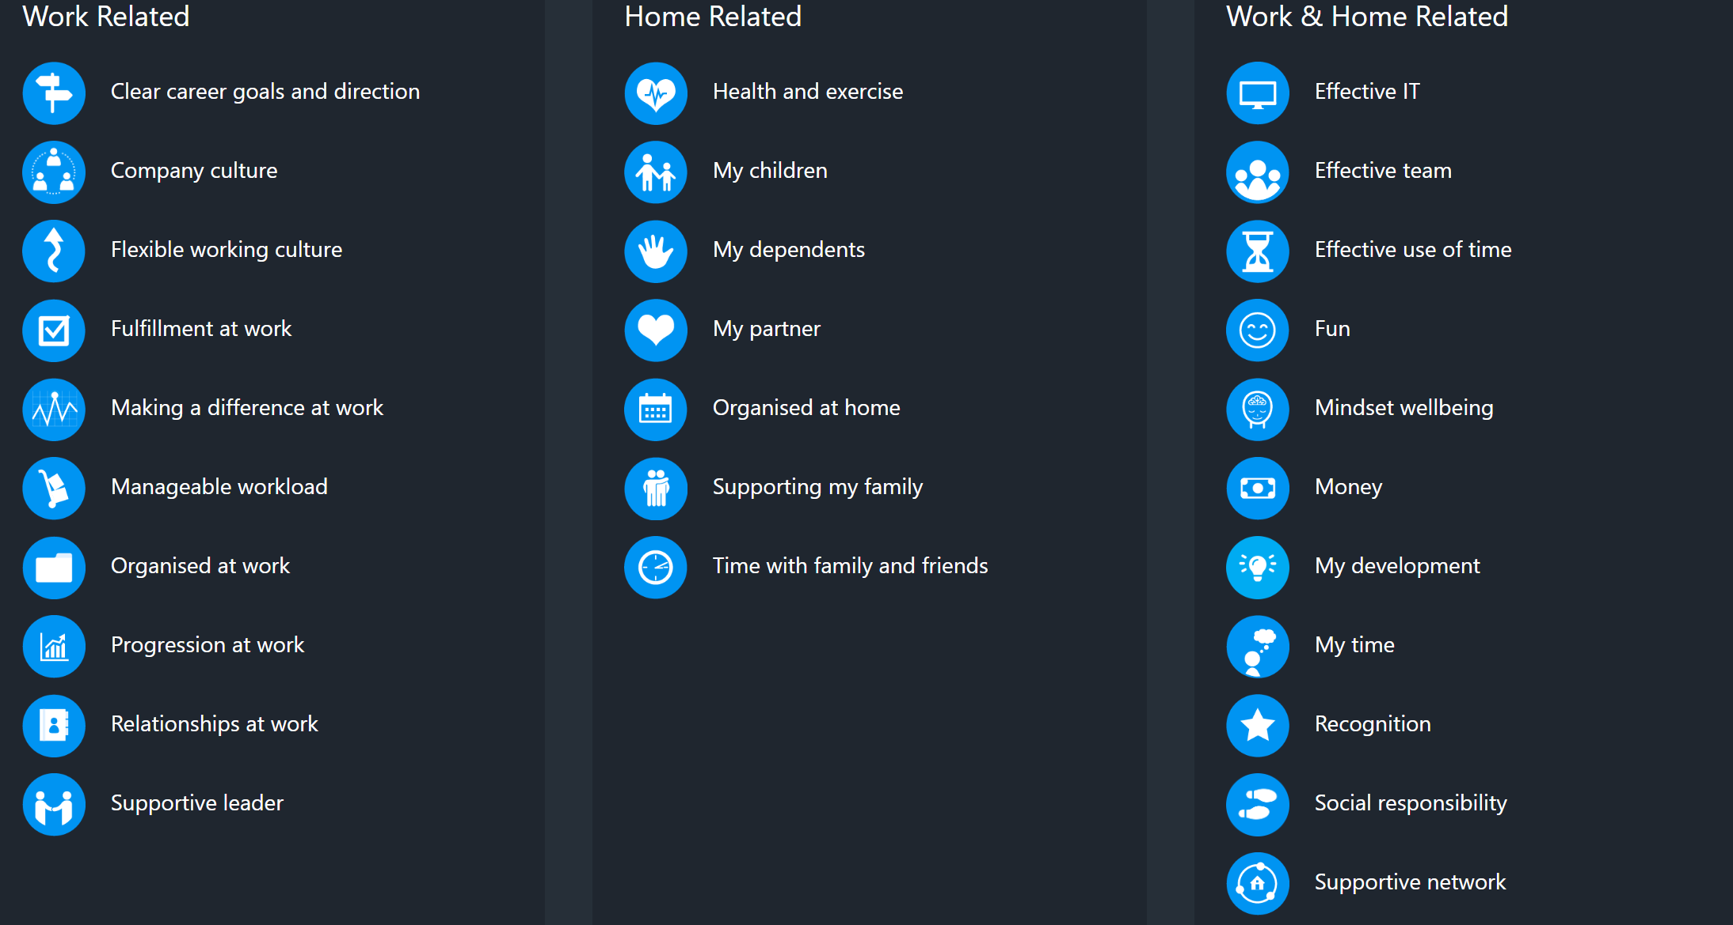
Notes:
To bring up on screen if needed

Slide 32

What is current Blend?
Clear career goals and direction
Effective team
Part 2
Score current level of fulfillment in each element from 1-10
6
Exercise &
health
My
partner
5
This gives their
current
work/life
Blend
5
4
63%
7
9
Fulfillment
At work
Manageable
workload
7
8
My children
Progression
at work
Notes:
BRINGING BLEND TO LIFE –
this is your blend,
28 elements,
you have selected,
you have scored and scored again,
this is unique to you.
Everyone has their own unique blend.
This represents your whole self at work.
This is the basis of having more meaningful, coaching led conversations that work with the whole person
all of these elements make up your drivers.
Tapping in to these drivers and values enables your people to be more fulfilled, happier and more successful at work
SCORE CURRENT
What is a 6 to me is an 8 to another
What partner means to be is less rows about time working late, to others its having time to go out and date to find one

Slide 33

What is target Blend?
Part 3
Target score to reach their potential
Each element is scored from 1-10
Clear career goals and direction
Effective team
9
8
6
Exercise &
health
My
partner
5
8
7
5
4
This gives their
target
work/life
Blend
9
7
8
Manageable
workload
Fulfillment
At work
82%
7
8
9
My children
Progression
at work
Notes:
SCORE WHAT IT WOULD NEED TO BE TO ACHIEVE THEIR POTENTIAL
Talk anecdotally on how people might use this differently and let that be OK
We use the numbers to facilitate the conversation – don’t get too hung up on it, remember perceptions of reality
Don’t go through segment by segment – ask Talent what they want to talk about, as they might not want to cover everything

Slide 34

Simply…
Your current
Blend is 63%
Your target
Blend is 82%
A
B
Where are
you now?
Where do
you want to be?
Notes:
After scoring we know the gap
We have a common language to communicate from
We can track and quantify
We work on closing the gap

Slide 35
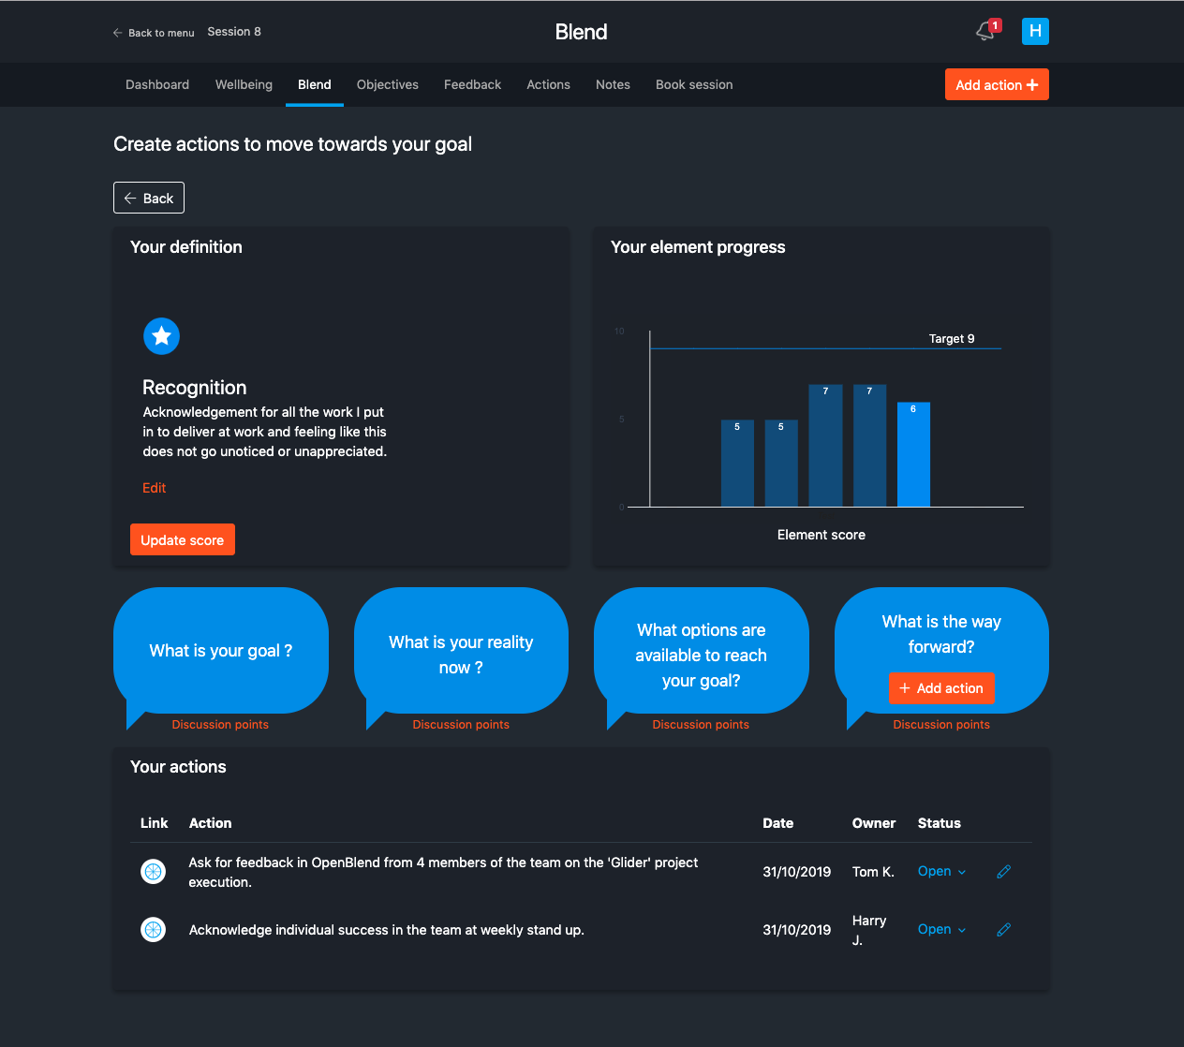
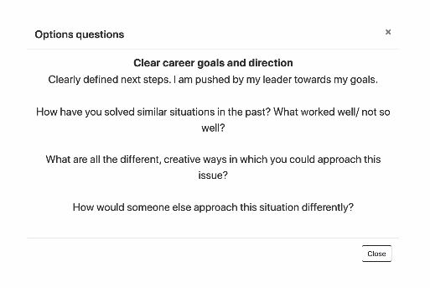
GROW in Blend
Goal.
The definition should establish the goal. Build this out with them.
Look at their target score
Reality
What is the reality now? This current score.
Options
What are the option?
Use discussion points
Way forward
What actions will we commit to?
Notes:
HOW GROW WORKS IN OpenBlend – first session we suggest cover wellbeing and this for sure (always cover 2/3)
Check in and understand what the element means to them - G
See their current, previous and target scores to help facilitate conversations on progress/how things are - R
Questions help you in order GROW
Remember it is always action led, so encourages you to add an action and agree owner – you or your talent
When you come back next time you have more data and actions to check in on

Slide 36
Working with the Wellbeing module
Notes:
1HR 40 TO HERE

Slide 37
Wellbeing

Slide 38
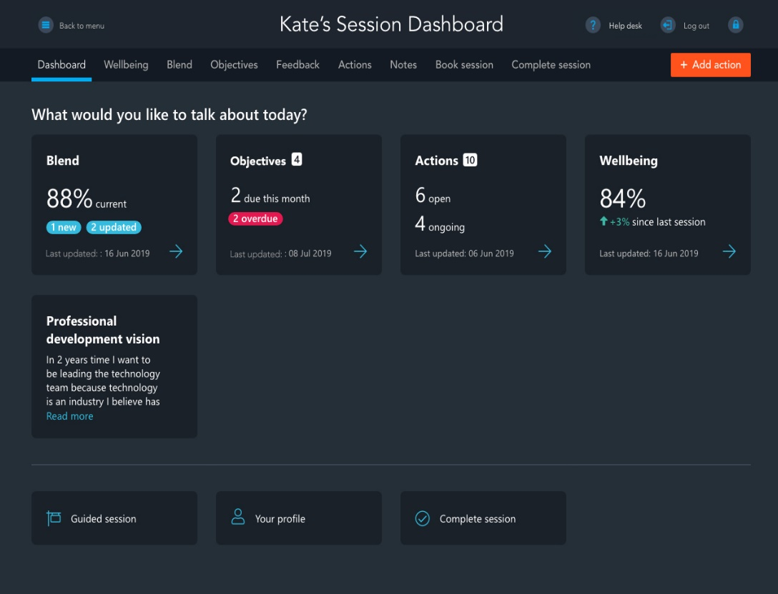
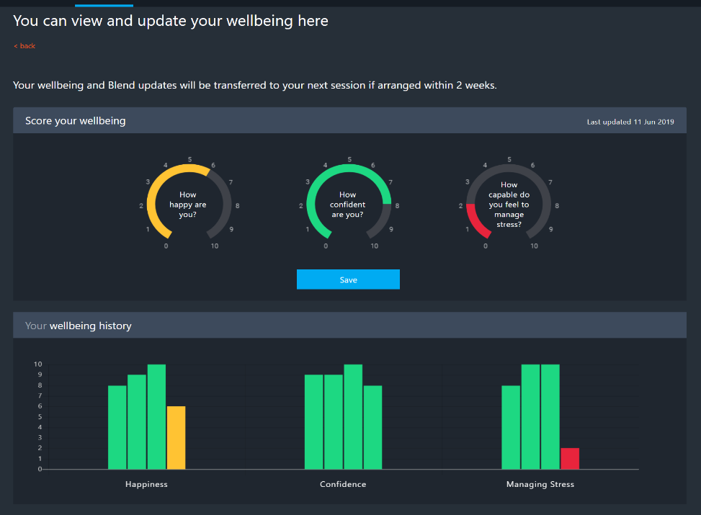
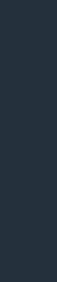
Wellbeing
Let Talent decide how you use this
Opportunity for Talent to talk things through and access support
Talent drive the conversation
Move through to other areas e.g. Blend or Objectives
Notes:
5 mins
Might want to just cover work context
Up to Talent how you use it
Capability to manage stress – reassure talent wont be judged
Historic graphs enable you to spot patterns
Don’t get stuck here – let it feed Blend elements and objectives and progress to GROW conversations in those areas
Gives permission / Brokers more meaningful and intimate conversations

Slide 39
Supporting
Notes:
1HR 45 TO HERE

Slide 40








How we develop coaching capability
Manager onboarding
Onboarding
recaps
3 coaching frameworks
Coaching recap
email nudges
Session
prep functionality
Team data
insights
Notes:
Bring each point to life:
SESSION PREP – access within your Dashboard to all of talents blend elements, suggested questions for each element and also searchable by subject. Demo site for practicing
3 frameworks – for use inside and outside of OB
Manager onboarding workshop
Onboarding recaps - Bespoke learning content sent ahead of first session
Podcasts and articles sent with reminder nudges ahead of sessions
Insight dashboards data enabling gap analysis and macro development driven from people up – anonymized macro trends – flag confidentiality (only manager can see talent data) – Use example of company investing significantly in flexible working only to find it wasn’t even in top 10 – FLAG!!! OBJECTIVES ALIGNED TO A BUSINESS VALUE WILL BE VISIBLE TO PEL
YOU DON’T KNOW HOW TO DO IT ALL FROM THE START
LIKE GOOGLE MAPS
LEARN AS YOU GO 70%

Slide 41
The session experience

Slide 42
Layers of conversation in Blend
Layer 1 - Awareness of the element via Blend wheel
Minimum
requirement
Layer 2 – Work-related discussions and actions
NOT required
Layer 3 – Life-related discussions and actions
Notes:
You may not be qualified as a life coach so we want to ensure you are comfortable with the boundaries of creating actions in your talents’ life’ elements as well as ‘work’.
OpenBlend Method is a framework to support you, the leader, to create work related actions that allow an individual to experience a more fulfilled blend so they can progress in their career. All very work related. But, what if the solutions to improve fulfillment in a certain element is deemed too ‘lifey’?
I.e. actions in and around the elements of relationship with my partner, time with my kids, my time, good childcare support.
You need to focus on allowing the increase in fulfillment to stem from a work perspective – i.e. relationship with partner – Goal is to spend more time together in the evenings reality is I work 16 hrs. over my contracted hours per week and this is all done in the evenings.
Options are that the workload has to be covered, so a solution could be to focus the work allocation across the team, addressing deadlines, giving more notice on big projects, actions are: ensuring 2 nights a week there is no working in the evenings.
You are not expected to create life related actions if you don’t want to , don’t feel comfortable doing so or your individual doesn't’ want to.
Please note that if there is an area in the individuals life which needs specialist help, YOU MUST NOTIFY YOUR HR PARTNER. This may include depression, extreme stress, extreme sadness or anything you deem a concern that you are unable to deal with.

Slide 43
Bring it back to the business
”How does it impact work?”
”How does work impact it?”
“What can the business do to support you?”
Notes:
If you find yourself uncomfortable life related conversations in Blend bring it back to the business.

Slide 44

Session guidance
First session
Focus on
Blend and wellbeing
It’s about really understanding what drives your people
Second session
Focus on
Objectives
Ensure you know what
You people need to achieve in the next month/ quarter / year
Ongoing session
Focus on
What is important to
the individual’s performance
Sign off actions
Approx 1 hr
Approx
10 mins - 1 hr
Approx
30 mins - 1 hr
TIP - If your talent feel uncomfortable in Blend, move the focus to objectives
TIP – establish a development objectives as well as performance objectives
TIP – Blend gives people permission to discuss things. Do not force Blend conversations
Notes:
FEEDBACK ADHOC AS NEEDED

Slide 45







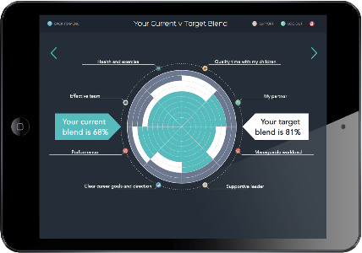
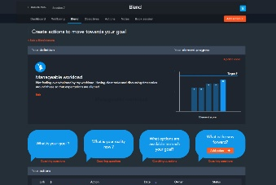
Sessions
Face to face
Meet in a flexible but private space, in or out of the office – use one device only
Remote sessions
Screen share via web conference tool
Begin a session
Use the button on the welcome page
Notes:
All you need: one device (computer or tablet) and an internet connection
Screen share for remote workers & employees that spend a lot of time travelling
Click ‘Begin session’ to start every session and remember to end session

Slide 46
Homework
Watch training videos
Practice a 15 minute GROW session with a colleague using GROW sheets
  Give each other feedback
Complete your own Blend if not already
Practice pulling together one SMART objective for yourself if not used before
Conducting a session in OpenBlend
Navigating the Team Dashboard video

