Slide 1
COVID-19 and Wildfire
Episode 2
HOSTED BY

Slide 2
Logistics
We will hold a brief Q&A at the end of the webinar- please submit all questions through the Q&A window. You may also use the Chat window to provide additional comments to our teams.
This webinar is being recorded- a survey with the webinar link will be sent in the next 24 hours. Please respond to the survey- your feedback is extremely valuable. This series is for you!
Links to all references will also be available on the webinar recording page.

Slide 3
Opening Statement
Robert Edson
Chief Sales & Marketing Officer, Intterra

Slide 4
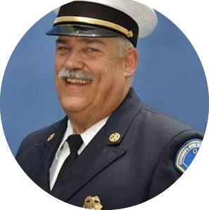
Opening Statements
Chief Kim Zagaris
Wildfire Policy and Technology Advisor at WFCA

Slide 5
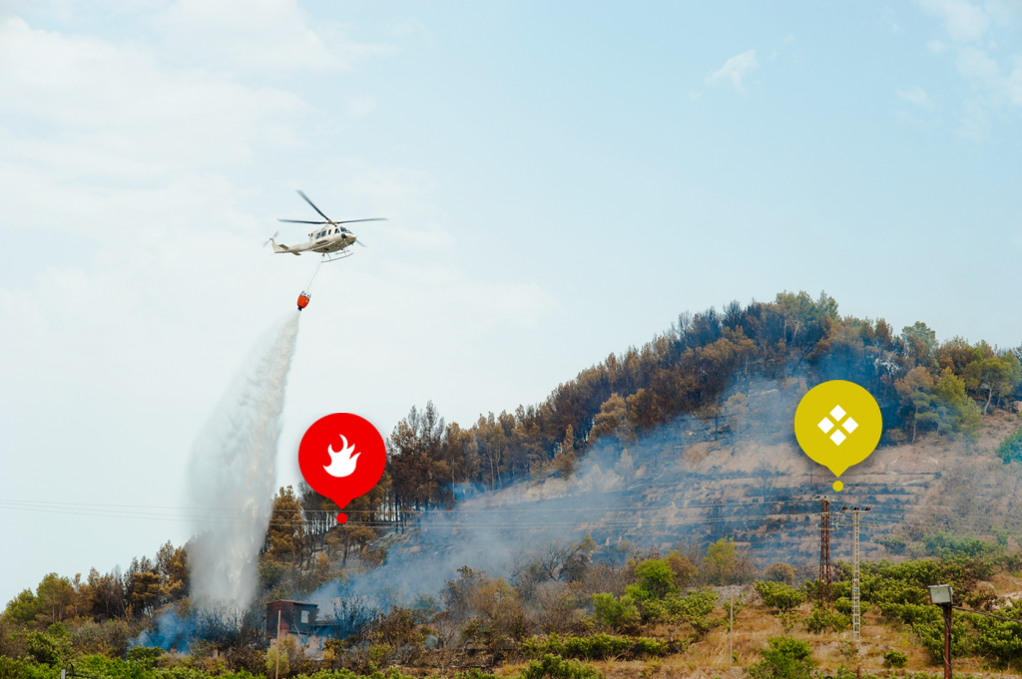
Panelists’ Introductions
Scott Jalbert
Area Commander Team 3, Fire Chief, San Luis Obispo County
Ron Graham
Deputy Chief, Fire Protection
Oregon Department of Forestry
Les Hallman
Tualatin Valley Fire & Rescue Assistant Chief, Oregon Wildfire Council

Slide 6
Agencies began the thought process back in April about what precautions we need to address with COVID and wildfire season. What have you as panelists found that differs from the original plans or guidance that was issued? How were those changes addressed?
Topic 1 – 2020 Mid-Season Check-In

Slide 7
- During demobilization, how were staff tested or quarantined? - How are we recording that data? - What opportunities do the collection of that data potentially offer?
Topic 2

Slide 8
- Have any of your incidents experienced COVID issues? - If so, how were they handled? - Do you believe COVID has contributed to extraordinary stress for incident staff?
Topic 3

Slide 9
Topic 4
What has been the biggest shortage of resources and how was it addressed?
IMTs, crews, aircraft, tenders, dozers, engines?

Slide 10
What are the future challenges you are preparing for today?
Topic 5

Slide 11
LIVE Q&A
THANK YOU
QUESTIONS?
VISIT OUR WEBSITE
intterragroup.com
FOLLOW US ON SOCIAL MEDIA

Slide 12
RESOURCES

Slide 13
THE END
THAT’S IT!
WHAT’S NEXT?
Check your email for a follow-up containing:
A Recording of This Presentation
Information About Upcoming Webinars in This Series
Links to Resources Referenced During This Webinar
An Invitation to a 2-Minute Survey. Your feedback about today’s webinar is greatly appreciated.
VISIT OUR WEBSITE
FOLLOW US ON SOCIAL MEDIA
intterragroup.com

