Slide 1

Saving Lives with Geospatial AI
New insights on how Geospatial Analytics can become a lifesaver for billions

Slide 2




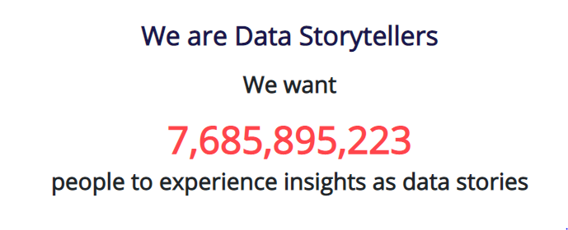






Introduction
Shravan Kumar A
Director, Client Success
Insights as Stories
in/shravankumara
Help start, apply and adopt Data Science
sh_ra_van
100+ Clients
“Simplify Data Science for all”

Slide 3
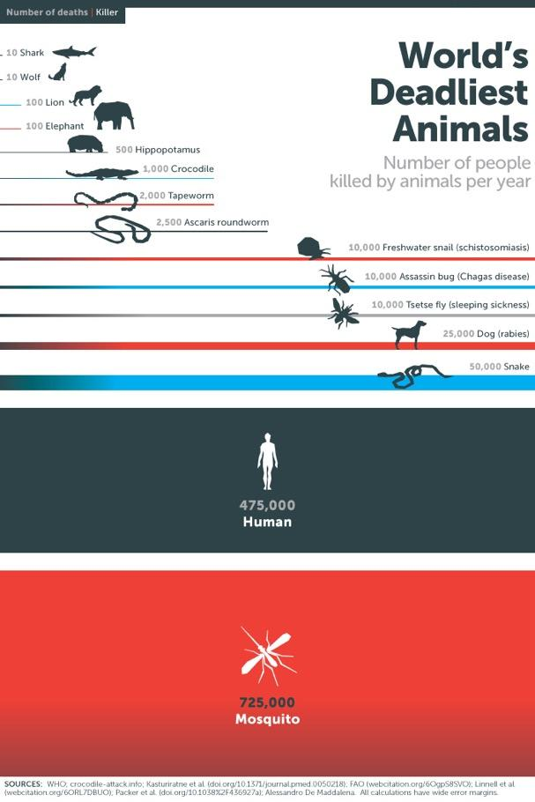
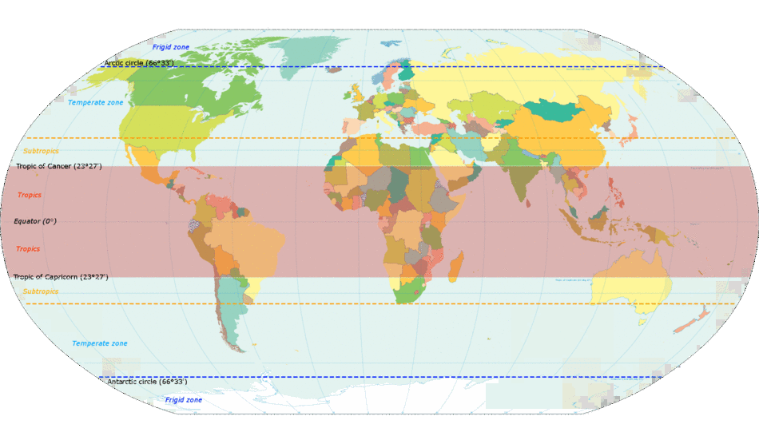
What’s the most Dangerous Animal on our Planet?
Mosquito-borne diseases: A health hazard in the tropics
Dengue
400 million cases..
..in 100+ countries..
..40% of world population
Image Source: Infographic - Gates Notes | World map from Wikimedia – by KVDP – Own work, CC BY-SA 3.0
Notes:
Dengue fever is ranked by the World Health Organisation (WHO) as the most significant mosquito-borne disease in the world – and the most rapidly spreading – with a 30-fold increase in global incidence over the past 50 years.
Dengue is endemic in more than 100 countries, with 40% of the world at risk,
Severe dengue is a leading cause of serious illness and death among children in some Asian and Latin American countries.
Mosquito-borne diseases such as dengue place significant financial pressure on families and communities, as people who fall ill are unable to work or attend school, and often need to be supported by their family

Slide 4
Global Burden of Mosquito-borne diseases
40% of the world’s population is at risk of contracting dengue
Every 4 minutes, a case of chikungunya is conﬁrmed
400 million Dengue infections each year
84 countries are aﬀected by Zika
Source: WMP Website page on Mosquito-borne diseases
700 million people contract mosquito-borne illnesses each year, causing ~1 MILLION deaths

Slide 5


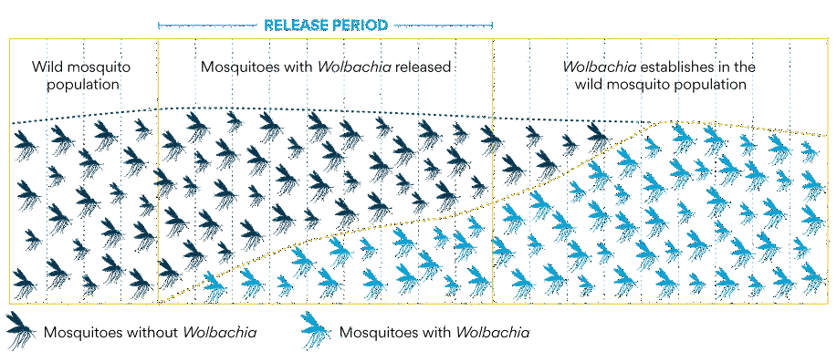
Innovation: Infect the Mosquitoes!
Image Source: WMP website

Slide 6
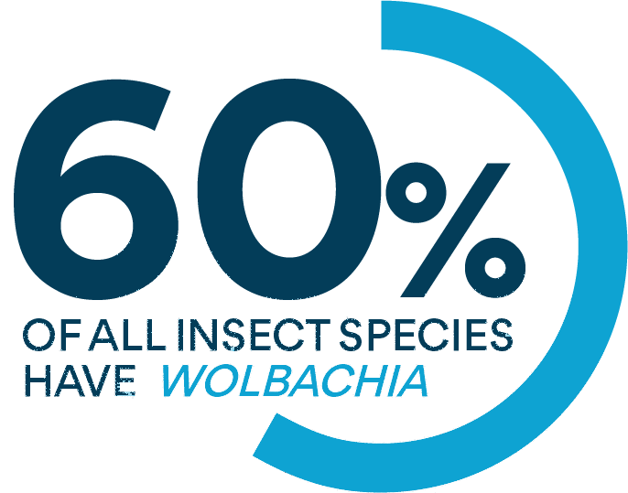
What is Wolbachia?
  Naturally occurring
  Non-toxic bacteria (for humans and environment)
  Environmentally Sustainable transmitted genetically from parent to offspring
  Reduces ability of mosquitoes to transmit disease (dengue, Zika, chikungunya)
Notes:
Wolbachia are safe, natural bacteria present in up to 60% of insect species, including some mosquitoes.
However, Wolbachia is not usually found in the Aedes aegypti mosquito, the primary species responsible for transmitting human viruses such as Zika, dengue and chikungunya.
Our team pioneered our Wolbachia method, successfully transferring Wolbachia from insects into Aedes aegypti mosquitoes.
Once they carry Wolbachia, aedes aegypti mosquitoes have a reduced ability to transmit viruses to people, which decreases the risk of dengue, Zika and chikungunya outbreaks.

Slide 7
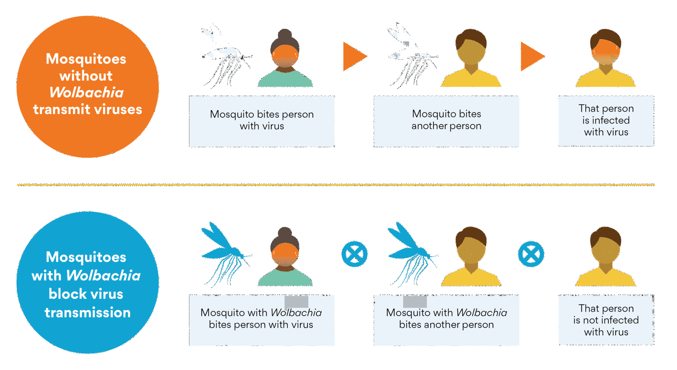
Wolbachia blocks Dengue, Zika & Chikungunya virus transmission
Notes:
This diagram shows that Wolbachia blocks the transmission of the dengue, Zika and chikungunya viruses.
The top of the diagram shows that mosquitoes without Wolbachia transmit viruses between people.
The mosquito bites a person who carries a virus and then bites another person, infecting that person with the virus.
The bottom of the diagram shows that when mosquitoes carry Wolbachia, they have a reduced ability to transmit these viruses.
So, when the mosquito bites a person who carries a virus such as Zika, dengue or chikungunya and then bites another person, that person is not infected with the virus.

Slide 8
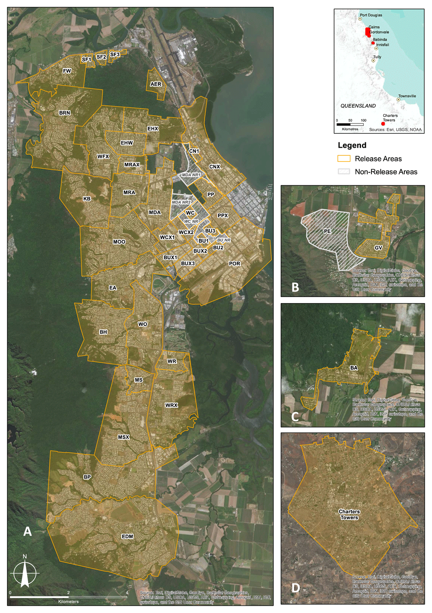
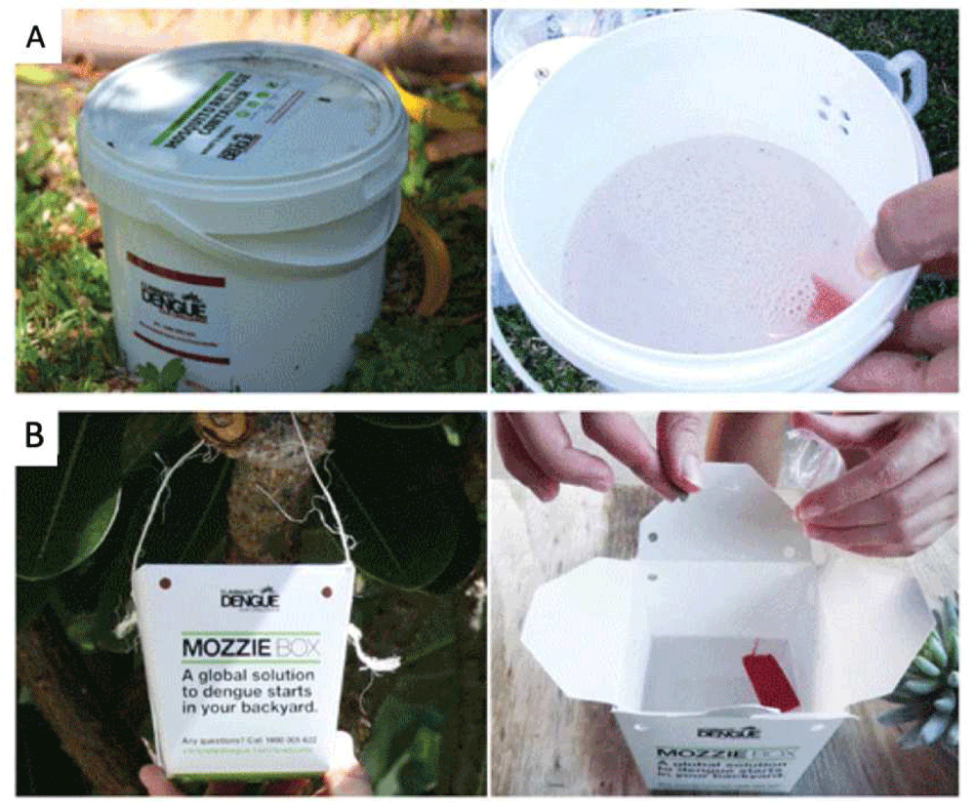
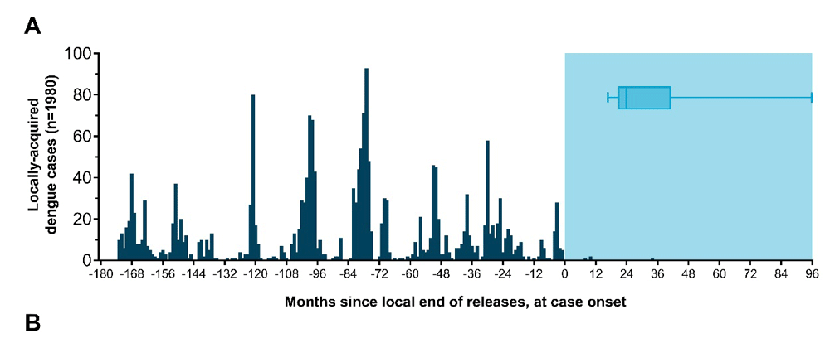
Success Story: Northern Queensland
Source: Success story - WMP website | Paper - Gates Open Research

Slide 9
How is this done?
Scoping
Setup
Prepare
Release
Monitoring
Identify Potential release sites at the locality level
Establish infra and regulatory processes
Mosquito-rearing : AI-assisted precise genetic engineering
Surgically release mosquitoes with precision
Monitor the wild mosquitoes over time

Slide 10
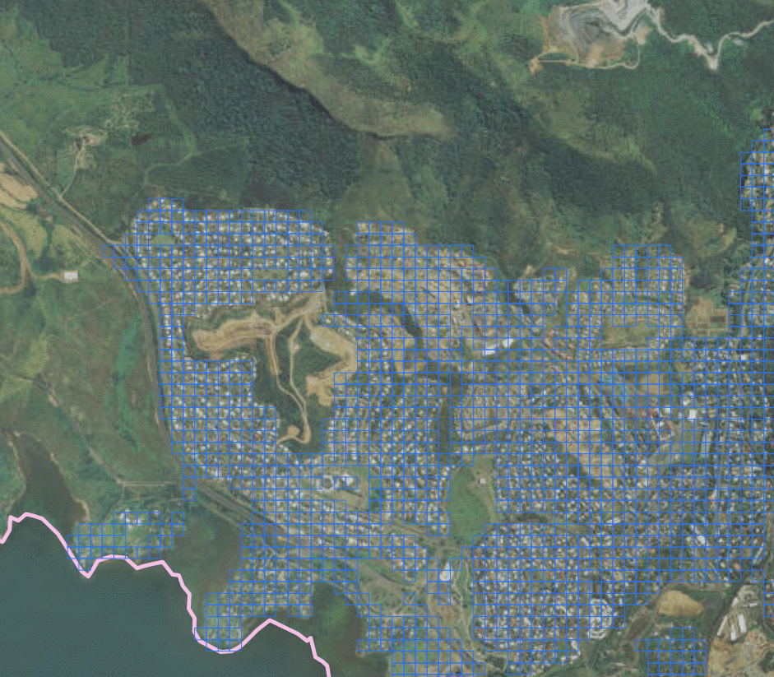






Where should we release the Mosquitoes?
Resource-Intensive
Process
People Issues
Requires Specialist
Teams (GIS, Analytics)
Accuracy of Choosing Release Sites in Large Cities
Operational Issues
Risk of Missing
Human Settlement Areas
Requires Correction by Ground-Truthing

Slide 11
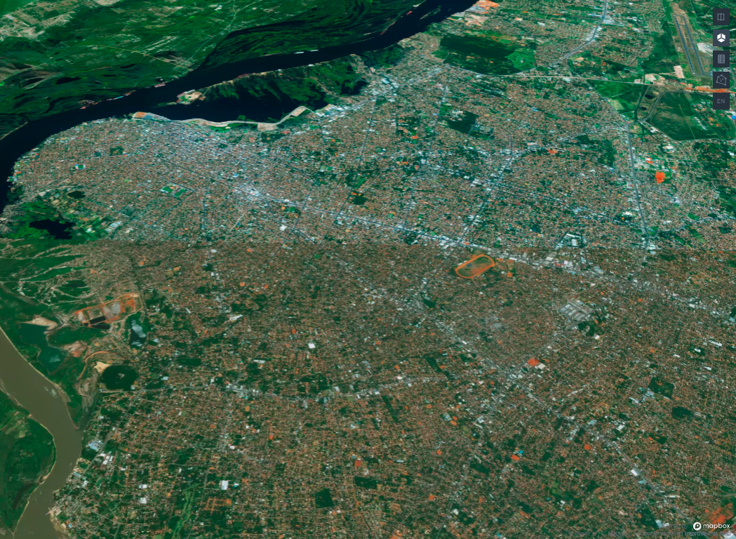
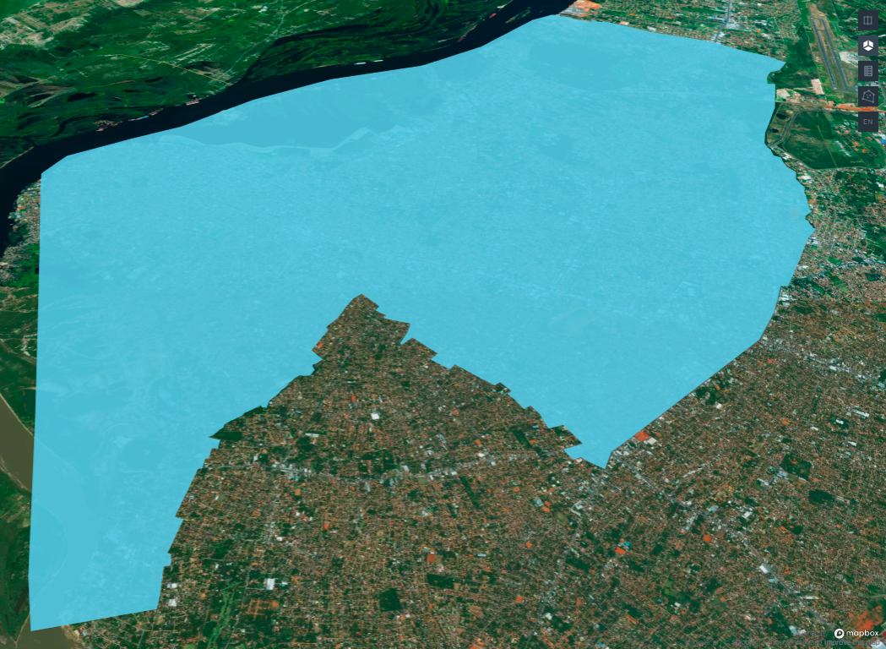
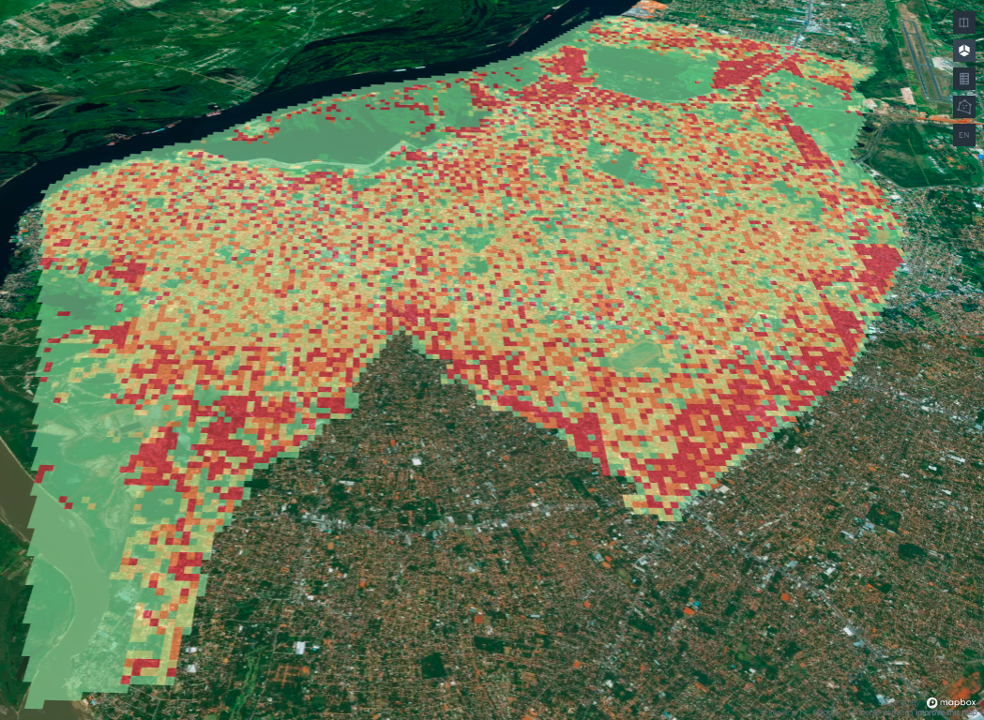
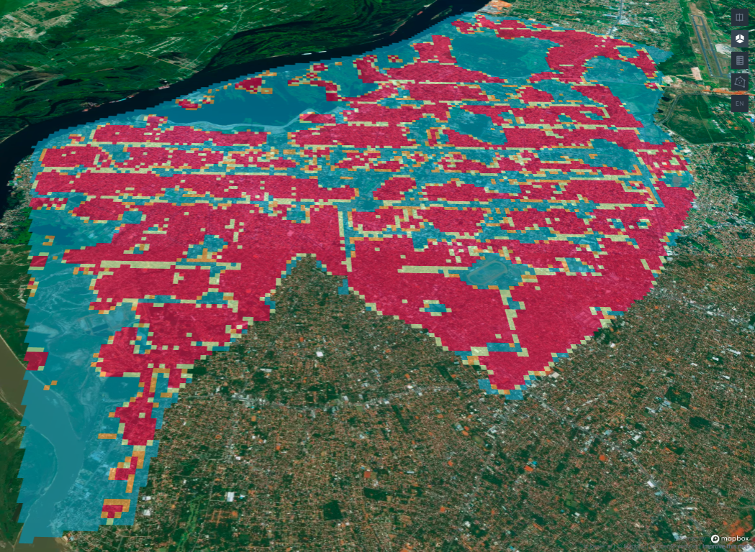
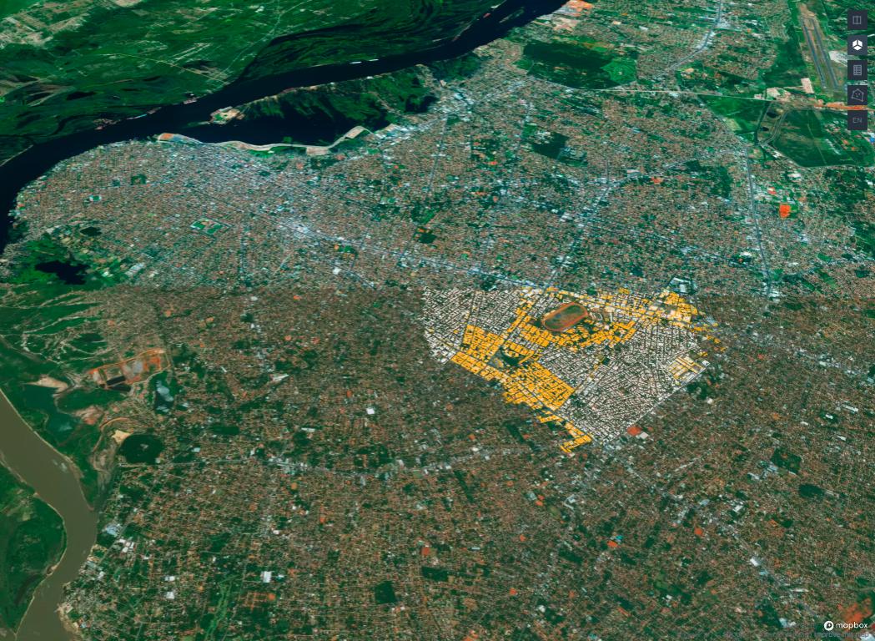
Steps involved in Site Scoping : Resource-Intensive & Cross-functional Activity
Higher Density Human Population = Larger Aedes Aegypti Mosquito Population = Higher Density of Mosquito Release Points
To maximize the reach of site scoping, WMP needs to follow the below process…
…Choose city Boundary for release areas
…Locate built-up areas where people live
…Determine individual mosquito release points
…Sequence & Prioritize areas within the city
and
…Plan downstream processes, the project budget, mosquito production planning & resource planning
Notes:
Choose City Boundary for release areas.
Locate Built-up Areas where people live.
Determine how many individual mosquito release points are required
To successfully establish Wolbachia Curve, the density of the people guides the number release points.
Higher Density Human Population = Larger Aedes Aegypti Mosquito Population = Higher Density of Mosquito Release Points e.g. an Indonesian city will need higher density release points than and Australian city.
Sequence and Prioritize Areas within the City & local partners can have data from vector control & disease monitoring
Downstream processes, the project budget, mosquito production planning & resource planning will take this an input

Slide 12
Site Scoping : Resource-Intensive
So, coming back to WMP site scoping process…
WMP process before – a mix of manual and semi-automated methods – does not scale well
Resource intensive – it can take many days to generate scoping estimates
Places a limit on geographic area that can be analysed well
It results in a non-uniform and non-optimized distribution of mosquito release points
We thought we had to develop a better approach to be effective at the scale that we wanted to operate at.
Backup slide

Slide 13
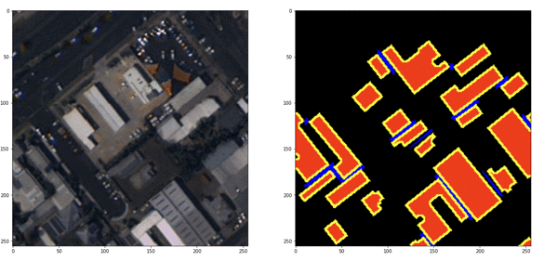
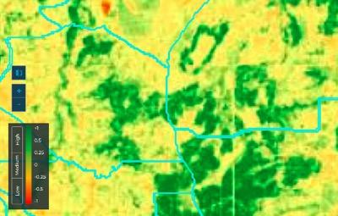
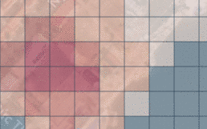
3 Steps for Site Scoping : Location Intelligence
Detect Buildings
Overlay multiple geo-statistical data layers
Estimate Population
100m² grids
20,000 ppl / km²
e.g.
15,000 ppl / km²
Deep Learning Model to detect building footprints
Geospatial Analytics to compute vegetation and overlay population data
Statistical distribution Population Count to a
100m * 100m grid

Slide 14
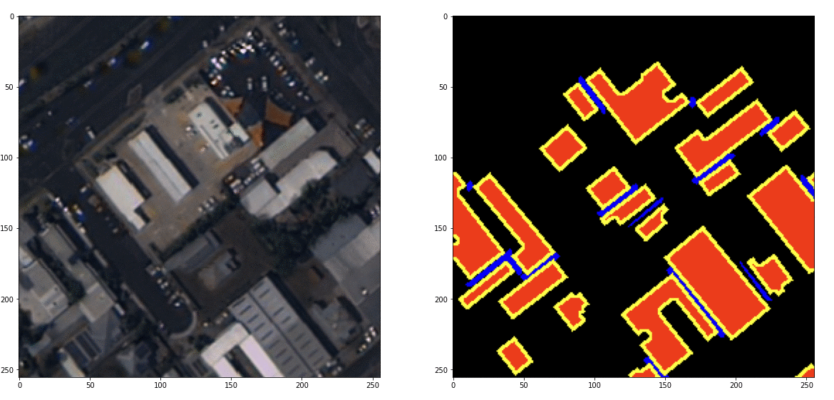
Stage 1: Deep Learning Model for Building Footprint Extraction
Phase 1 :
Building Footprints
Phase 2 :
Population (Statistical Distribution of population data), Land Use & Other Sources

Slide 15
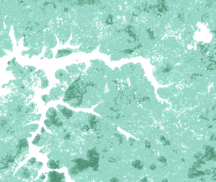
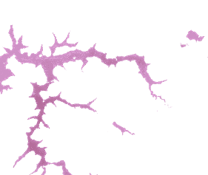
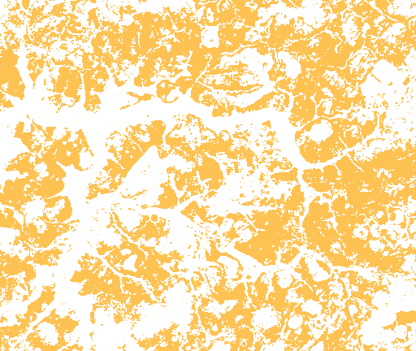
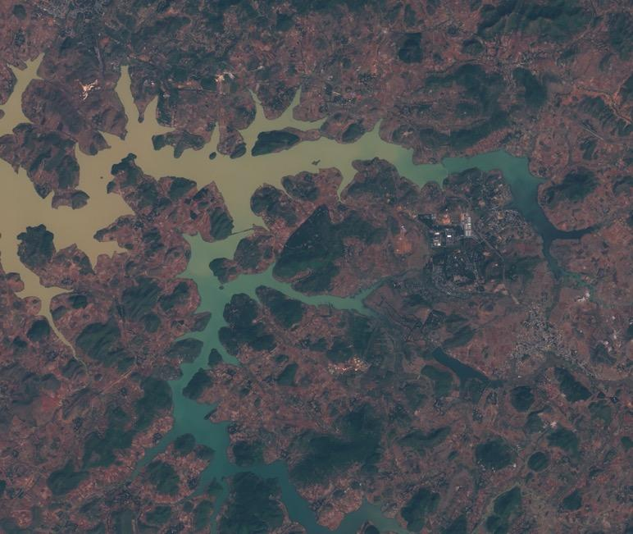
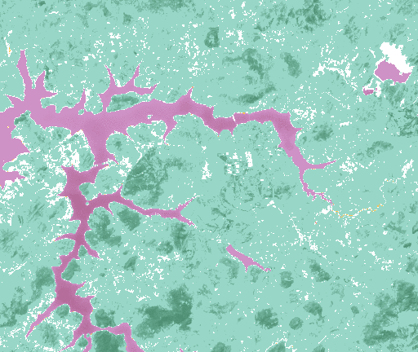
Stage 2: Detecting hidden features in Satellite images
Green cover
Water cover
Land cover
+
+
=
Sentinel 2 satellite image-MSI, Sunabeda, Odisha

Slide 16
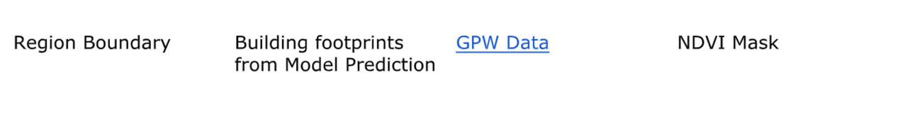
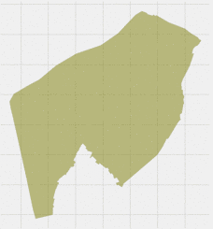
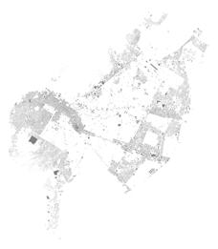
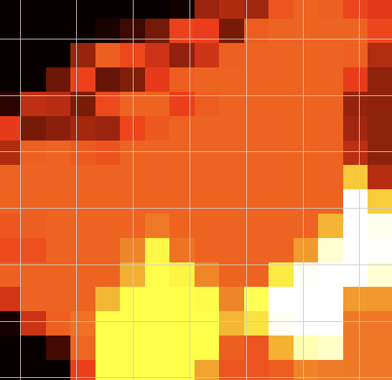
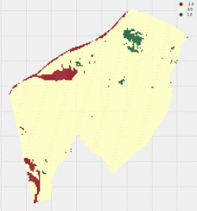
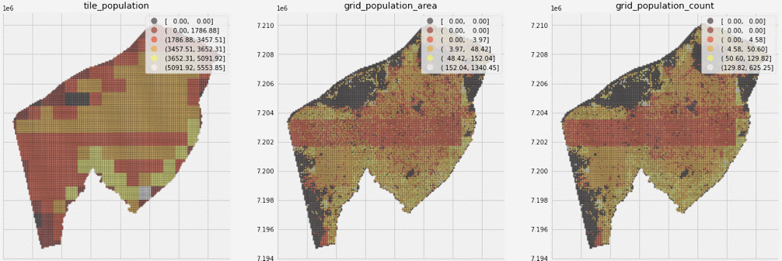
Stage 3: Post-Processing & Packaging : Output Data Pipeline

Slide 17
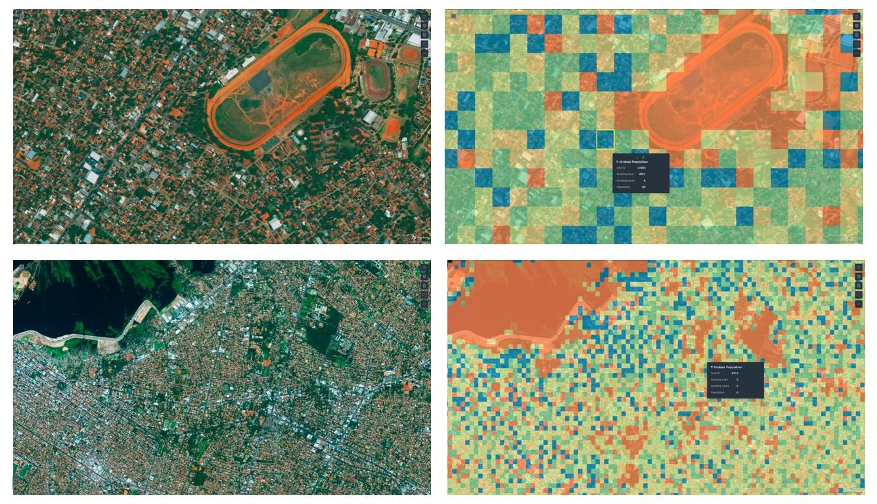
What do the Region Density maps look like?
Input
Satellite Imagery (50 cm resolution)
Output
Gridded Maps (50m * 50m)
Low Population
High Population
Raw Satellite Image (locality)
Gridded Map
(100m*100m micro-scale)
Micro-Scale
Raw Satellite Image (locality)
Gridded Map for the City
(100m*100m micro-scale)
City-Scale

Slide 18
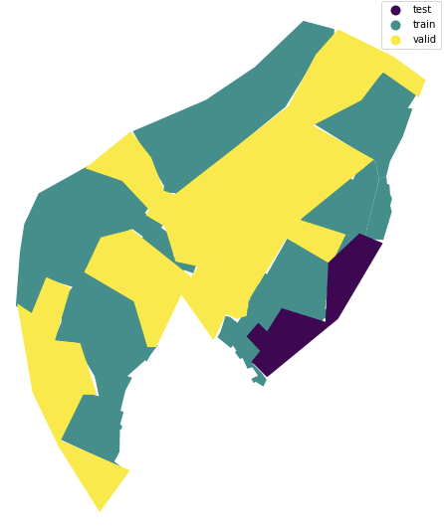

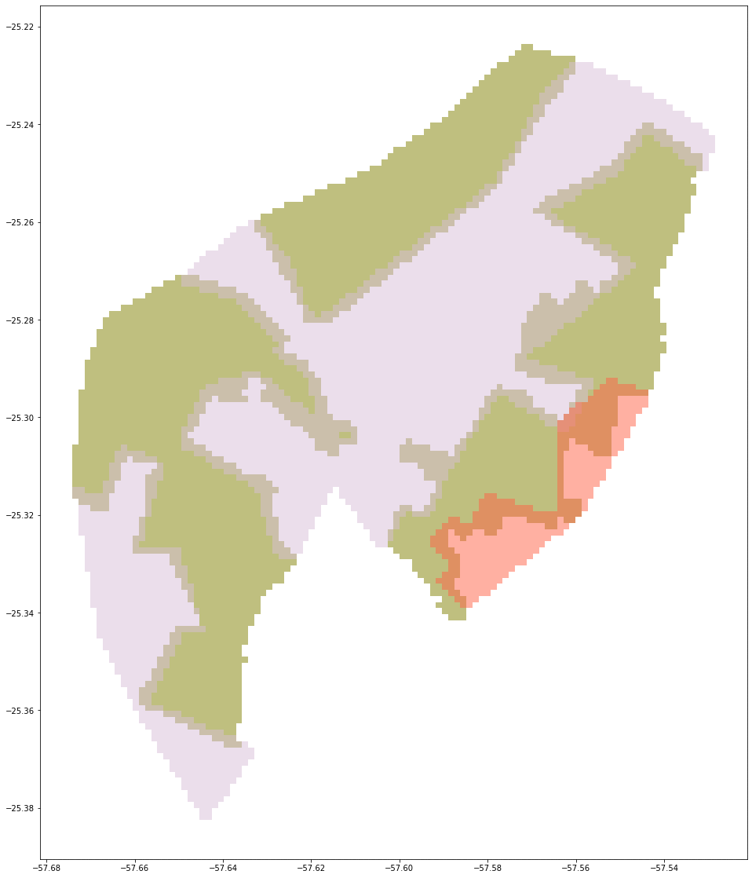
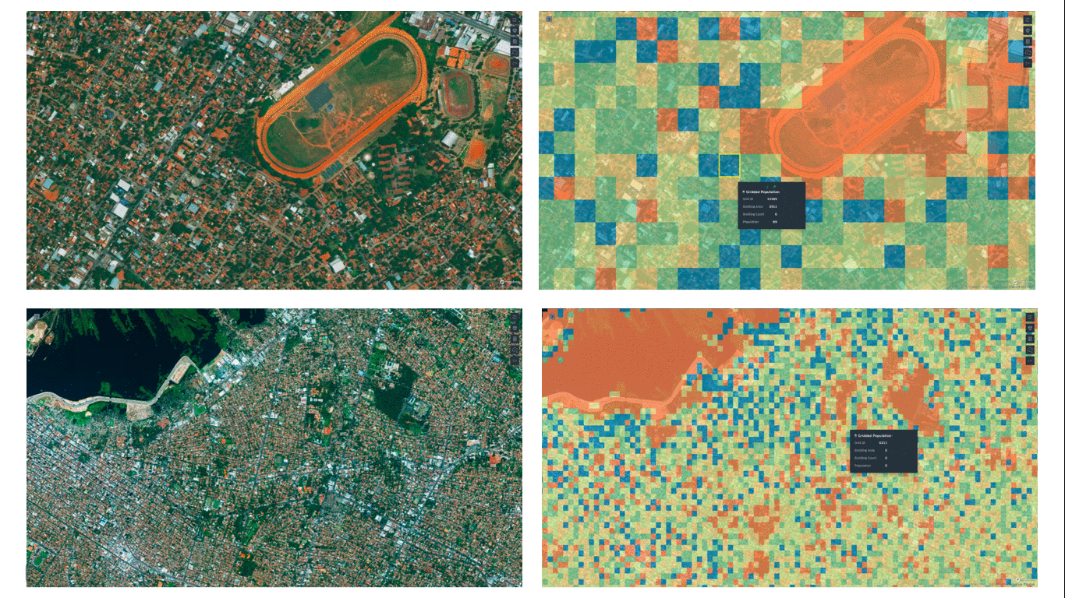
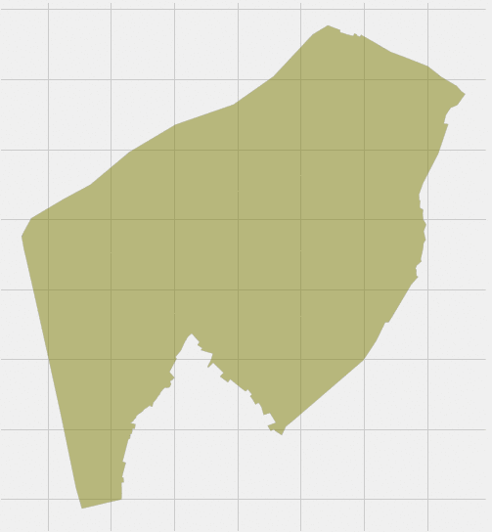
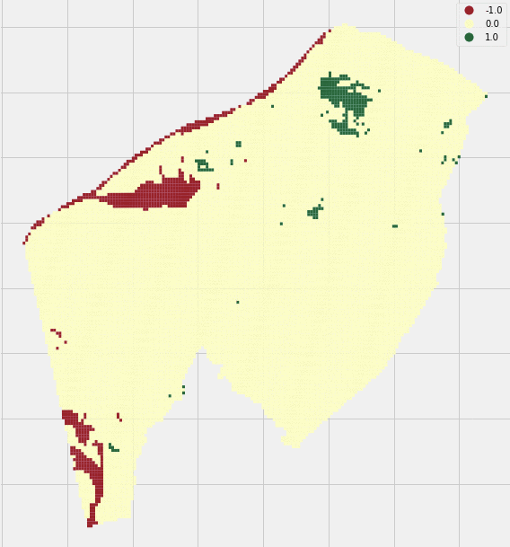
From Satellite Imagery to Site Scoping..
Site Scoping = Location Intelligence in a City of Interest
Get inputs from Ranjan, Soumya, Sumedh
Input Pipeline
Output Imagery with
Population by Area Coverage and areas with No Human settlement
Grid-wise Building area with Number of Buildings
Spatial Clustering of Grids
Satellite Imagery Input
75-cm resolution,
Pan Sharpened : 50-cm
4-band: RGB + Near Infrared
You can edit this text
Train Test
Split
Building Footprints
Gridded
Map
2. Model Pipeline
Grids
Building Footprints
3. Output Pipeline
Region
Boundary
BFP from
Model
GPW
Data
NDVI Mask

Slide 19
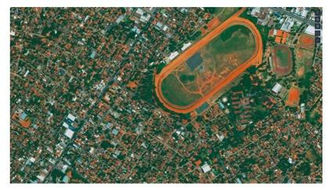


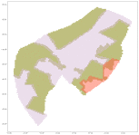
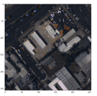
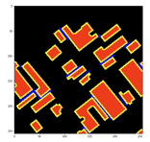
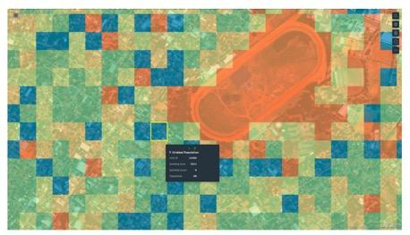
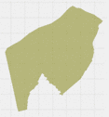


The Solution: Putting it all together
Identify Region of Interest
Data Preparation
Site Planning Decisions
You can edit this text
Output Imagery with
Population by Area Coverage and areas with No Human settlement
Grid-wise Building area with Number of Buildings
Spatial Clustering of Grids
Train Test
Split
Building Footprints
Gridded
Map
Model execution
Grids
Building Footprints
Population estimation
Backup slide
Region
Boundary
BFP from
Model
GPW
Data
NDVI Mask

Slide 20

Sample Anonymized Output (Indicative)
Satellite Imagery Input
75-cm resolution,
Pan Sharpened : 50-cm
4-band: RGB + Near Infrared
Input
Satellite Imagery
Output
Gridded Maps (50m * 50m)
Low Population
High Population
Micro-Scale
Output Imagery with
Population by Area Coverage and areas with No Human settlement
Grid-wise Building area with Number of Buildings
Spatial Clustering of Grids
City-Scale
Backup slide

Slide 21

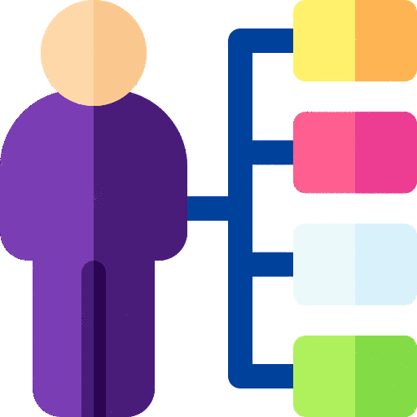



Problems with Status quo that solution proposes to address
Resource-Intensive
Process
To identify, research & partner with the right local organizations & agencies, plan and works takes a lot of resources, time and legalese.
People Issues
Requires Specialist
Teams (GIS, Analytics)
Technology can solve this problem of scale (state, city-scale), it needs very surgical approach & precise, micro-scale implementation. Requires specialized teams of varied skill set
Accuracy of Choosing Release Sites in Large Cities
Precision & Accuracy at a city level needs to at a building level 50m/100m micro-scale. Scope too much – budgets will overrun, scope too little coverage will be less.
Operational Issues
Risk of Missing
Human Settlement Areas
Releasing mosquitoes in the less populated areas will result in wasted resources without having much impact of the mosquito population
Backup slide
Requires Correction by Ground-Truthing
Normal/Manual operations need to check/validate the stats – population, vegetation, land usage etc. to check if its true on the ground.

Slide 22
Outcomes : Highlights of the Solution
98%
Reduced the time taken from ~3 weeks to 2 hrs
1. Effort Savings
70%+
Accurate release plan with very high ROI
2. Better Effectiveness
50%
Efficient post-release monitoring & validation
3. Higher Efficiency

Slide 23
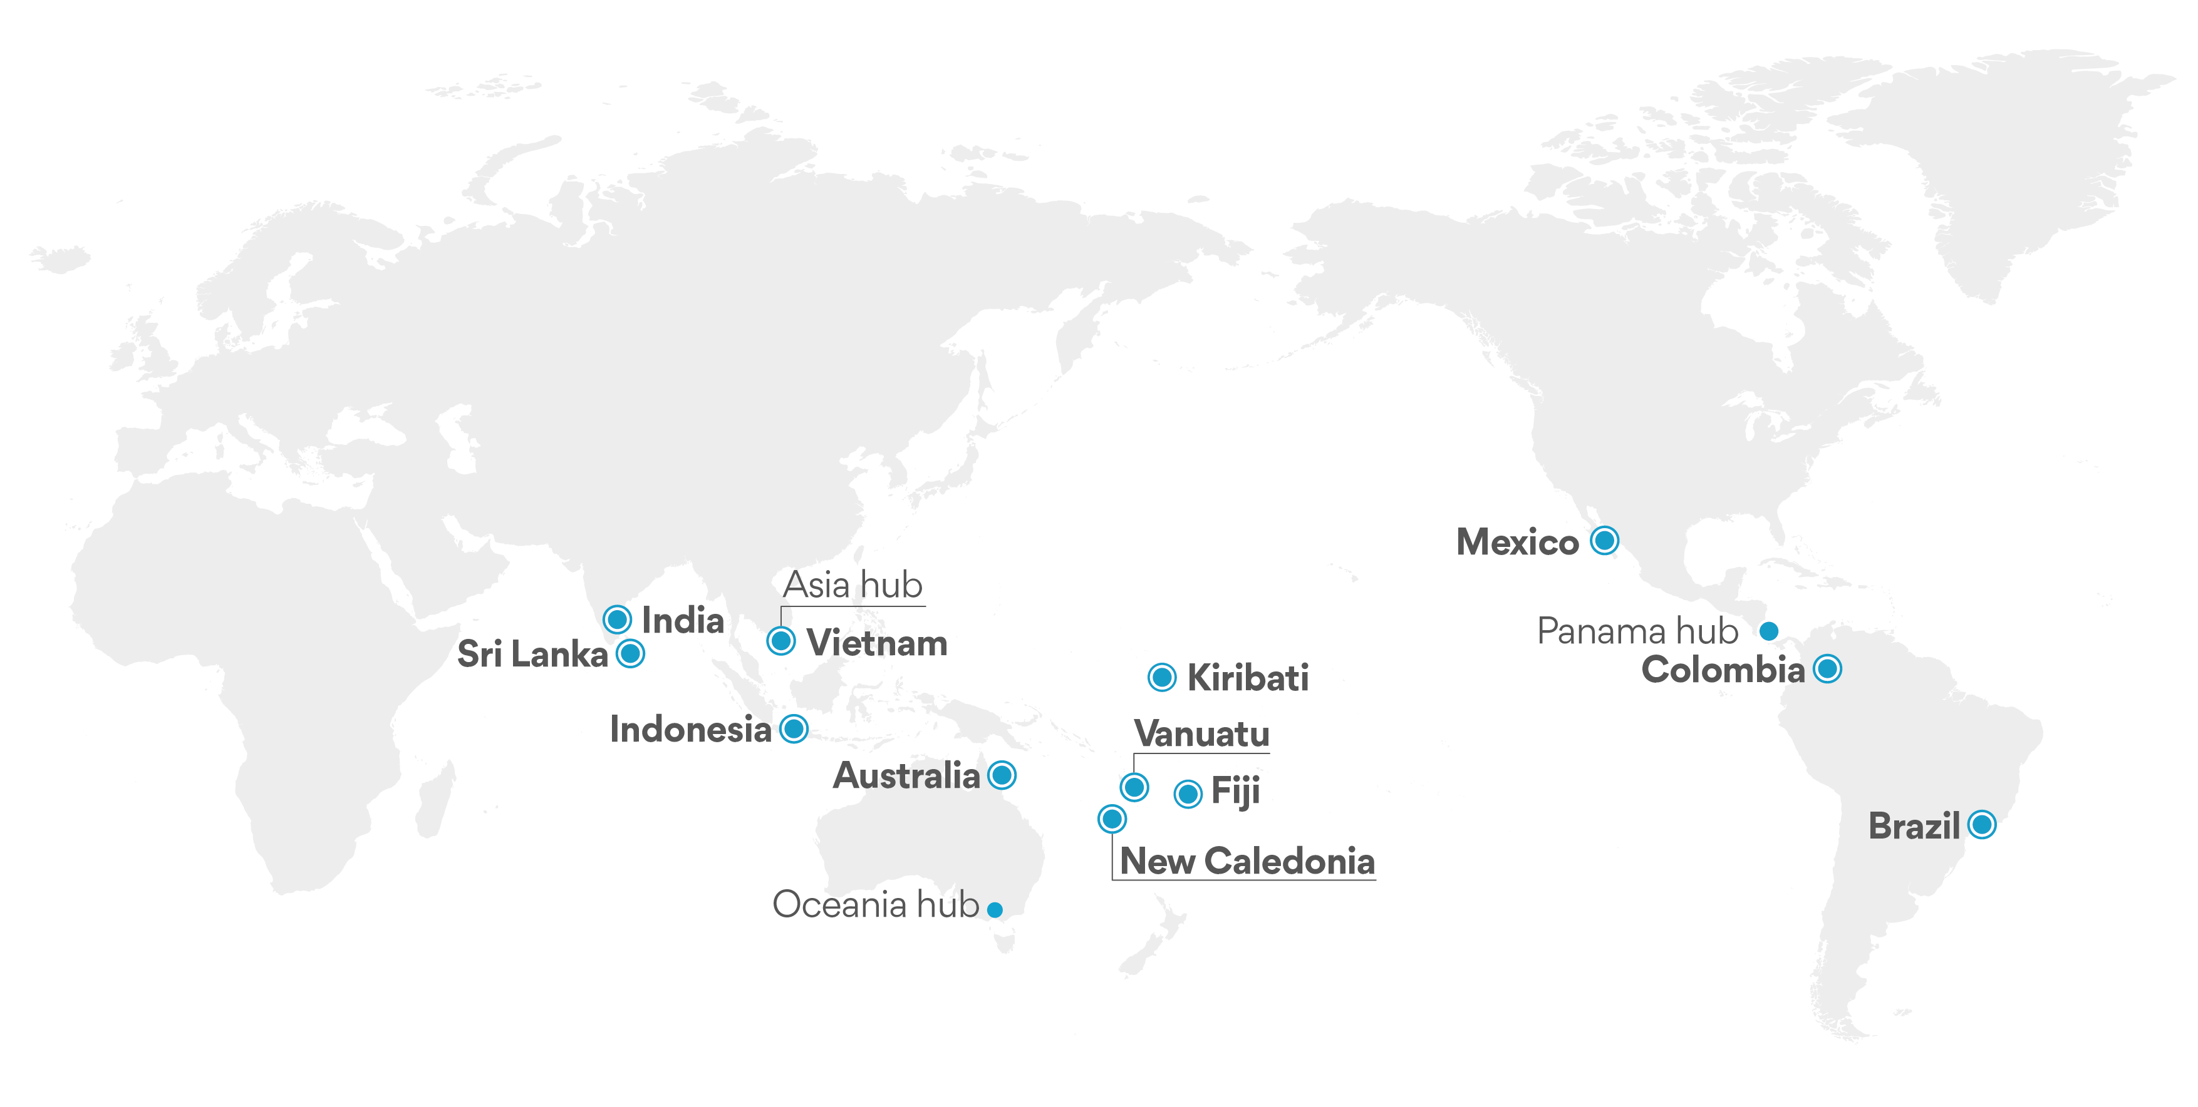
Being Implemented in 10 Countries..

Slide 24
Proposed AI-Assisted Solution addresses operational problems
AI can help choose the mosquito release points at the best sites of a city
at a micro-scale
2 hrs
For a process that previously took 2-3 weeks to produce a gridded map (GIS Expert). Particularly, when large cities are involved scaling, budgeting, planning becomes crucial. Country-level release scoping possible now.
70%+
More accurate Forecast Release Plan, Budgeting, Planning, Scheduling, Monitoring, Evaluation of RoI & Value Capture, Benchmarking for all stakeholders. Near real-time Analyses.
50%
More efficient post-release monitoring & validation through custom-built computer vision AI models (florescent marker gene detection).
Backup slide
Using Computer Vision and Land Cover Statistics to solve a problem of scale
The elevator pitch – How Artificial Intelligence could change the way we work https://www.worldmosquitoprogram.org/en/news-stories/news/elevator-pitch-how-artificial-intelligence-could-change-way-we-work

Slide 25





Humanizing Analytics to Capture Minds & Hearts
Gramener bridges the gap between representation and captivating the human mind, leveraging its analytics framework to capture impactful insights and engaging human emotions through powerful storytelling
Discover business problem and capture information
Deliver best in class analytics around
measurable ROI
Impact Data culture through visual storytelling
1
0
1
1
Engage through storytelling
0
1
0
2019 Global Annual Achievement Award for AI
Named in Gartner’s market guide for to Analytics providers
2019 Great Place to Work
Growth Champions 2020 – Economic Times
Featured in
TechCrunch

Slide 26
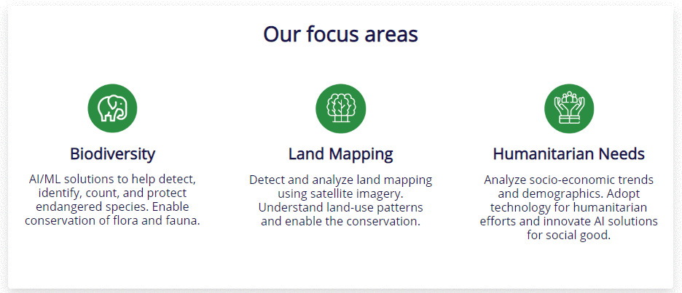

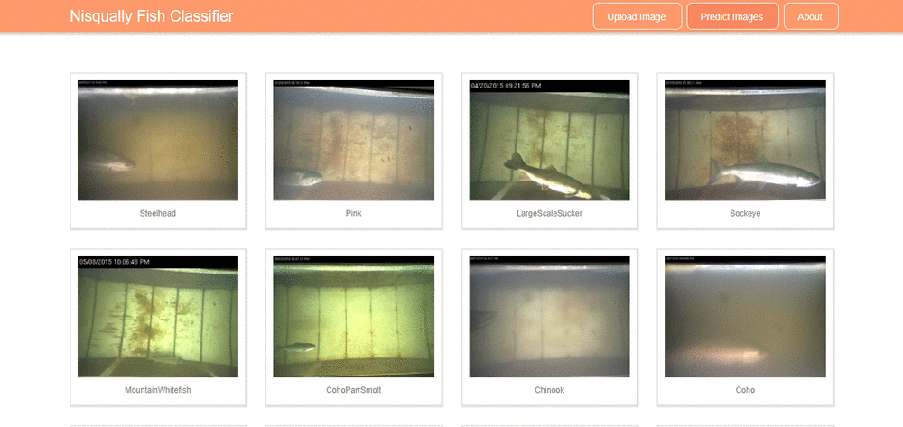
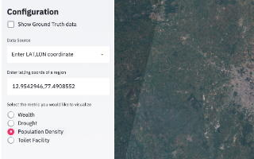
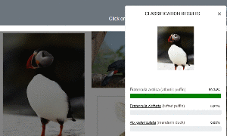
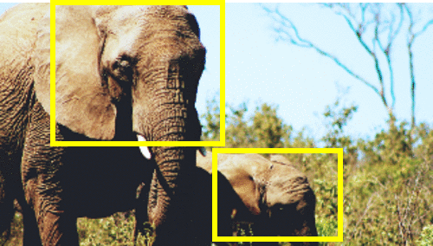
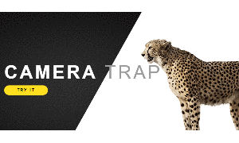

WHY Gramener?
Gramener, with this team of highly passionate individuals has executed numerous high impact projects in the AI for Good line of initiatives and have been contributing to the AI community. (Event Summary)
Gramener has been awarded at multiple forums for the contribution made to Societal Good through AI.
The team consists of seasoned professionals in AI, ML & DL specialized in Computer Vision, Image Recognition, Satellite Imagery, Camera Trap Imagery and Drone Imagery.
Innovating sustainable data solutions.
Predicting Quality of Life from Satellite Imagery
Monitoring Salmon in Rivers
Species Classification API
Gramener, in association with Microsoft has been offering solutions to customers across different domains, globally, ranging from point solutions like clustering to advanced analytics solutions using AI, ML, and Deep Learning models.
Saving the African Elephant
Camera Traps
Penguin Counts in Antarctica

Slide 27





Applying AI for Environmental Good to solve problems come in different forms
Computer Vision
Geo Satellite Analytics
Storytelling
Identity patterns from pictures & videos. Detect and recognize entities. Count crowds & Drive Actions.
Process high-res satellite imagery. Enrich geospatial analyses with structured data for deeper insights
Use the power of data and information design to demystify AI & make data-to-action faster by storifying.
Gramener is solving problems in environmental conservation, to protect biodiversity and to tackle humanitarian challenges.
Our efforts under the AI for Good initiative covered as part of the Microsoft AI4Earth initiative.
More about our efforts for AI for Good https://gramener.com/aiforgood, https://youtu.be/xL1FiZnp1Y0

Slide 28



MICROSOFT AI AWARD 2018
It was an honor for Gramener to be conferred with the CNBC - Microsoft award on “Empowering Societal Progress with AI” in the recent ‘AI for All’ event at Mumbai.
Gramener partnered with Microsoft AI for Earth to help Nisqually River Foundation automate the identification of fish species using AI-driven deep learning models.

Slide 29


Thank You!
Download today’s presentation:
To stay tuned to how we are making a difference in the AI Space
https://bit.ly/2TPeZ26
gramener.com/aiforgood
gramener.com
in/shravankumara
@sh_ra_van

