Slide 1
Impact of COVID-19 on Finance Leaders
👍👎
How can data help?

Slide 2
Finance leaders are prioritizing cash flow, cost reduction and scenario modeling as the top levers to minimize COVID-19 impact on their business
Over 2/3rd of finance leaders have already taken steps to contain COVID-19 impact¹.
The specific response varies by sector².
Financial Services: Modeling multiple scenarios, including worst case options
Manufacturing: Relying on hiring freezes and delayed CAPEX investments
Retail: Focused on securing short-term relief on their rent payments
Services: Freezing hiring and T&E spend. Cutting marketing & IT budget
Technology: Modeling worst case scenarios, Canceling discretion spend
Utility: Identifying opportunities to scale back reliance on suppliers
Cash flow, cost reduction & scenario planning are a consistent focus across all.
Actions are already underway against all three priorities
Cash Flow Management
Cost Reduction
Scenario Modeling
1
Estimate customer default rates and predict churn
1
Critically question the need for third-party spend
1
Model worst-case scenarios by types of recovery patterns
2
Forecast and defer discretionary cash flows
2
Identify new ways to further reduce costs
2
Understand the drivers of cost & spend to create what-if scenarios
3
Closely monitor days sales outstanding by client & agent
3
Seek short-term rent reliefs and reevaluate long-term spends
3
Rely on statisticians’ view of the future to identify likely outcomes
4
Renegotiate supplier payment terms on case-to-case basis
4
Build out a scenario for two years of below-trend growth
The effects of the outbreak aren’t going away quickly. This realization has settled in.
PwC’s COVID-19 CFO Pulse Survey, 30 Mar 2020
Gartner: FO Actions in Response to COVID-19

Slide 3
Finance Leaders are leveraging data science to find patterns that were not possible on spreadsheet and ERP workflows
Gramener has worked with several clients on areas Finance Leaders are prioritizing
Our work unearthed new insights in all 3 areas Finance Leaders focus on
Cash Flow Management
Cost Reduction
Scenario Modeling
Case studies
Churn model: find customers at risk
Forecast spend: plan cash flow well
Cost explorer: find biggest spends
Procurement cost: consolidate vendors
Financial drivers: root cause analysis
What-if scenarios: explore the impact
Our work has tangible benefits.
Click on a topic to understand the challenges our clients faced, and the impact analytics had on their business.
Collection analysis: where to focus first
Order lead time: how to reduce it
Replacement cost: rationalize hiring
Cost forecasting: plan & control spend
Price forecasting: plan for volatility
Budget forecasts: rationalize sensibly
Discounts analysis: reduce safely
HR cost analysis: explore people cost
Building expenses: reduce capital spend
Currency impact: model the impact
Stock correlation: find risk clusters
Explore these case studies to understand how you can use them

Slide 4
Telecom company saved 66% customer acquisition cost by predicting churn
A national telecom provider had a churn rate of over 10% a month. Thanks to low switching cost, their entire customer base churns within a year.
The cost of replacing each customer was thrice the cost of retention – provided the customers could be identified with some confidence.
Gramener used the customer profile, transaction data, payment data, service log data, and other related information to create a series of classification models. These predict whether a customer will churn one month in advance.
The simplest model – the decision tree (shown alongside) – reduced the cost of attrition by 39%.
A second, more robust machine learning model increased this to 66%. This model only missed 0.6% of customers and incorrectly spotted only 2.5% of customers.
OUTGOING CALL
N
0 - 4
5-14
15+
> 1 Recharge
Y
N
Y
Recharge amt > $20
N
N
Y
Y
N
66%
99.4%
MODELs
COST PER CUST.
IMPROVEMENT
MISSED
WASTED
Decision Tree
4.0
39%
3.2%
3.6%
reduction in customer re-acquisition cost
potential churn customers correctly identified

Slide 5
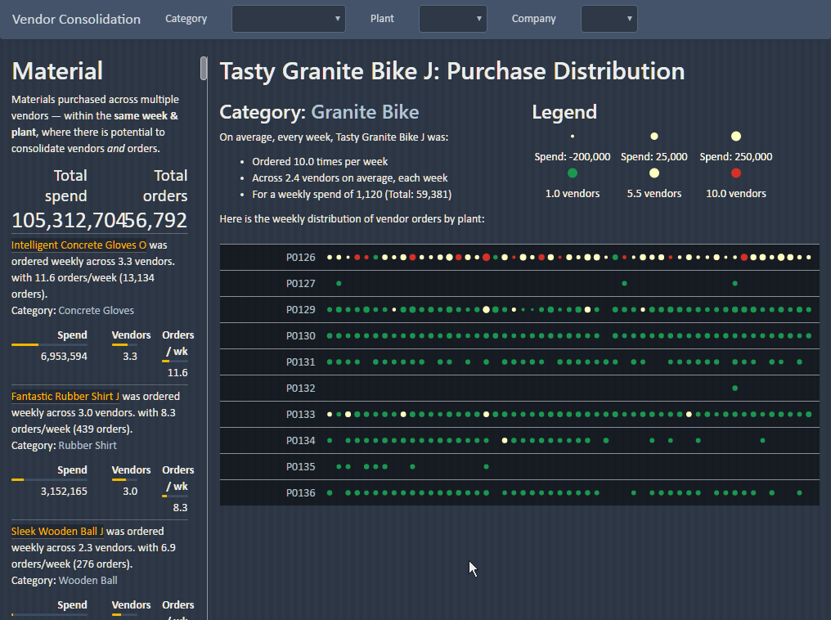
European brewery identified €15 m cost savings after consolidating vendors
A leading European brewery’s plants purchased commodity raw materials from several vendors each – and had low volume discounts.
Plants also placed multiple orders placed every week, leading to higher logistics cost.
When plant managers were shown the data, they objected, saying “That’s not always the case.” Or, “That’s the only way– no one else does better.”
Gramener built a custom analytics solution that sourced their SAP order data, automatically identified which plants ordered which commodities the most from multiple vendors – and when.
It showed how each plant performed compared to peers – shaming those with poor performance.
With this, they identified savings of €15 m — which the plant managers couldn’t refute.
€15 m
40%
savings potential identified annually
vendor based reduction identified
See live demo
Watch a 4-minute video

Slide 6
Global airline reduced cargo turnaround time by 15% with scenario modeling
A global airline company took up a service level agreement to deliver cargo from the flight to the warehouse in under 1.5 hours. This target was 15% lower than their current best.
Several factors affect cargo delay across airports. Availability of forklifts, staff size, cargo type, part shipment, and many others. Altering any of these is expensive and takes long.
Gramener built a visual analytics solution that showed where cargo was delayed. We built an ML model that identified the drivers of delay (forklifts, trained staff), and the impact of these on turnaround time. What-if scenario modelling helped pick the optimal combination that reduced TAT.
This allowed the airline to reduce the turnaround time by 15% from 1.76 hrs to 1.5 hrs. The worst-case turnaround time also reduced by 34% from 2.9 hrs to 1.92 hrs.
This slide is best viewed in slideshow mode. The animations tell a story that isn’t obvious on the static version.
Recovery times are neutral during the evening and morning shifts (mornings are slightly worse), night times are the best.
Evening
Morning
Night
Shift
Specifically, Friday mornings are particularly bad.
So are Thursday mornings.
Recovery times are worst on Fridays, and best on Saturdays & Wednesdays.
Fri
Mon
Sat
Sun
Thu
Tue
Wed
Weekday
However, RPP on Sundays is unusually slow.
The FAH product category has the best recovery time, while ZDH is much worse.
FAH
N70
RPP
TDS
ZDH
Product category
15%
34%
This is especially problematic for ZDH
cargo turnaround time reduction (from 1.76 to 1.5 hrs)
reduction in worst-case turnaround time
Part shipped products tend to perform worse than full-shipments. Specifically the <20% and 40-60% part-shipments.
20-40%
40-60%
60-80%
<20%
Full
Part shipment
See live demo

Slide 7
At Gramener, our focus is on narrates insights from data as stories
👍👎
Insights are useful, non-obvious, Big
Facts are not useful
E.g. Delay in cargo delivery grew 8% last quarter.
Insights enable action
Lack of forklifts and fewer trained staff led to the delay.
Improving these can reduce cargo delay by 15%.
Stories are memorable, viral
Numbers are not enough
Stories explain them
Delays are due to fragile cargo. Trained staff and forklifts reduce risk of breakage, and hence reduce delay.
Insight
Story
Gramener
combines
Data
We review every fact to check if it’s an insight and a story

Slide 8
We help people really understand data – logically, and intuitively
We use technology to automate Analysis, Visuals and Narration
Critical Reasoning
Creative Thinking
AI & MACHINE LEARNING
VISUAL NARRATIVES
SERVICES
SOFTWARE
INSIGHTS Extract meaning using automated patterns
THROUGH SERVWARE: augmenting human intelligence with technology
STORYTELLING Binding visuals together into a logical story
STORYTELLING

Slide 9
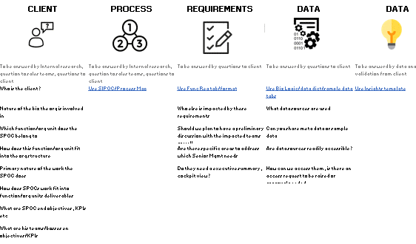
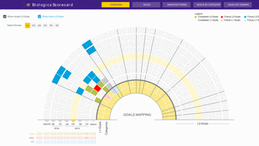
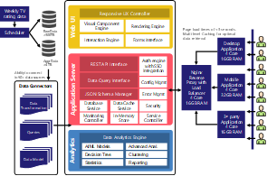
We do this through rapid custom solutions that deliver insights on live data
A typical solution is customized ground-up in just 10-15 weeks
Requirements
Solutioning
Development
Testing
Deployment
We use our process and platform to deliver fast
We’ll kick off with a workshop, followed by user interviews using our Insight Discovery Process. We’ll summarize requirements as a document for your sign-off.
We use our Insights Framework to identify indicative solutions. To repeat this, we use our Design Library to create a visual solution for your review.
We convert this into an app that will deliver insights as data changes. We build rapidly using pre-built components on our platform – Gramex.
We make mistakes, but we catch them here along with you. This ensures that the insights are not just correct, but also actionable and repeatable.
We host the solution in your environment (or the cloud if you prefer.) Data is protected. Your entire organization can use it as and when data is refreshed.
Here’s what we deliver
Requirements document
Insight document
High-fidelity design
Technical architecture
Functioning application
Test execution reports
Tested application
Deployment architecture
Productionized solution
We do this jointly
We need all users to share views, and a point of contact full time working with us
A few main users and a decision maker must be involved for 1-2 days a week
We may have a few clarifications. A point of contact should be available at least a day a week.
You’ll be doing a fair bit of the testing. 2-3 users for 50% of the time are essential.
A contact from the IT team will be required 50% to ensure the application is deployed.
Custom solutions are worth it but take time. Our platform & process shrink that effort

Slide 10
Today, we work with over 100 clients across verticals
👍👎
Media & Marketing
Public Sector & NGO
Technology & Consulting
Banking & Financial Services
Pharma & Healthcare
Manufacturing, Retail & Others

Slide 11
Our team is led by ex-IBMers with rare skill mix: design, coding & statistics
👍👎
S. Anand
CEO, Co-founder
Naveen Gattu
COO, Co-founder
Gramener was founded in 2011 by a team of ex-IBMers. We are self-funded and profitable.
The firm began in India, and expanded operations to Asia, Europe and North America. Today, Gramener has offices in the east & west coast of the US, in Singapore, and a presence in Europe & Middle East.
Gramener’s data science expertise is drawn from a team of ~200 with a rare skill combination:
Analytics
Consulting
Programming
Statistics
Visual Design
Anand drives Strategy - Business & Technical at Gramener and is rated among the top 10 data scientists in India.
Naveen drives Sales & Operations, and focuses on client success & relationship.
Ganes Kesari
SVP Analytics & Innovation,
Co-founder
Mayank Kapur
CDO, Co-founder
Mayank drives the project delivery and has a proven record of driving growth and client value creation.
Ganes leads AI Labs & Analytics practice. He is a thought leader and an international speaker.
Sivakumar Sangubotla
SVP, Delivery
Siva has two decades of rich experience in IT Industry spanning Global Delivery, PMO, and Operations Management.

Slide 12
You can contact us at our offices in the USA, India and Singapore
👍👎
USA-New Jersey
India-Hyderabad
2 Research Way, Princeton, NJ 08540,
Ph: +1 609 454 5170 Fax: +1 609 454 3669
Plot No.9/2, 2nd Floor Survey No.64, HUDA Techno Enclave, Phase - II, Madhapur, Hyderabad Telangana - 500081
Ph: +91 40 6764 2100 Fax: +91 40 6764 2121
USA-California
India-Bengaluru
5000 Birch Street West Tower Suite 3000 Newport Beach, CA - 92660 Ph: +1 949 878 0703
NCR Arcade, 2nd floor, 580/B, Sector 6, HSR Layout, Bengaluru, 560102 Ph: +91 80 4122 5398
Singapore
India-Mumbai
High Street Centre, #18-03 1 North Bridge Road Singapore - 179094 Ph: +65 6536 0036
Supreme Business Park, 2nd floor, Wing B, Behind Lake Castle Building, Hiranandani Gardens, Powai, Mumbai, 400 076

