Slide 1
BREAKING BOUNDARIES
ENGINEERING
THE FUTURE OF
TARGETED MEDICINE
CORPORATE PRESENTATION
MARCH 2022

Slide 2
Forward Looking Statements
To the extent that statements contained in this presentation are not descriptions of historical facts regarding Vascular Biogenics Ltd., they are forward-looking statements reflecting management’s current beliefs and expectations. Forward-looking statements are subject to known and unknown risks, uncertainties, and other factors that may cause our or our industry’s actual results, levels of activity, performance, or achievements to be materially different from those anticipated by such statements. You can identify forward-looking statements by terminology such as “may,” “will,” “should,” “expects,” “plans,” “anticipates,” “believes,” “estimates,” “predicts,” “potential,” “intends,” or “continue,” or the negative of these terms or other comparable terminology. Forward-looking statements contained in this presentation include, among others, statements regarding: (i) the timing of the commencement, progress and receipt of data from pre-clinical studies and clinical trials; (ii) our plans for future trials, efficacy or clinical utility of our product candidates; (iii) the scope of protection we establish and maintain for intellectual property rights covering our product candidates and our technology; (iv) our ability to obtain and maintain regulatory approval for our product candidates and the timing or likelihood of regulatory filings and approvals for our product candidates; (v) expectations relating to the commercialization of our product candidates; and (vi) estimates of our expenses, future revenues, capital requirements and our needs for additional financing.
Various factors may cause differences between our expectations reflected in these forward-looking statements and actual results, including unexpected safety or efficacy data, unexpected side effects observed during preclinical studies or in clinical trials, lower than expected enrollment rates in clinical trials, changes in expected or existing competition, changes in the regulatory environment for our drug candidates and our need for future capital, the inability to protect our intellectual property, and the risk that we become a party to unexpected litigation or other disputes. You should read our filings with the Securities and Exchange Commission, including the Risk Factors set forth in our Annual Report on Form 20-F for the year ended December 31, 2020 and our other filings with the Securities and Exchange Commission, completely and with the understanding that our actual future results may be materially different from what we expect. Except as required by law, we assume no obligation to update these forward-looking statements publicly, or to update the reasons why actual results could differ materially from those anticipated in the forward-looking statements, even if new information becomes available in the future

Slide 3





NOVEL TARGETED INVESTIGATIONAL THERAPIES TRANSFORMING THE WAY WE ADDRESS SOLID TUMORS AND INFLAMMATORY DISEASE
Late Stage Opportunity
Disruptive Technologies
Broad Market Potential
Multiple Upcoming Catalysts
Ongoing Phase 3 trial of
ofra-vec in platinum resistant
ovarian cancer (OVAL Study)
Two additional Phase 2 trials ongoing in rGBM and colorectal cancer
Completing IND-enabling ​
studies for VB-601 monocyte ​
targeting program
Gene-based platform technology enables ofra-vec program to target tumor vasculature and recruit the immune system into tumors
Potential for broad applicability
across many solid tumor types
Meaningful improvements in
survival seen in multiple solid tumor clinical trials
Many highly prevalent inflammatory diseases involve monocytes including multiple sclerosis, rheumatoid arthritis and IBD
Readout of Phase 3 OVAL PFS
co-primary endpoint - 2H22
Readout of two additional
ofra-vec Phase 2 trials – 2022
Initiate trial for VB-601 monocyte targeting program – 2H22
Cash runway into Q4 2023
Antibody platform targeting monocytes, one of the key components in chronic inflammation
rGBM: recurrent GlioBlastoma Multiforme
IND: Investigational New Drug
IBD: Inflammatory Bowel Disease
PFS: Progression Free Survival

Slide 4



Differentiated Platform Technologies
VTS™ (VASCULAR TARGETING SYSTEM)
MTT (MONOCYTE TARGETING TECHNOLOGY)
Most advanced program (ofra-vec) in clinical Phase 3
Most advanced program (VB-601) entering clinic in 2H22
Novel promoter targeting tumor blood vessels
Therapeutic gene
Vector based delivery
Monoclonal Antibody Targeting Monocytes

Slide 5



Broad Pipeline in Oncology and Inflammation
Platform | Candidate | Program Area | Pre-clinical | Phase 1 | Phase 2 | Phase 3 | Status | Partner | Next Milestones
Vascular Targeting System (VTS™) (Gene-Based Therapy) | OFRA-VEC (ofranergene obadenovec; VB-111) | Platinum Resistant Ovarian Cancer (PROC) |  |  |  |  | Fully Enrolled | (Japan) Wholly-owned ROW | PFS Co-primary Readout - 2H22 OS Co-primary Readout - 2023
 |  | Recurrent Glioblastoma |  |  |  |  | Recruiting |  | Preliminary Data – 2H22
 |  | Colorectal Cancer |  |  |  |  | Recruiting |  | Preliminary Data – 1H22
Monocyte Targeting Technology (MTT) (mAbs) | VB-601 | Anti-inflammatory |  |  |  |  | IND Enabling Studies | Wholly-owned | First in Human – 2H22
REGISTRATION ENABLING STUDY (OVAL)
RANDOMIZED
CONTROLLED STUDY
NIVOLUMAB COMBO
mAb: monoclonal Antibody
IND: Investigational New Drug
PFS: Progression Free Survival
OS: Overall Survival

Slide 6
Ofra-Vec
(VB-111):
Targeting Solid Tumors

Slide 7
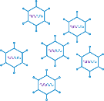

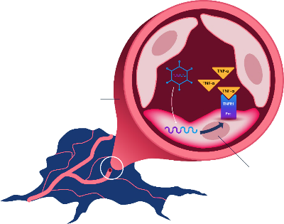









Ofra-Vec Designed to Combine Vascular Disruption with Immune Recruitment
Novel Dual Mechanism of Action for Oncology Applications
Angiogenesis-specific
Promoter (PPE-1-3x)
Death receptor
(TNFR1/Fas chimera)
Tumor starvation
and necrosis
Disruption of
tumor blood supply
Release of tumor
antigens that stimulate immune
response
IV administration
(every 6-8 weeks)
IV administration
(every 6-8 weeks)
Virus stimulates an immune response within the tumor
Tumor Shrinkage
Tumor
Non-replicating
Non-integrating
Adenovirus 5 (Ad5)
T cells recruited
into the tumor
Anti tumor
Immune response

Slide 8
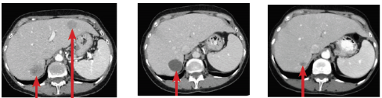
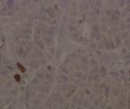
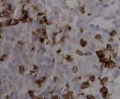
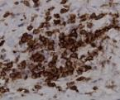

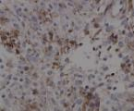
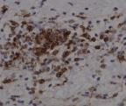
Ofra-Vec Designed to Combine Vascular Disruption with Immune Recruitment
Radiographic and Histological Evidence from Ofra-Vec Clinical Trials
VASCULAR DISRUPTION LEADING TO
TUMOR NECROSIS & SHRINKAGE
IMMUNE SYSTEM RECRUITMENT:
TURNING COLD TUMORS HOT
CT scans of an ovarian cancer patient treated with ofra-vec
CD4 Cells: 40x increase after ofra-vec treatment
Baseline (BL)
Pre-Treatment
Multiple Lesions
BL + 3 Months
Lesion Liquification
BL + 6 Months
RECIST Response
Baseline
After First Dose
After Third Dose
CD8 Cells: >25x increase after ofra-vec treatment
Imaging shows 2 metastatic lesions
in the liver at baseline
Disappearance of the upper-right lesion; lower-left lesion turns translucent, representing liquification/necrosis
Lower-left lesion
shrinks significantly
Baseline
After First Dose
After Third Dose
CT Scans from ovarian cancer patient. Shapira-Frommer et al., 2019 (SGO)
Histology data from ovarian cancer patient. Shapira-Frommer et al., 2019 (SGO)

Slide 9
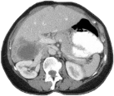
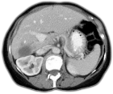
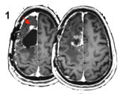
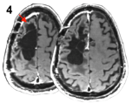


Encouraging Survival Benefit Across Multiple Tumor Types
Data from Phase 2 Trials of Ofra-Vec
PLATINUM-RESISTANT
OVARIAN CANCER
RECURRENT GBM
(rGBM)
RADIOIODINE-REFRACTORY
THYROID CANCER
Median OS: 498 Vs. 172 days
P=0.03
Median OS: 414 Vs. 223 days
P=0.043
Tail of >40%
After 3.7 years
High Dose
Low Dose
Primed Combination
Limited Exposure
Multiple High Doses
Single Low Dose
Survival Probability
Survival Probability
Survival Probability
Days
Days
Days
Baseline
PR post single dose
Baseline
CR for >1500 days
Baseline
Response post 2 doses
Arend et al., Gynecologic Oncology 157 (2020) 578–584
Brenner et al., Neuro Oncology 22(5), 694–704, 2020
Harats et al., FISEB Conference, 2017

Slide 10





Multiple Ofra-Vec Phase 2 and Phase 3 Trials Ongoing
Recurrent GBM
Phase 2 Trial
Aim: Replicate previous positive Phase 2 results in rGBM with single agent ofra-vec therapy, without bevacizumab, which neutralizes its effects. Preliminary data expected in 2H22
Platinum-Resistant
Ovarian Cancer
Phase 3 Registration-Enabling Trial
Colorectal Cancer
Phase 2a Trial
Aim: Pilot exploratory study to evaluate activity and immune response in colorectal cancer when combined with nivolumab. Preliminary data expected in 1H22
Co-Primary endpoints:
Progression Free Survival - Expected 2H22
Overall Survival - Expected 2023
Successfully meeting either PFS or OS expected to support regulatory approval

Slide 11





OVAL: Phase 3 Study In Platinum-Resistant Ovarian Cancer
ofra-vec + weekly paclitaxel
400 Patients
1:1
Placebo + weekly paclitaxel
ofra-vec / placebo dosing
CT Follow Up
Week
1
4
8
12
16
20
24
Global multi-center study
Dual primary endpoint: PFS and OS
Successfully meeting either PFS or OS
primary endpoints expected to be sufficient for submitting a BLA for potential full FDA approval
Clinical collaboration with the
Activity successfully demonstrated in interim analysis, with response rate ≥ 58% *
Enrollment complete
*Arend et al., Gynecologic Oncology 2021 Feb 23;S0090-8258(21)00151-7.
GOG Foundation, Inc., is an independent international non-profit organization whose mission is dedicated to transforming the standard of care in gynecologic oncology.

Slide 12
High Response Rate Demonstrated in OVAL Study Interim Analysis
Reproduced Phase 2 Results and Compares Favorably to Historical Data with Paclitaxel Monotherapy
OVAL Study Pre-Specified Interim Analysis (n=60)
Interim analysis conducted to de-risk the trial
Trial would be stopped if ofra-vec did not have at least a 10% increase in response rate vs control
DSMC reviewed unblinded data and reported a 53% overall response rate in the combined data
Analysis endpoint was met and, assuming a balanced randomization, implies that ofra-vec had at least a 58% response rate
Response rate compares favorably to historical data (AURELIA study; Post-hoc analysis of weekly paclitaxel subgroup)
Response seen even though OVAL Study enrolled heavily pre-treated patients
Results published in peer reviewed journal
Response Rate (%)
Phase 2
*
OVAL
Phase 3
interim
**
AURELIA
(post-hoc)
***
* Response rate of 58% (CA-125) was seen for ofra-vec + paclitaxel in a Phase 1/2 study, despite poor prognostic features in heavily pre-treated population in which 48% of patients had a
platinum free interval of less than three months, and 52% previously received anti-angiogenic medications. Arend et al., Gynecologic Oncology 157 (2020) 578–584). [NCT01711970]
** OVAL Phase 3 interim analysis demonstrated RR (CA-125) of 58% or higher for the ofra-vec + paclitaxel arm. Arend et al., Gynecologic Oncology 161 (2021) 496–501. [NCT0339865]
*** Weekly paclitaxel arm historical data, AURELIA trial post-hoc analysis; Poveda et al., J Clin Oncol. 2015 Nov 10;33(32):3836-8. [NCT00976911]

Slide 13
Potential for Differentiated Safety Profile vs. Standard of Care
Most common adverse events (AEs) are fever, chills and fatigue
Over 300 patients have been treated with ofra-vec in completed clinical trials
Usually mild-moderate. Only 5% of fever
cases are grade 3
Usually occur on the day of treatment and resolves within 24 hours
The ongoing OVAL registration-enabling Phase 3
trial has completed enrollment
Responds well to antipyretic medications,
are tolerable and do not trigger
treatment discontinuation
OVAL Study is monitored by an independent Data
Safety Monitoring Committee (DSMC) that has conducted 6 reviews of unblinded data thus far. Following each review, the DSMC recommended the study proceed without modifications.
Compatible with the viral-based nature
of ofra-vec

Slide 14





Potential Competitive Advantages of Ofra-Vec in Ovarian Cancer*
 | Clinical Development |  | Approved Drugs
CRITERIA
Potential for Survival Benefit | mOS 498 vs 172.5 days (p=0.03) in Phase 2** | Unknown (Response Rate) | Approved on PFS only | Approved on PFS only
Applicability to All Platinum-Resistant Patients |  | Only ~40% (FRa-high patients)*** |  | Only ~50% (BRCA⁺,HRD⁺ patients)*** Most patients are treated with PARPi in earlier line
Dual Mechanism of Action
Dosing Regimen | IV, every 8 weeks | IV, every 3 weeks | IV, every 2-3 weeks | oral, once/twice daily
PRODUCT
PRODUCT
  PARP Inhibitors
OFRA-VEC
MIRVETUXIMAB SORAVTANSINE
***
***
* No head-to-head studies have been conducted
** Arend et al., Gynecol Oncol. 2020 Jun;157(3):578-584.
*** Applicable to additional tumor types

Slide 15









Dual Mechanism and Preliminary Data Indicate Broad Utility Potential
Significant Market Potential with Initial Indication Expected to be Ovarian Cancer
Targeting of tumor vasculature and immune recruitment has the potential to be translatable across many solid tumors
Ovarian
$1.98B ¹
Brain
$2.83B ²
Thyroid
$0.34B ³
Neuroendocrine
$2.6B ⁴
Supported by Phase 2 data in multiple applications
Potential for use in combination with other targeted agents and immunotherapies
Liver
$0.7B ⁵
Lung
$6.86B ⁶
Kidney
$3.3B ⁷
Colorectal
$15.7B ⁸
Numbers represent estimated global market size in 2021 in USD
¹ Market Reports World, calculated
² Fortune Business Insights
³ Market Data Forecast
⁴ DataBridge market research, calculated
⁵ 2021 Market Data Forecast
⁶ Market Data Forecast
⁷ Reseach and Markets
⁸ Market Data Forecast

Slide 16
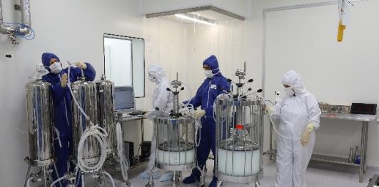
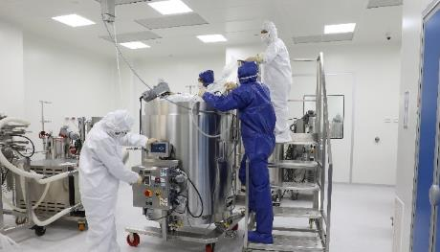

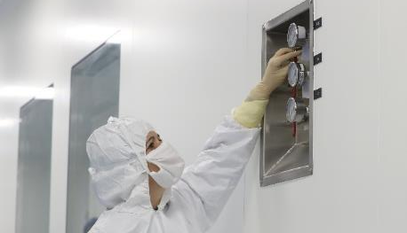
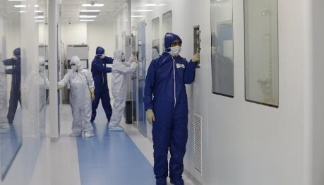
In-House GMP Gene Product Manufacturing
GMP gene product manufacturing facility
Approximately
20,000 sq.ft
Facility design was discussed with the US FDA
Up to 1000L
bioreactor capacity
Multiple batches of ofra-vec produced
Batches approved for clinical use by FDA, EMA, PMDA, Israeli MoH
Inspected by European QP
and Israeli MoH
Facility expected to be used for commercialization

Slide 17


Path Forward to Multiple Ofra-Vec Clinical Catalysts
*
DSMC review 1Q22
Topline Overall
Survival co-primary endpoint Data*
2023
Topline PFS
co-primary endpoint Data*
2H22
Potential BLA filing with PFS data
1H23
2022
2023
Preliminary data from NCI-sponsored Phase 2 study in colorectal cancer
1H22
Preliminary data from investigator-sponsored Phase 2 study of ofra-vec in rGBM
2H22
*The OVAL study is event-driven. Timing of top-line results depends on # of events.

Slide 18
VB-601:
Targeting Monocytes in Inflammation

Slide 19
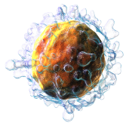
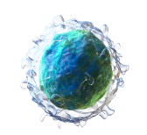

VB-601 Designed to Specifically Target Monocytes with the MTT Platform
Monocytes are Key Cells Involved in the Inflammatory Process and Implicated in Chronicity of Disease
T-cell
VB-601
mAb Utilizing Monocyte Targeting Technology (MTT)
Inflammation
Triangle
B-cell
Monocyte / Macrophage
Circulating Monocytes
migrate to inflammatory tissues where they differentiate into Macrophages
Macrophages are key players in the chronic state of many inflammatory diseases
Currently available therapies are focused on modulating
T- and B- lymphocytes
VB-601 is designed to address an unmet need – targeting monocytes/macrophages, a crucial missing point in the inflammation triangle

Slide 20
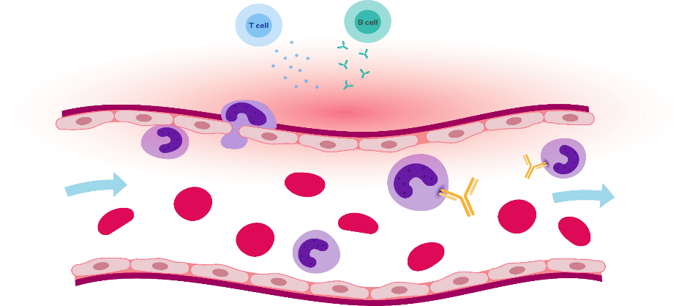
VB-601 Designed to Target the MOSPD2 “Mono-Walk” Receptor
Mechanism of Action Blocks Monocytes Ability to Enter Inflammatory Tissue
The Problem
Our Solution
There is no approved treatment targeting monocytes, key immune cells
controlling the inflammatory response
Several approved drugs target and inhibit T cell or B cell mediated immune response, but the inflammation persists
VB-601 is an antibody that has been engineered to specifically target the MOSPD2 “mono-walk” receptor. By targeting this receptor, VB-601 is designed to prevent monocyte migration to sites of inflammation, with the potential to restrain the chronic inflammatory process.
Inflammatory
tissue
VB-601
monocyte

Slide 21
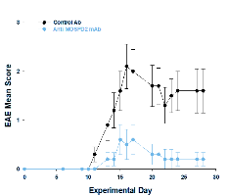
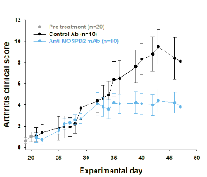
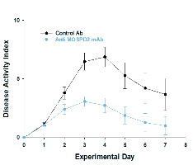


VB-601 Proof-of-Concept Pre-Clinical Data Indicating Broad Utility
In Immune-Inflammatory Indications
Validating Pre-clinical Data in Human Ex-vivo and Murine In-vivo Models
HUMAN EX-VIVO
MURINE IN-VIVO
MULTIPLE SCLEROSIS (Experimental Autoimmune Encephalomyelitis Model)
RHEUMATIOD ARTHRITIS
(Collagen Induced Arthritis Model)
INFLAMMATORY BOWEL DISEASE (2,4,6-trinitrobenzene sulfonic acid [TNBS] Model)
*
POTENTIAL FOR A WIDE RANGE OF IMMUNE-INFLAMMATORY INDICATIONS
2020 Market Estimates:
Multiple Sclerosis
$26.05B ¹
Rheumatoid Arthritis
$24.46B ²
Inflammatory Bowel Disease
$12.8B ³
NASH
$4.57B ⁴
¹ Business insights report ID: FBI100386
² Research and Markets report ID: 5504577
³ Market reports world, ID: 19608437
⁴ Reports and Data ID: 001111

Slide 22

2022: A Potentially Transformational Year With Significant Catalysts
*
DSMC review
1Q22
Topline Overall
Survival co-primary endpoint Data*
2023
Completion of recruitment
1Q22
Topline PFS
co-primary endpoint Data*
2H22
Potential BLA filing with PFS data
1H23
2022
2023
Preliminary data from NCI-sponsored Phase 2 study in colorectal cancer
1H22
Regulatory
Submission
VB-601 2H22
Preliminary data from investigator-sponsored Phase 2 study of ofra-vec in rGBM
2H22
Data from
VB-601 Phase 1 trial 2023
First patient enrolled in VB-601
Phase 1 trial
2H22
*The OVAL Study is event-driven. Timing of top-line results depends on # of events.

Slide 23
Corporate

Slide 24



















Expert Leadership And Drug Developers
MANAGEMENT
SAB
DROR HARATS, MD
CEO
NAAMIT SHER, PHD
VP, Drug Development
& Regulatory
RUTH ARNON, PHD
SAB
PATRICK WEN, MD
SAB
SAM BACKENROTH
CFO
EYAL BREITBART, PHD
VP, Research & Operations
BRADLEY MONK, MD
SAB
TIMOTHY CLOUGHESY, MD
SAB
TAMI RACHMILEWITZ, MD
VP, Clinical Development
MATT TRUDEAU
Chief Commercial Officer
JONATHAN LEDERMAN, MD
SAB
EREZ FEIGE, PHD MBA
VP, Business Operations
AMOS RON
Corporate Secretary

Slide 25














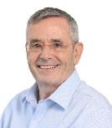






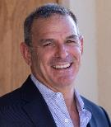








Broad Pharma and Business Expertise at the Board Level
MARC KOZIN
Chairman
RUTH ALON
SHMUEL (MULI) BEN ZVI, PHD
RON COHEN, MD
ALISON FINGER
DROR HARATS, MD
CEO
DAVID HASTINGS
MICHAEL RICE
BENNETT SHAPIRO, MD

Slide 26
Financial Snapshot
NASDAQ: | VBLT
Market Cap* | $84 Million
Shares Outstanding** | 69.2 Million
Share Price* | $1.21
Avg. Daily Volume* | ~245,000 Shares
52 Week Range* | $1.13-$3.17
Cash*** | $60.4 Million
Analyst Coverage | Guggenheim — HC Wainwright— Swayampakula Ramakanth Jones Trading— Soumit Roy Oppenheimer — Kevin DeGeeter Roth — Johnathan Aschoff
Multiple Clinical Catalysts Expected in 2022 Including Phase 3 Data
Well Capitalized - Cash Runway into Q4 2023
Emerging Clinical Pipeline in Oncology and Inflammation
Broad Market Potential
*As of 1/27/22
**6-k Filed on November 15 and disclosed subsequent event warrant exercises
***Proforma cash balance; 9/30/21 reported numbers plus subsequent warrant exercises (does not include 17.5mm Euro blended finance grant announced in December 2021)

Slide 27
Thank you
www.vblrx.com
ir@vblrx.com

