Slide 1

In partnership with
Tech Policies for Virtual Teams
A Leader’s Responsibility
Notes:
*75 minutes
*Jeanne will open the webinar and introduce speakers
*Take questions throughout, with specific Q&A pauses between sections (up to 5 min)

Slide 2

FRANCIS JOHNSON
Managing Director of Technology Services, Tech Impact
Pronouns: He/Him
I oversee all technology infrastructure projects and support services. I lead a team of engineers and analysts who support the work of thousands of users across 240 nonprofits nationally. Our team works with nonprofits to implement on-premises and cloud infrastructure, improve security and provide mobile working opportunities.
Notes:
Francis

Slide 3

KAREN GRAHAM
Director of Education & Outreach, Tech Impact
Pronouns: She/Her
I lead the Idealware team of researchers, presenters, and writers who create technology information resources designed to help nonprofit leaders put their vision into action.
Notes:
Karen

Slide 4



Tech Impact delivers tech services, education, and training that help nonprofits and communities thrive.
NONPROFIT TECH SERVICES:
Managed IT Support
Cloud Services
Strategic Consulting
Security & Compliance
Data Support
Machine Learning & AI
Community Integrated Design
NONPROFIT EDUCATION & TRAINING:
Reports
Consumer Guides
Assessments
Workbooks & Articles
Online Training
Free Webinars
WORKFORCE DEVELOPMENT:
ITWorks & CXWorks: Free IT and Customer Experience training programs
PunchCode:
12-week immersive programming bootcamp
Notes:
Karen
Tech Impact: A NONPROFIT ON A MISSION TO USE TECHNOLOGY TO BETTER SERVE THE WORLD.

Slide 5





WHY TECH IMPACT?
We’ve helped thousands of organizations use technology to make a bigger and better impact on the communities they serve.
WE GET IT.
We’re a nonprofit too.
WE TRULY CARE.
Our first priority is to help.
WE’RE AGILE.
We constantly evolve to address changing landscapes.
WE DELIVER.
We work with the brightest minds in tech to bring you superior products and services that are affordable.
WE COLLABORATE.
We work with tech and corporate powerhouses to provide you with the best tools and platforms.
Notes:
Karen

Slide 6
POLL
What is your role in your organization?
Accidental techie
IT staff
Executive director
Other management/senior staff
Notes:
Francis
Pause for POLL results
Jeanne will execute the polls (prompt her verbally)

Slide 7

STORY TIME
Notes:
Francis
REMOTE WORK STORY (Start of Pandemic)

Slide 8
AGENDA
What has changed
Six key technology policies
Your role as a leader
Questions - throughout
Resources
Notes:
Karen
We won’t be covering whether you should allow employees to work from home or in what circumstances. We’re assuming that you do have employees working from home—at least some of them some of the time, for the foreseeable future.
It’s hard to cover policy without also talking about practices and protocols, so we will touch on those throughout.
You will get access to the recording.

Slide 9
WHAT HAS CHANGED
Notes:
Karen

Slide 10
CHAT (USE Q&A):
What has changed about your technology use in the past six to eight months?
Notes:
Karen

Slide 11
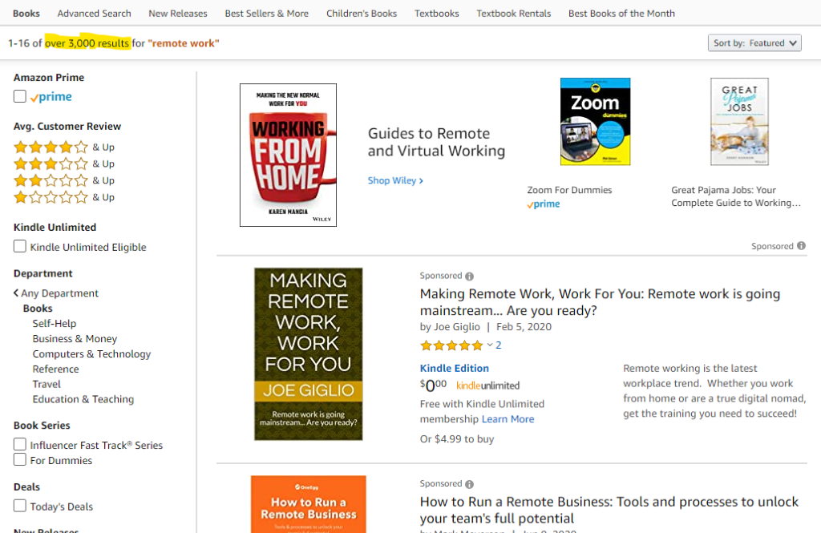
PLENTY OF ADVICE, FEW ANSWERS
Notes:
Karen

Slide 12
ORGANIZATION-PROVIDED TECHNOLOGY RESOURCES
What are the risks and pitfalls of having this equipment out in people’s homes?
Household members using organization-owned computers
Personal use of organization-owned computers
Notes:
Francis

Slide 13
PERSONAL DEVICES AND RESOURCES
Should organizations provide minimum requirements, reimbursement or stipends, and tech support for employee-owned technology?
Working on personal PC
Auxiliary equipment: second monitor, camera, printer
Home network, internet
Notes:
Francis

Slide 14
DIFFERENT COLLABORATION CHANNELS
How can you adjust habits and remain connected, productive, organized, and secure?
Sharing passwords
Using shadow IT to communicate and share documents
Learning curve for official channels
Notes:
Francis

Slide 15
Q&A BREAK
Type your questions into the Question box.
Notes:
Jeanne
What about work hours? Compensation for hourly employees who are checking email from home outside of normal schedule, Fair Labor Standards Act might come in to play here, get legal counsel on that. (Not to mention OSHA and workers comp—employers have some responsibility for employees regardless of where the work happens—maybe this means providing ergonomic mouse and keyboard, things like that.)
[post in chat] This article has more info on legal and HR aspects: https://nonprofitquarterly.org/a-quick-hands-on-lesson-in-teleworking-laws-in-the-age-of-covid-19/

Slide 16
SIX KEY TECH POLICIES

Slide 17
ACCEPTABLE USE
A guide to the overall use of your networks and equipment.
SECURITY
How to protect your data.
BRING YOUR OWN DEVICE
Considerations for employees using personal devices in the workspace.
INCIDENT RESPONSE & DISASTER RECOVERY
What to consider in case things go wrong.
REMOTE WORK
Considerations for employees who work outside of the office.
SOCIAL MEDIA & DIGITAL COMMUNICATION
Guidelines for how to represent the organization.
Notes:
Karen

Slide 18
POLL:
Which of these policies does your organization have?
Notes:
Karen

Slide 19

ACCEPTABLE USE
What could go wrong?
Misuse of equipment
Low productivity
Bypassing security measures
Policy considerations
Who maintains and fixes equipment? How?
Who can install software?
Can people use org’s IT for personal or commercial purposes?
Ideas
Automation
Remote access for IT support
Notes:
Francis
What could go wrong?
Damage to equipment
Low productivity from poorly maintained devices
Bypassing security measures
Policy considerations
Who maintains and fixes equipment? How?
Who can install software? And which software is approved?
Can people use computers, internet, or email for personal purposes? What is not allowed e.g. certain websites? What about commercial purposes such as operating a freelance business on the side?
Approaches
Automation
Remote access for IT support

Slide 20

DATA SECURITY
What could go wrong?
Lost data
Compromised privacy
Harm to your reputation
Policy considerations
Who has access to what data?
Do you encrypt email or flag sensitive data in email?
Do you require multi-factor authentication, vaults, and device locks?
Ideas
Automated backups
Password vaults, conditional MFA
Notes:
Francis

Slide 21

BRING YOUR OWN DEVICE
What could go wrong?
Loss/theft
Insecure networks
Failure to update
Data follows former employees
Policy considerations
Who can use personal devices?
What types?
What activities/apps are okay?
Ideas
Device Encryption
Mobile Device Management
Notes:
Francis

Slide 22

INCIDENT RESPONSE
What could go wrong?
Cyber crime
Data loss
Electrical or internet outages
Policy considerations
Whom will you communicate with?
How?
Ideas
Have a plan
Run simulations
Notes:
Francis
Let’s touch on incident response. Say you have a ransomware attack. What’s the procedure? You’ll want to plug the hole first so it doesn’t get any worse. Then repair the damage. Your policy might tell you who you have to communicate about the breach and how—keeping in mind that usual communication channels could be compromised.

Slide 23

REMOTE WORK
What could go wrong?
Insufficient coordination
Lack of visibility into work habits
Loss of culture and team bond
Policy considerations
HR policies
Where should files be saved?
What digital communication and collaboration tools should be used?
Norms re: cameras, availability
Ideas
Messaging platform
Time tracking
Notes:
Francis
HR policies will cover your criteria for bringing people back into the office as the pandemic gets under control, under what circumstances they can choose to continue working from home, and so on.

Slide 24

SOCIAL MEDIA AND DIGITAL COMMUNICATION
What could go wrong?
Staff or constituents venting on social media
Unwanted political messaging
Policy considerations
Do you want someone to review and approve messages?
Under what circumstances will you block someone?
Ideas
Social media management tools
Notes:
Francis/Karen
People are under a lot of stress! Might be more likely to post something harmful.

Slide 25
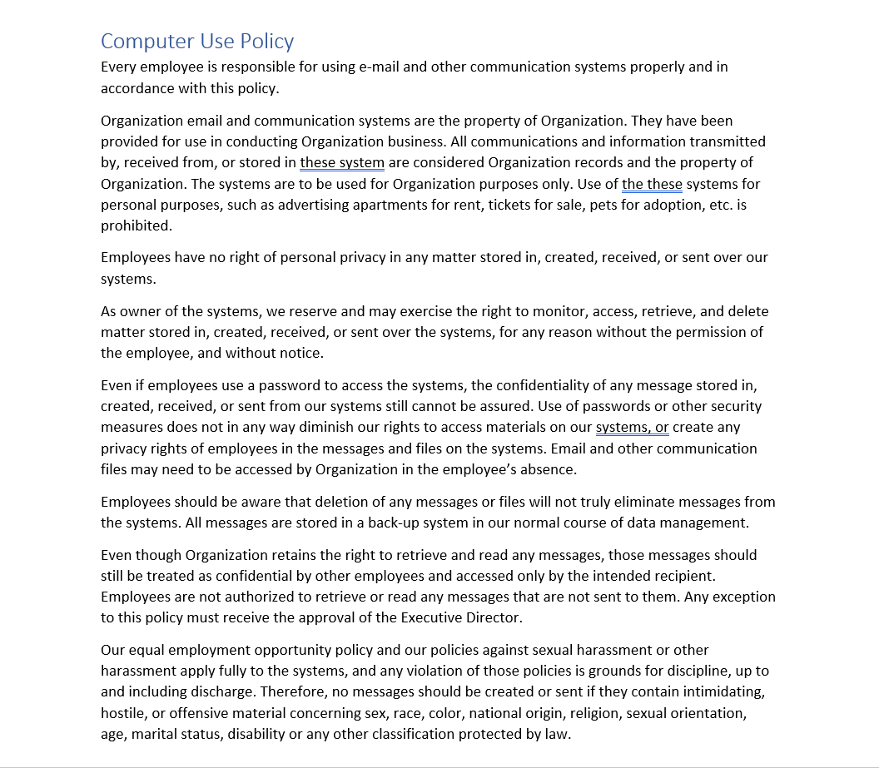
Notes:
This is an example policy, which is pretty standard.
It goes on to cover installing software, some more stuff about privacy and confidentiality, and a list of things not to do.

Slide 26
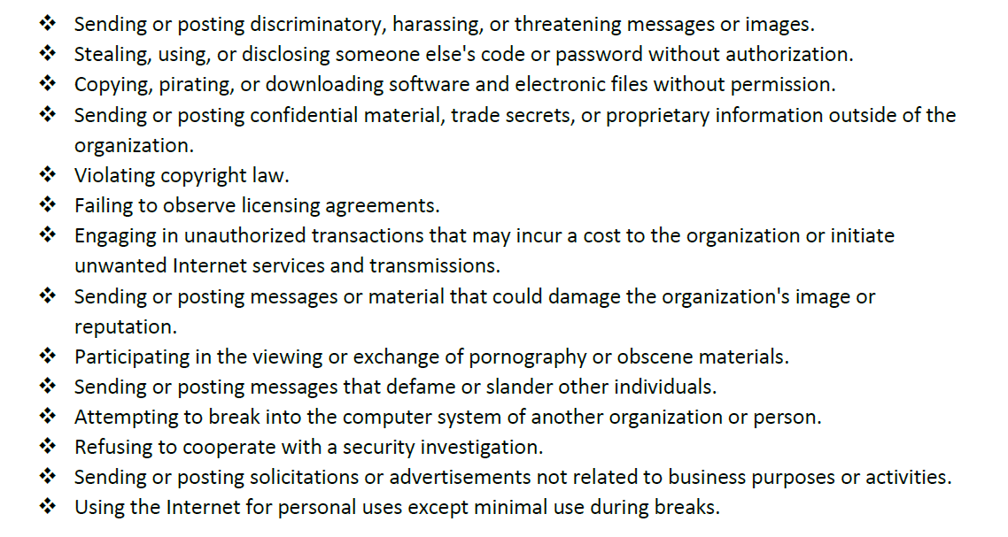
PROHIBITED ACTIVITIES
Notes:
(Part of the list, goes on to the next page)
This isn’t perfect—anyone want to critique it based on what you have heard so far? What might we want to update or change?

Slide 27
POLL:
Which of these policies needs the most work at your organization?
Notes:
Karen

Slide 28
Q&A BREAK
Type your questions into the Question box.
Notes:
Jeanne

Slide 29
A LEADER’S ROLE
Notes:
Karen

Slide 30

HOW NOT TO DO IT
Notes:
Karen
The Office – imagine Michael Scott is developing tech policies for Dundler Mifflin.
Doesn’t consult anyone, hands them down from on high.
Policies don’t make any sense, cause a lot of extra work, probably reports to file and encourage Dwight to spy on everyone.
Michael doesn’t follow any of the polices himself.

Slide 31
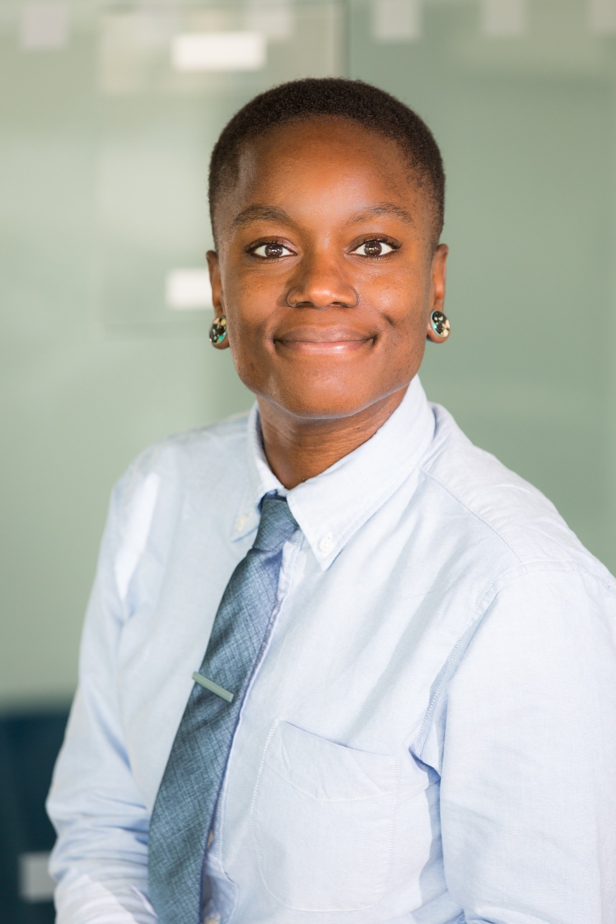
WHAT SHOULD YOU BE DOING, AS A LEADER?
Understand your situation
Set the tone
Make policies accessible
Balance kindness and enforcement
Consider equity
Notes:
Understand your risks (board members esp, fiduciary responsibility)
Know what your org is and isn’t doing, know your own policies
Set the tone – tie policy to your mission and success, best interest of people you serve
Make policies accessible, easy to find and understand, accessible to different abilities and learning styles
Make sure sure everyone knows about them - communication, training
Make the policies humane
Hold people accountable
Applying policies equally to every person and every situation might not be equitable, might contain unfair assumptions and power imbalances (*Francis)
Karen

Slide 32

BASIC POLICY RECIPE
State the purpose
Explain the risks
Specify the scope
Describe the consequences
Note exceptions
Notes:
[Karen]: Here’s a basic recipe for every IT policy. First, say what the purpose of the policy is. Then explain why it’s needed—what could go wrong if this policy isn’t followed? Say who it applies to and in what circumstances—that’s the scope. Indicate what the consequences will be for people who don’t follow it—will there by disciplinary action, revoking privileges, or what? And then tell people if there are any exceptions, for example in certain circumstances data privacy policies can be overridden if a person is harming themselves or others or if there is a subpoena.

Slide 33
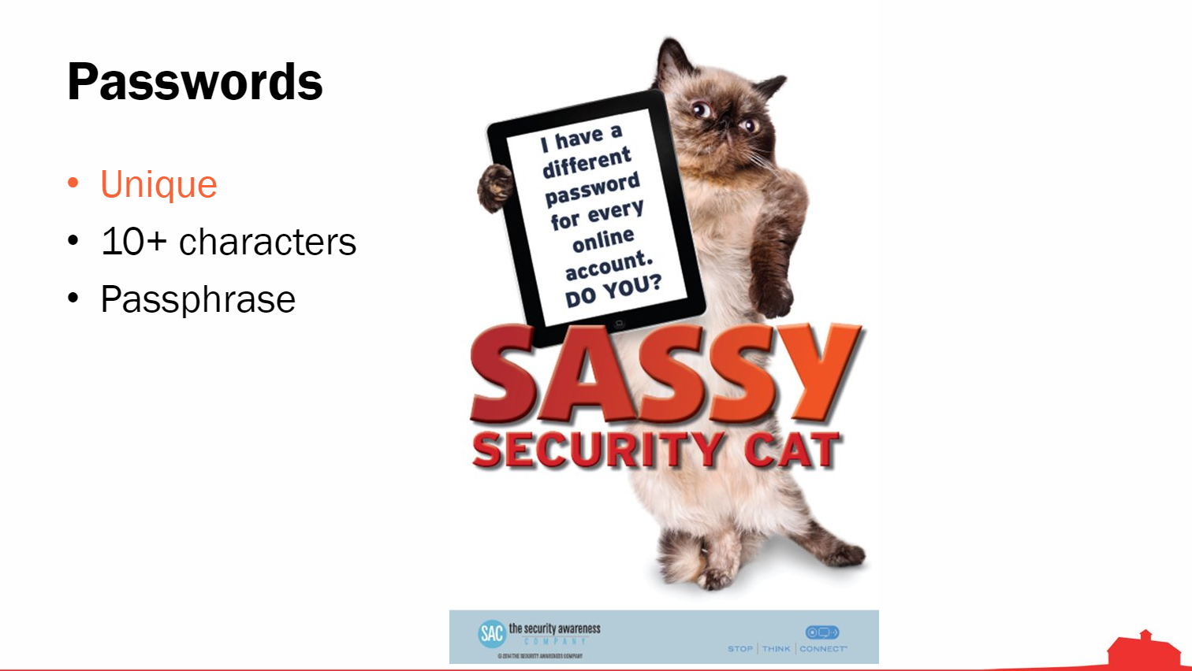
BALANCING CONVENIENCE AND PROTECTION
People at Animal Rescue League of Boston weren’t thrilled about long, complex passwords.
The compromise:
10 characters
Removed the requirement to update every 90 days
They did all-staff training and a quiz on password practices.
Actual slide from their staff training
Notes:
Karen
Example of balance, and training that is memorable and entertaining.
At first ARLB had a password requirement that was pretty stringent, and people weren’t crazy about it. So they relaxed it to 10 characters, which is still considered a strong password. And then they did this all-staff training—with pictures of pets of course—that was a fun and memorable way to get people familiar with the new policies.

Slide 34

TO DO
Take inventory of your policies
Review existing policies
Solicit input from your team
Seek help from a consultant
Rewrite
Consider a trial period
Run it by your lawyer
Train the team
Post policies in an accessible place
Review periodically
Notes:
Karen
Review with your HR manager or consultant, if you have one.
To solicit team input, post for comment, go over it in a meeting, give people time to digest it.
When training, don’t just talk at people – confirm their understanding. Make it part of new hire orientation and do a regular review with everyone.

Slide 35
QUESTIONS?
Notes:
Jeanne, Karen, Francis

Slide 36


NONPROFIT TECHNOLOGY POLICY WORKBOOK
A free guide to create and document policies for the acceptable use of technology and networks, personal devices for work, how to provide IT guidance to “accidental techies,” how to respond to an IT incident, and how to recover your technology after a major disaster.
https://offers.techimpact.org/reports/nptechpolicyworkbook/
Notes:
[Karen]: We have a free policy workbook on our website that will walk you through creating these policies for your own organization. If you have other resources on this topic that have been helpful to you, please chat them in to us.

Slide 37
MORE RESOURCES
What Nonprofits Need to Know About Security: A Practical Guide to Managing Risk
https://offers.techimpact.org/reports/nonprofits-need-know-security-practical-guide-managing-risk/
A Guide to Managing Your (Newly) Remote Workers https://hbr.org/2020/03/a-guide-to-managing-your-newly-remote-workers
Spiceworks Security Forum
https://community.spiceworks.com/security
Security Awareness Training Resources from KnowBe4
https://www.knowbe4.com/resources
IT Security Case Study: Prospect Park Alliance
https://www.idealware.org/it-security-prospect-park-alliance/

Slide 38
ACKNOWLEDGEMENTS
Karen Graham, Francis Johnson, and Jeanne Bell contributed to the
development of this curriculum.
All presentation materials copyright Tech Impact except where indicated. All images are used under a Creative Commons royalty-free non-attribution license, except for speaker headshots which were provided by the speakers.

