Slide 1
| Welcome Video
Notes:
NOTE: This PowerPoint presentation was created to help you introduce the YouScience experience to your students. However, you should feel free to make this your own. Edit, rearrange, cut, add, do whatever is comfortable for you.
*******Click the middle to play the video; if you cannot access it, access it here - https://www.youscience.com/#explainer******

Slide 2
Q&A| But why am I taking YouScience?
To help you answer these questions:
What are my career interests?
What pathways are
good fits for high school?
What career clusters are a good fit for me based on my interests?
How can I describe myself and who I am with confidence?

Slide 3
Q&A| So how does YouScience Snippet work?
You will take one 5-7 minute
interest survey called Snippet. Just answer as the questions as truthfully as you can!
After you complete Snippet, you can log back into your account to see your best fit career cluster matches and learn more about different career options!

Slide 4
SMILE!
THIS IS NOT A TEST
- or -
An intelligence or personality test
A test you can study for
A test that compares you to others

Slide 5
THE YOUSCIENCE EXPERIENCE | Know your interests
Make a short list: What are your greatest interests?
They can relate to school, another activity or club outside of school, or even qualities relating to your personality.
For example:
I love spending time with my friends
Soccer if my favorite sport to play and watch
I like classes like science, where I can work with my hands
Discover what career fields are most closely linked to your interests right now. They will change throughout your life!
Notes:
Final Activity
GOAL: Have students attempt to verbalize their unique interests, then after taking Snippet, compare their answers to new interests and/or career clusters they learned about through Snippet.

Slide 6
GETTING STARTED| Do you have?
1)
Notes:
All 6th grade students need is a computer! It must be a laptop, desktop, or Chromebook.

Slide 7
GETTING STARTED| Questions?
The chat tool is available to you in the bottom right-hand corner of the screen as soon as you log in. Use it any time if you have questions about the test.
Inappropriate chats and those not related to YouScience
will be reported to your school.

Slide 8
LOG ON – Step 1
Notes:
During the Assessment, provide 10- and 5-minute warnings before class time is up.
Do not have students be in the middle of an exercise when the bell rings. Give 10- and 5- minute warnings, and tell your students not to begin a new exercise if it will take longer than the amount of time they have left. See The YouScience Profile Timeframe in Introduction to YouScience.
If a student was interrupted in the middle of an exercise and could not complete it, please contact YouScience through chat. We will reset that student’s interrupted exercise so they can complete it in one sitting when they return.
Make sure the students LOG OUT of their account prior to shutting down their computer or closing the browser.
If they do not, the computer will remember them as the user and the next student will immediately be in that student’s account. You do not want students completing each others’ assessment.

Slide 9
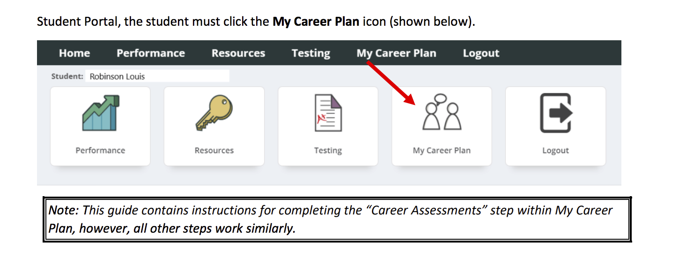
LOG ON – Step 2
Notes:
During the Assessment, provide 10- and 5-minute warnings before class time is up.
Do not have students be in the middle of an exercise when the bell rings. Give 10- and 5- minute warnings, and tell your students not to begin a new exercise if it will take longer than the amount of time they have left. See The YouScience Profile Timeframe in Introduction to YouScience.
If a student was interrupted in the middle of an exercise and could not complete it, please contact YouScience through chat. We will reset that student’s interrupted exercise so they can complete it in one sitting when they return.
Make sure the students LOG OUT of their account prior to shutting down their computer or closing the browser.
If they do not, the computer will remember them as the user and the next student will immediately be in that student’s account. You do not want students completing each others’ assessment.

Slide 10
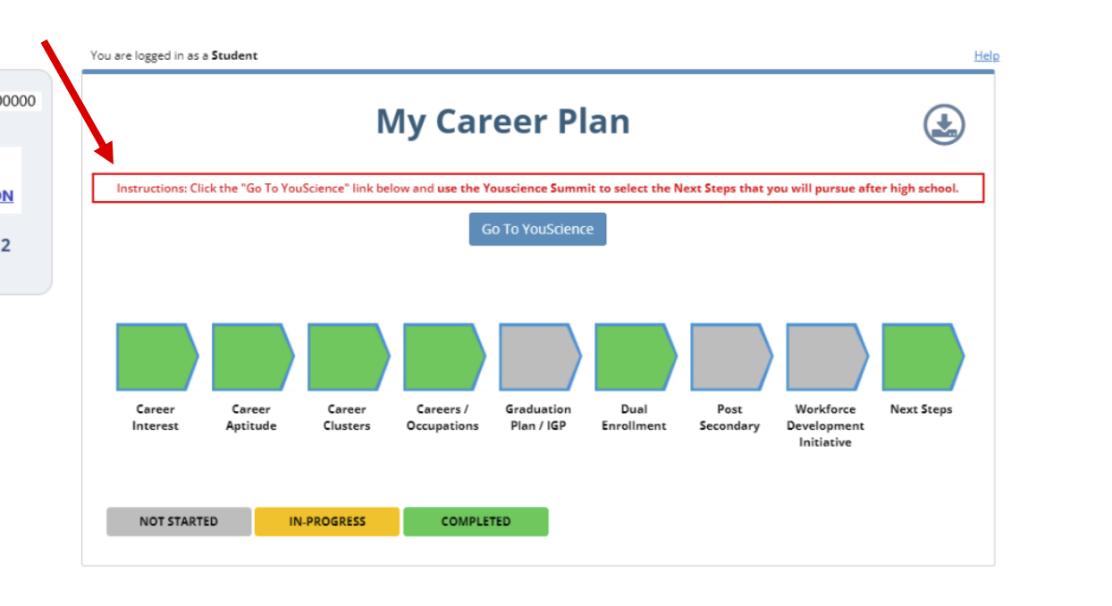
LOG ON – Step 3
Notes:
During the Assessment, provide 10- and 5-minute warnings before class time is up.
Do not have students be in the middle of an exercise when the bell rings. Give 10- and 5- minute warnings, and tell your students not to begin a new exercise if it will take longer than the amount of time they have left. See The YouScience Profile Timeframe in Introduction to YouScience.
If a student was interrupted in the middle of an exercise and could not complete it, please contact YouScience through chat. We will reset that student’s interrupted exercise so they can complete it in one sitting when they return.
Make sure the students LOG OUT of their account prior to shutting down their computer or closing the browser.
If they do not, the computer will remember them as the user and the next student will immediately be in that student’s account. You do not want students completing each others’ assessment.

Slide 11
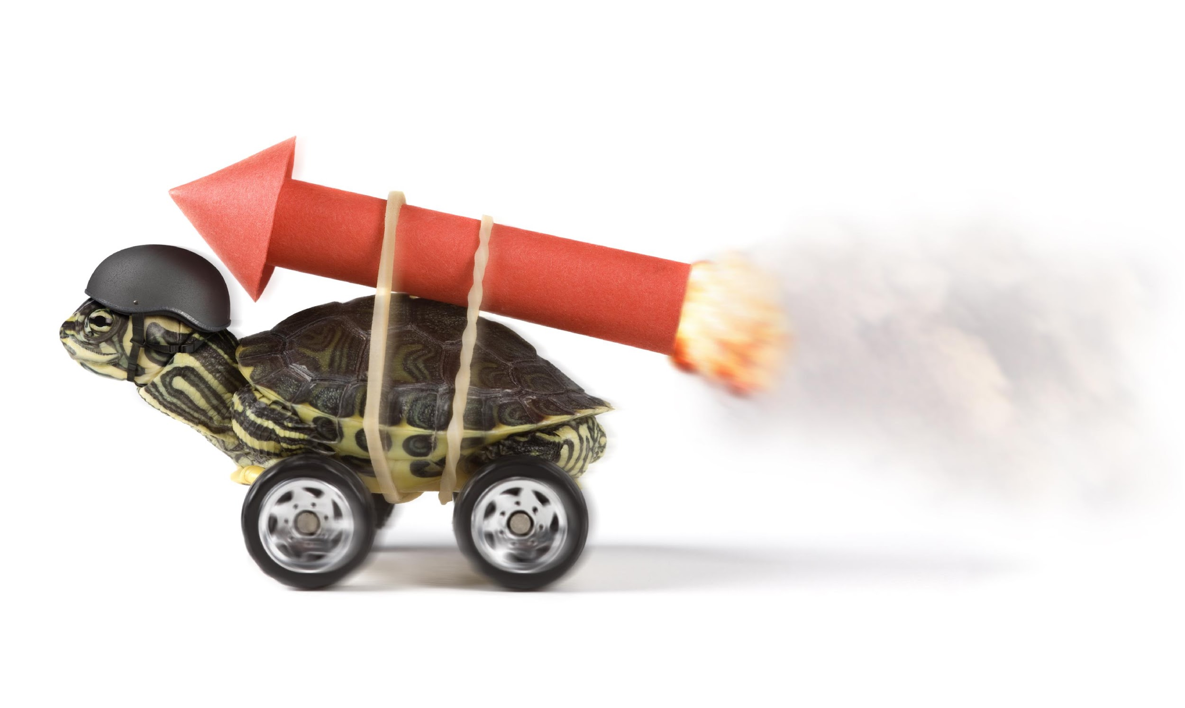
Ready, set, go…

