Slide 1
Unveiling Cybercrime Markets

Slide 2
jump into the chat
ask questions
(troll the presenters)

Slide 3
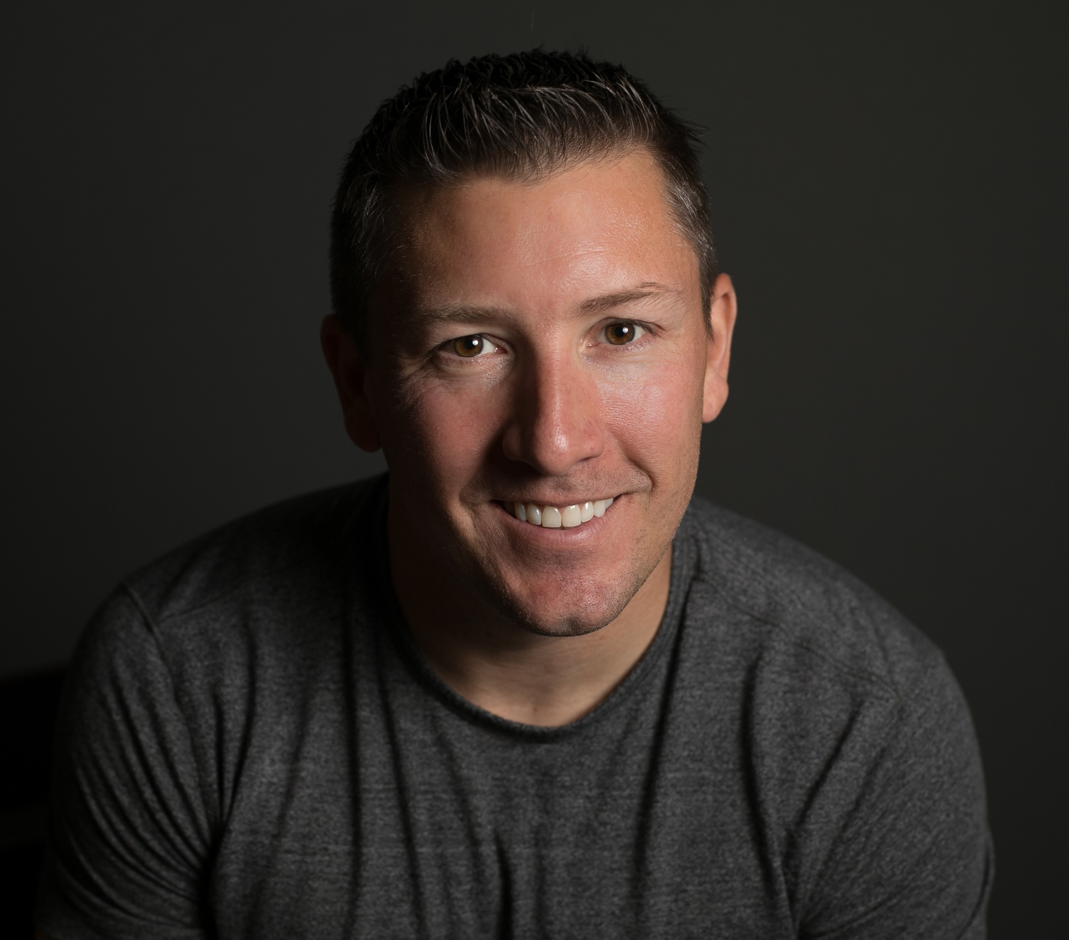
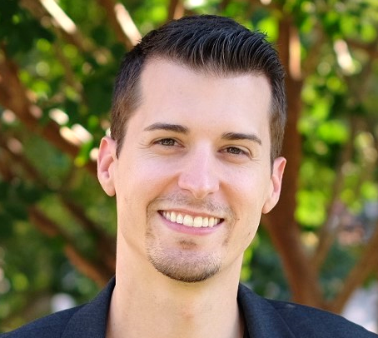
Kevin Lancaster
@KyleHanslovan

Slide 4
WEBCAST AGENDA
DARK WEB OFFERINGS
MALICIOUS MARKETING
HOW YOU’RE TARGETED
FREE RESOURCES

Slide 5
Dark Web OFFERINGs

Slide 6
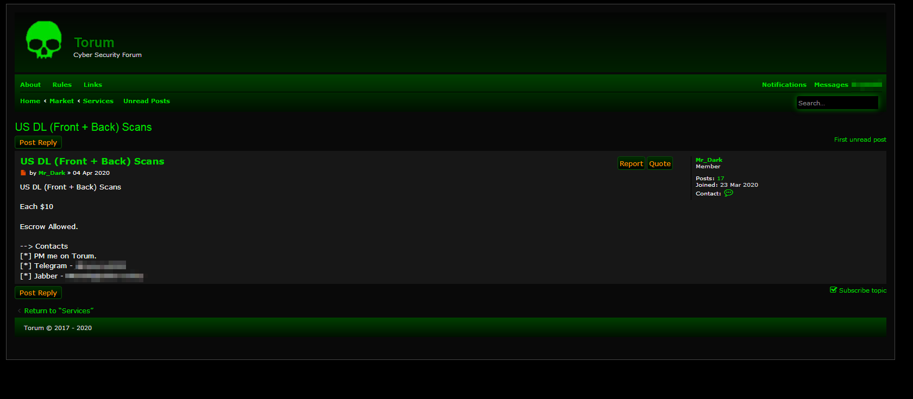

Slide 7
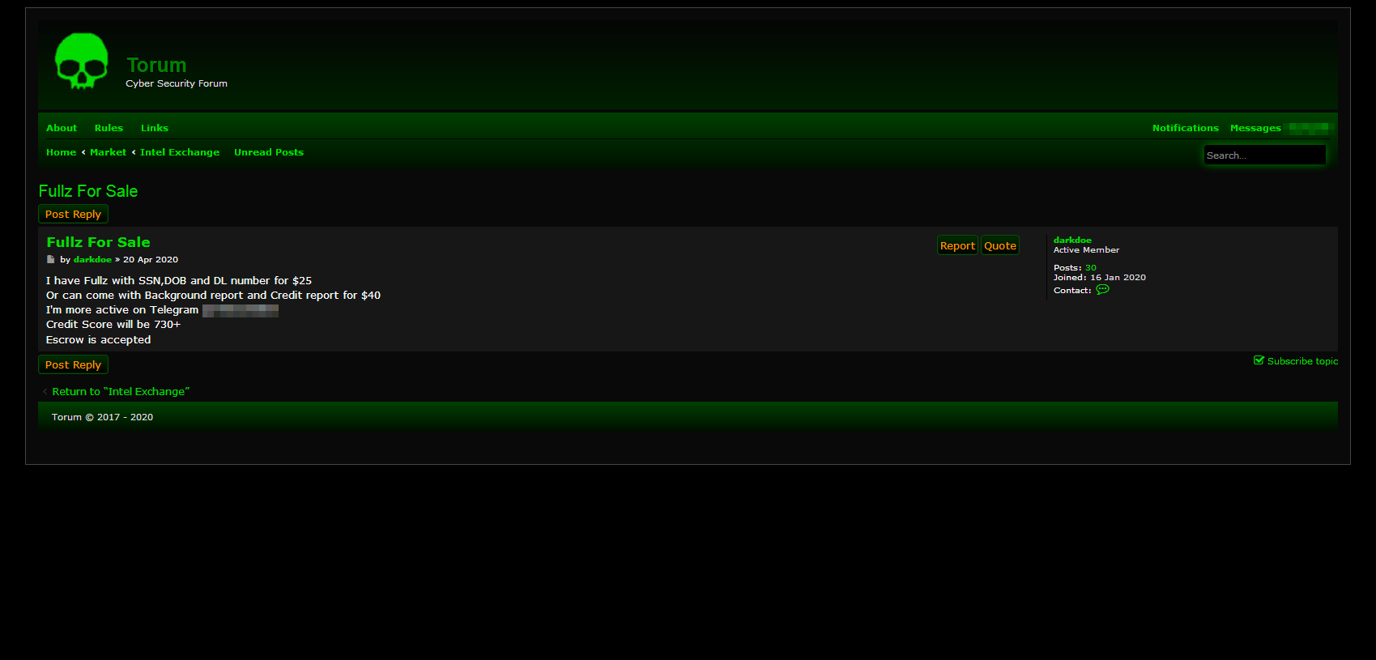

Slide 8
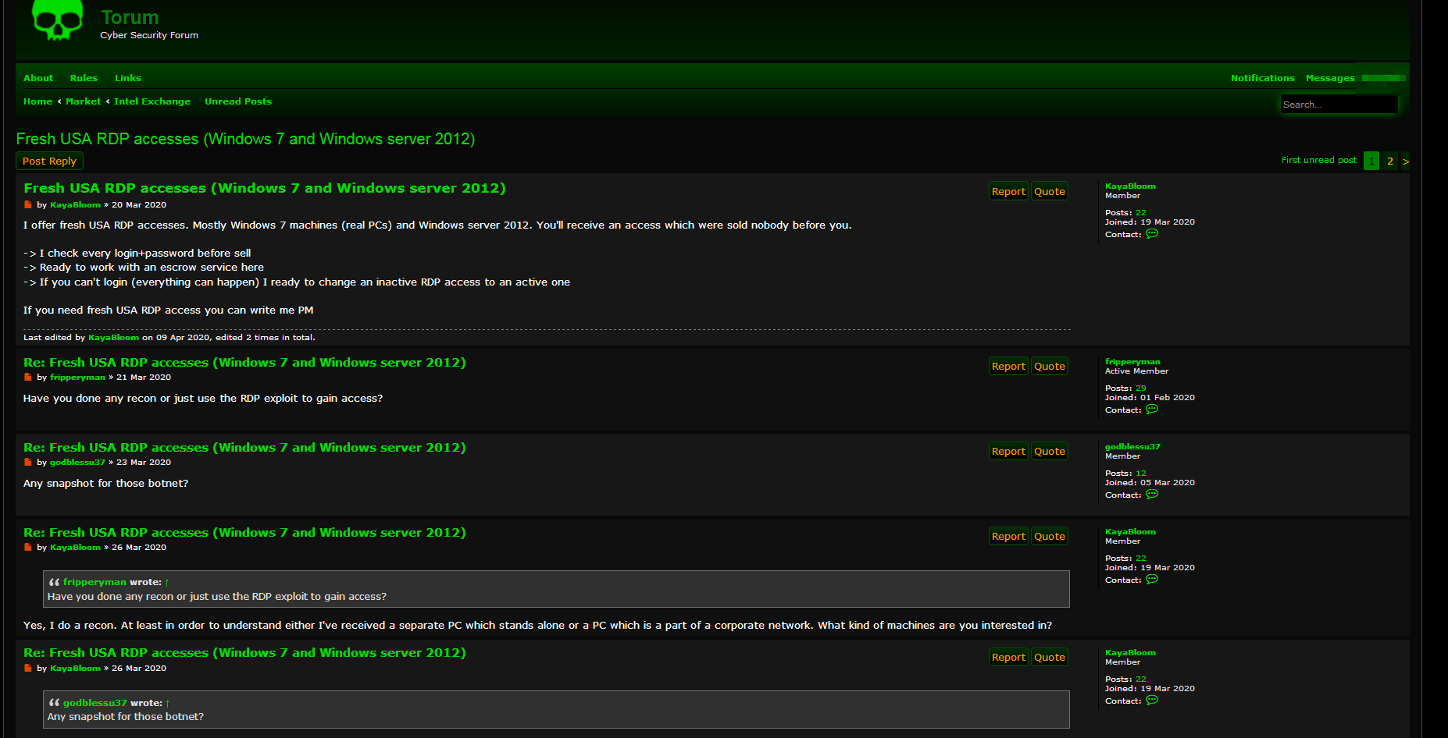

Slide 9
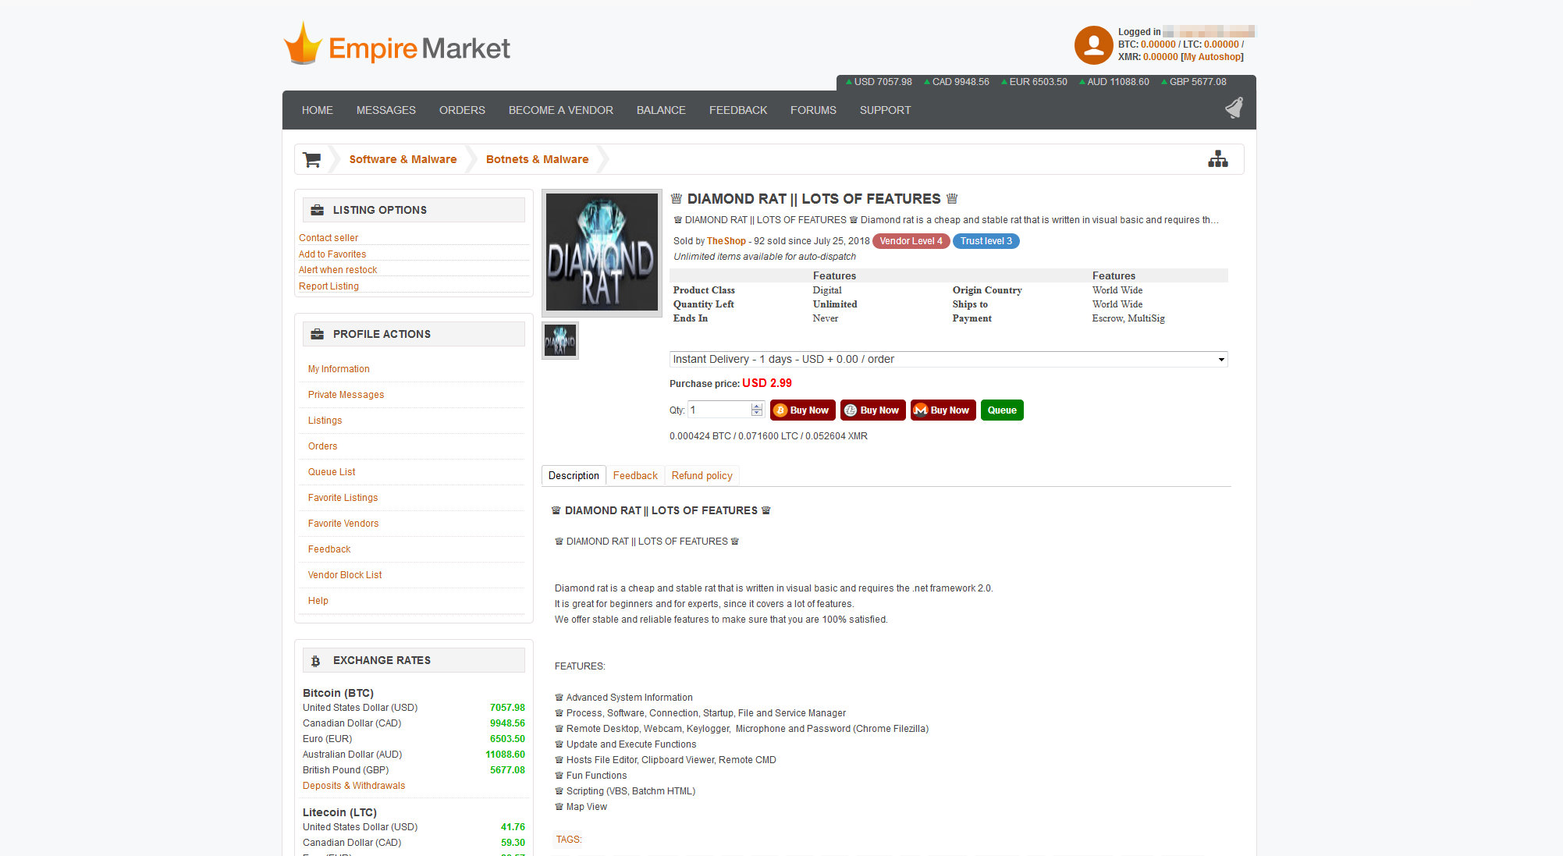

Slide 12
MALICIOUS MARKETING

Slide 13
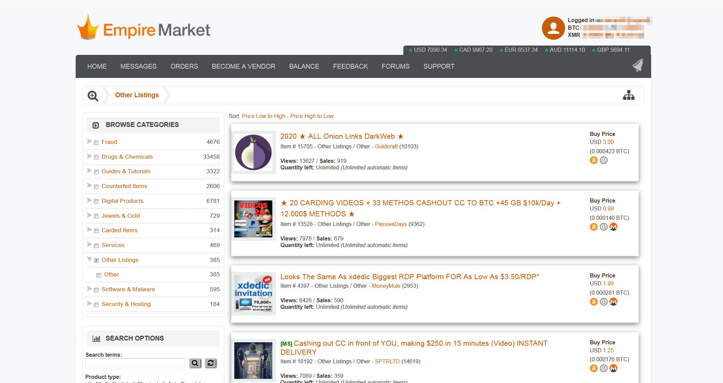

Slide 14
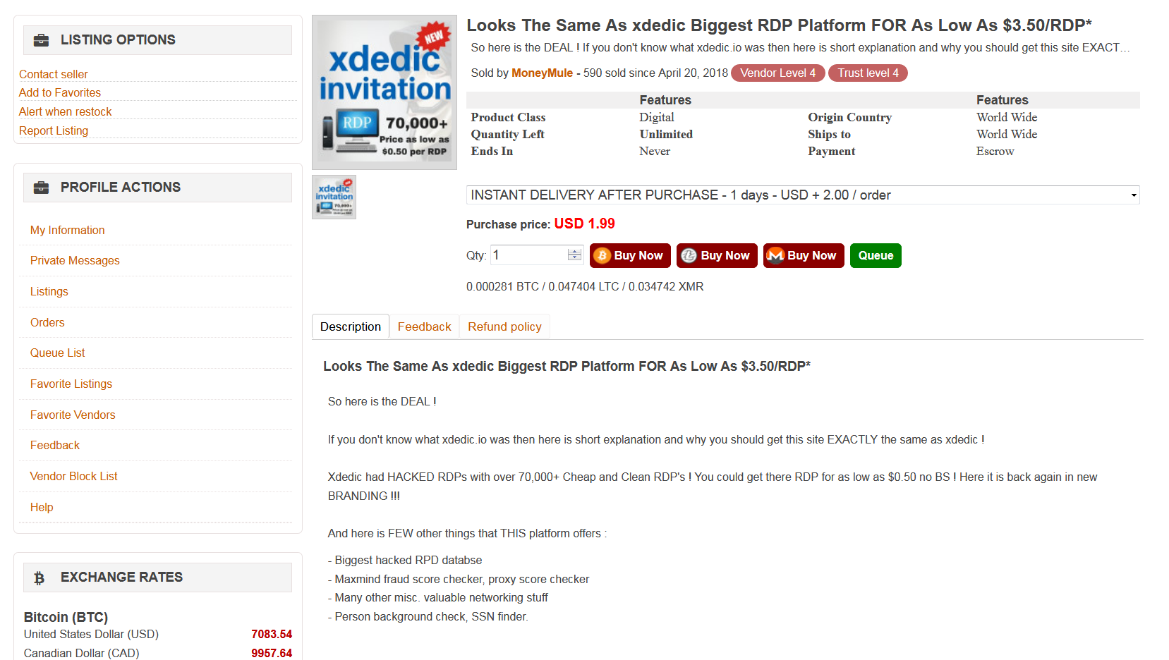

Slide 16
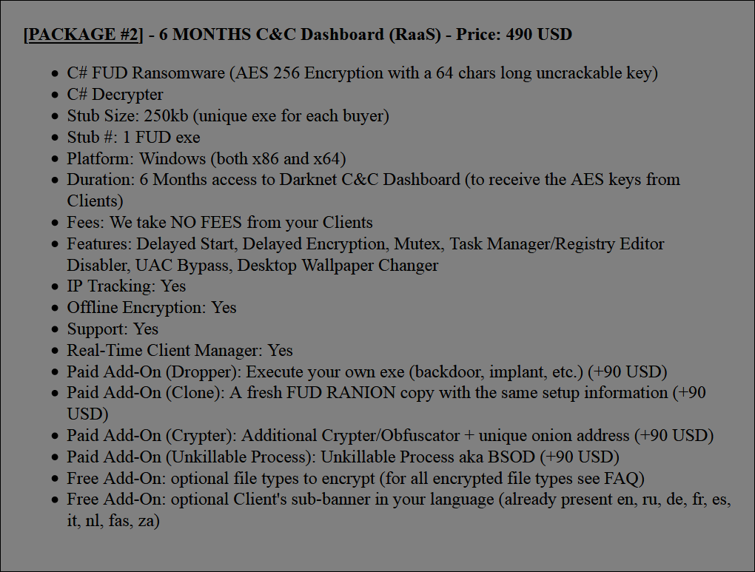
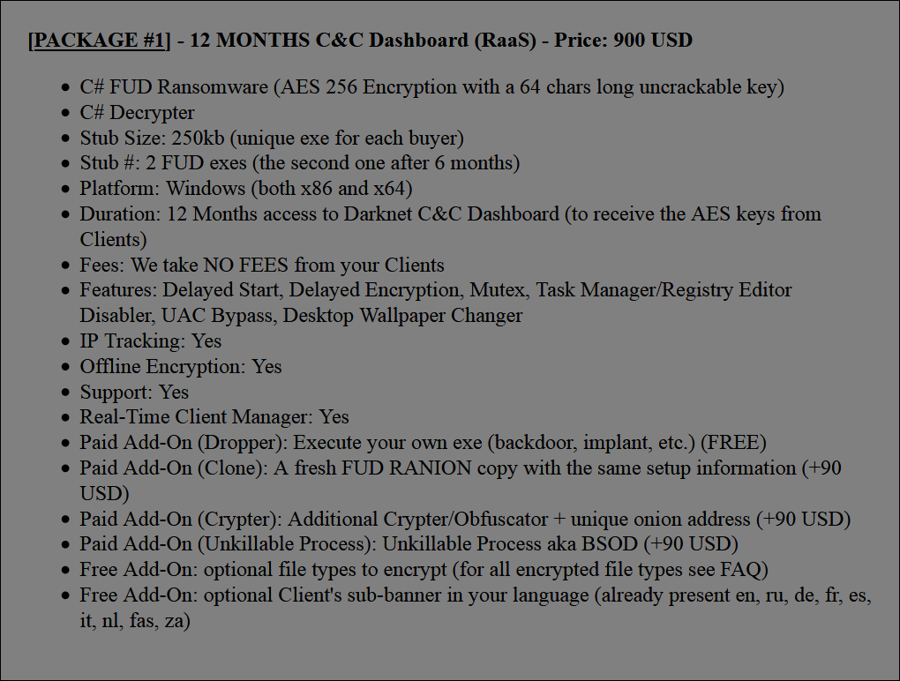

Slide 17
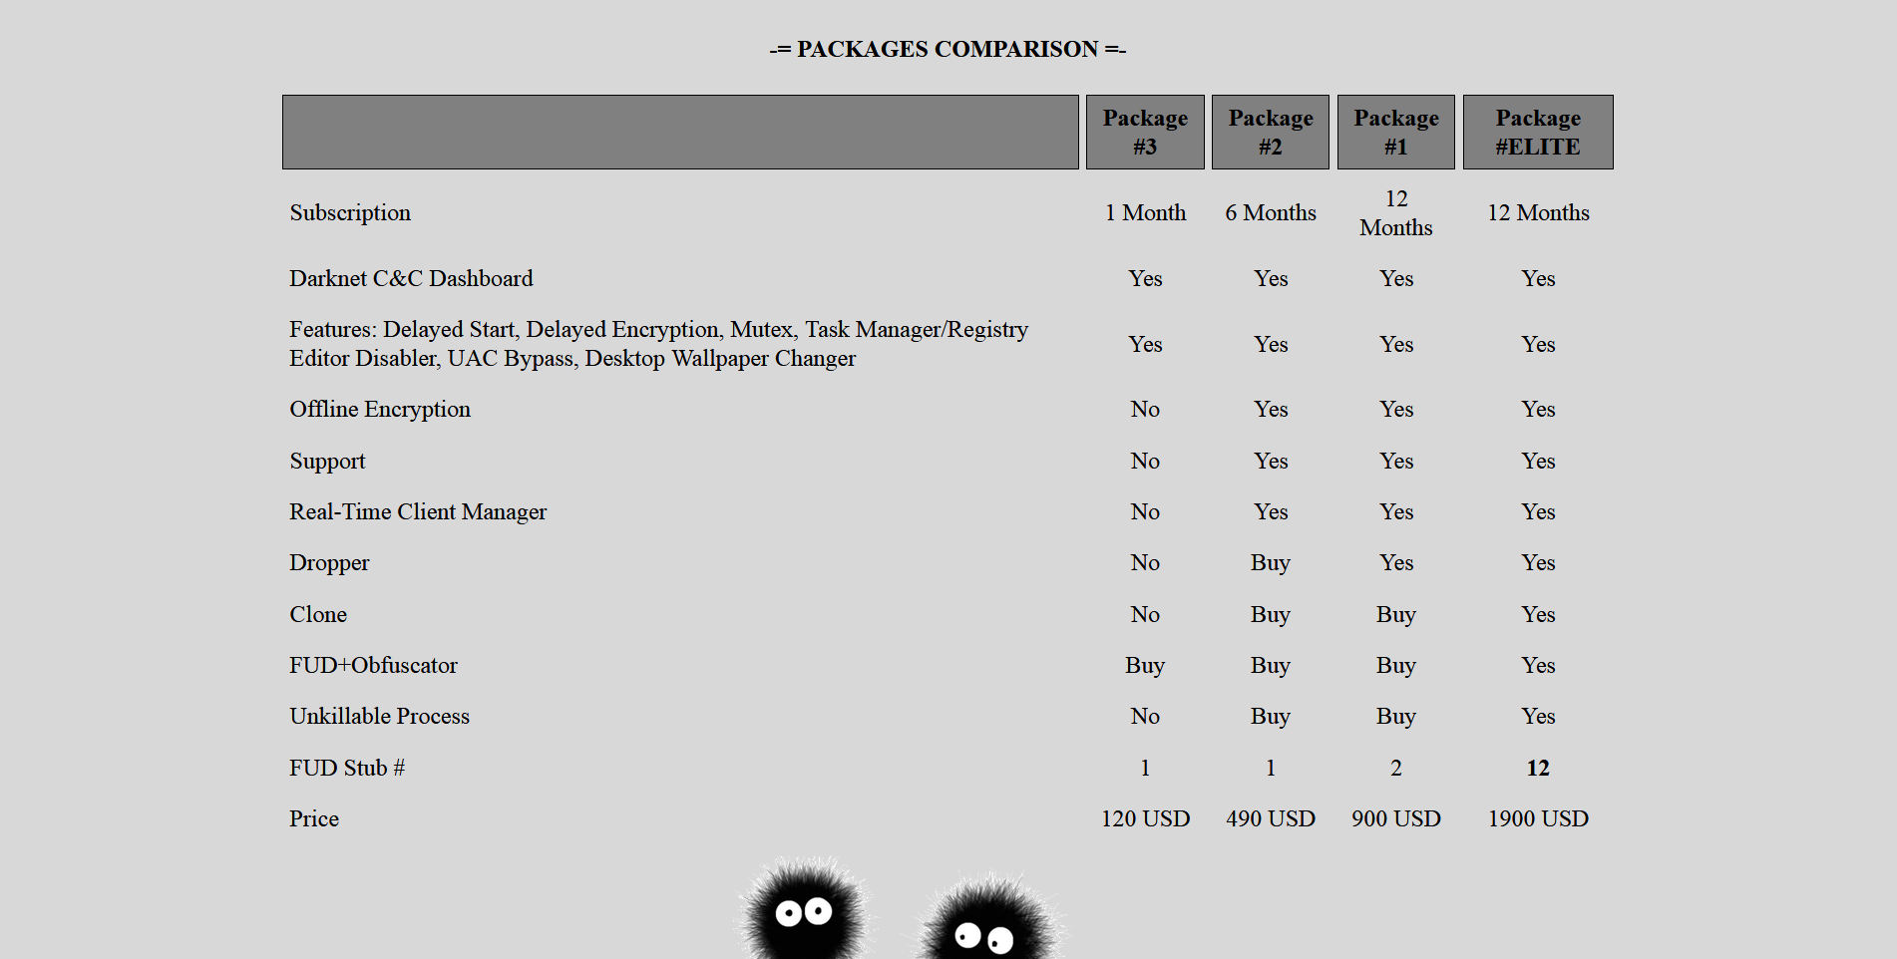

Slide 18
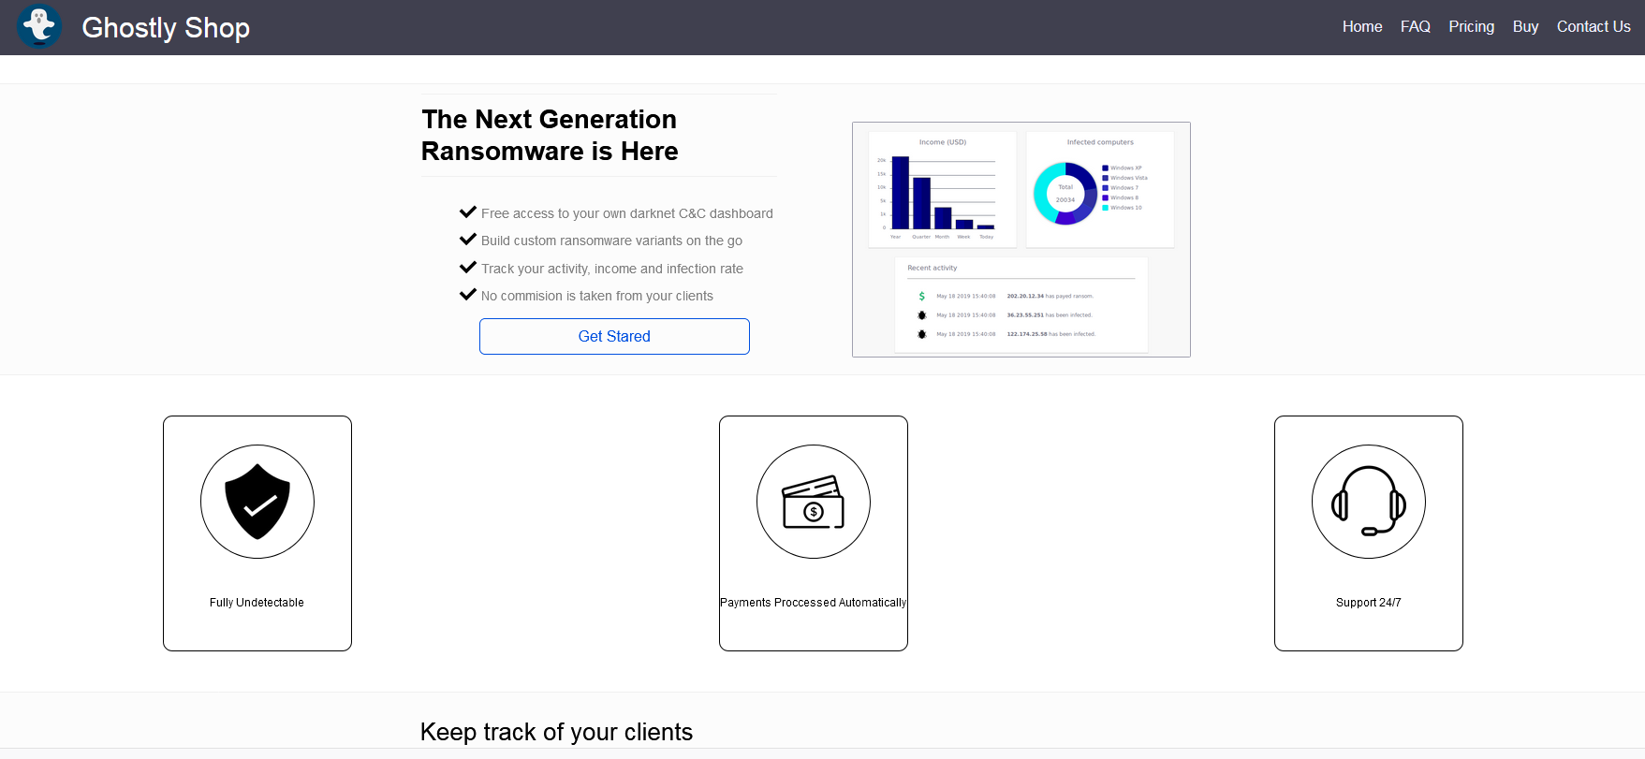

Slide 19
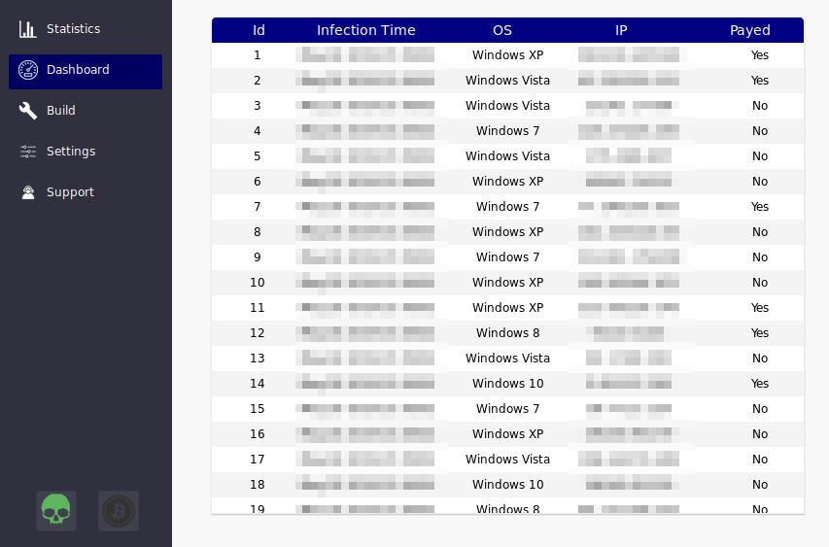
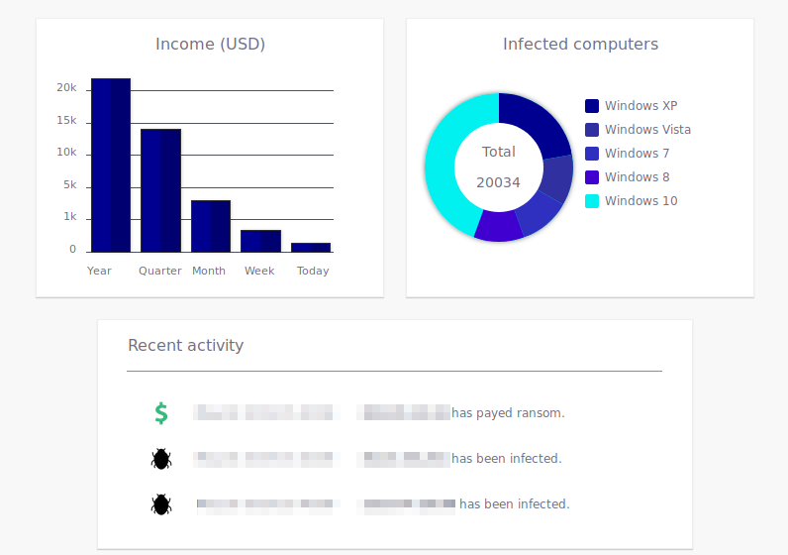

Slide 20
HOW THEY TARGET YOU

Slide 22
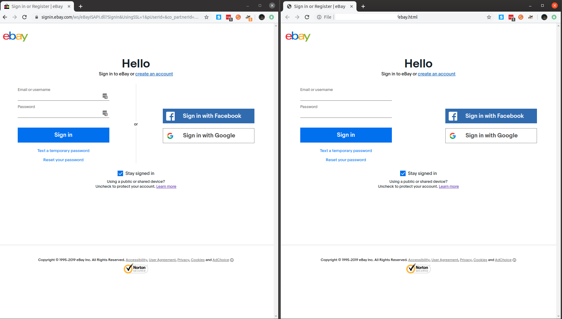

Slide 23
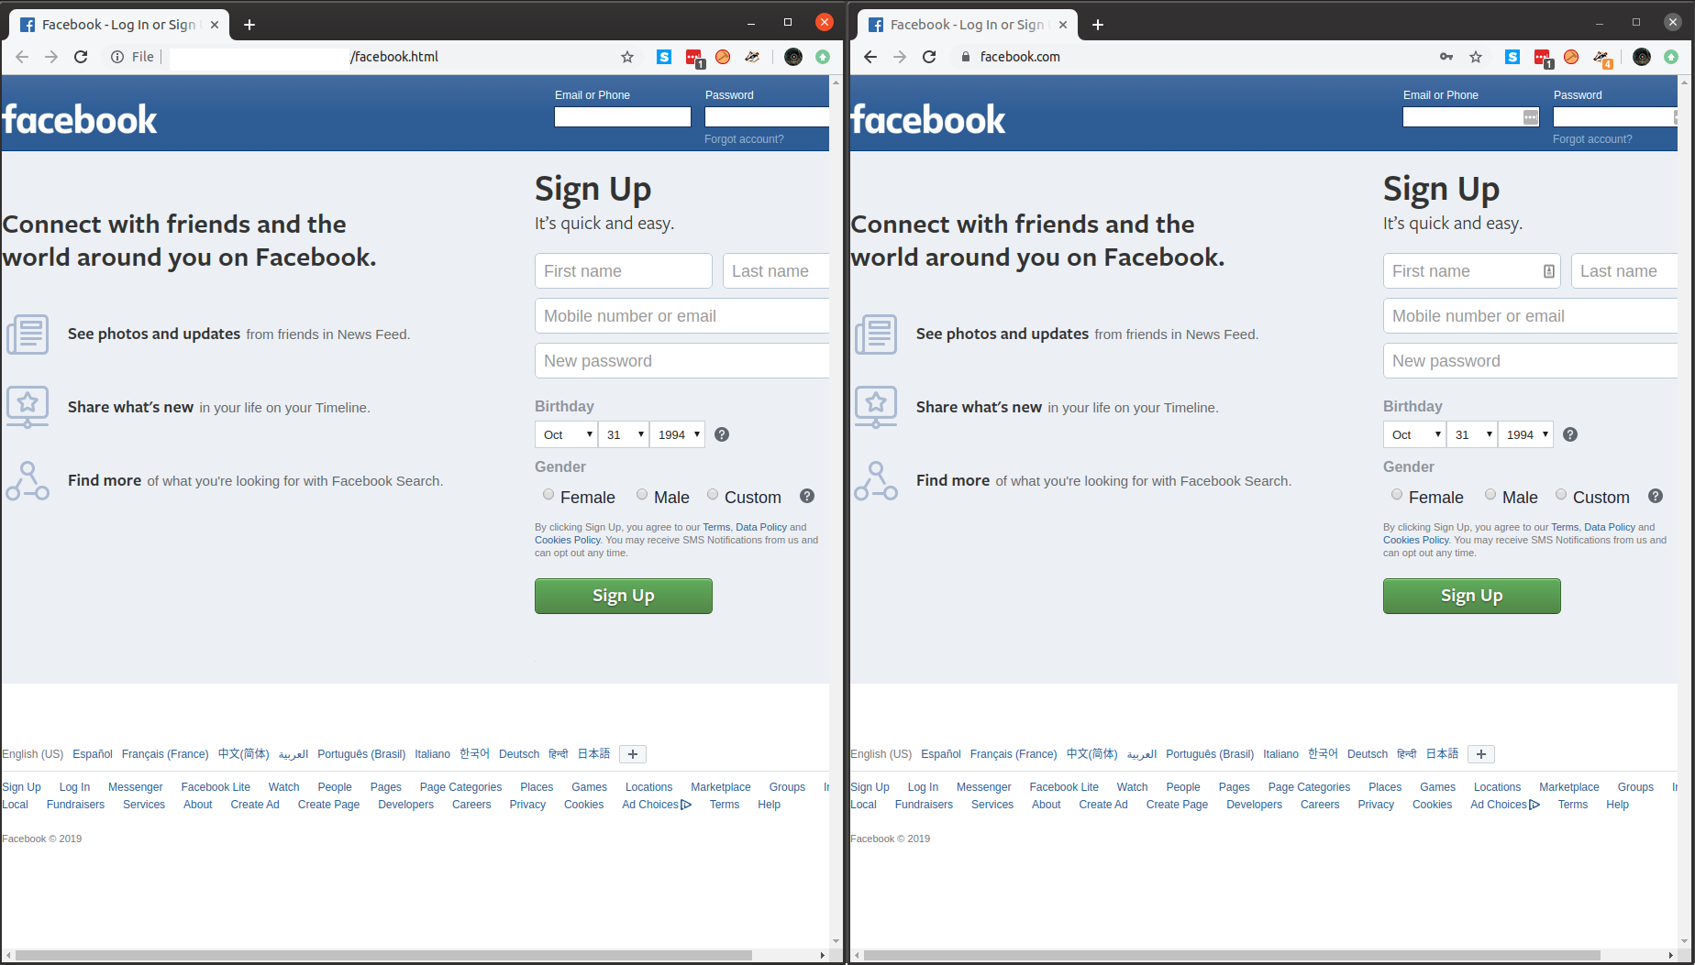

Slide 24
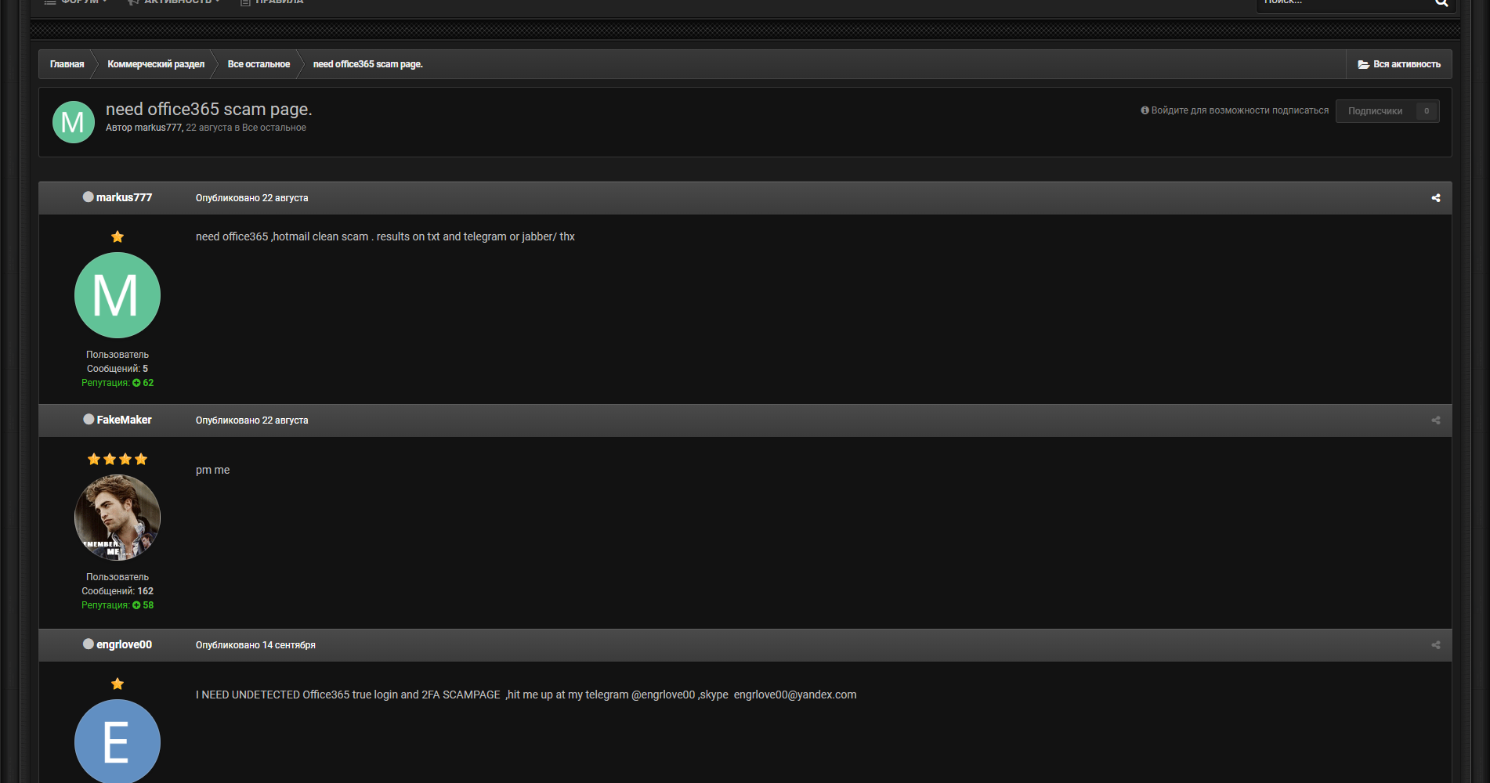
“
need office365 ,hotmail clean scam .
results on txt and telegram or jabber/ thx

Slide 25
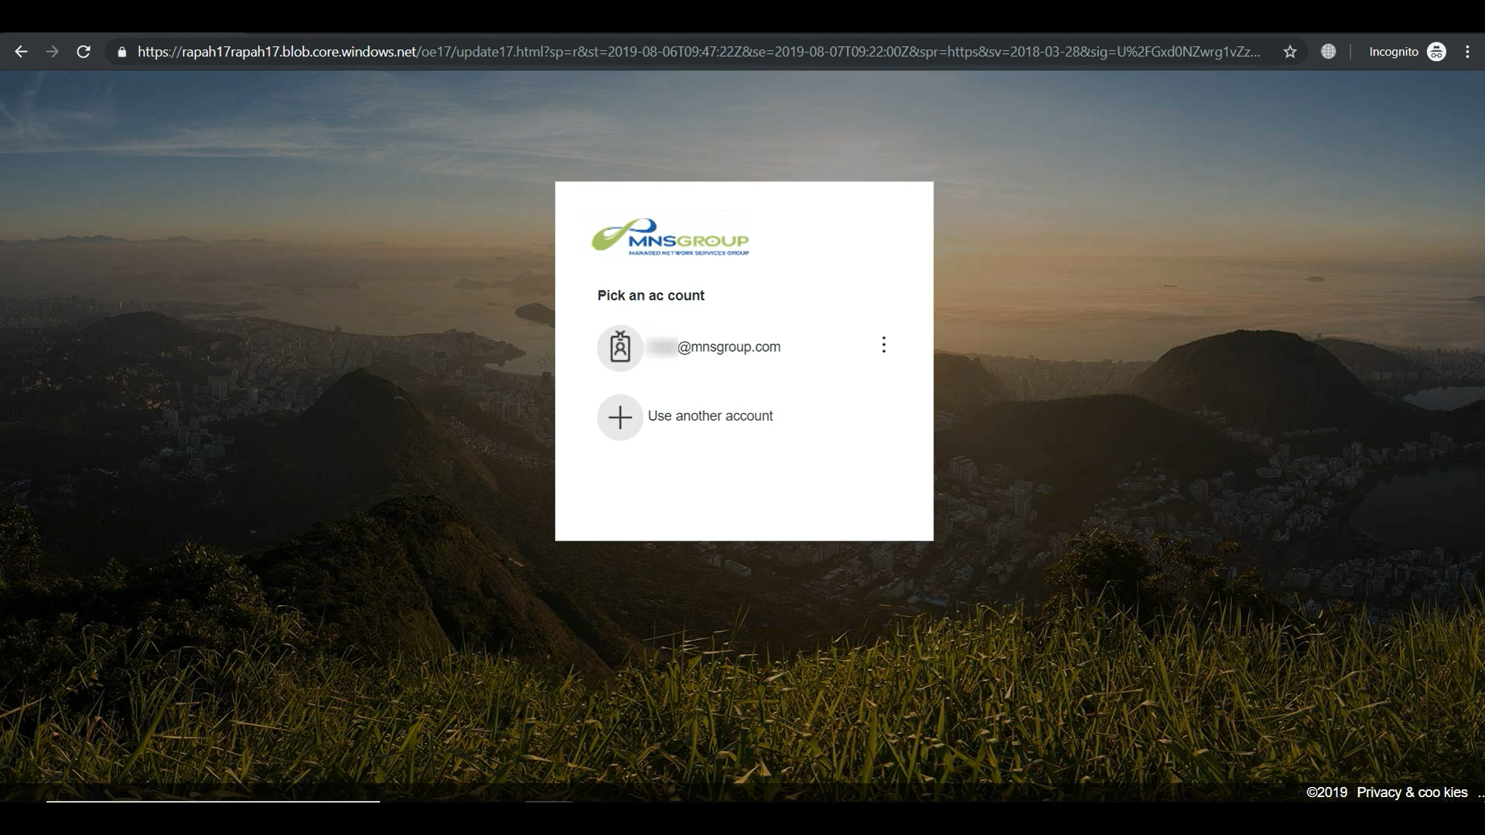

Slide 26
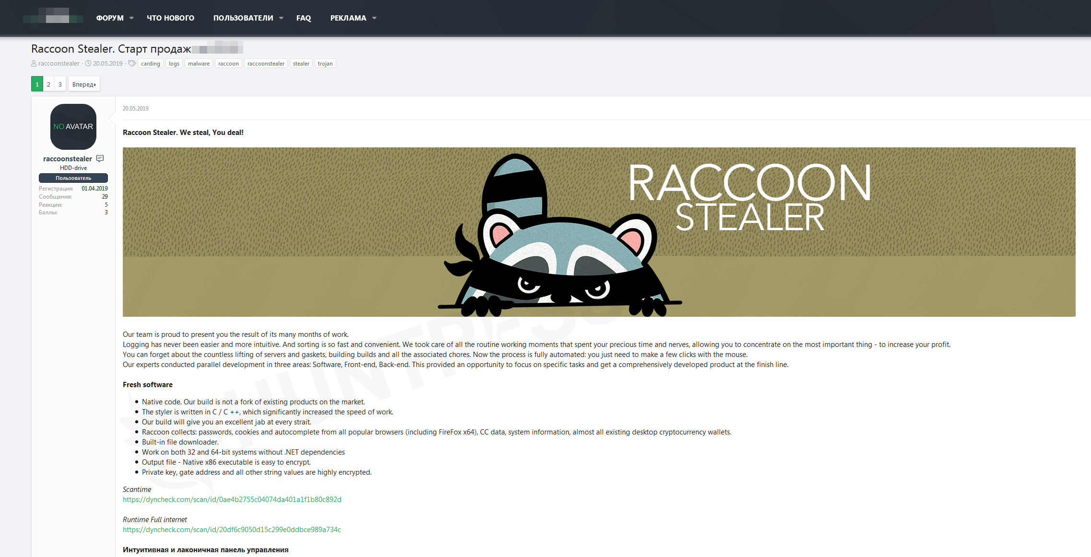

Slide 27
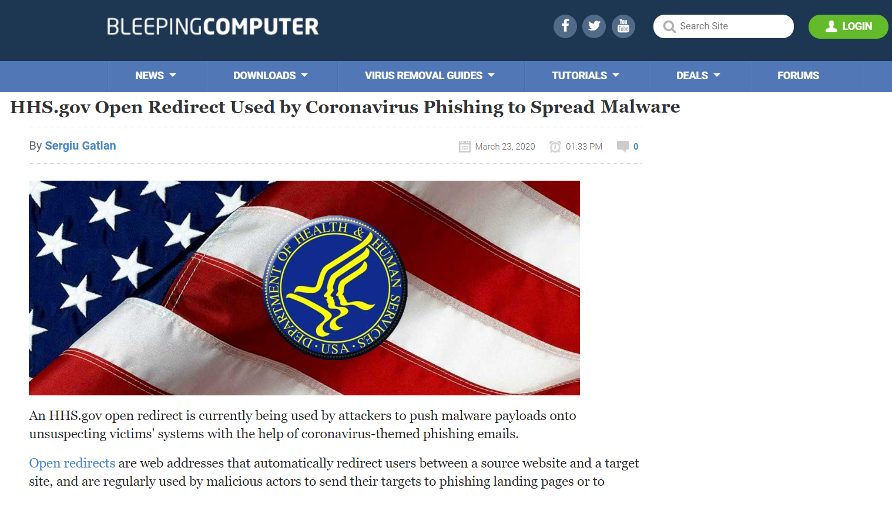
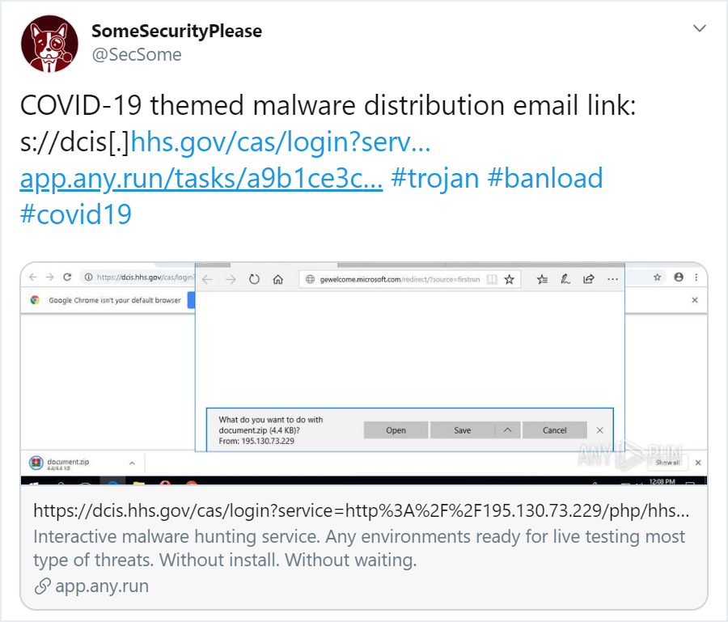

Slide 29
https://dcis.hhs.gov/cas/login?
service=http://195.130.73.229/php/hhs/&gateway=true
https://dcis.hhs.gov/cas/login?
service=http://195.130.73.229/php/hhs/&gateway=true

Slide 30
Open Redirect Vulnerability
Malicious Destination
Open Redirect
Trusted Site
Desired Destination

Slide 33
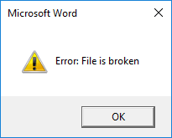
coronavirus.doc

Slide 34
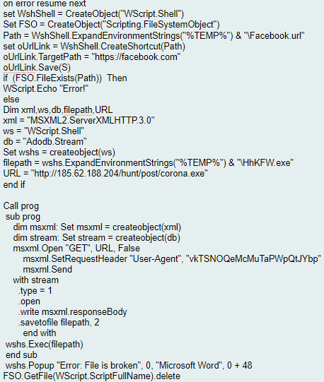

Slide 36
Simple, scalable & profitable
Workflow Integrated | Best-In-Class | Single Monthly Invoice | Powered Services with Goal Assist
Dark Web ID
Phishing Simulation
Multifactor Authentication
BullPhish ID
Business Email Compromise Intelligence
Business Email Compromise Monitoring
Security Awareness Training
Passly ID
Single Sign-On
Password Management
Reduce Security Kit Cost and Vendor Redundancy

Slide 37
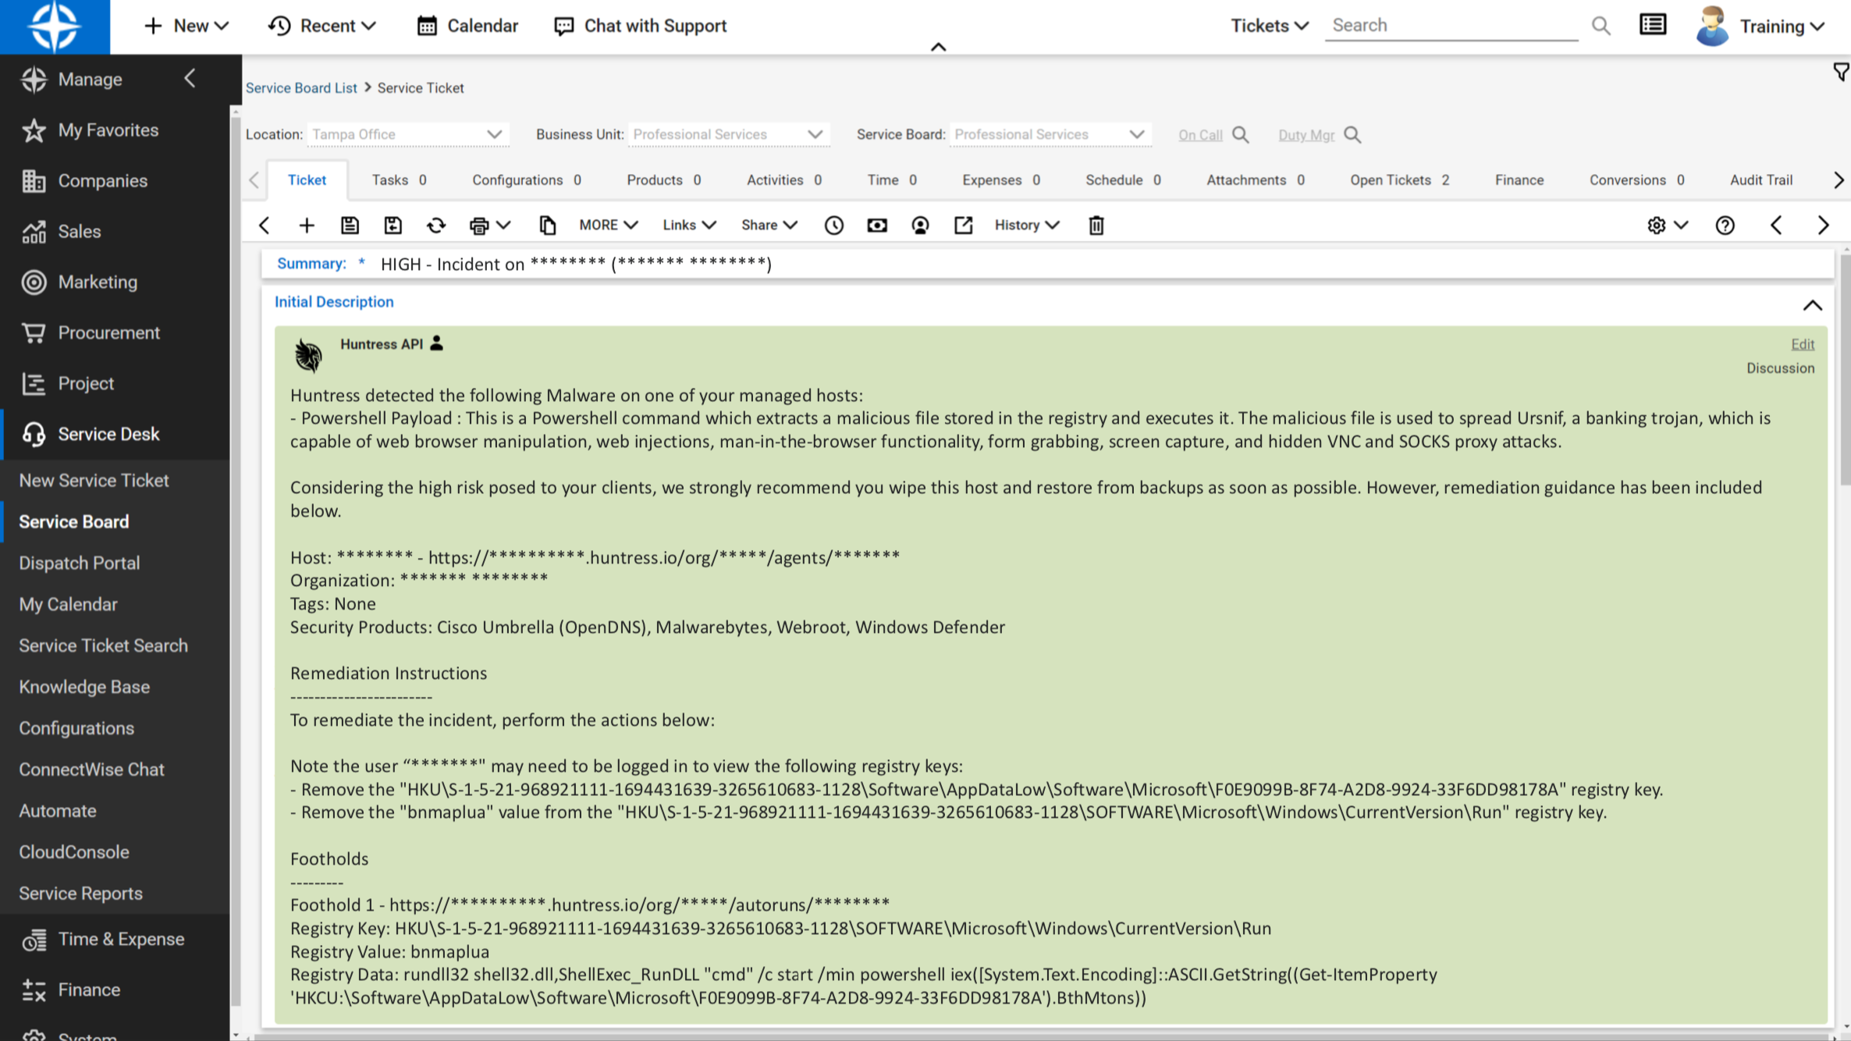
No Security Experience Needed

Slide 38
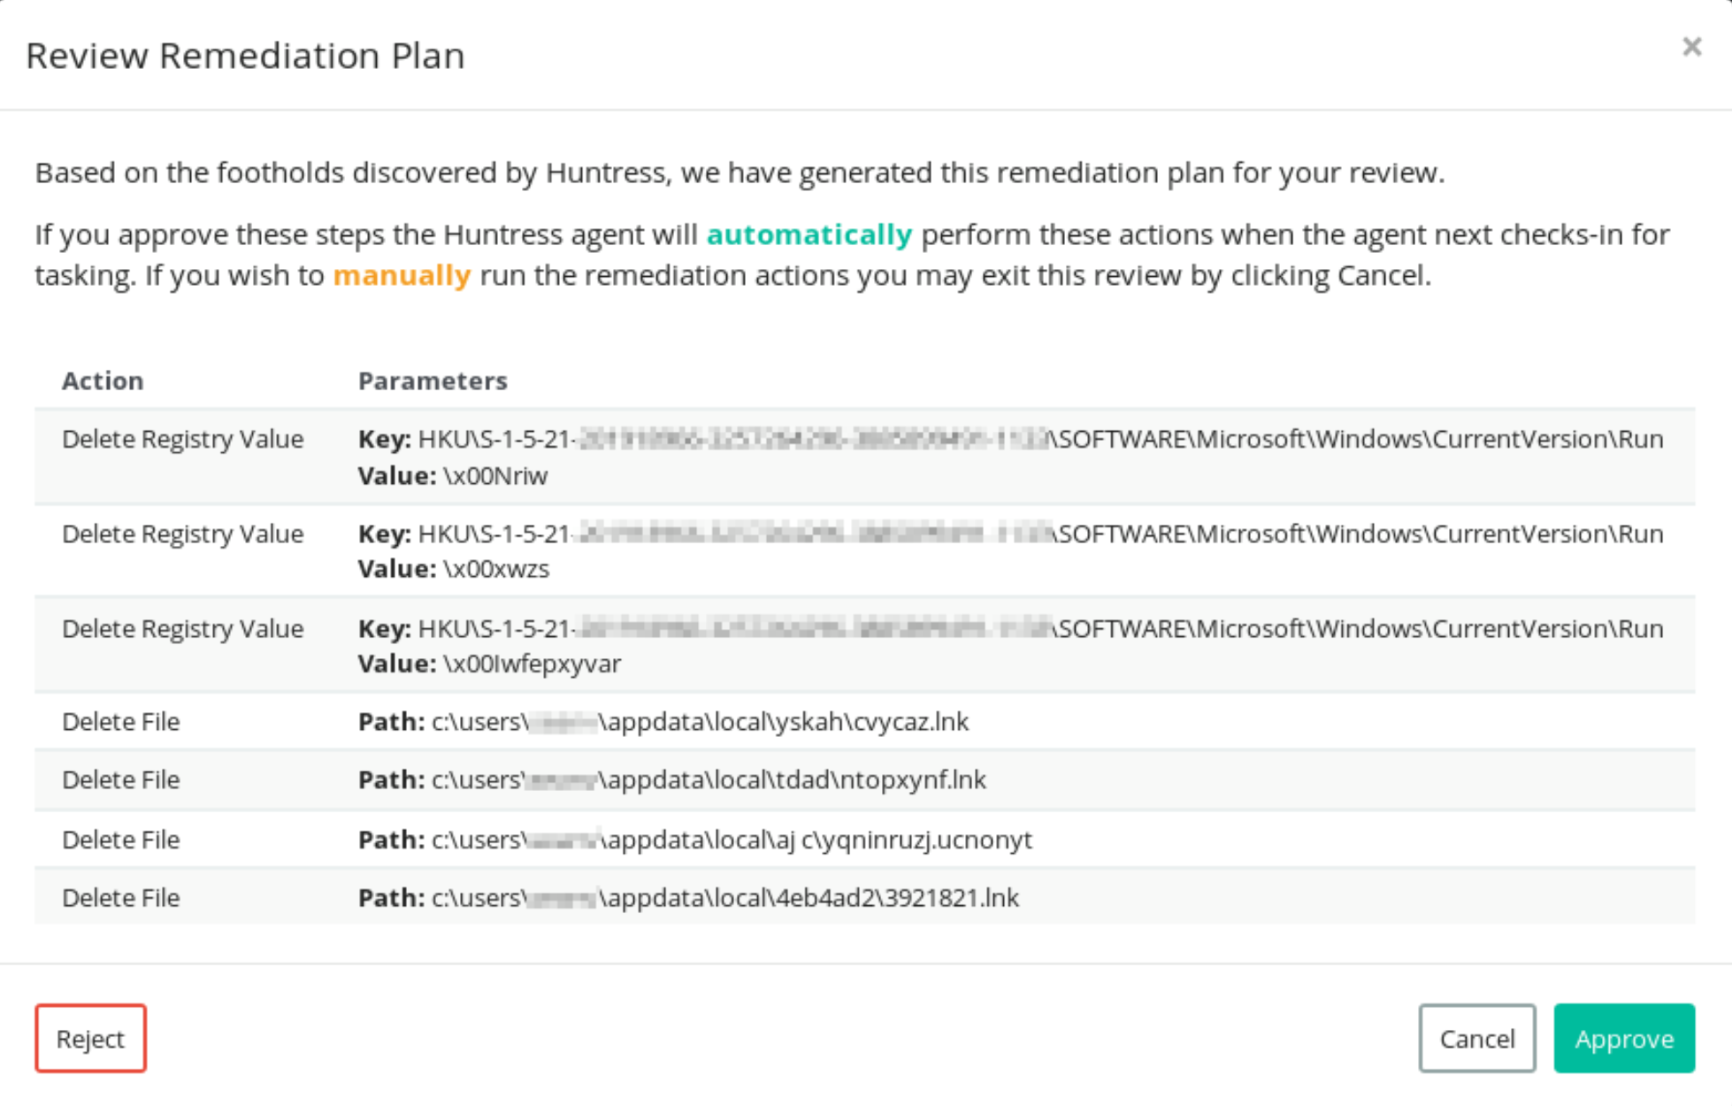
New Feature: Assisted Remediation

Slide 39
Free Educational Resources

Slide 40
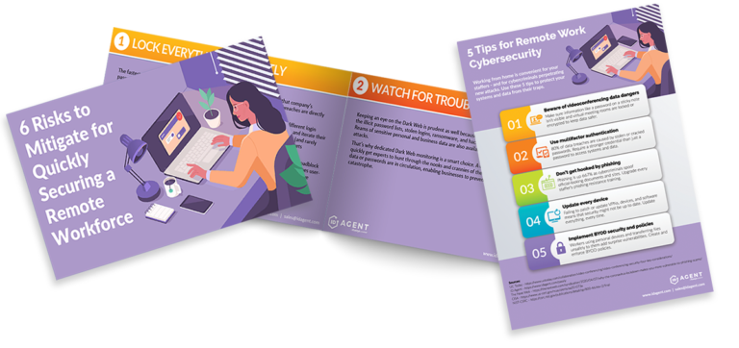
FREE RESOURCES
Social media graphics, infographics, free on-demand webinars and more:
https://www.idagent.com/resources/

Slide 41
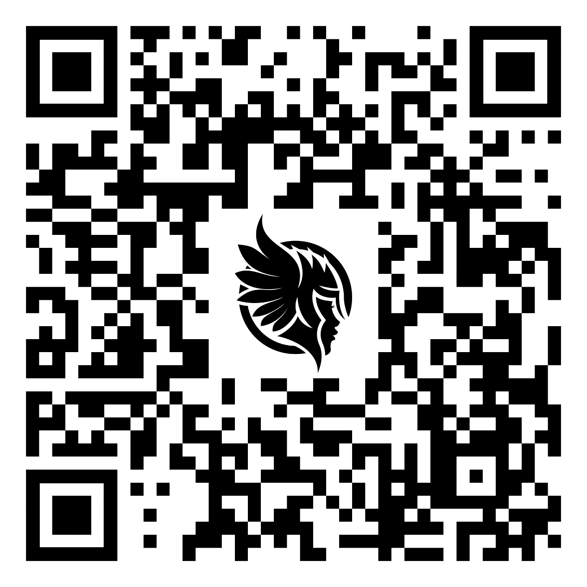
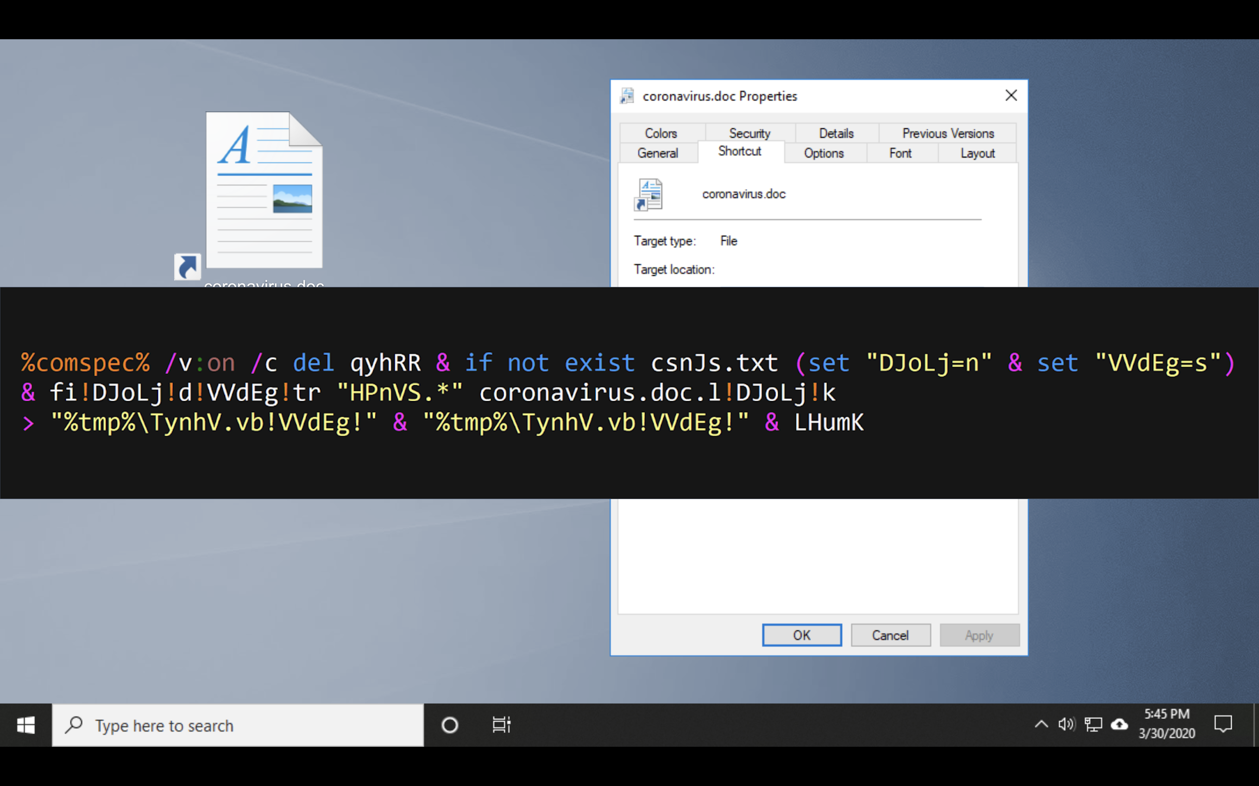
Cybersecurity Educational Materials and Assets
https://cos.huntresslabs.com/covid-19-assets
https://cos.huntresslabs.com/security-assets-and-tools

Slide 42
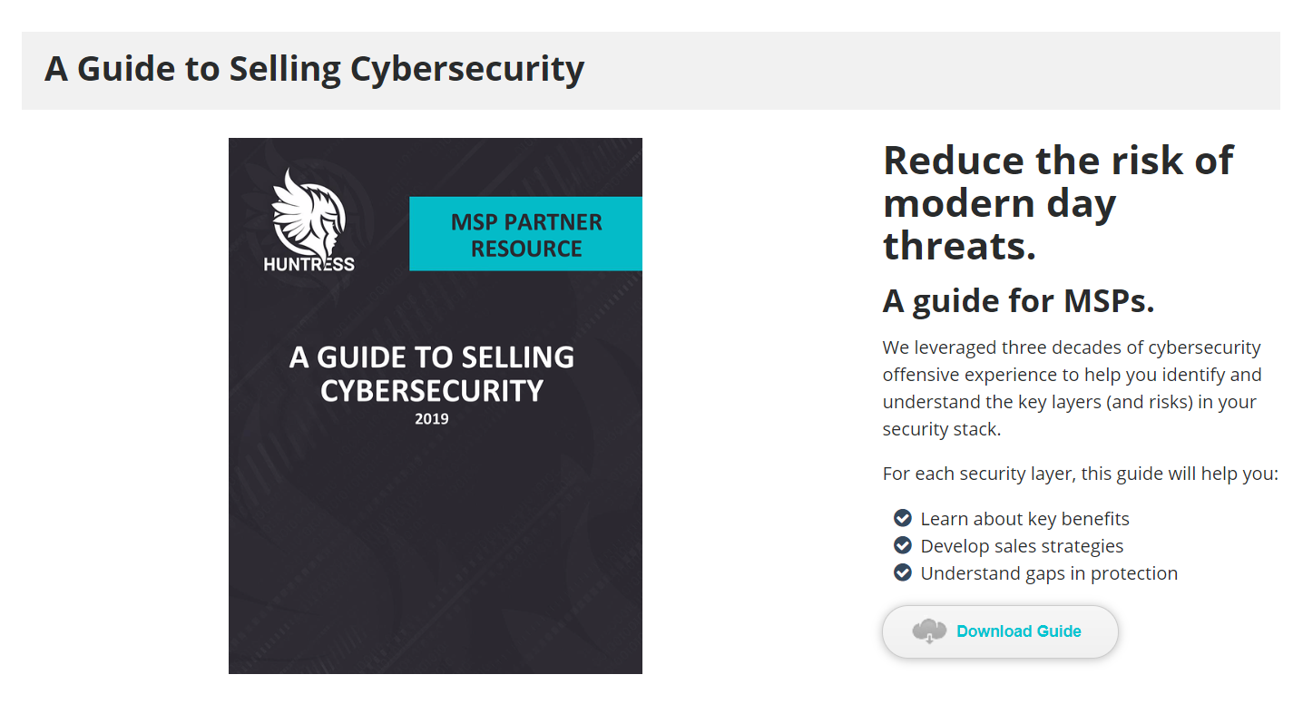
https://cos.huntresslabs.com/
guide-to-selling-cybersecurity

Slide 43
Increase security and Margins
Protect up to 5,000 customers for as little as $0.08/user/month
Security & Awareness Training + Phishing Campaigns
COVID-19 and Remote Work Risk-themed marketing resources free and branded for you in Powered Services
10 free licenses for Passly Digital Risk Protection Platform to protect your own MSP
Deferred payment options available
To order or set up a demo: www.idagent.com/partners

Slide 44
Thank You!
@KyleHanslovan -
1st 3 Breaches/21 Day Free Trial
Unlimited Hosts
https://huntress.io/register
hello@huntress.com
(833) 486-8669 ext. #1

