Slide 1
BUSINESS CASE for why we need
a dedicated insights platform

Slide 2
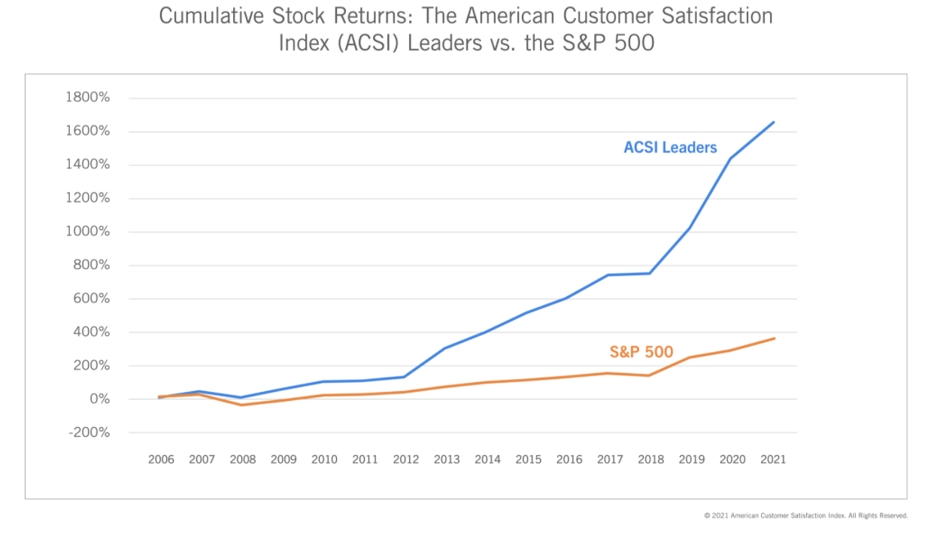
Why do we need a dedicated insights platform?
The traditional approach to uncovering customer insights is no longer enough. It’s outdated, expensive and inefficient.
The result?
Revenue growth stalls
Competitors win market share at our expense due to poor CX
Organizations that take care of their customers perform better than the S&P 500 average (ACSI)

Slide 3
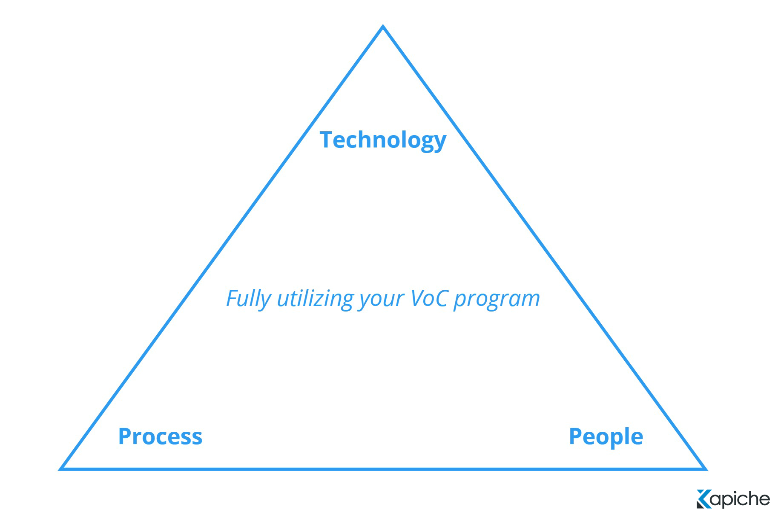
We don’t have the capability to turn what customers are saying about us into meaningful action; technology can bridge this gap.

Slide 4
Key problems we need to solve right now with technology
NPS/CSAT is down but we have no idea why
We’re losing market share to competitors but don’t really know why
Customer churn rates are up but we don’t understand why this is happening and what can be done to prevent it
Our CX initiatives aren’t resonating with customers
Tangible benefits solved by Kapiche
Cost savings
Improve CX
Revenue growth
Reduce time-to-insights
Reduced dependency on manual processes
Contextual insights from every channel
Financial ROI
Non-financial ROI

Slide 5
The case for improving CX
Stronger revenue growth
Brands with superior customer experience bring in 5.7X more revenue than competitors that lag in customer experience.
Higher lifetime value
Loyal customers are 5X more likely to purchase again and four times more likely to refer a friend to the company
Reduced service costs
Offering a high-quality customer experience can reduce the cost of serving customers by up to 33%

Slide 6
ROI of Kapiche
ROI from improved time savings with Kapiche
Projected growth if CX is improved
Current monthly cost (without Kapiche) | $ -
New monthly cost (with Kapiche) | $ -
Cost reduction | X %
Revenue growth | $ -
Lifetime value | $ -
Service delivery cost reduction | $ -
Return on investment = ____X
Return on investment = ____X

