Slide 1
MyChoice® Mobile App
User Instructions

Slide 2
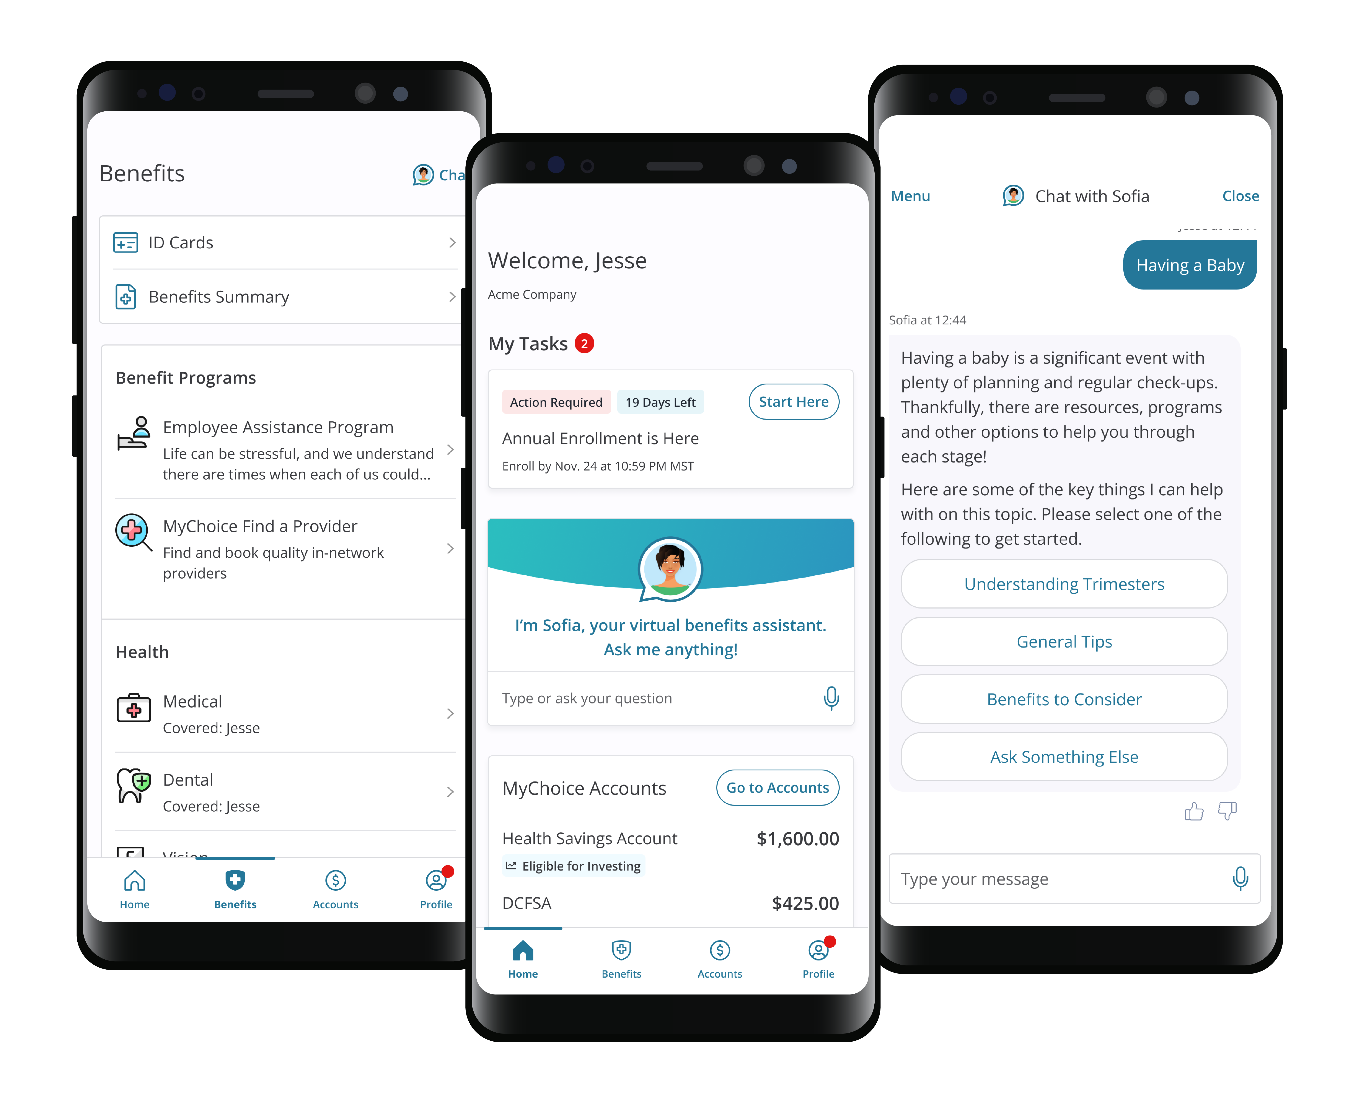
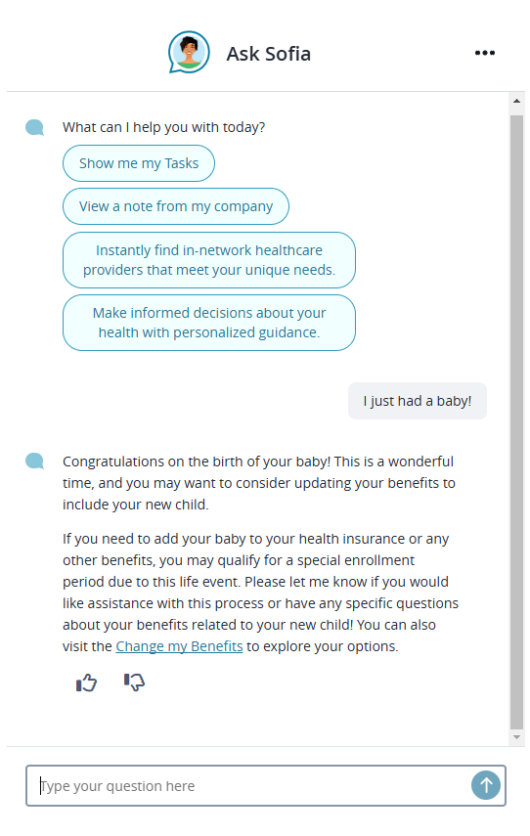
Providing you access to your benefits when and where you need it.
Available on iOS and Android*
*For best results, we recommend using the most current operating system. This app may not run effectively on outdated versions.

Slide 3
Key Features
YOUR ELECTIONS – View your current (and future) benefits elections including medical, dental, vision, savings accounts, and voluntary benefits.
CHANGE YOUR BENEFITS – Simple buttons direct you to the mobile-optimized site to change your benefits when eligible.
REVIEW DEPENDENTS & BENEFICIARIES – View your listed primary and contingent beneficiaries, as well as covered dependents.
ID CARDS – Keep your ID cards (even custom cards) at your fingertips by storing them in the App.
MESSAGES – Stay on top of important deadlines, send and receive important documentation in regards to your benefits, such as dependent verification information and Evidence of Insurability.
CONTACT INFO – Easily contact a representative or Sofia for questions about your benefits, benefits enrollment, life events, and required documentation.
ACCOUNTS – Manage your MyChoice Account balances, request reimbursement, request new cards and more.

Slide 4
Accessing the MyChoice®
Mobile App

Slide 5
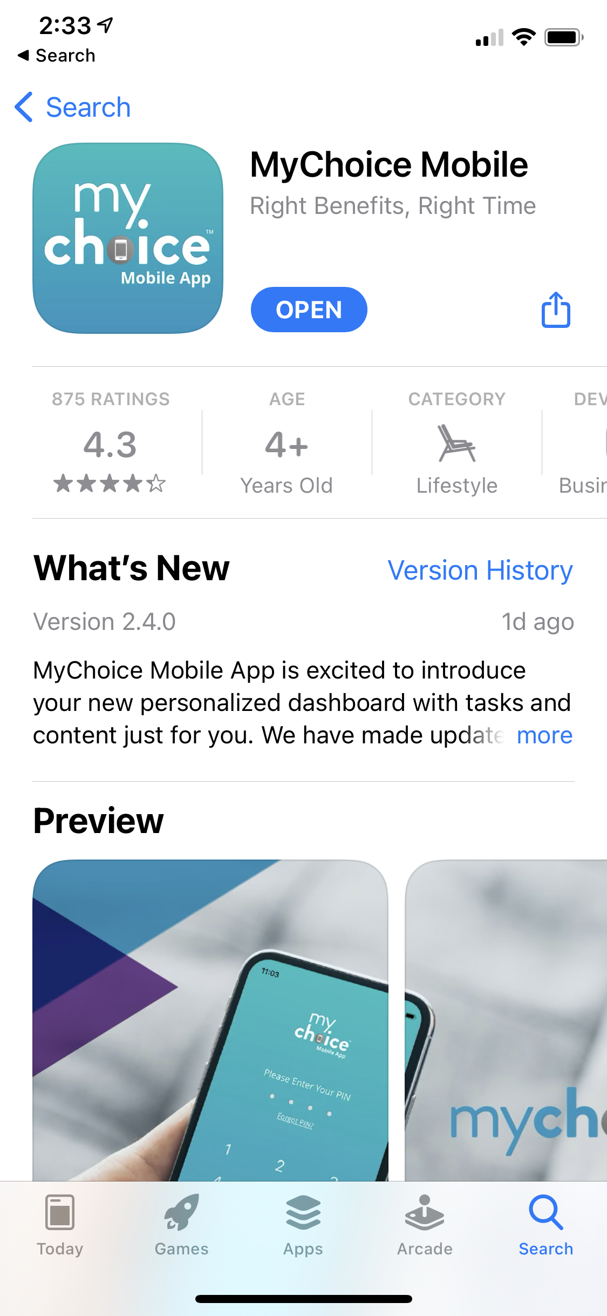
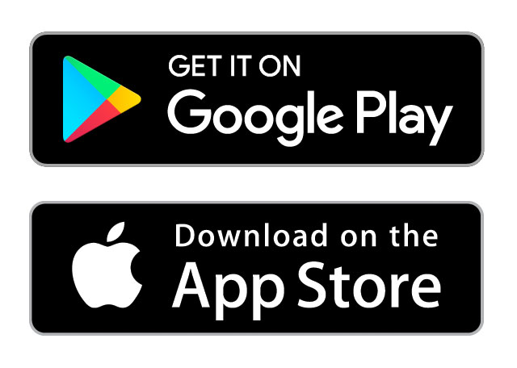
Getting Started
Step 1:
Download MyChoice Mobile from the applicable store, either Google Play or the App Store, depending upon your mobile device.
DOWNLOAD THE APP FROM YOUR DEVICE’S APP STORE
IT LOOKS LIKE THIS

Slide 6
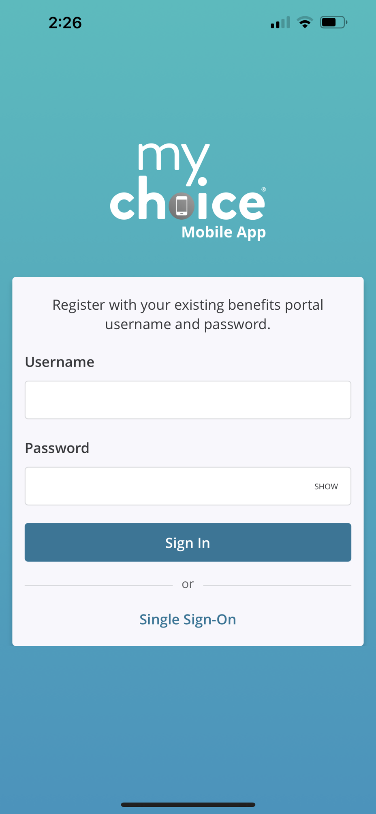
Getting Started
Step 2:
Launch the app on your device and input your benefit portal username and password. If you don’t have a username and password, tap “Single Sign-On” at the bottom of the screen to see directions for using a QR Code or Access Code (page 10).

Slide 7
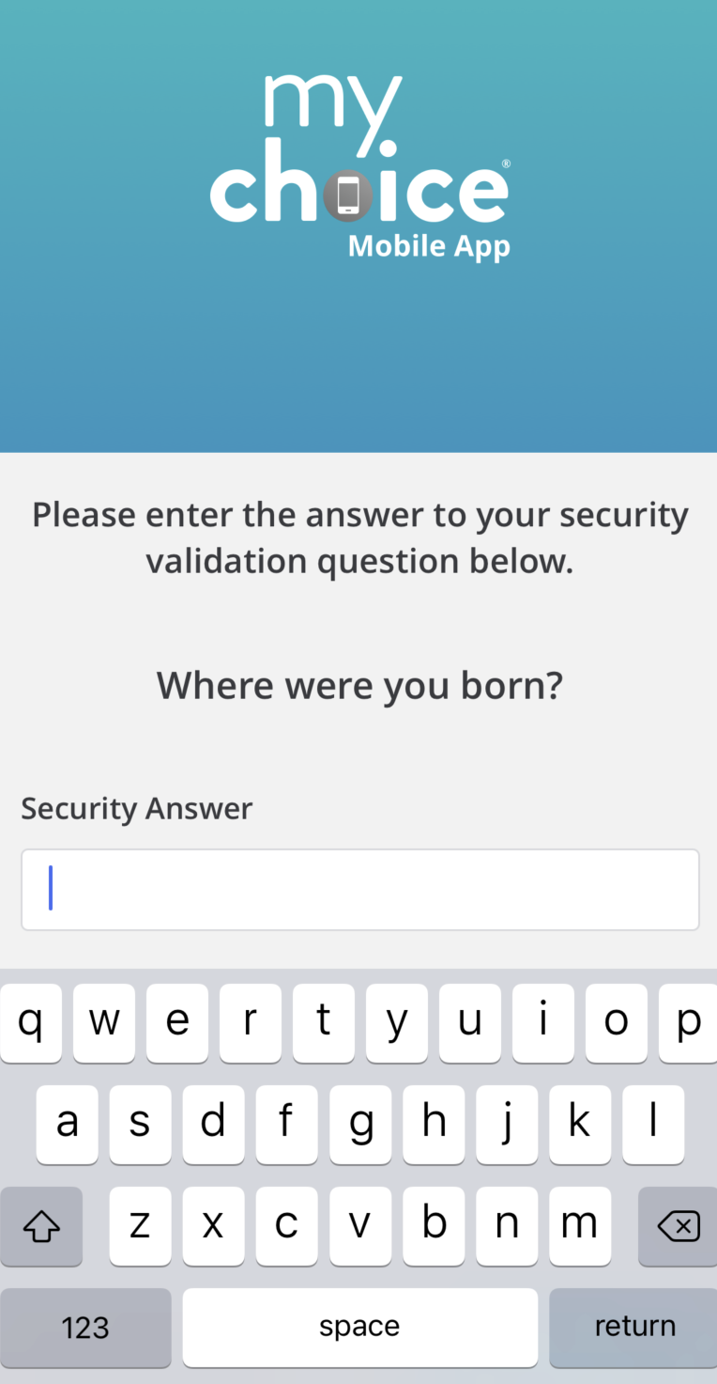
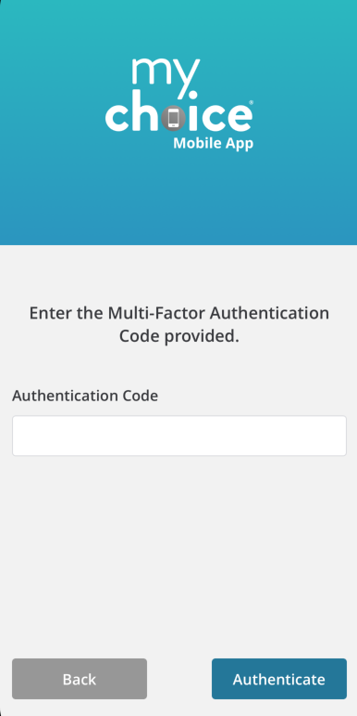
Getting Started
Step 3:
You may be prompted to answer one of the security questions you selected in your profile or to enter a code for Multi-factor Authentication (MFA).

Slide 8
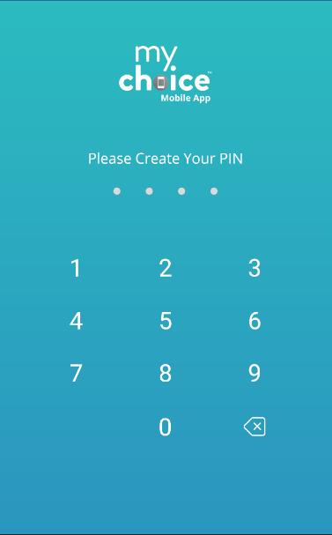
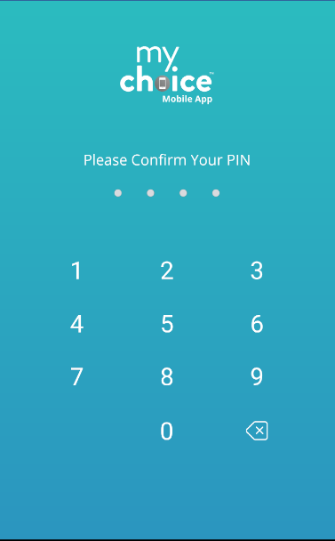
Getting Started
Step 4:
Following acceptance of the Terms and Conditions, you will create, and confirm, the PIN of your choice. Use your PIN to access the app going forward. If you forget your PIN, tap “Forgot PIN?” when you enter the app for assistance.

Slide 9
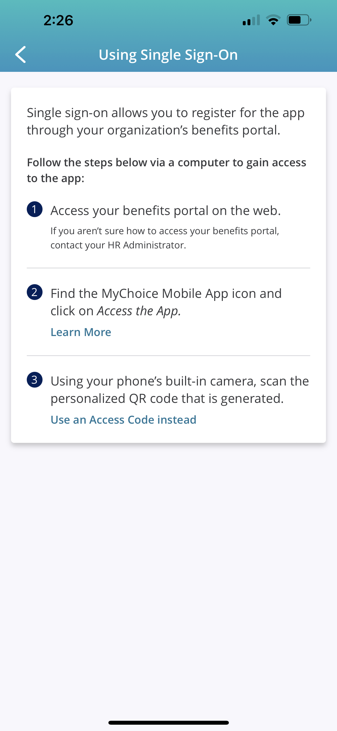
Getting Started
Using a QR Code or Access Code
In the app, tap “Single Sign-On” at the bottom of the screen to see directions for retrieving a personalized QR code or access code.

Slide 10
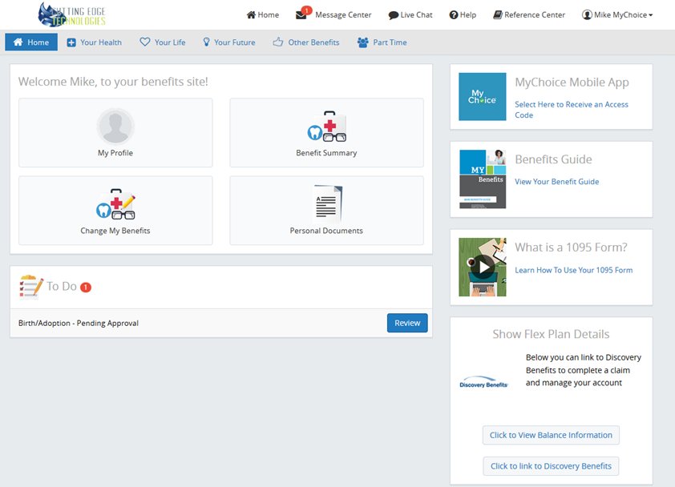
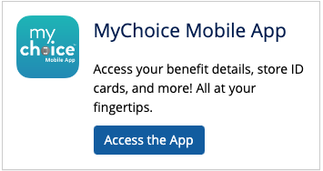
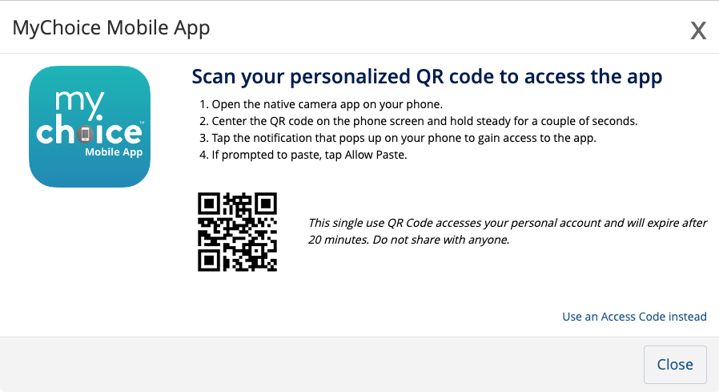
Getting Started
Using a QR Code or Access Code
As the directions show, you must log in to your benefits portal account and click the “Access the App” button in the MyChoice Mobile App section of your home page. The page will open displaying a personalized QR Code. An Access Code is also available if needed by clicking “Use an Access Code Instead” in the bottom righthand corner
CLICK HERE
SCAN WITH PHONE CAMERA FOR INSTANT ACCESS
RECEIVE CODE HERE IF NEEDED

Slide 11
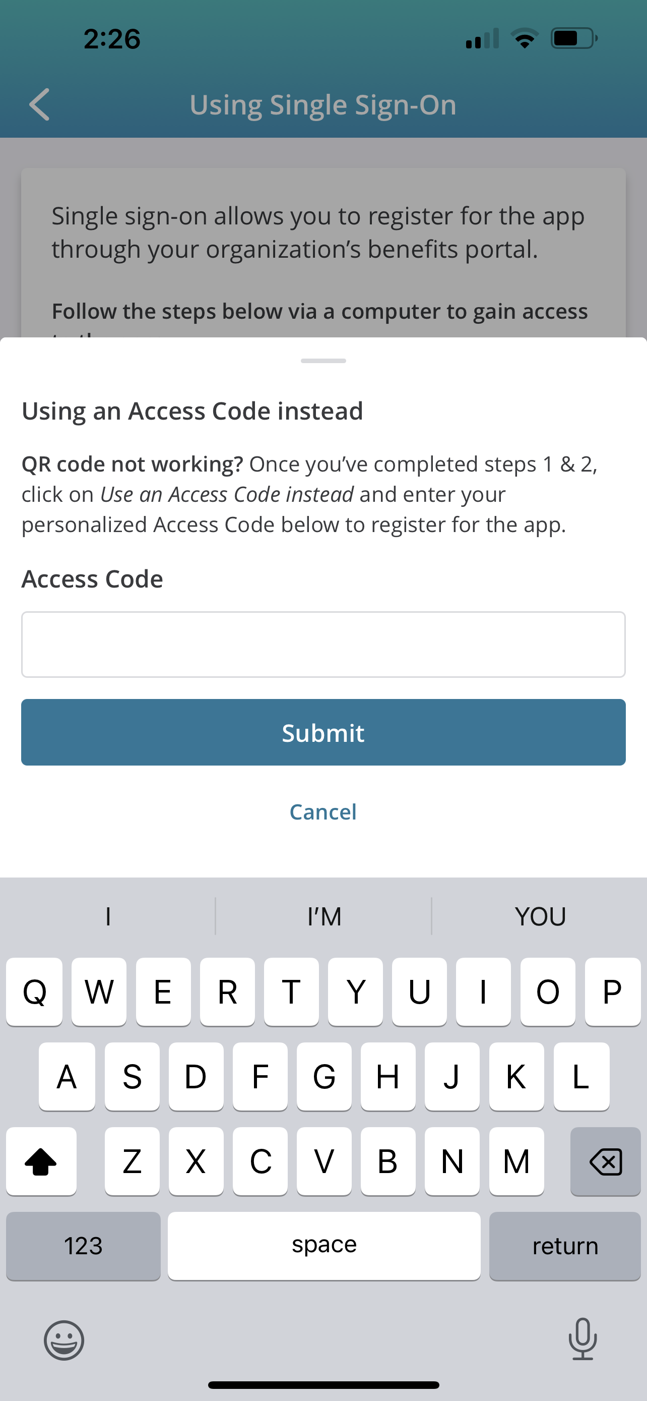
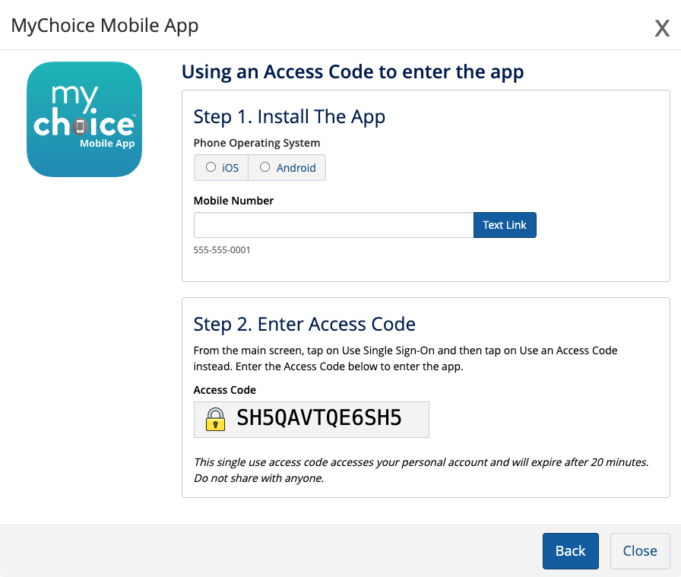
Getting Started
Using a QR Code or Access Code
If choosing to use the Access Code instead of the QR Code, click “Use an Access Code Instead” on the web and enter the code under step 3 in the app.

Slide 12
Getting Started
Entering the App
Following acceptance of the Terms and Conditions, you will create, and confirm, the PIN of your choice. Use your PIN to access the app going forward. If you forget your PIN, tap “Forgot PIN?” when you enter the app for assistance.

Slide 13
Features of the MyChoice®
Mobile App

Slide 14
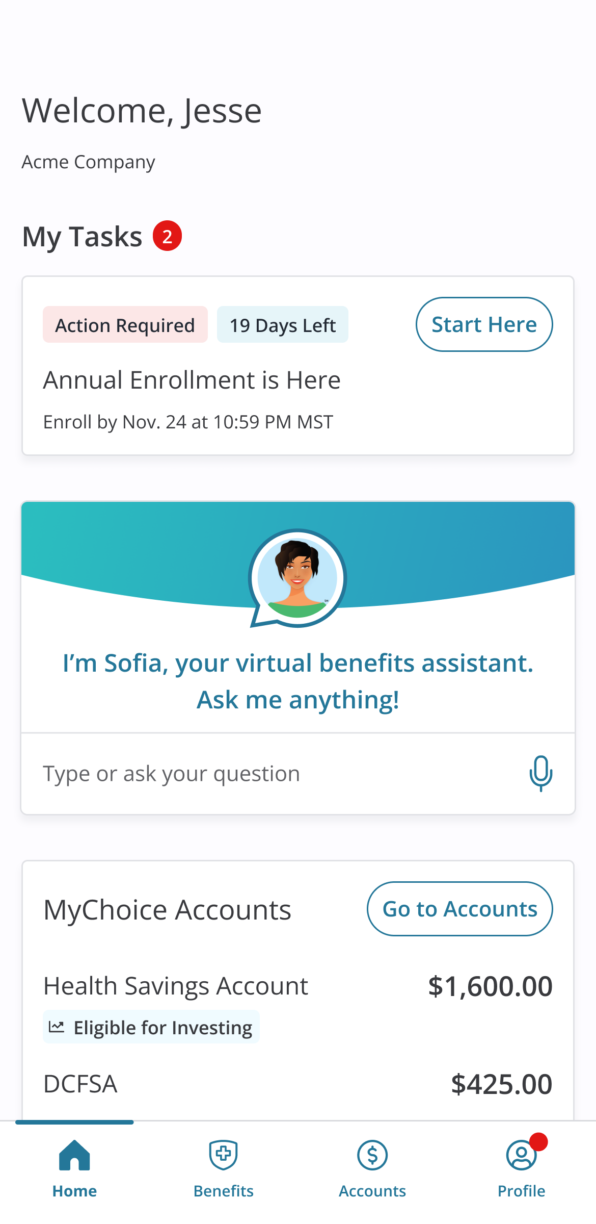
Home
Consider this your homepage dashboard with quick access to your actionable items.
Action Needed
Review items that require your action.
Sofia
Easily access Sofia to get answers to your questions
Accounts
Quick access to your MyChoice Account balances.

Slide 15
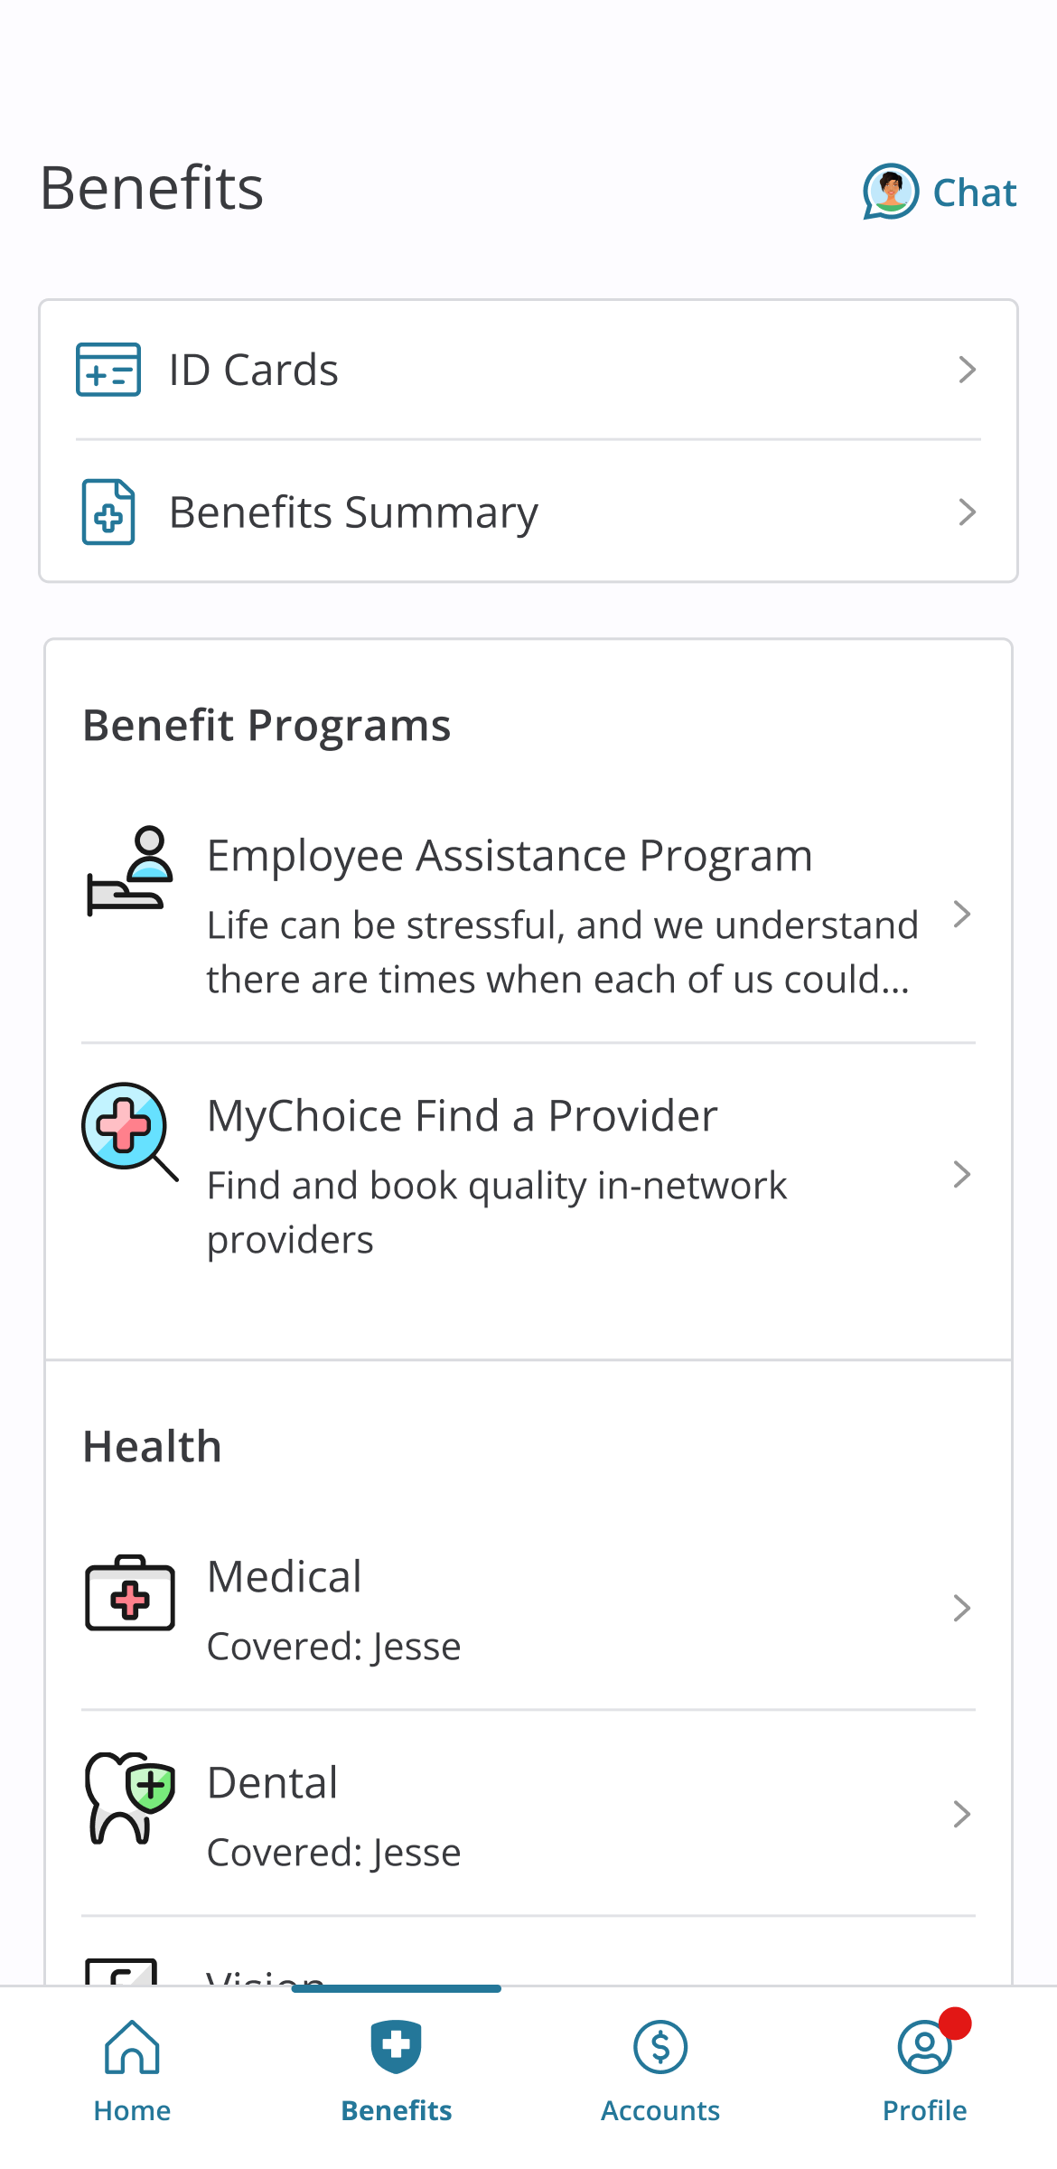
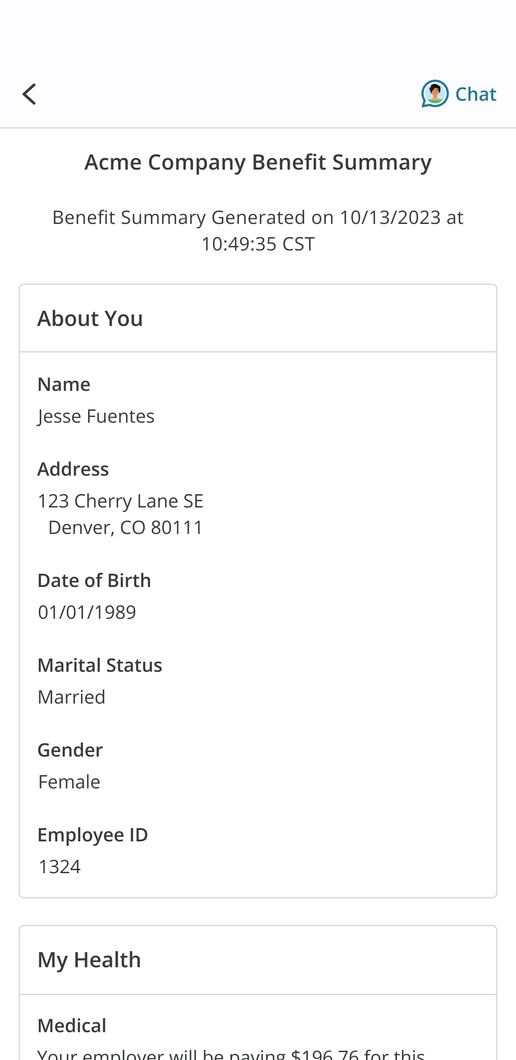
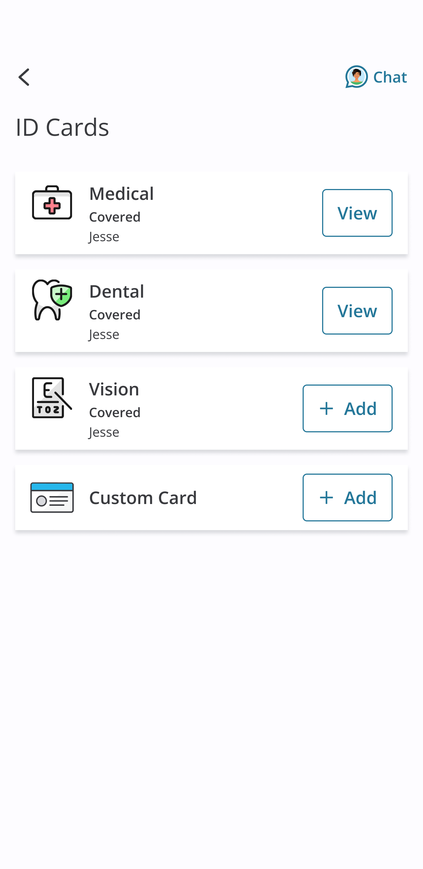
Benefits
From the Benefits menu, you can review your electable and non-electable programs, view ID cards and check out your Benefit Summary.
ID Cards
Upload and manage your ID cards for all benefits
Benefits Summary
Quick access to your full benefits summary
Benefits List
Review you all the benefits you have access to. Click in to each benefit to learn more!

Slide 16
ID Cards
The App allows you to save a photo of your ID cards, including custom cards, on your device and store it for easy access.
How to store your ID cards:
Place ID card on a neutral, well-lit background.
Tap “ID Cards”.
Tap “Add Card” next to the desired plan or custom card.
Tap “Continue”.
Tap “Take/Select Photo” button to open your device’s camera and snap a photo.
Tap “Save”.
Tap “Back” to repeat the process for the back of the card.

Slide 17
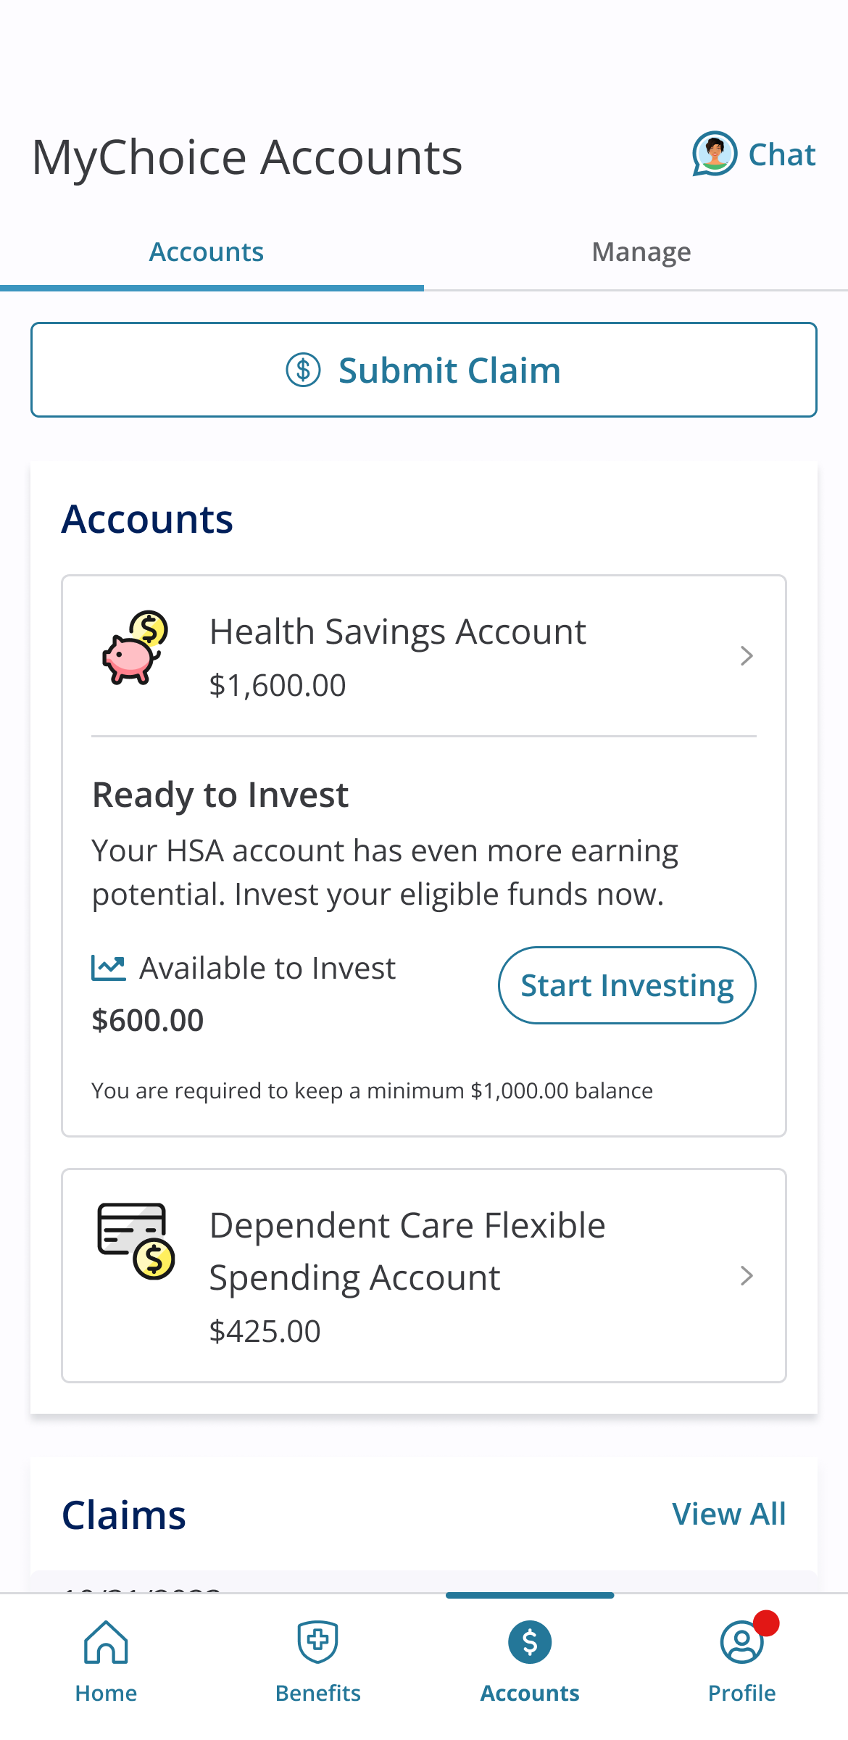
Accounts
Easily manage all details of your MyChoice Account for simplified access to your dollars on the go.
Submit Claim
Request a reimbursement for a recent claim
Accounts
Quick access to the key details of your account and balance
Manage
Request a new card, add or remove a bank account and more.

Slide 18
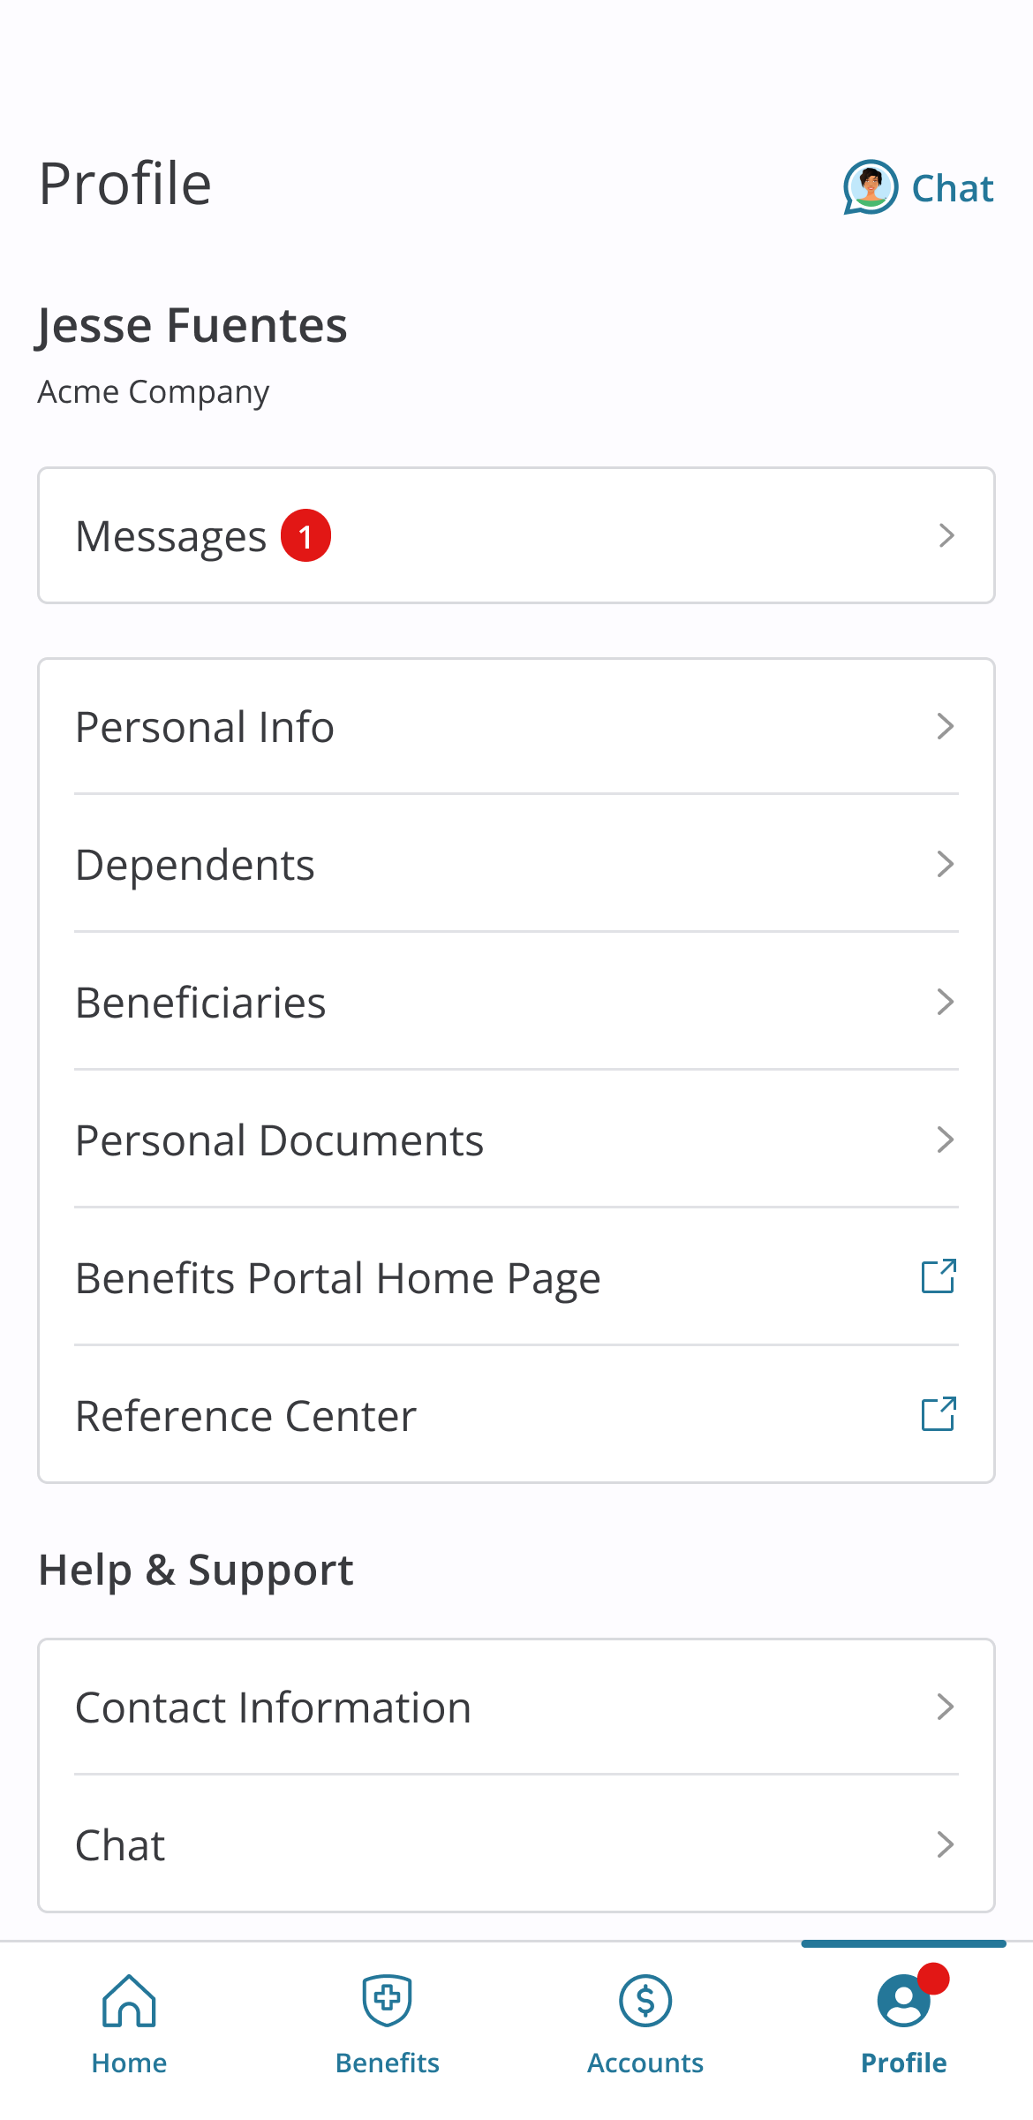
Profile
Review your profile to see dependents, beneficiaries, contact information, login settings and more!
Messages
Quickly check your messages for key notifications.
Personal Info
Review personal information such as date of birth, email and address.
Dependents
Find all listed dependents on your account and applicable benefits.
Beneficiaries
Review your beneficiaries for each applicable coverage.
Benefits Portal Home & Reference Center
Both options will launch you into the mobile optimized browser to review the portal home page or library of documents.

Slide 19
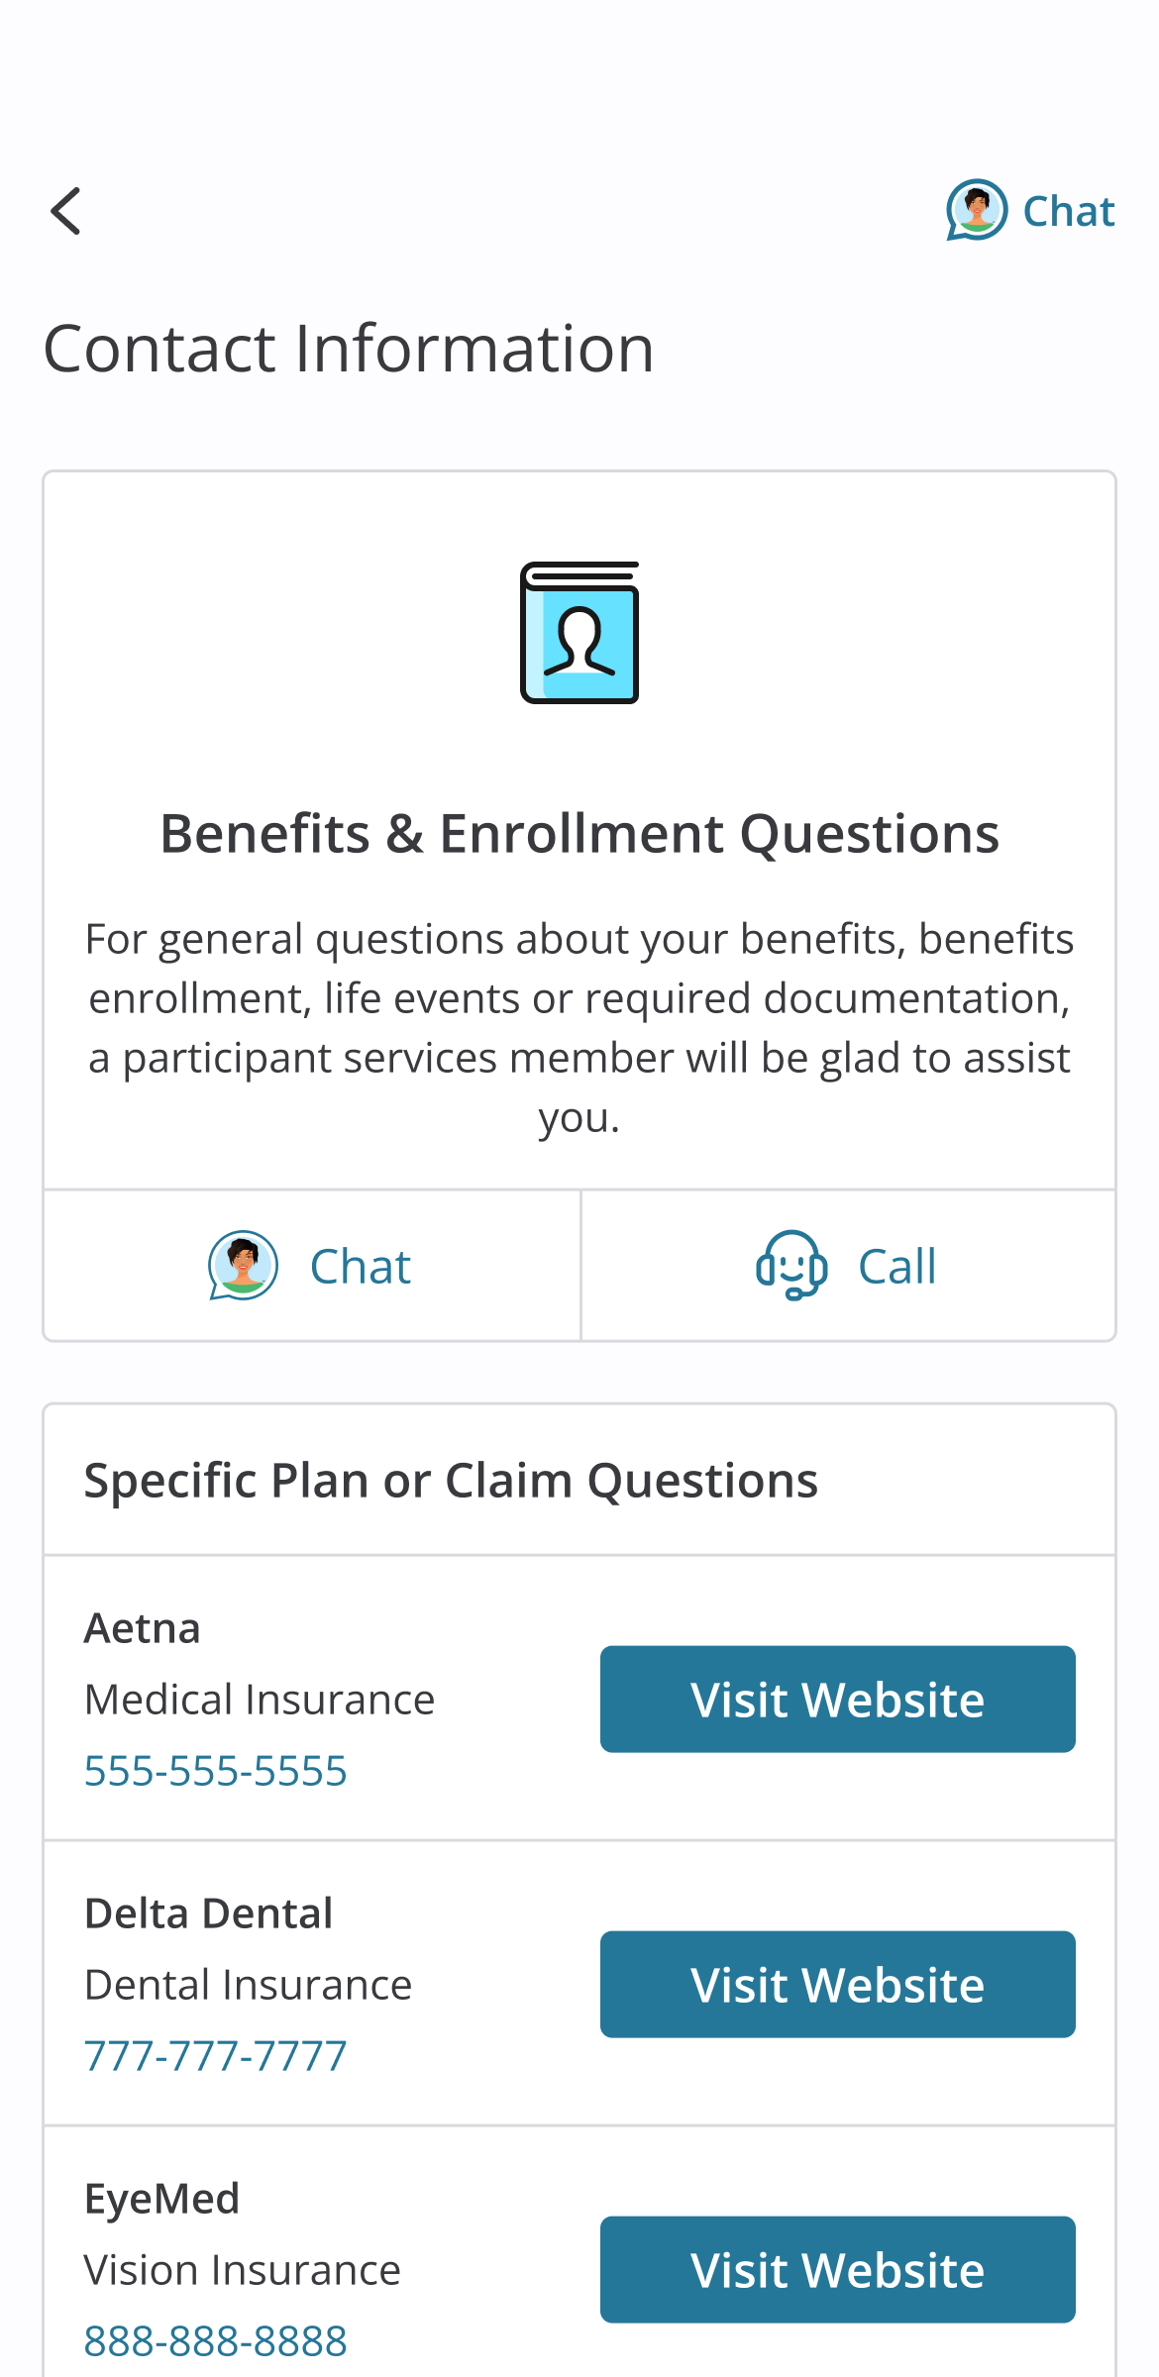
Additional Support
Need help in finding the answer you are looking for? Select the Chat option in the top right to talk with Sofia, or select Contact Information from the Profile page.
Chat
Sofia is available 24/7 to answer your employee questions.
Contact Information
Review personal information such as date of birth, email and address.

