Slide 1
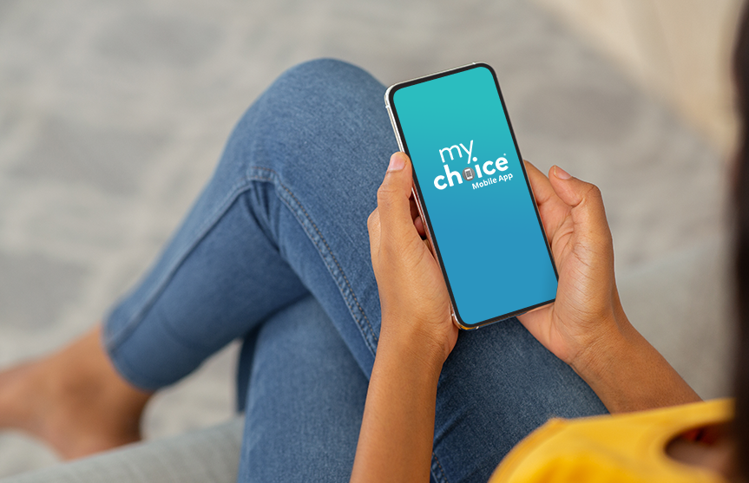
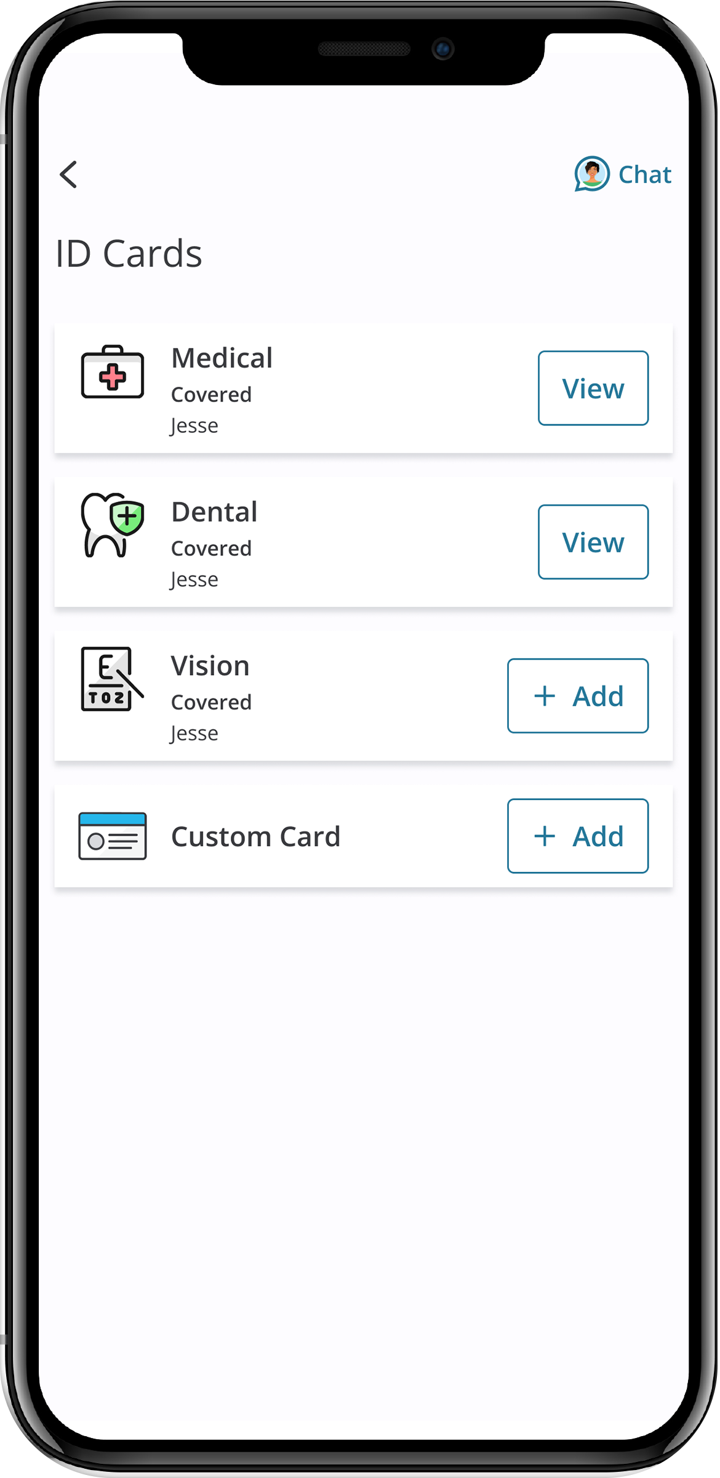
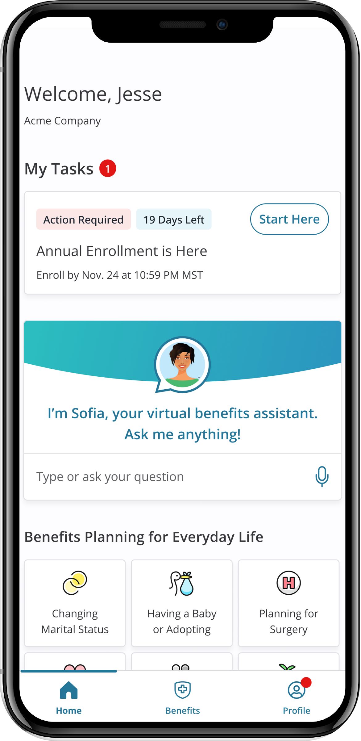
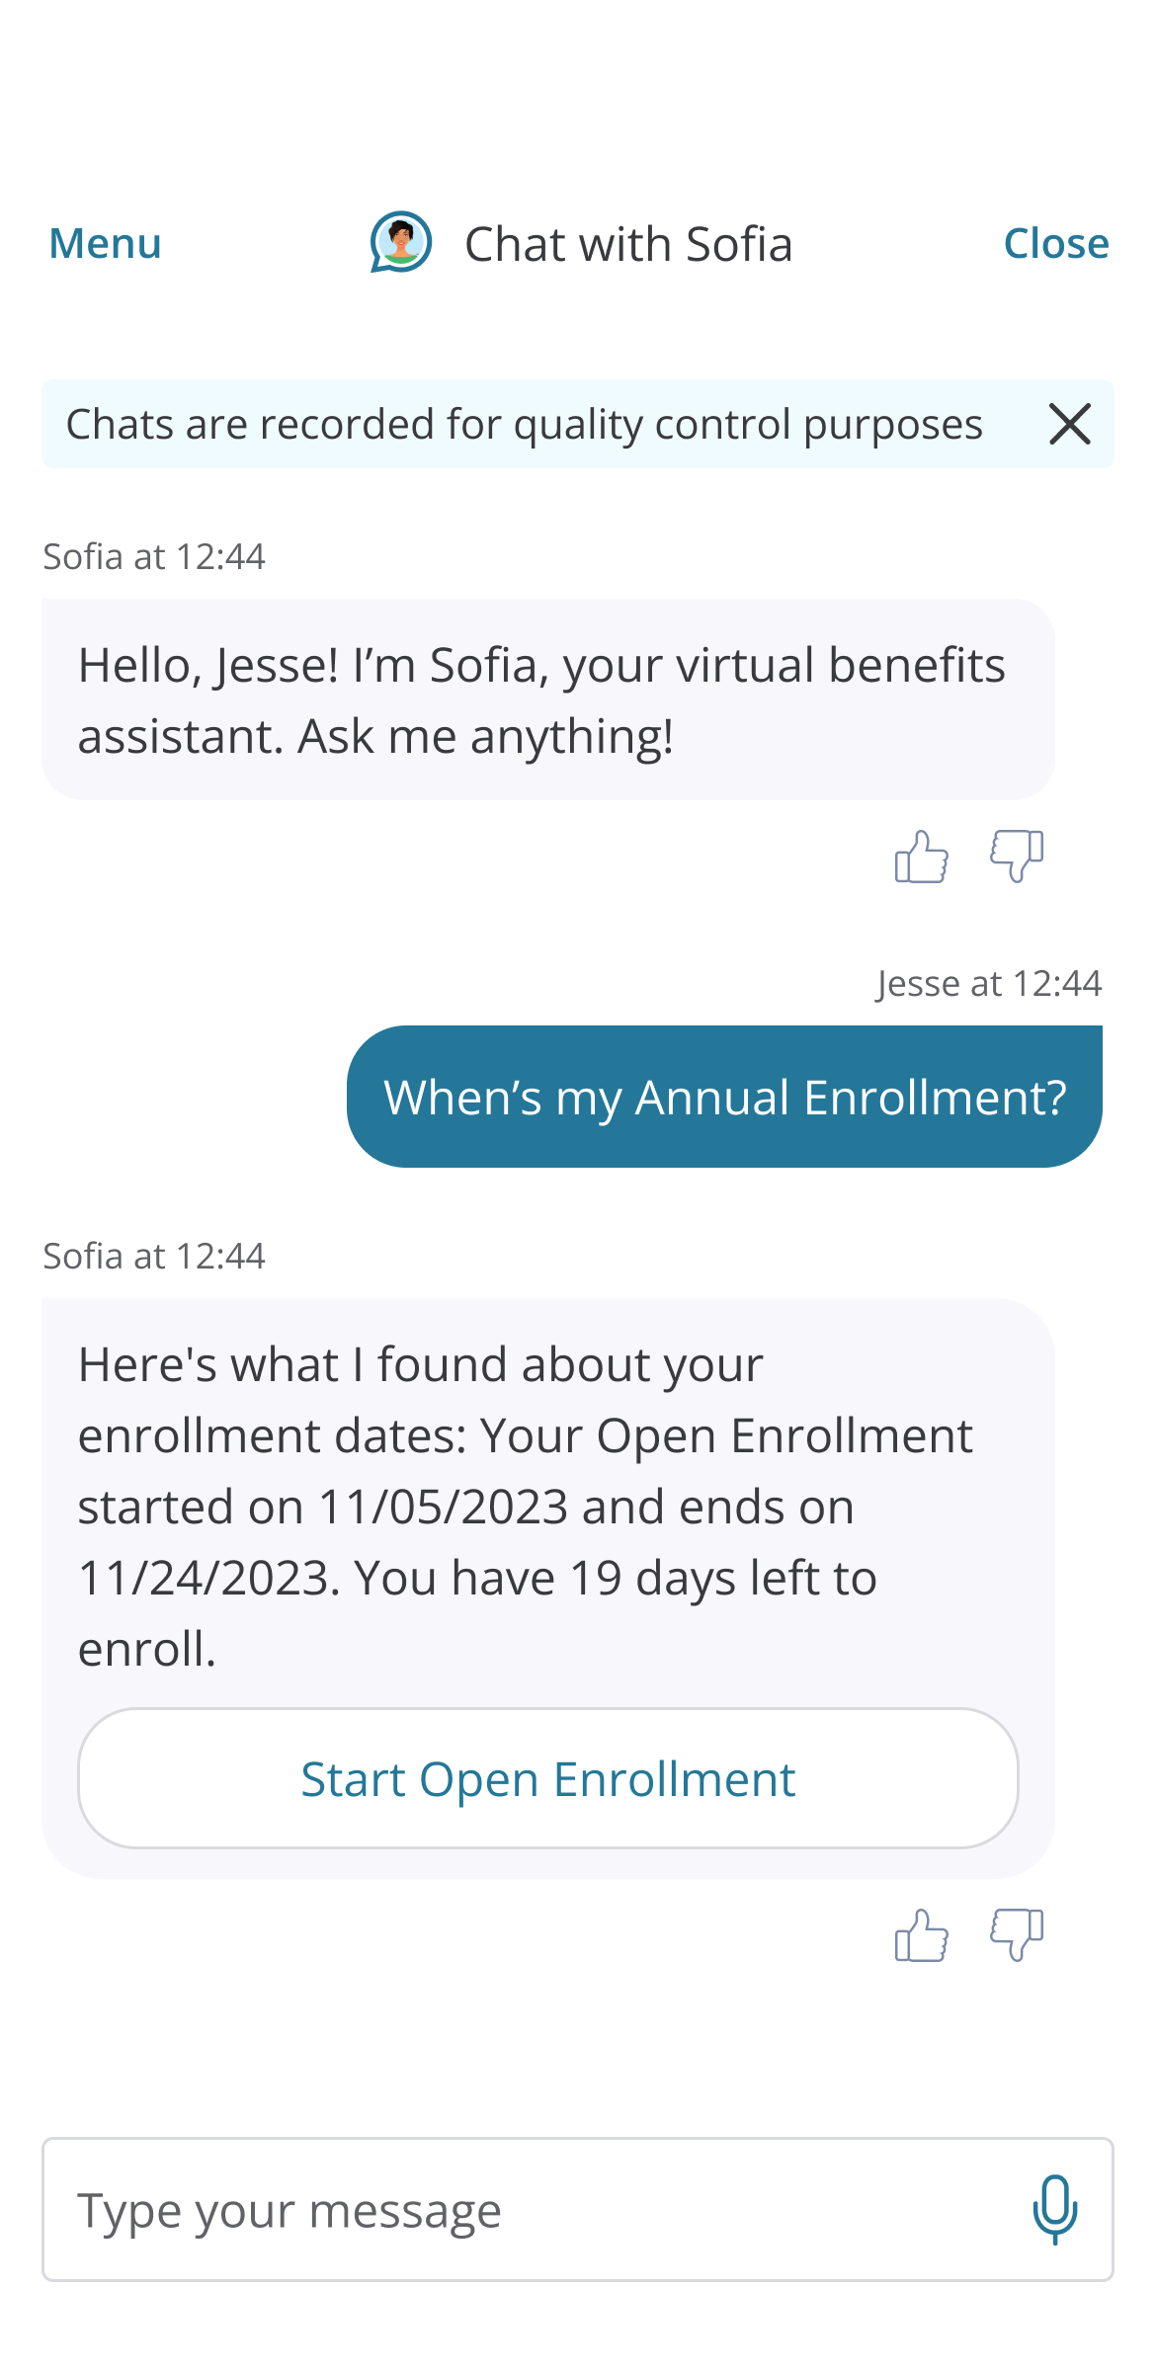
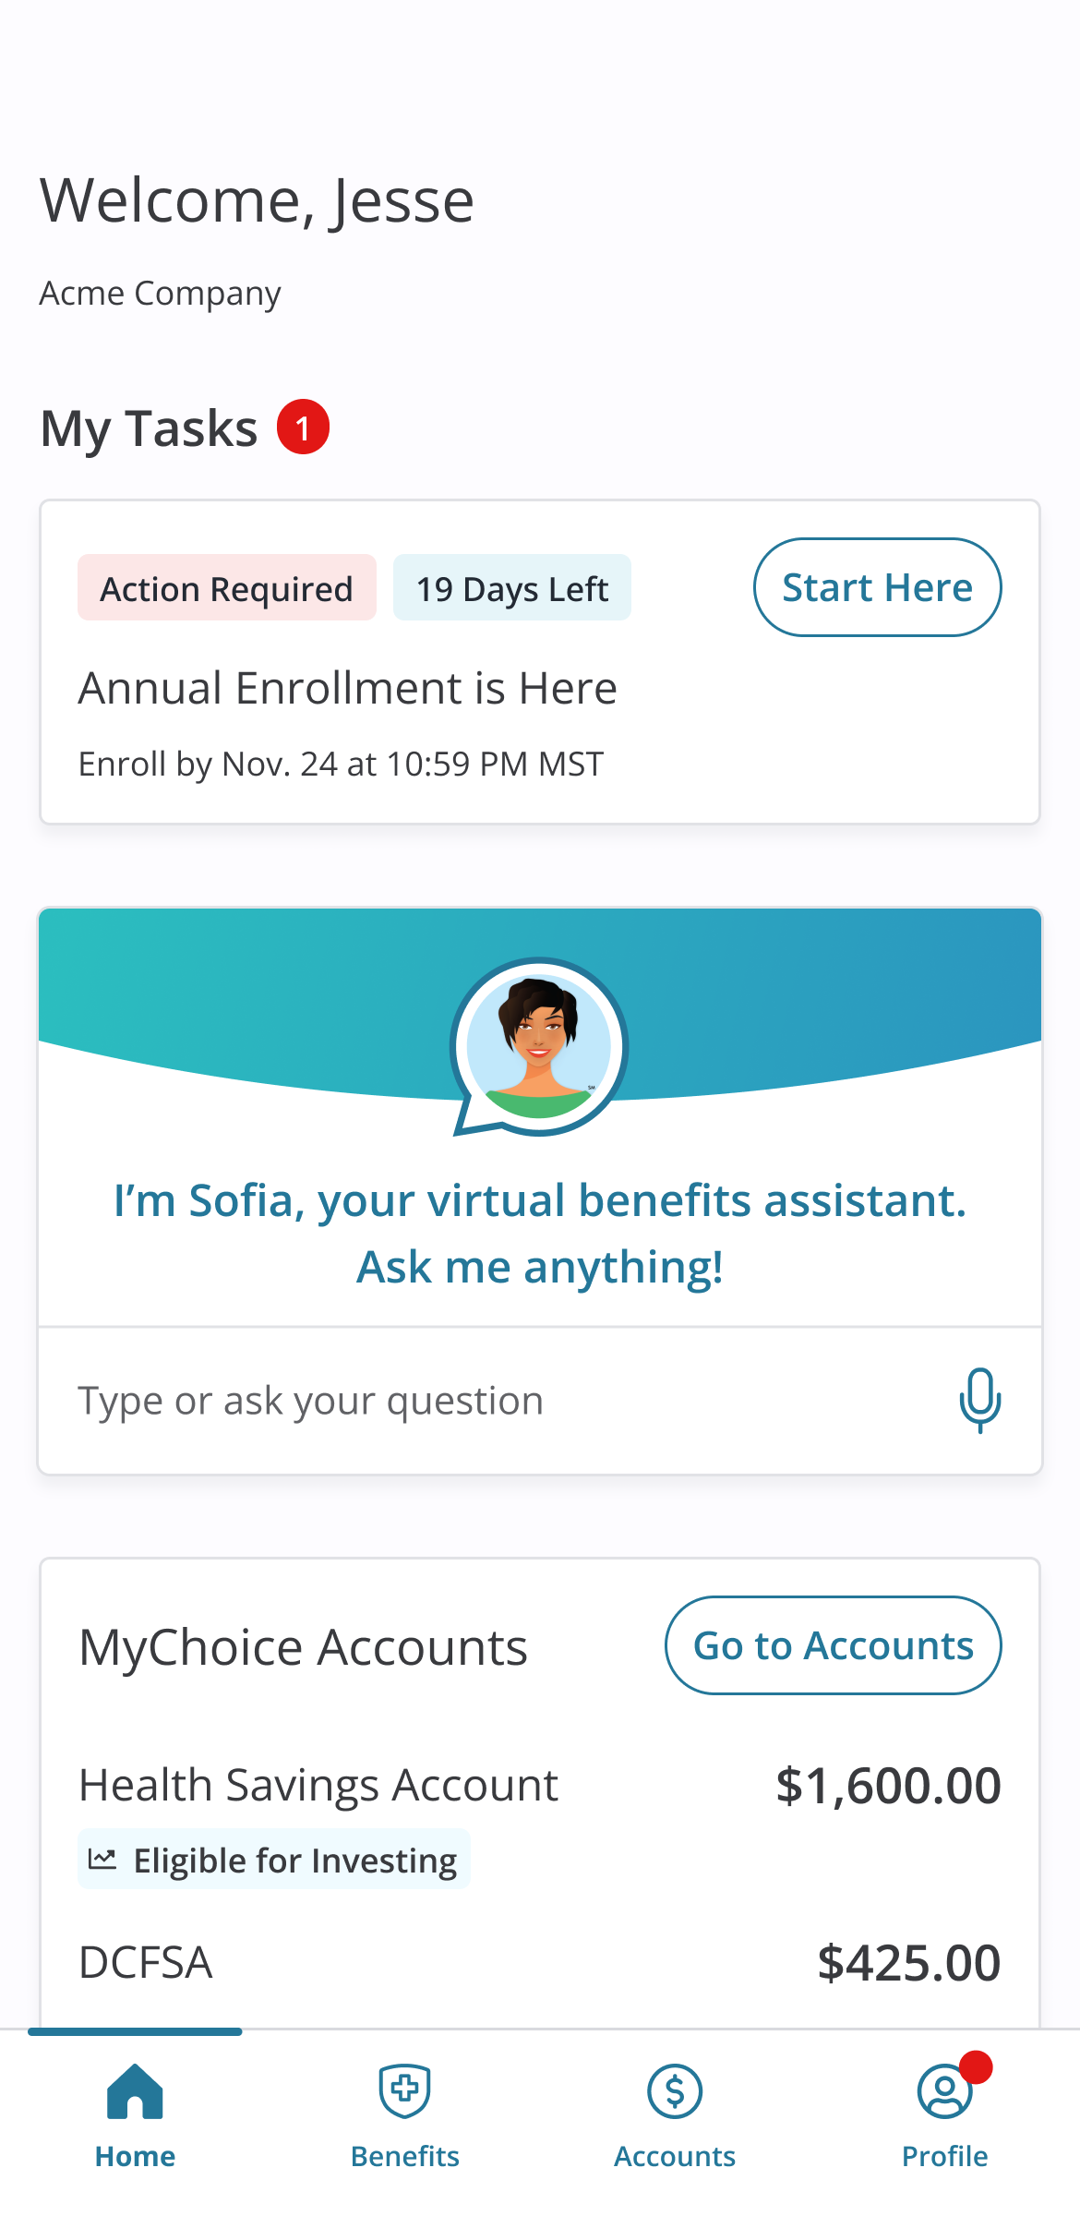
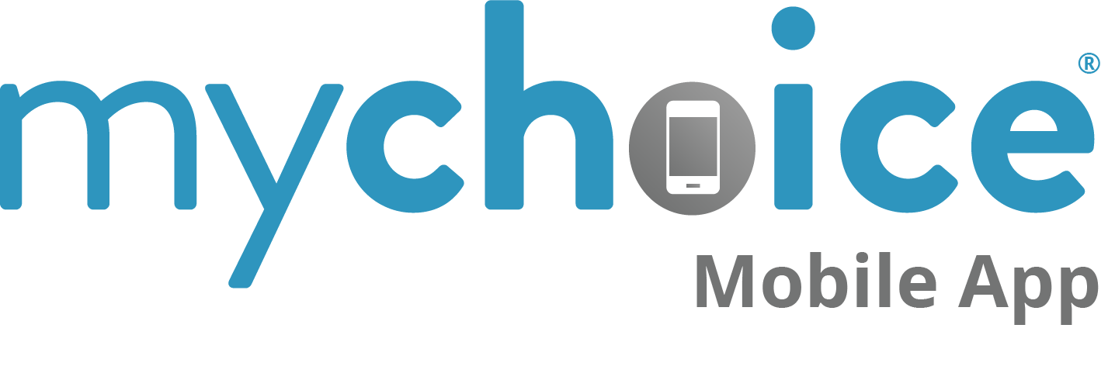
Access your benefits information, when and where you need it
A sleek design, easy navigation, and access to important messages makes managing your health benefits a breeze.
Your Logo Here

Slide 2






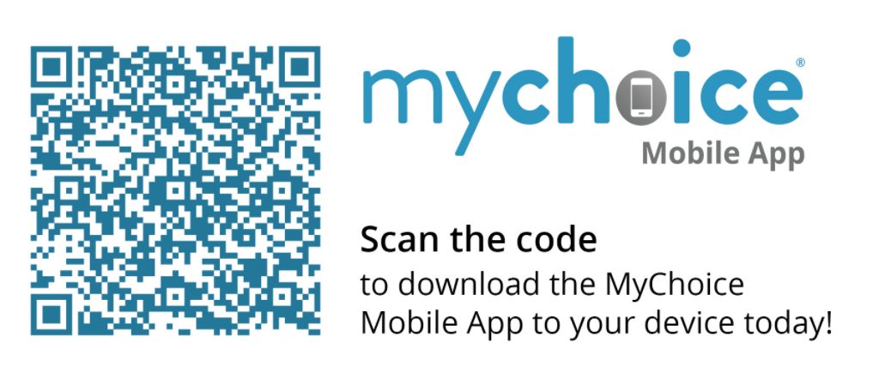
Review and manage
your benefits on the go!
Access your benefits information on the MyChoice® benefits app!
This is one app that will make your life much easier. Here are some of the valuable features the MyChoice benefits app offers you:
Plan Details – View your medical, dental and vision plans, and voluntary and supplementary benefits.
Beneficiaries – View and change all listed primary and contingent beneficiaries for applicable insurance policies.
Document Upload – Snap and upload important documents in a breeze!
Instant ID Access – Never be caught without your ID card again.
24/7 Chat with Sofia – Connect with your virtual personal benefits assistant anytime, anywhere.
Do all this with a few taps of a finger, plus much more!
Scan the code to download the MyChoice benefits app to your device today!

