Slide 1
Visitor Management
For Access Management System

Slide 2
Why do you need a modern visitor management system?
Visitor Management
First impression
Make a good first impression with a professional visitor management system
Busy reception staff
Support receptionists with a system that eases their job
Overview of visits and visitors
Keep overview of expected, checked in and checked out visitors
High visitor volumes
Handle high visitor volumes smoothly and efficiently
Efficient pre-registration process
Allow hosts to easily pre-register their visitors for fast processing
Compliance
Comply with data privacy rules when saving visitors’ data
Minimal contact time
Reduce contact time at front desk to minimize infection risks
Health and safety policies
Allow only pre-registered visitors with negative COVID-19 test to enter the facility

Slide 3
Ideal solution for medium to large sized applications
Visitor Management
Office buildings
Hospitals and health institutions
Governmental buildings
Banking
Education
Commercial buildings

Slide 4
Easy onboarding for best user experience
Visitor Management
Web browser based visitor management system
Comprehensive and user-friendly application for receptionists
Self-registration option for visitors
Host view for employees to pre-register their visitors
Scanning of ID / passport for fast upload of personal information
Upload and signing of documents
Flexible configuration options to adjust the system to individual requirements and legal needs
Fully integrated with Access Management System (version 3.0.1 and higher) via an additional license

Slide 5
Benefits
Visitor Management
Increases user experience for visitors
Increases efficiency for receptionists and allows them to focus on other tasks
Overview of past and upcoming visits helps receptionists and security managers to organize their day
Self-onboarding streamlines registration process
Modern user interface provides easy and intuitive navigation
Integration with Access Management System allows for easy assignment of authorization rights

Slide 6
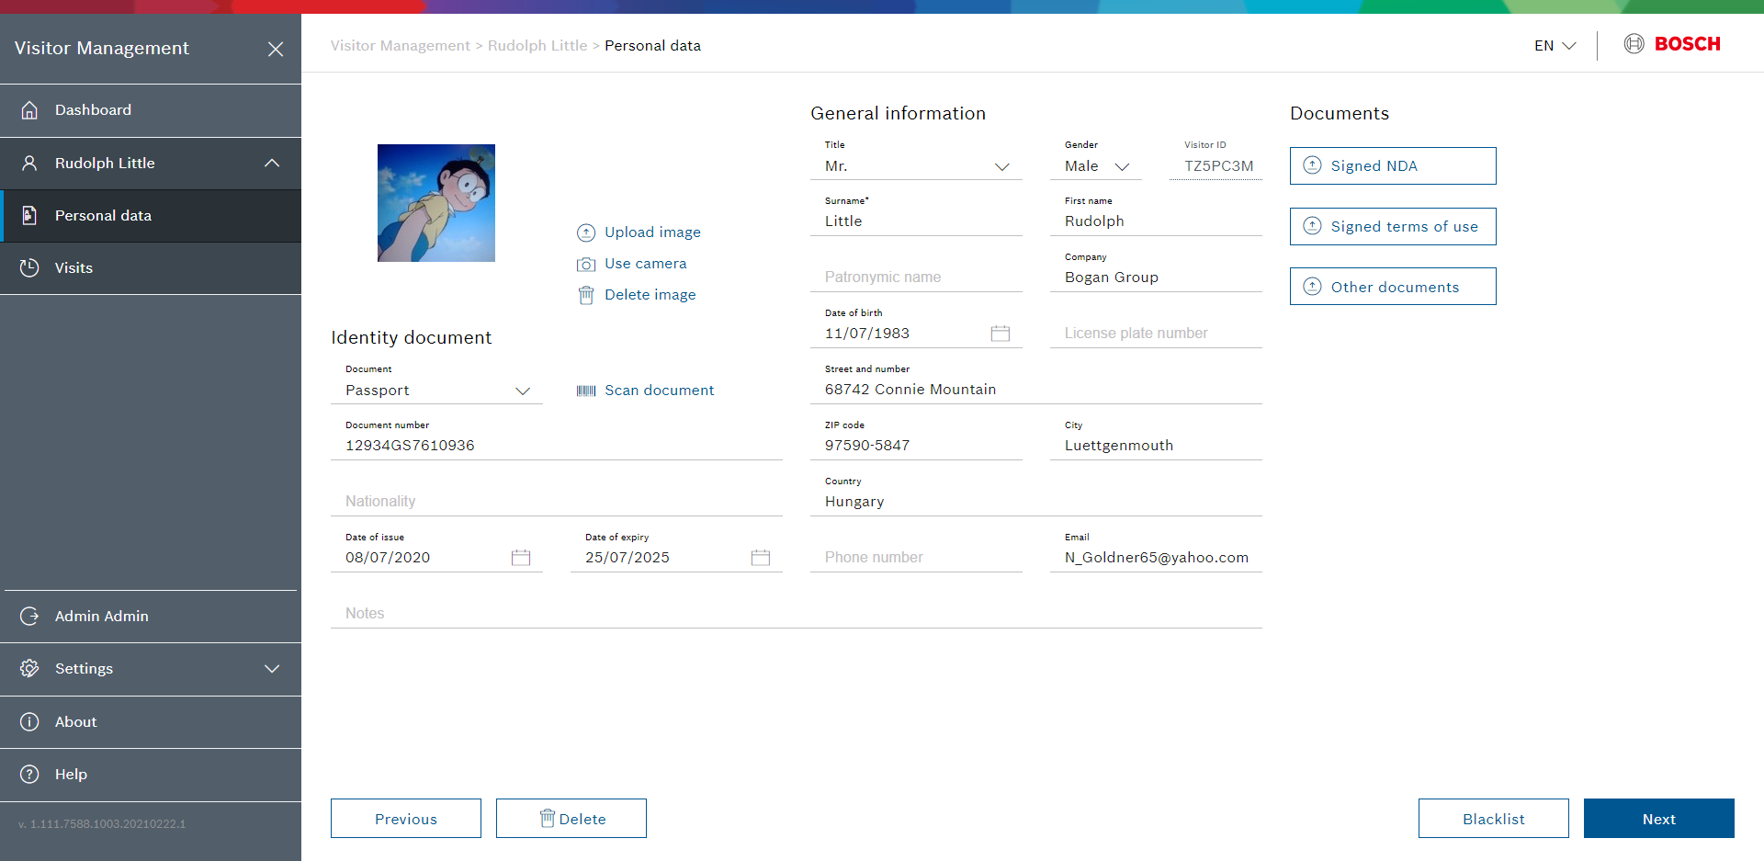
Receptionist view – Onboarding a visitor
Visitor Management
Create, change and delete visitor data
Create and change visits
Assign person type with defined authorizations to visitor (VIP, regular visitor)
Search for visitors that have been pre-registered by a host or via self-registration
Assign card to visitor
Blacklist persons
Upload documents

Slide 7
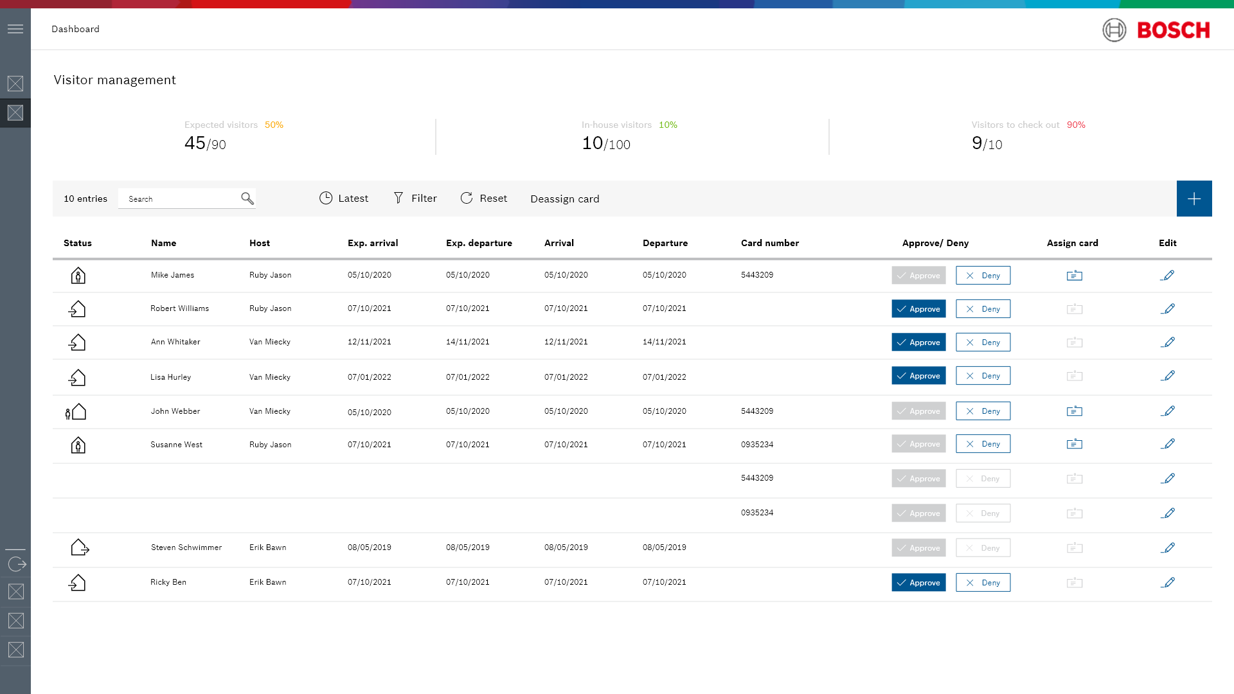
Receptionist view – Dashboard
Visitor Management
Quick overview of visitor status in a site including:
Expected visitors
Checked in visitors
Visitors to check out
Filtering options for visits by name, date or per host
Data is stored in an SQL databank, and can be used to create custom reports

Slide 8
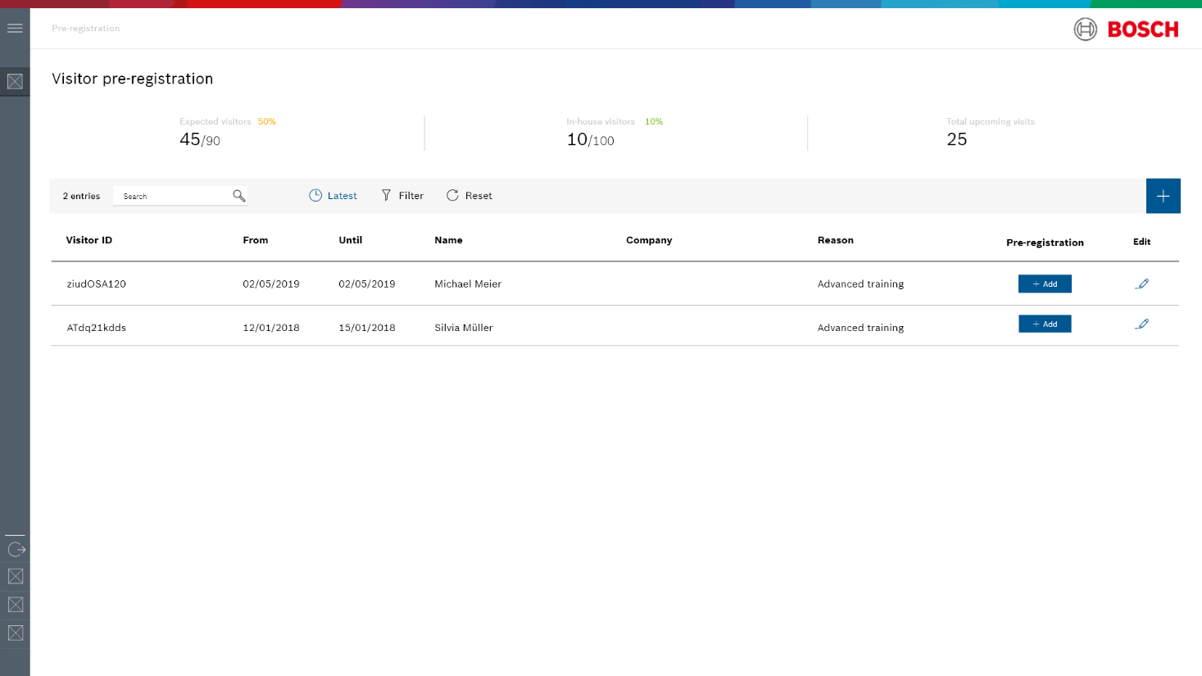
Host view for employees
Visitor Management
Accessible for employees on site who want to pre-register upcoming visits
Easy access via web browser
Create a new visit
Check previous or open visits
Possibility to update visits at any time
Works across different sites

Slide 9
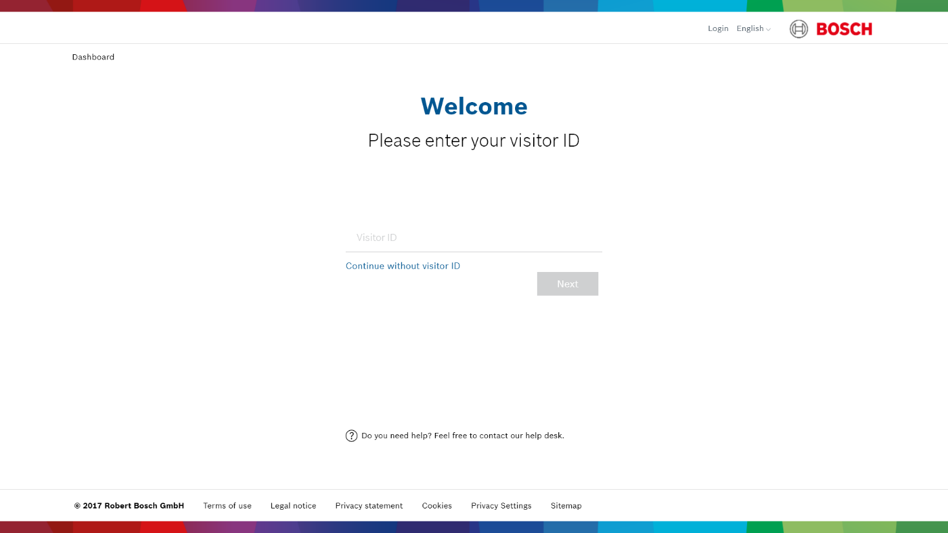
Visitor self-registration
Visitor Management
First time pre-registration
Scanning of ID / passport to upload personal information
Signing of contracts, legal documents and consent forms with signature pad
Checkbox for GDPR compliance
Recurring visitors can use fast check in with visitor ID

Slide 10
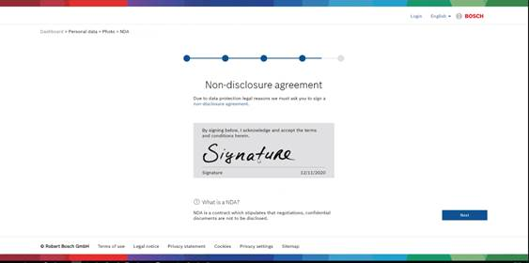
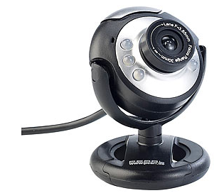
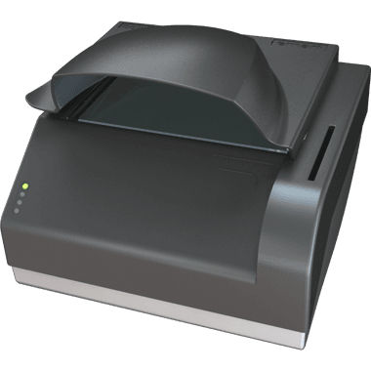
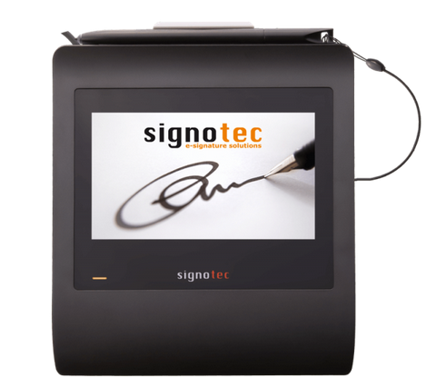
Visitor self-registration – supported devices
Visitor Management
USB camera for picture capturing (type independent)
Signotec signature pad Omega (world wide delivery)
ComboSmart N ID scanner (world wide delivery)

