Slide 1
Intervl
Case Study
Intervl only launched in July 2020 and already need to grow to cope with the increase of inbound business since graduating The Personal Branding Bootcamp For Recruiters.
Presented by The Hoxo Academy

Slide 2
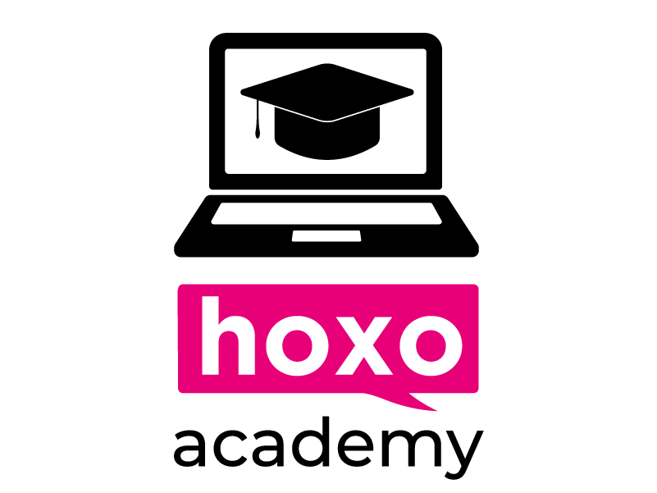
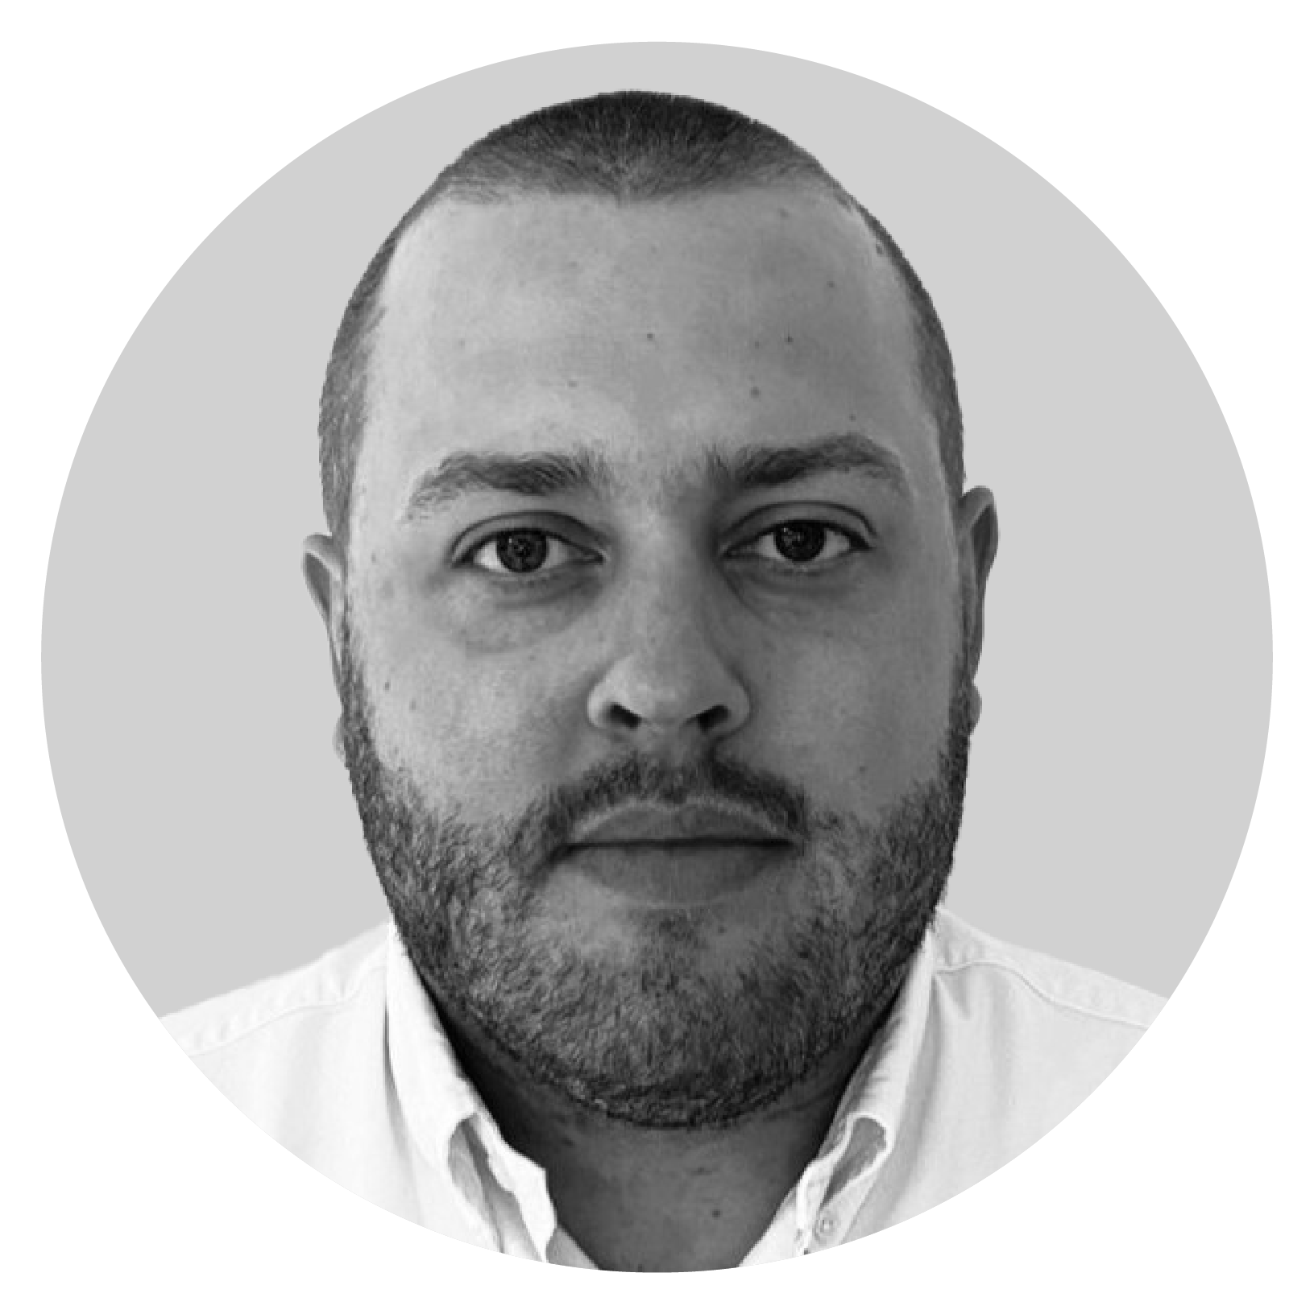
“To become a leader. You got to know what you're good at and what you're not so good at. My weakness was definitely content creation and social media presence, because I'd never done it before."
I always knew that personal branding was important. So for me, it was about finding and partnering with a business that could really, understand who I was as a person, understand where we wanted to be as a business, and that's what you guys did which has been great!”
- Stuart Middleton, Managing Director of Intervl
Watch video testimonial here
‹#›
Case Study | Intervl
hoxoacademy.hoxomedia.com

Slide 3
Key results
Huge increase in views, engagement, and direct business
Close to £100,000 in 4 months of new business "we never knew existed!"
2 potential new clients approach us directly for our services every week
Overview
Intervl is a specialist boutique recruitment agency who joined the academy in March 2021. Interval are focused on supporting companies that develop new products and services in Cleantech. Stuart Middleton started the business in July 2020 and has now grown to four people.
Stuart made a name for himself in the market, but wasn’t sure how to get his brand out to his ideal target audience after starting Intervl.
‹#›
Case Study | Intervl
hoxoacademy.hoxomedia.com
Notes:
Collate information and summarise onto one slide which can be designed up to look appealing and “simple”

Slide 4
Solution
Intervl have absolutely no problems speaking to and converting prospects to clients face to face. The issue was sourcing those prospects in the first place. It's a niche market and the right people exist - they just needed to find them.
Stuart knew his team needed to start using LinkedIn to its full potential, but had no clue where to start. Once he saw there was a personal branding programme specifically designed for recruiters, he knew he needed to take the opportunity to learn how to grow his and his team’s brands on LinkedIn.
The Intervl team joined the Personal Branding Bootcamp in March 2021 and after starting the 8-week programme, joined the Hoxo Academy Community for recruiters as well. They set aside time to post content on LinkedIn according to the Hoxo Academy formula and added KPIs for the team that are purely based on LinkedIn metrics.
‹#›
Case Study | Intervl
hoxoacademy.hoxomedia.com

Slide 5
Conclusion
Since joining the Academy and implementing principles learnt on the Bootcamp, the Intervl team has seen phenomenal growth in engagement. They’ve been able to connect with people that are more comfortable and familiar with their brand, which has led to inbound conversations and leads.
They’ve been able to punch above their weight because they’re growing a big network and this is leading to them having people coming up and talking to them, which they hardly ever happened before.
Implementing the teachings of the Personal Branding Bootcamp has led them to a point where they’re forced to grow to take on the demand that’s coming through inbound business.
‹#›
Case Study | Intervl
hoxoacademy.hoxomedia.com
hoxoacademy.hoxomedia.com

Slide 6
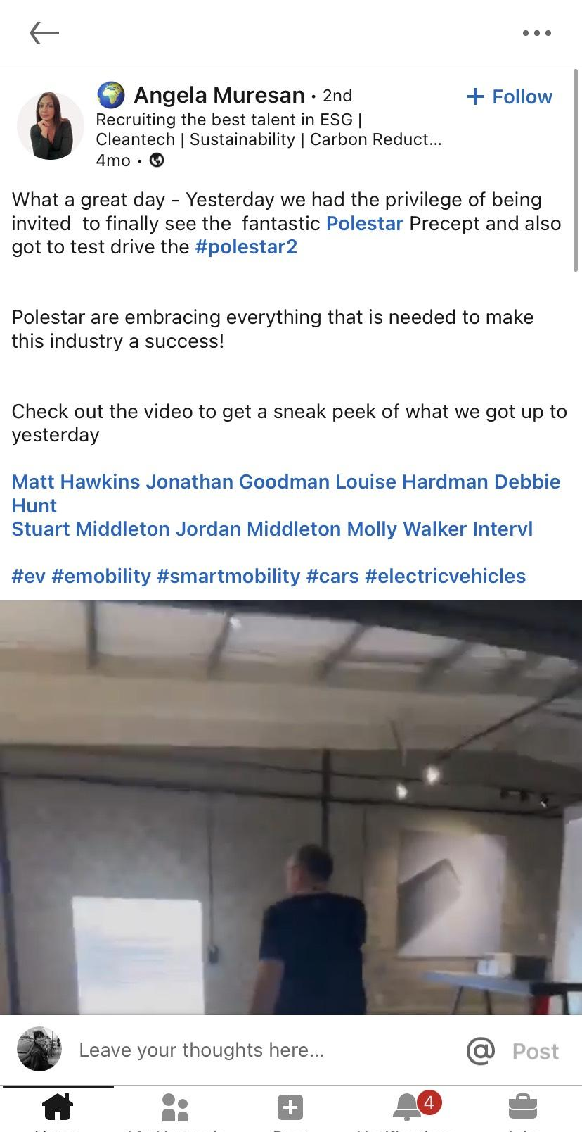
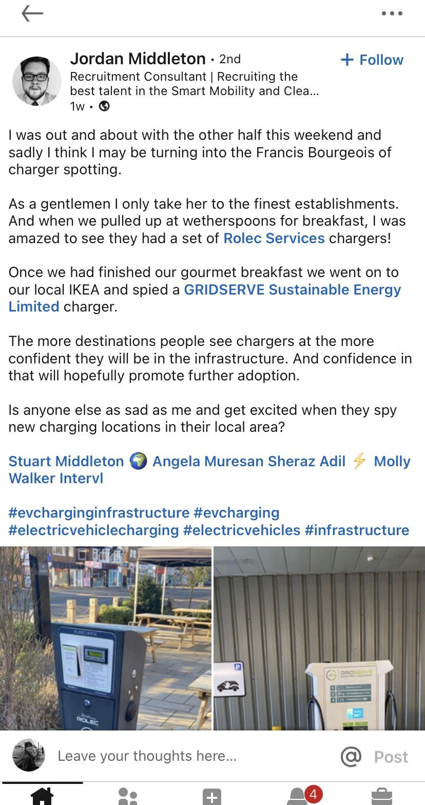
Team success
“I put out a post and got over 7,000 views and over 40 comments with a network of 400 connections. It's still active over a week after posting. Received a few DMs and loads of connections”
- Jordan Middleton
‹#›
hoxoacademy.hoxomedia.com
Case Study | Intervl

Slide 7
The end beginning.
hoxoacademy.hoxomedia.com
hoxomedia.com

