Slide 1
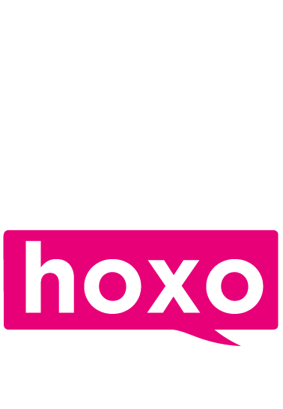
Helm Specialist Recruitment Case Study
Helm Specialist Recruitment joined The Hoxo Academy earlier this year and, after adopting The Personal Branding Bootcamp methodology, saw an increase in brand awareness, trust, and new business relationships - as well as the rejuvenation of existing and legacy clients.
Presented by The Hoxo Academy

Slide 2
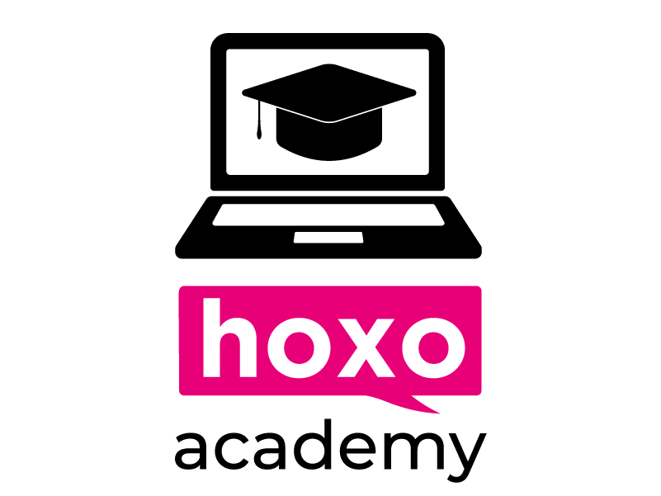
“Saying you’re different from your competition and actually being different are not the same.
Developing our personal brand was paramount if we were going to break the mould within our sector.”
- Stine Martinussen, CEO of Helm Specialist Recruitment
‹#›
Case Study | Helm Specialists
hoxoacademy.hoxomedia.com

Slide 3
Key results
Strengthened existing client relationships
Over 165k in revenue since joining The Personal Branding Bootcamp in Aug 2021
Renewed several legacy clients
Overview
Helm joined the hoxo academy in Aug 2021, at which point were at 11 people as they approached their 2nd anniversary. They work within the shipping and maritime sector, and each consultant has a niche focus within that market.
The team were already creating content, albeit with minimal direction: they posted when they had something to post, but weren’t fully aware of the intricacies of the LinkedIn algorithm.
Helm needed a way to set themselves apart from their competition. CEO Stine Martinussen believed there was a better approach to generating awareness that didn’t revolve around KPI driven cold calling.
‹#›
Case Study | Helm Specialists
hoxoacademy.hoxomedia.com

Slide 4
Solution
Since completing the Personal Branding Bootcamp For Recruiters, the whole company’s approach to LinkedIn has changed dramatically.
The team have completely bought in to the training. They follow the Personal Branding Bootcamp methodology, regularly post content specific to their target audience on LinkedIn, and have updated their individual profiles to function as more effective lead magnets.
Helm implemented KPIs around LinkedIn content and make sure their teams are consistent with adopting The Hoxo Academy methodologies on a daily basis.
Now, instead of merely reading industry news and updates, they’re the ones leading the conversation. LinkedIn is no longer just a job board or extension of the CRM, it’s what it was always meant to be: a powerful networking site.
In the words of Stine: “Needless to say, we’re all the better for it.”
‹#›
Case Study | Helm Specialists
hoxoacademy.hoxomedia.com

Slide 5
Conclusion
Helm have secured a considerable amount of inbound business they otherwise would’ve missed out on, if not for following The Hoxo Academy methodology and building a business winning brand on LinkedIn.
They’ve strengthened existing relationships and renewed several legacy clients through consistent processes and content that builds trust across the market.
Now when they’re having conversations, most of them start along the lines of: “Oh I know you! I follow your posts on LinkedIn”.
Thinking about joining The Hoxo Academy? Here’s the final word from Stine:
“Deciding whether to invest in the Personal Branding Bootcamp is like deciding between growth and stagnation”
‹#›
Case Study | Helm Specialists
hoxoacademy.hoxomedia.com
hoxoacademy.hoxomedia.com

Slide 6
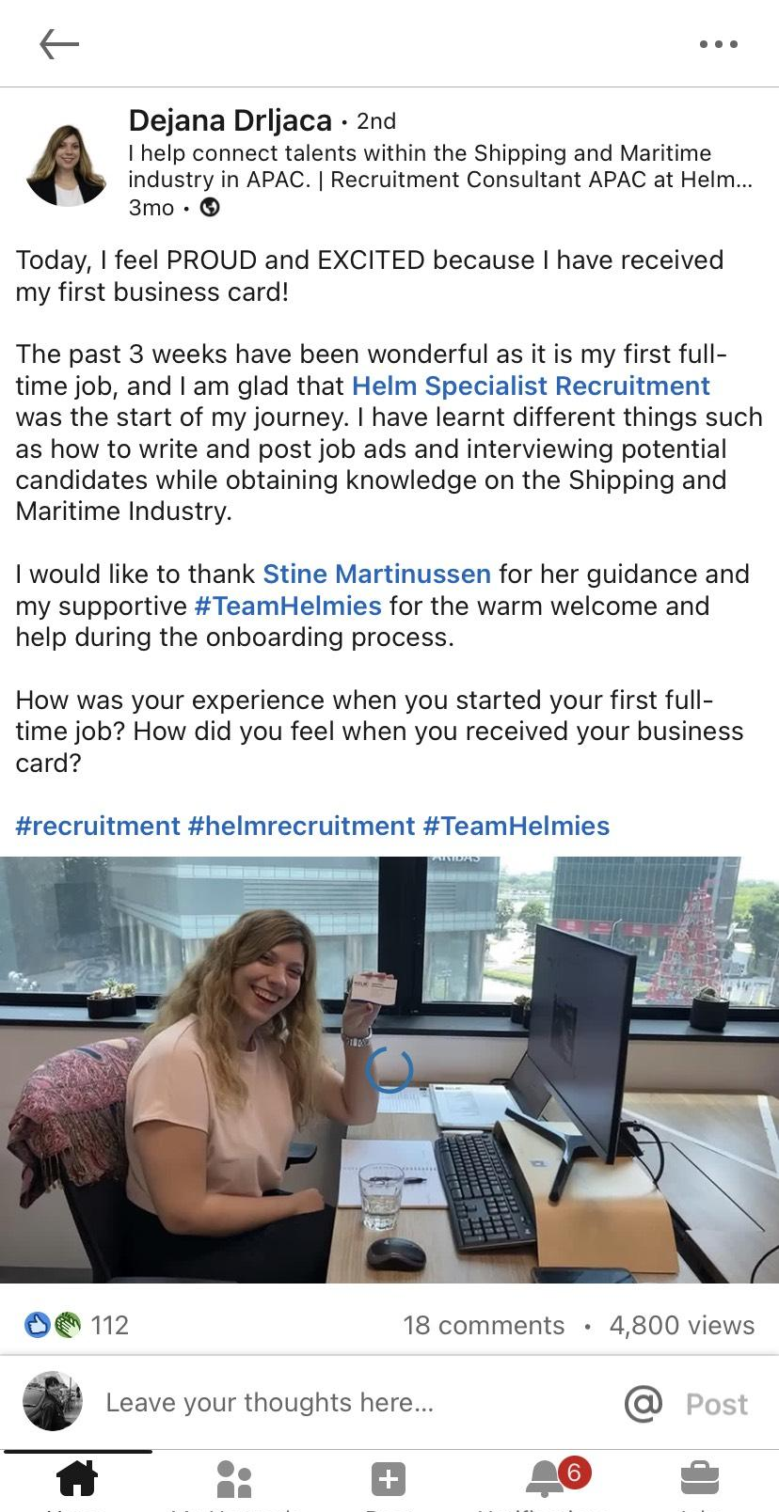
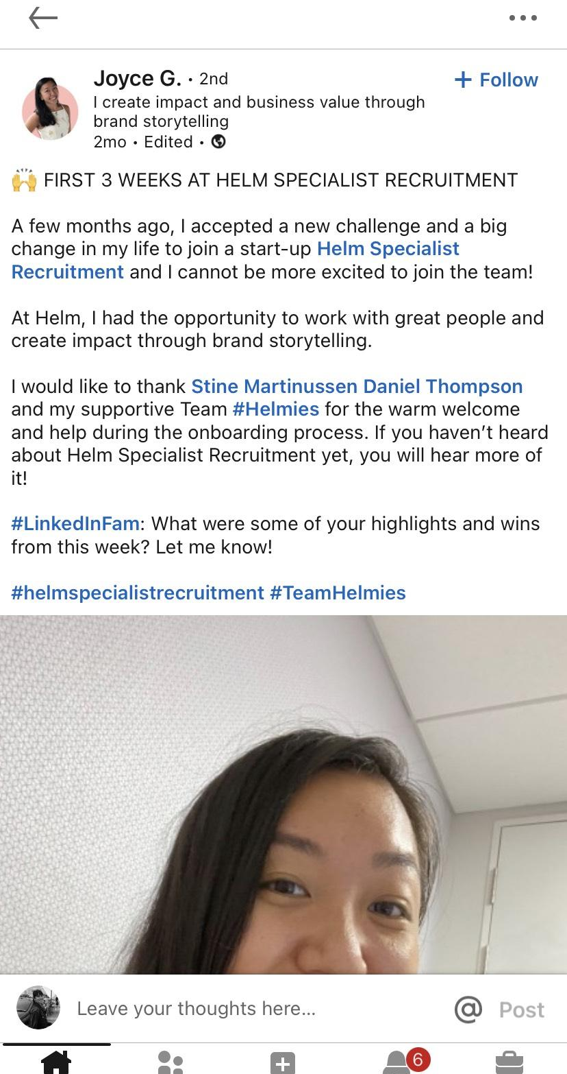
Team success
“Made a post straight after training based off of using the headline as something to pull in engagement (maybe even a little controversial) and attention. 24 hours later it's sitting at 7k+ views, 36 likes and 19 Comments. By far the most amount of engagement I have ever had on any post in 5+ years on the platform.
The kicker comes when a high level potential client DM's me as he didn't want to comment on a publics forum:
we set up a call, he gives me a tonne of info about the inner workings of his current company and also informs me he is looking to leave and sends me his CV. My first major win and it's really given me concrete evidence rather than just hope and faith!”
- Ross McGrane
‹#›
Case Study | Helm Specialists
hoxoacademy.hoxomedia.com

Slide 7
The end beginning.
hoxoacademy.hoxomedia.com
hoxomedia.com

