Slide 1
Microsoft Teams Phone System Solutions
Presented by American Technology Services
Powered by Altigen
Notes:
Hello everyone, my name’s Mukta Kori and I will be presenting and moderating today’s Webinar along with Mark Sexauer. ATS is an IT consulting firm focused on delivering managed IT and security services, along with secure cloud services to small and mid-sized organizations.
American Technology Services and Altigen, our trusted Teams Communications partner, want to welcome you all to our Webinar “The Power of Microsoft Teams Phone System.”
This is our first webinar on Teams Phone system, and we would like to introduce you to the Microsoft’s VoIP world and empower you with all the information needed to make the right decision.

Slide 2
Introduction
Presenter:
Mark Sexauer
Director, Intelligent Communications
AltiGen Communications Inc.
Moderator:
Young Kim
Senior Account Executive
American Technology Services
Notes:
Mukta - I am a client Manager at ATS and have been with the team for over 7 years with 10 years of experience working with MSP’s.
Introduce Mark - Mark Sexauer is the Director of Intelligent Communications with Altigen Communications with over 20 years of experience working within the Unified Communications space with a number of Fortune 500 companies. Mark specializes in Microsoft Teams UCaaS with Teams technology with an emphasis on voice and value add applications such as Contact Center for the modern workplace as well as, line of business applications such as CRM.
Before we start our presentation, I would like to encourage you to enter any questions you might have in the Q&A window either on top or bottom of the screen and we will do our best to answer all the questions at the end of the presentation. We are recording today’s session and we’ll send it to you in an email tomorrow including the slide deck.

Slide 3
Teams: The All-in-One Communications Platform
Transform how work gets done by unifying calling, chat, meetings, calendar, and email
Secure Call from anywhere, on any device
Single phone number across all devices
Calling, chat, and meetings in a single app
Unifying calling with chat and meetings in Teams
Built-in audio conferencing
Integrated into Microsoft 365
Do your best work, in one suite Unified contacts and calendars across Teams & Outlook
AI-powered intelligence
Auto VM transcription and analytics
Notes:
Why Teams? When companies made the decision of working from home last year, thanks to Covid, most of our clients had 1 question – Do we need to come into the office for our phones? In today's day and age our answer should be NO; however, for those with in-house phone system had no choice or had to connect to VPN but if they didn’t have soft phones, then they did need to bring their device home.
So, Teams! In addition to all the cloud apps including emails, and productivity apps, MS offers PBx (public branch exchange) as a cloud service
The first and biggest benefit of using Teams for your phone needs is that it helps you unify your communications and productivity channels under one roof. It also unifies your contacts and calendars across teams and outlook.

Slide 4
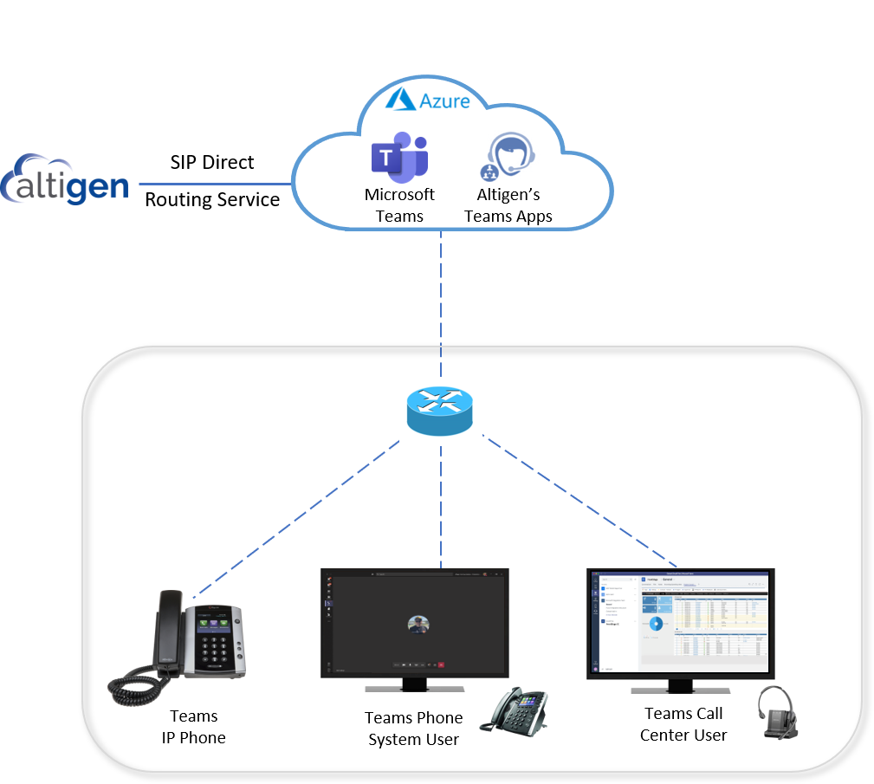
Microsoft Teams: The Game Changer
Altigen adds Enhanced PBX & Contact Center Apps to Teams
Enables Company PBX to be Replaced with Teams Phone System
Notes:
So that was a quick overview of why teams and what teams voice is. I’d like to hand this over to Mark so he can do a deep dive on this topic and show you how Altigen’s services will enhance your Teams Voice experience. I would like to add that Altigen has worked closely with MS to build their tools for Teams Voice application to support different business needs.
Over to you Mark.

Slide 5
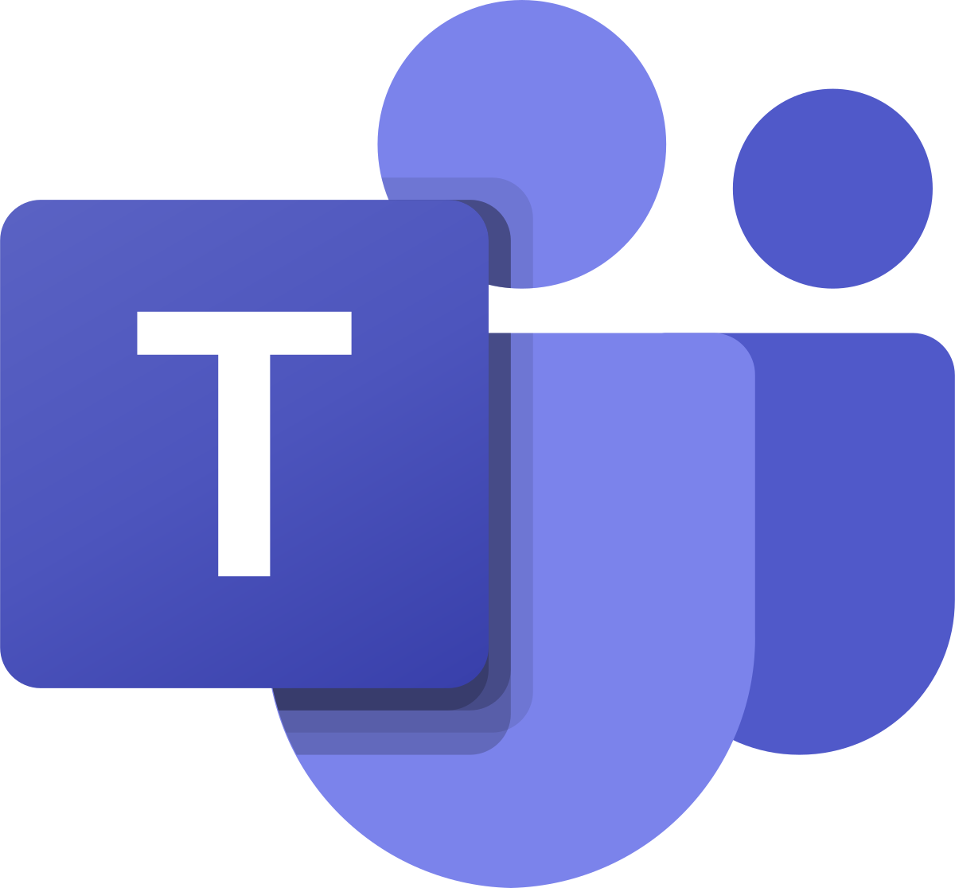
Altigen Solution for Microsoft Teams Phone System
Altigen Call
Reporting
Altigen CoreAttendant
Teams Phone
System
Altigen PBX
Device Gateway
Altigen SIP
Direct Routing
Teams Certified
Ribbon SBC
Altigen Service
Delivery Platform
Altigen Call
Recording
Altigen CoreInteract
Customer Engagement

Slide 6
Report and Analytics Altigen Enterprise Reporting
Report on All Teams Activities
Voice, Video, Conference Calls
Chat, File Transfers, Shared Apps
End-to-End Analytics
Call Quality / MOS
Endpoint Monitoring
User Adoption by Activity Type
Usage Statistics
Cost Allocation
Real-Time and Historical Reports
Detail and Summary Reports

Slide 7
Notes:
# How much bandwidth will I need?
​
# Will my current office phones be compatible?
# Can I keep the same number?
# When should I opt for MS calling plan?
# Are audio conference minutes same as calling minutes?

Slide 8
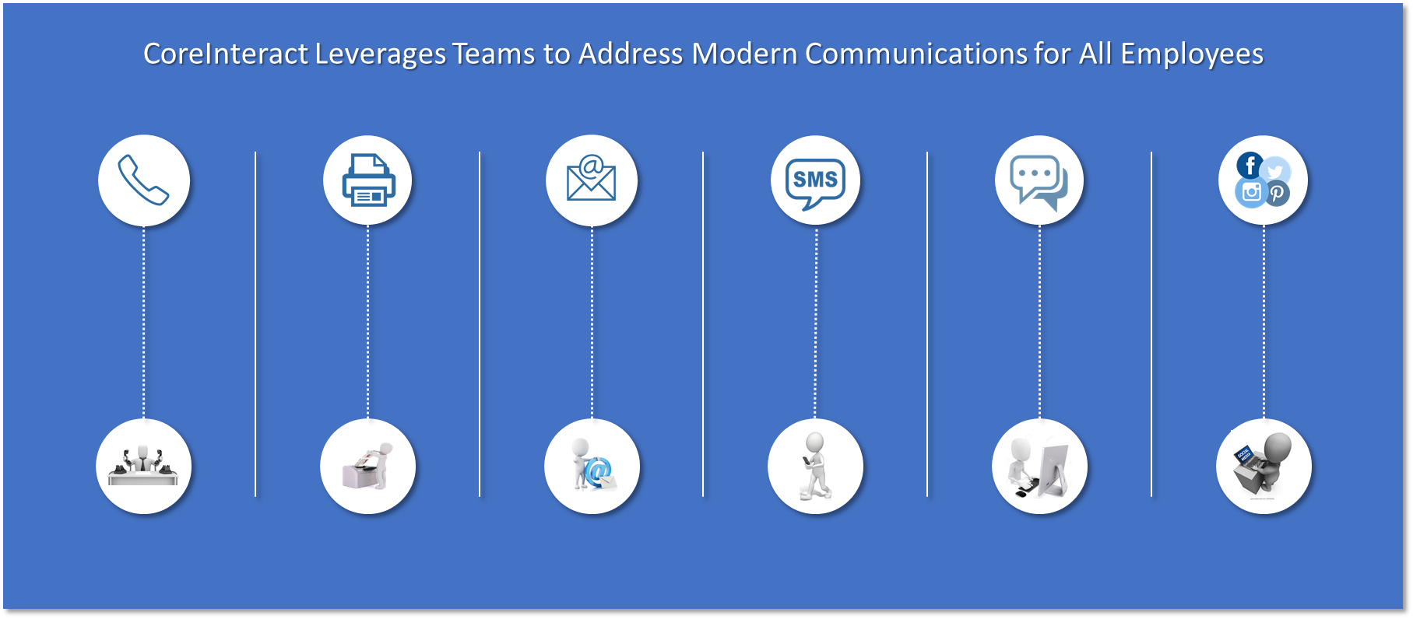
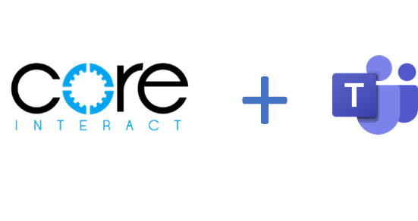
Notes:
# How much bandwidth will I need?
​
# Will my current office phones be compatible?
# Can I keep the same number?
# When should I opt for MS calling plan?
# Are audio conference minutes same as calling minutes?

Slide 9
Digital Transformation for Modern Office Communications
CoreInteract enables your Enterprise Users to Engage with Customers
Using the Customer’s Preferred Communications Channels
Loan
Origination
Help Desk
Corporate
Services
Human
Resources
Sales
Notes:
With CI + Teams, all enterprise employees now have the tools/apps to fully manage customer communications.

Slide 11
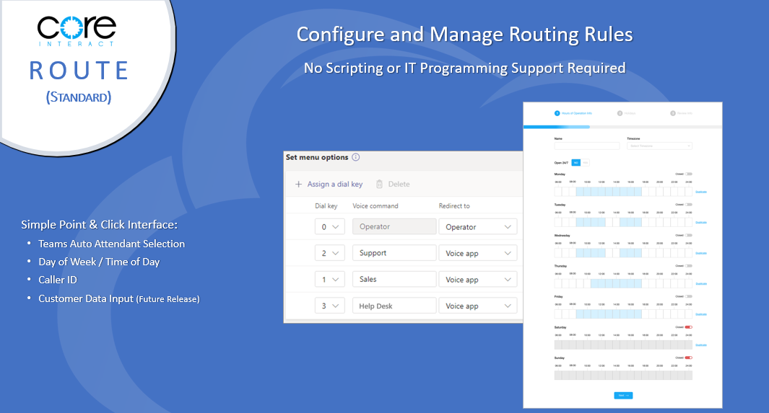

Slide 13
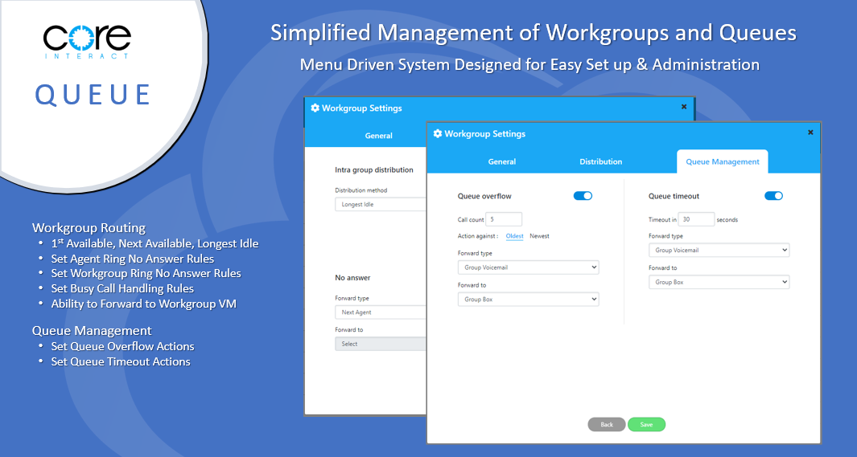

Slide 18
Notes:
# How much bandwidth will I need?
​
# Will my current office phones be compatible?
# Can I keep the same number?
# When should I opt for MS calling plan?
# Are audio conference minutes same as calling minutes?

Slide 19
CoreAttendant Console
for Teams Phone System
A Native Teams Application for Company
Operators, Receptionists and Administrative Assistants

Slide 20
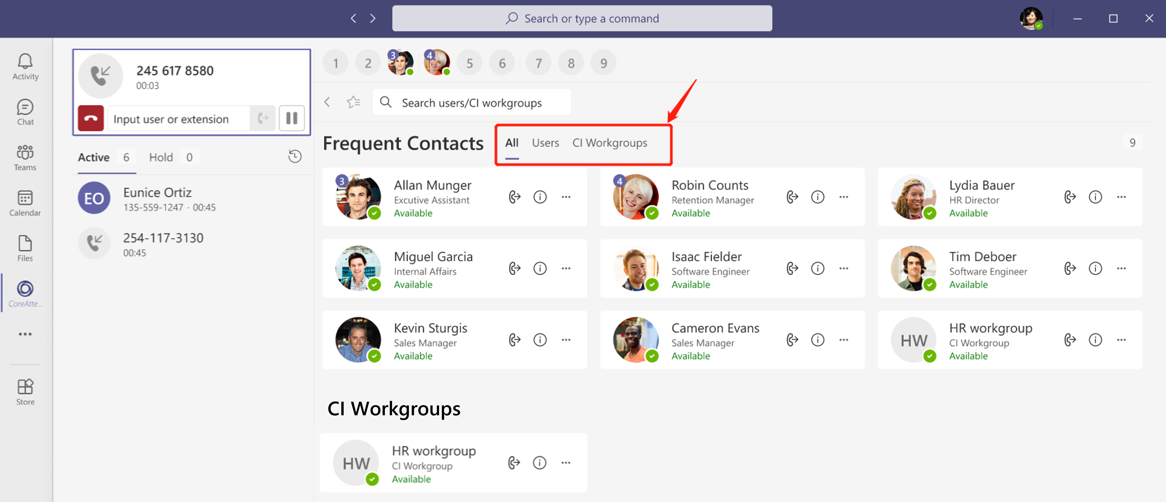
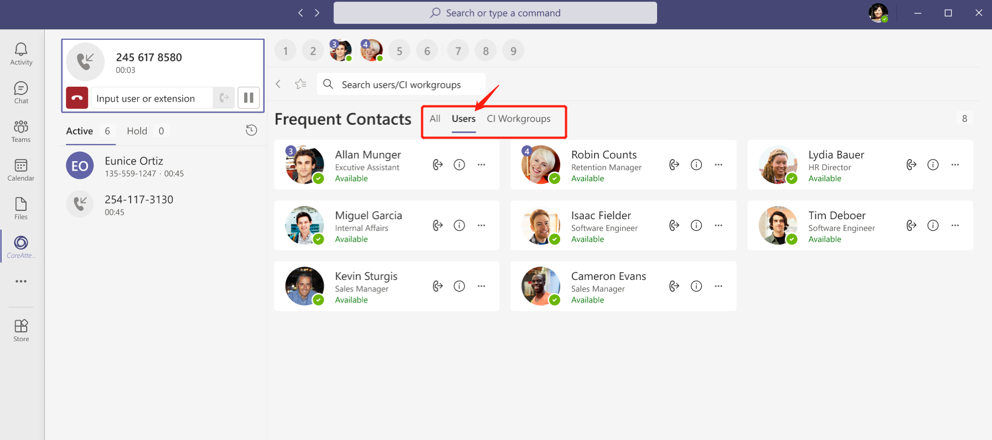
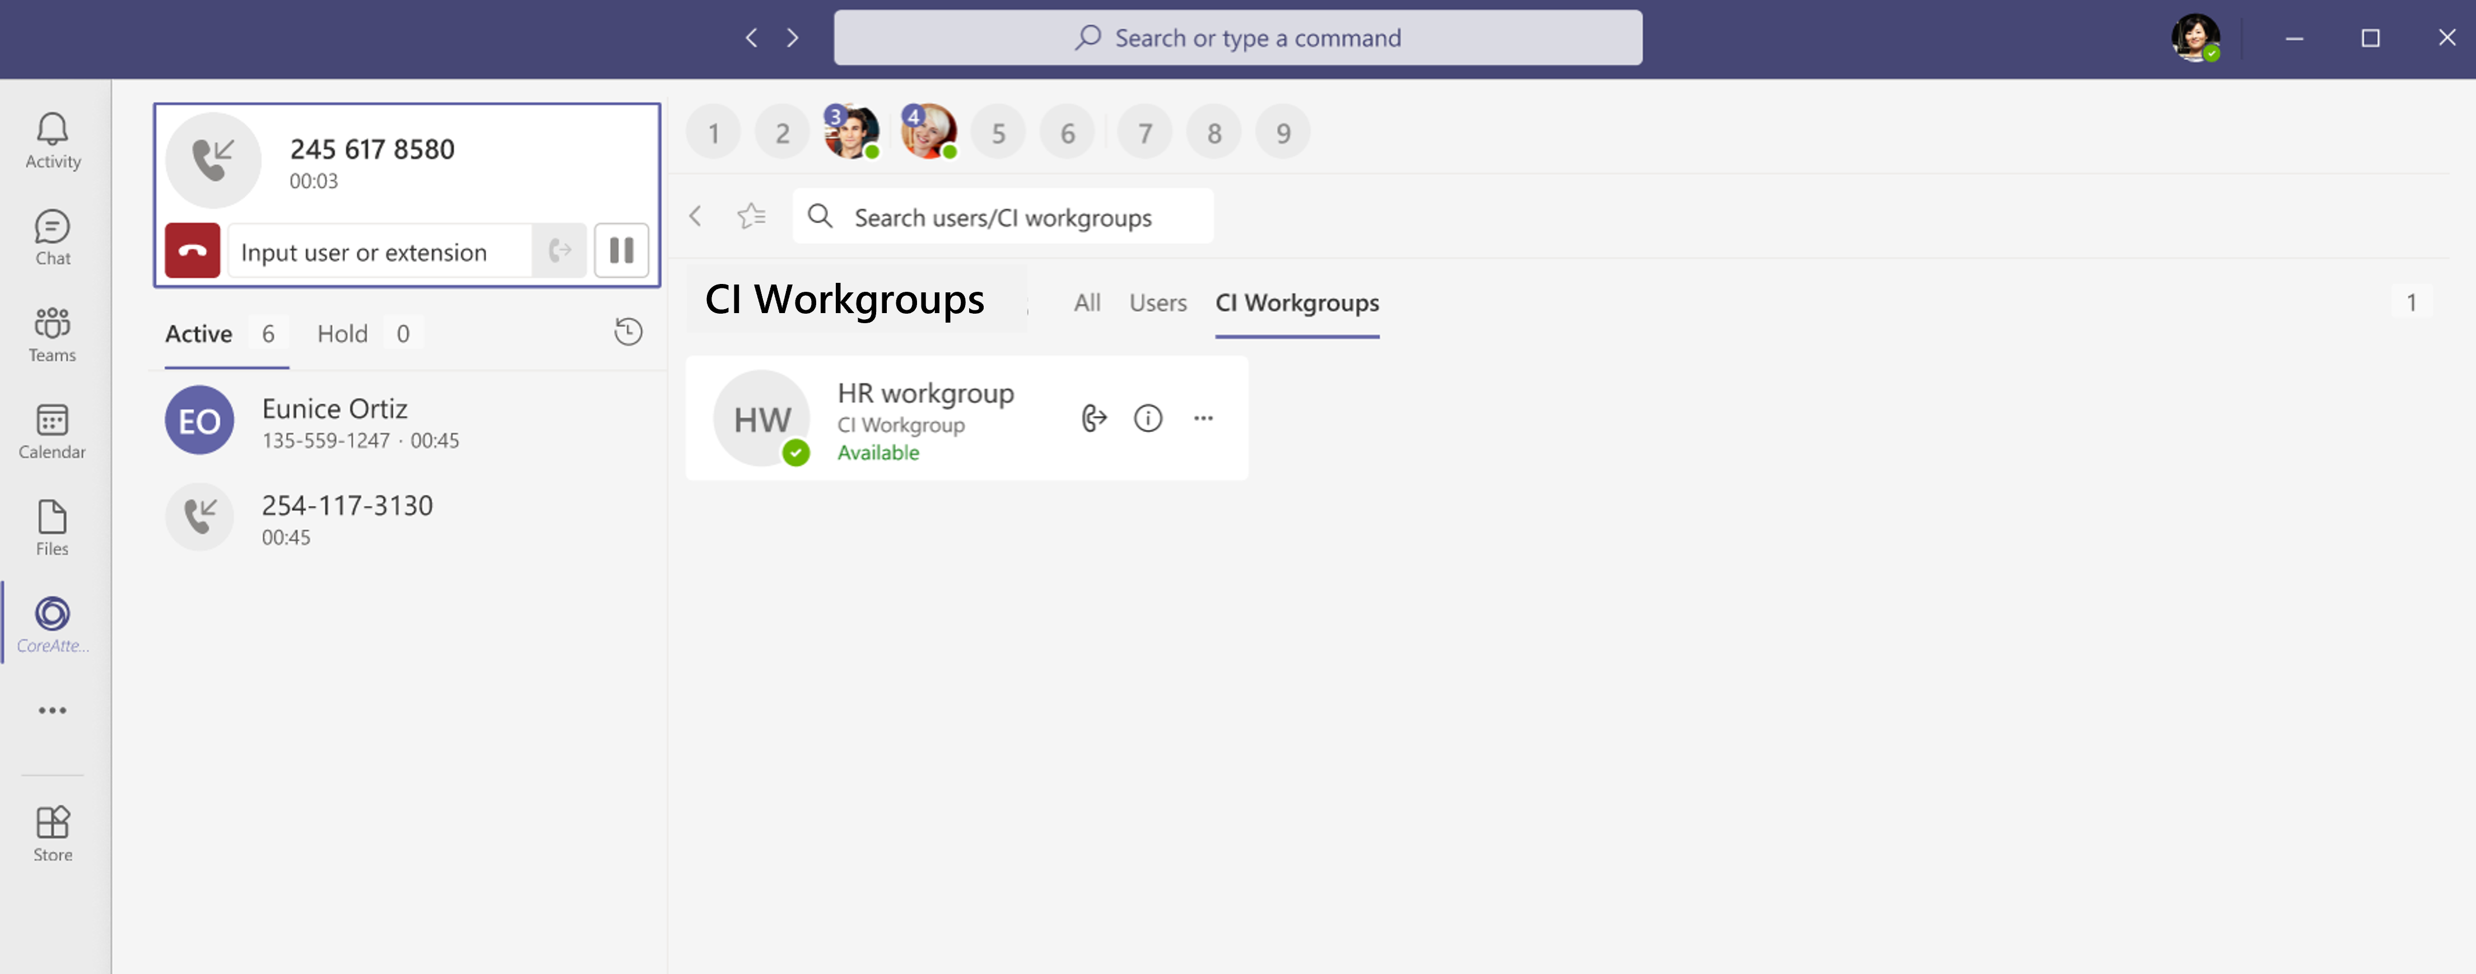
CoreAttendant Console for Teams
Operator / Attendant
Console Overview
Native Teams Application
All Calls Remain in Teams
Call Handling via Voice Bot
Graph API for User Presence
Deployed in Azure
Dual Mode Operator Queues
Active Call Queue
Hold Call Queue
Quick Transfer Call Options
Teams Users or Extensions
Hot Key List
Teams Frequent Contacts
CoreInteract Workgroups
User Configurable Views
All Teams Users / CI Workgroups
Teams Users Only
CI Workgroups Only
Confidential: Not for Distribution
Notes:
Our native S4B architecture + application suite enable MaxACD to address of your enterprise routing and queuing requirements
Not just the corp contact center
How often do you get user requests to automate…

Slide 21
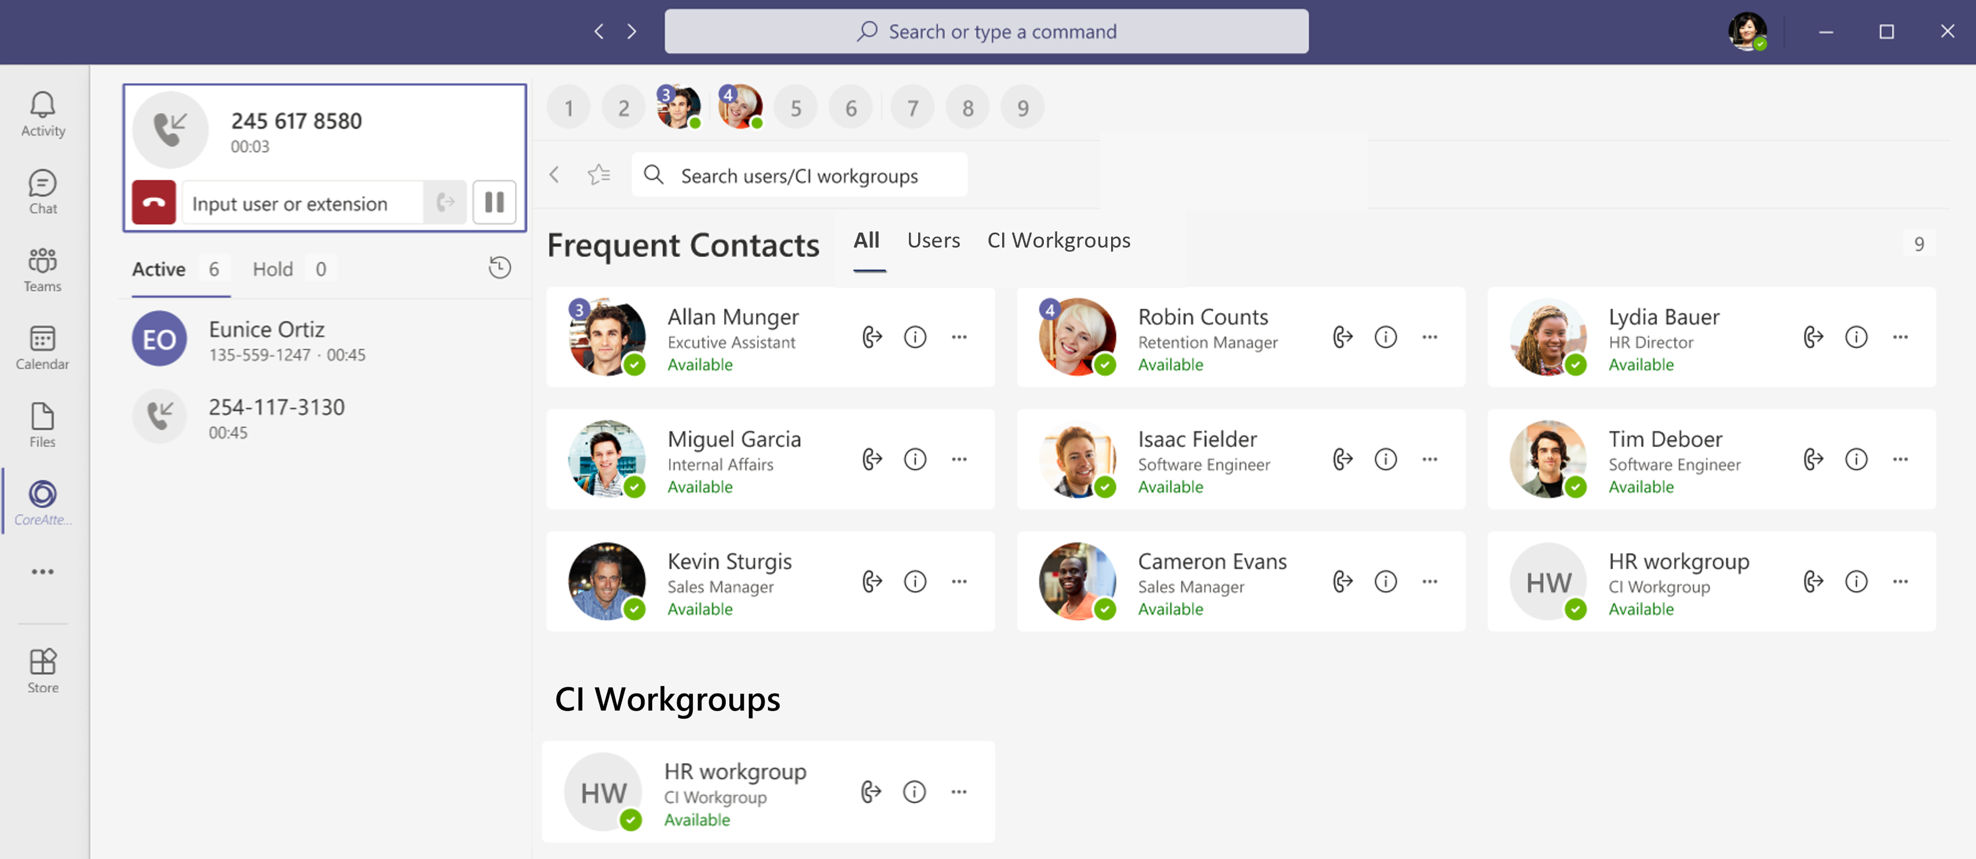
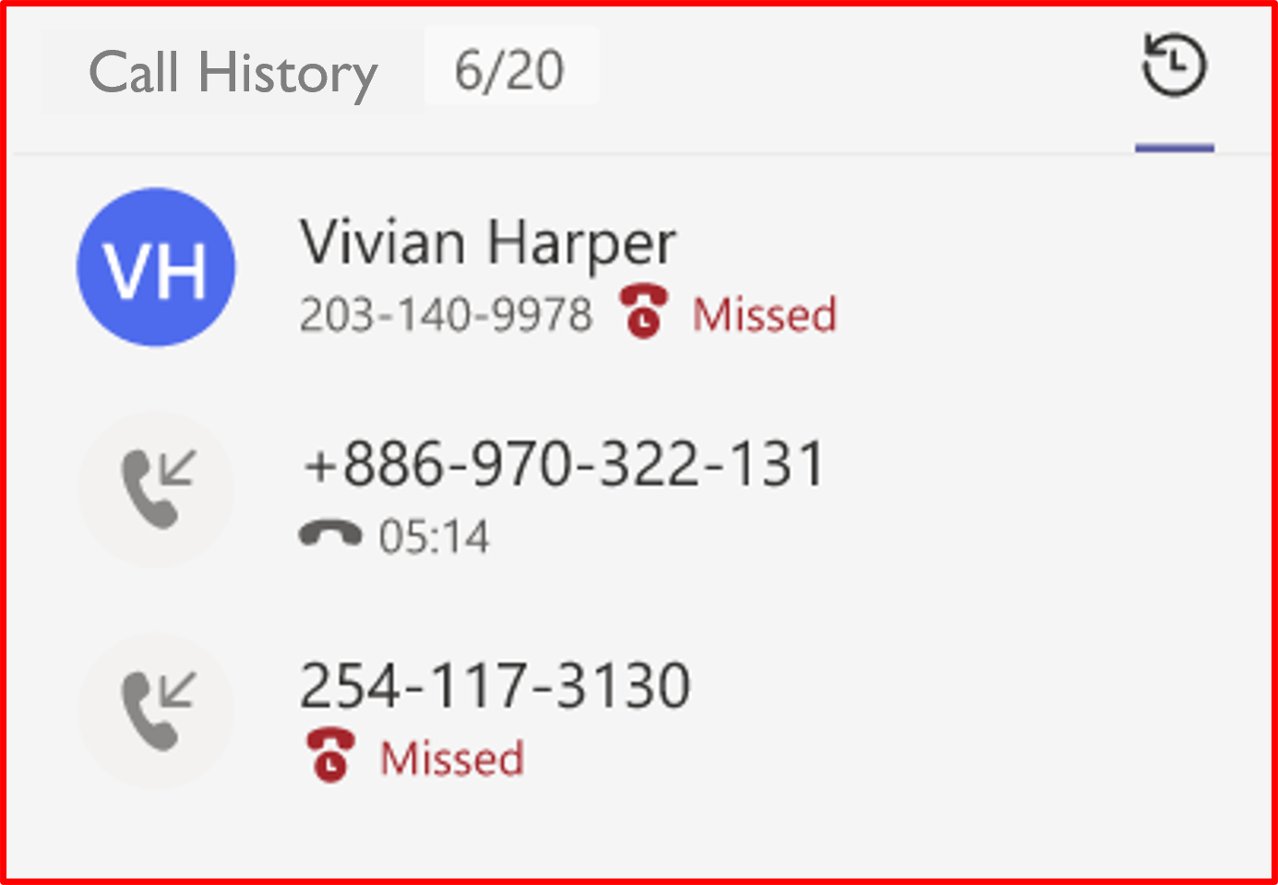
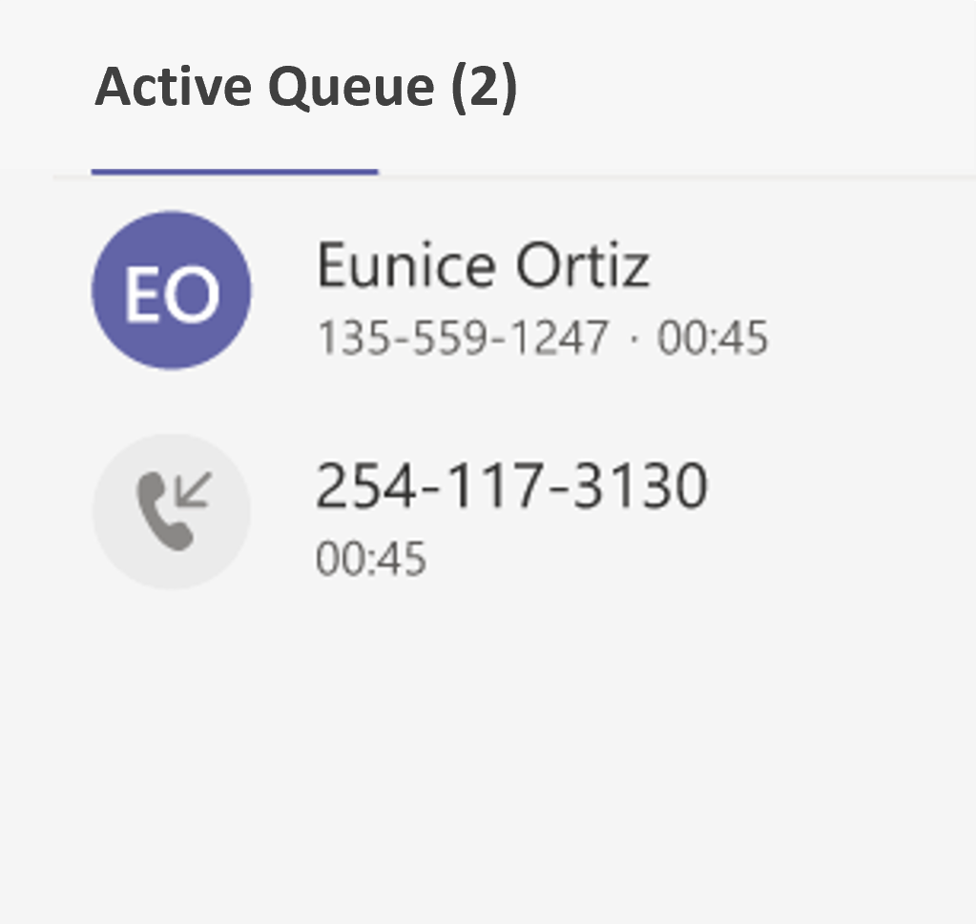
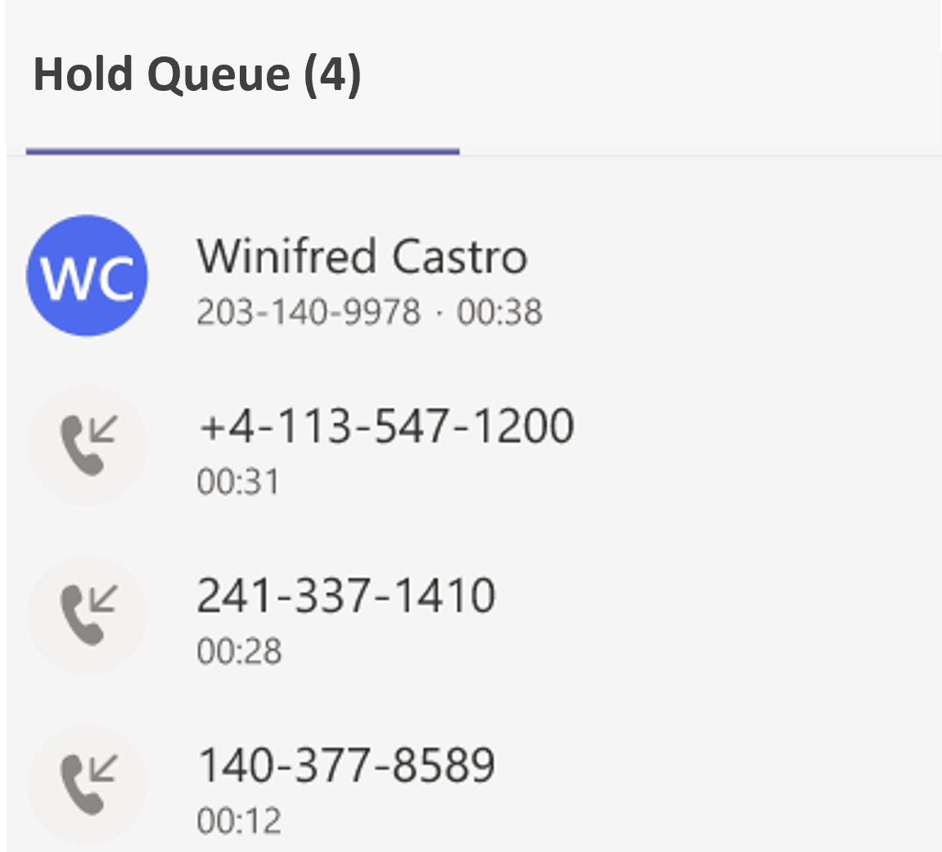
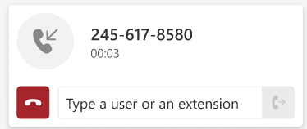
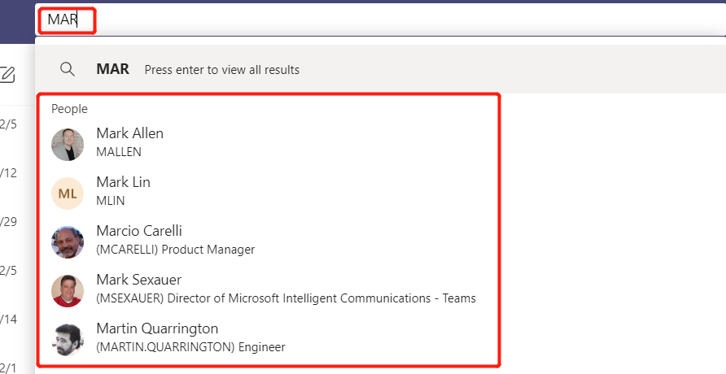
CoreAttendant Console for Teams Feature Highlights
Quick Search
Dynamically displays matching
Users or Workgroups for
Quick Transfer
Hot Key List
User configurable hot key assignment for quick call transfers
Active Call Panel
Displays Caller Information, User or Extension input
and Transfer and Disconnect buttons
Active Queue
Displays all UNANSWERED calls in the Operator Queue
Call History
Displays last 100 calls
Processed by Operator
Hold Queue
Displays all ANSWERED calls
waiting for distribution

Slide 22
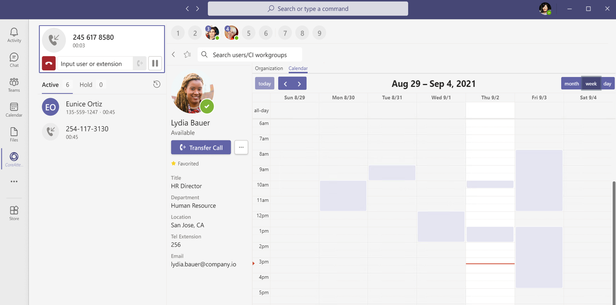
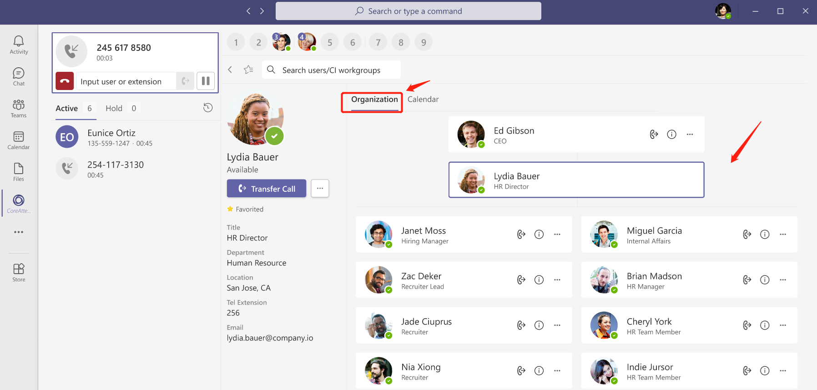
CoreAttendant Console Frequent Contact View
User Detail and Organization View
Provides additional information to assist Operator in connecting to the appropriate person Information pulled from customer’s M365 tenant
Click on a User to View User Details
Calendar View
Enables Operator to quickly view User’s future Availability
Confidential: Not for Distribution
Notes:
Our native S4B architecture + application suite enable MaxACD to address of your enterprise routing and queuing requirements
Not just the corp contact center
How often do you get user requests to automate…

Slide 23
CoreAttendant Console CI Workgroup View
Available in 4Q21
Click on a Workgroup to View Member Details
All Workgroup Members will be displayed with Presence
to enable Direct Transfer to a Specific Workgroup Member
Confidential: Not for Distribution
Notes:
Our native S4B architecture + application suite enable MaxACD to address of your enterprise routing and queuing requirements
Not just the corp contact center
How often do you get user requests to automate…

Slide 24
Notes:
# How much bandwidth will I need?
​
# Will my current office phones be compatible?
# Can I keep the same number?
# When should I opt for MS calling plan?
# Are audio conference minutes same as calling minutes?

Slide 25
Solution Summary A Complete, Integrated Enterprise Communications Solution Suite for Teams
Enhances Teams with an Integrated, End-to-End Communications Solution. Single user interface (UI)
Seamless integration with the communication and collaboration tools you already use every day
Single Vendor Solution Suite Eliminates Multi-Vendor Support Issues
Enables Organizations to Replace their Legacy PBX Systems
Cloud-based convenience – No phone system to manage, no tie to a physical site or office or location with peripheral flexibility.

Slide 26
Q & A
If you haven’t already, please submit your questions in the Q&A Zoom window (access it by clicking “Q&A” icon)
Notes:
# How much bandwidth will I need?
​
# Will my current office phones be compatible?
# Can I keep the same number?
# When should I opt for MS calling plan?
# Are audio conference minutes same as calling minutes?

Slide 27
Next Webinar
We look forward to you joining us on October 27th @ 1PM on “Cybersecurity Horror Stories and How Not to Be One”
Have a question we didn't address today?
Submit your question here: Ask_ATS@networkats.com
THANK YOU FOR JOINING!

