Slide 1
THREAT AWARENESS
SEMINAR

Slide 2
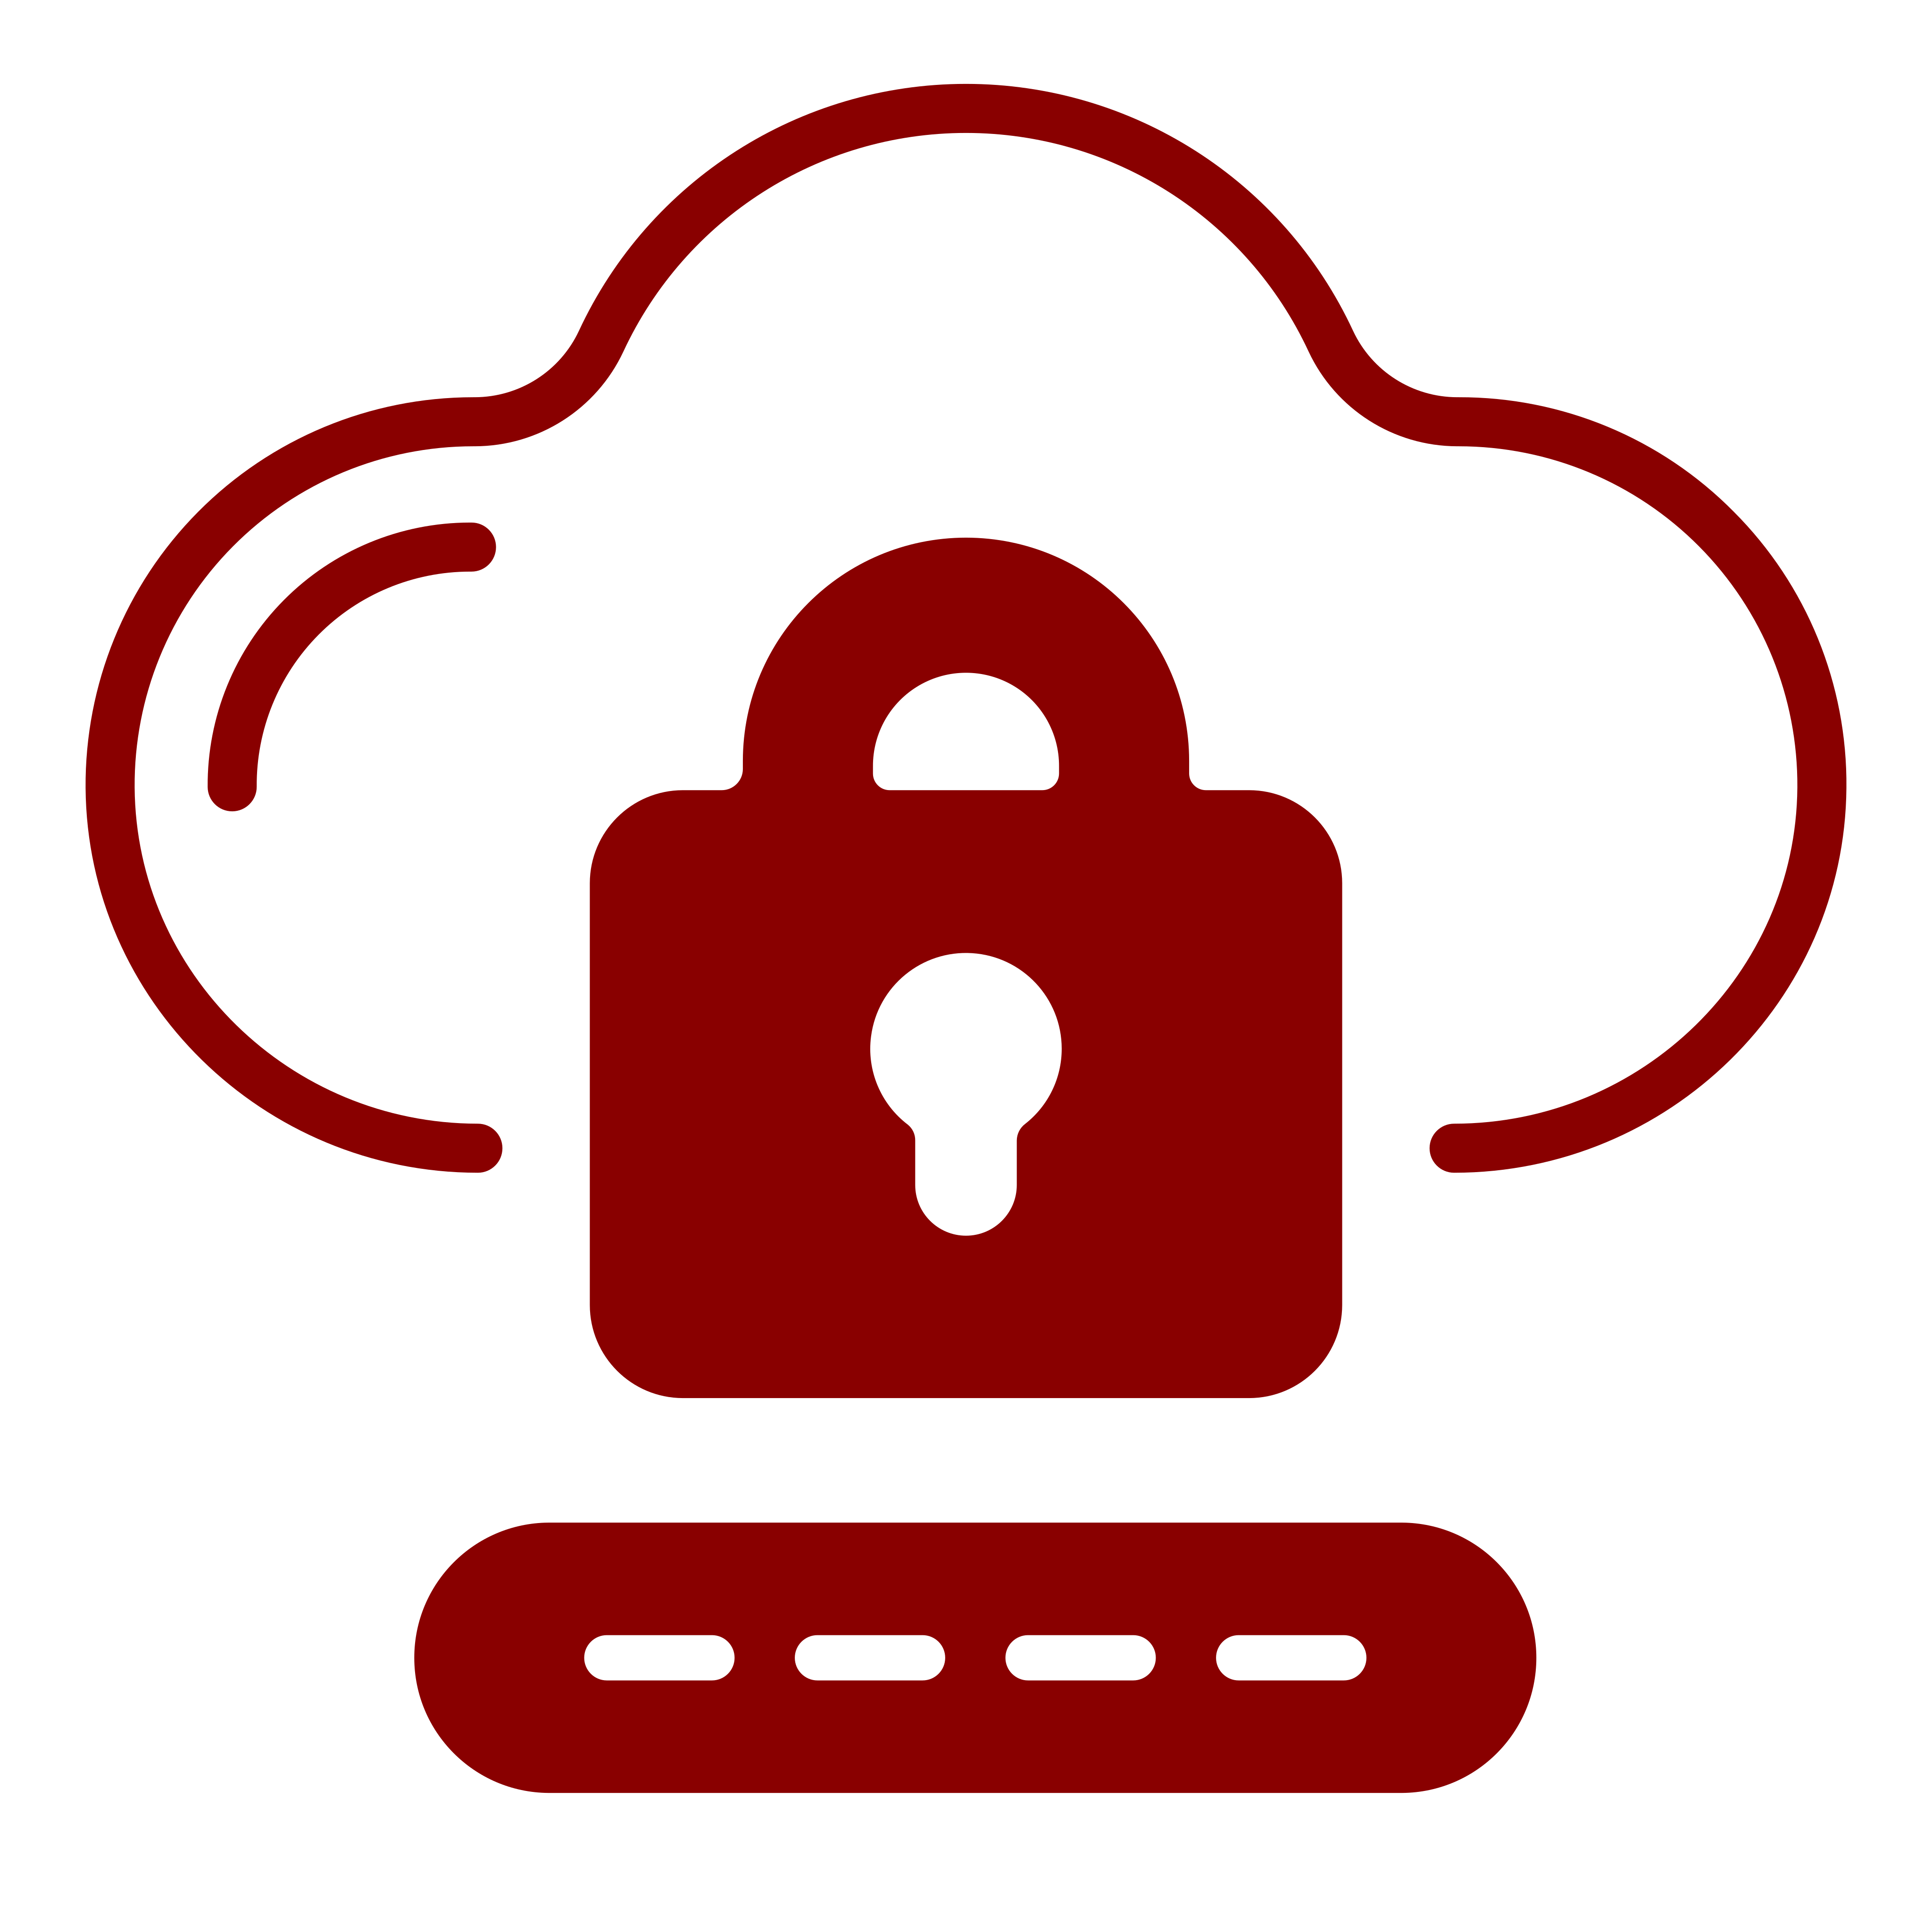
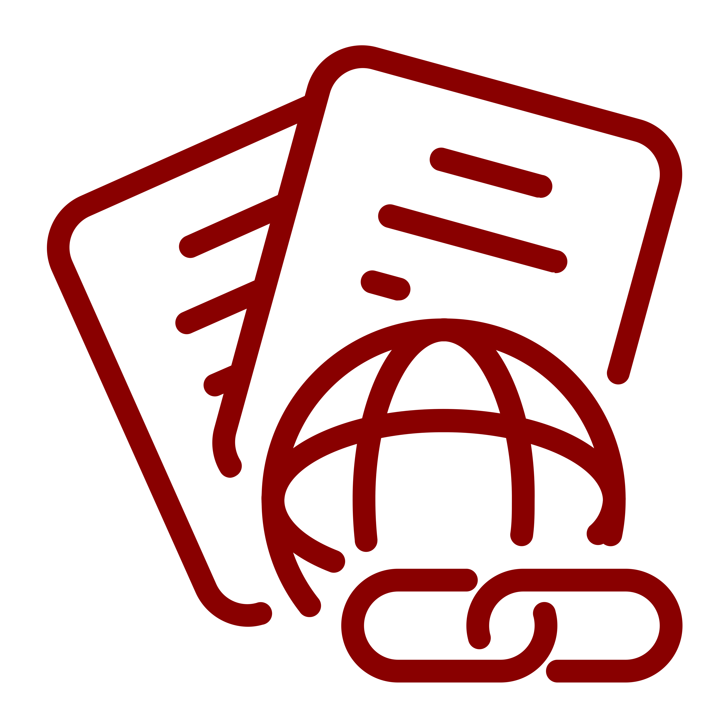
THE CURRENT
LANDSCAPE
Stolen user credentials have become the leading cause of cyberattacks
Hackers are compromising thousands of organizations simultaneously via attacks on the supply chain
Ransomware gangs are now conducting network intrusions in order to steal sensitive data. That data is then leveraged to extort the victim organization.

Slide 3
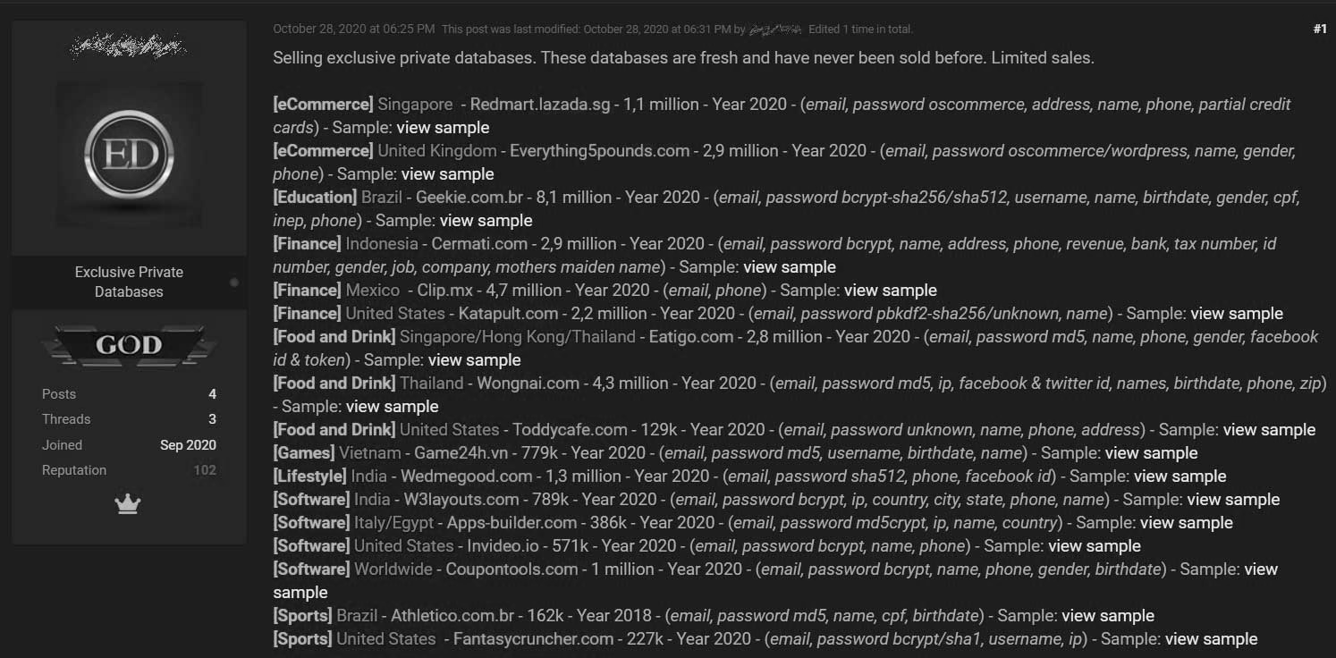
61%
8.4B
64%
Caused by leaked credentials
- Verizon 2021 Data breach investigations report
Passwords were posted on a forum
- tech republic
Phishing emails are attempting credential theft
- Phishlab
STOLEN CREDENTIALS
The most active forums on the Dark Web are those that sell stolen user credentials.
Notes:
61 percent of data breaches are caused by leaked credentials – Verizon 2021 Data breach investigations report
2. June 2021, Collection of 8.4 billion passwords named “rockyou2021 was posted on a forum. Represents the largest collection of leaked credentials to date. Gathered from past data breaches. – tech republic
3. Phishing is a huge source of stolen credentials. 64% of phishing emails are attempting credential theft - Phishlab
4. Threat actors routinely sell “fresh” credentials on the dark web or various “hacker” forums.
5. Colonial Pipeline – Attacked by Ransomware Gang Darkside
- Paid $5 Million dollar ransom
- Shutdown 5.5k miles of pipeline as a safety precaution
- Severely slowed fuel delivery on U.S East coast
- Hackers got in by leveraging stolen credentials to target a “legacy” vpn account that was unused and didn’t have Multi Factor Authentication(MFA) enabled. VPN access allows threat actor access to internal networks. They can then intercept traffic and/or pivot between machines on the network.
6. Key Takeaways
- Use MFA – If credentials are stolen MFA makes it significantly less likely threat actors will be able to exploit the stolen credentials
- Do not store credentials “in the clear” or unsecured. Use a Password Vault to store credentials.
- Do not reuse passwords across multiple accounts. Use a separate password for each account
Sources –
Colonial CEO says ransomware hackers exploited legacy VPN | Cybersecurity Dive
Back to Basics: A Deeper Look at the Colonial Pipeline Hack (govtech.com)
2021 DBIR Master's Guide | Verizon

Slide 4
REAL WORLD INCIDENT
Hackers obtained the stolen credentials of a single user account, logged into the company’s VPN and deployed ransomware.
$5M
5.5K
Ransom Paid
Miles of pipeline shutdown
Fuel shortage impacting U.S. East Coast
Notes:
61 percent of data breaches are caused by leaked credentials – Verizon 2021 Data breach investigations report
2. June 2021, Collection of 8.4 billion passwords named “rockyou2021 was posted on a forum. Represents the largest collection of leaked credentials to date. Gathered from past data breaches. – tech republic
3. Phishing is a huge source of stolen credentials. 64% of phishing emails are attempting credential theft - Phishlab
4. Threat actors routinely sell “fresh” credentials on the dark web or various “hacker” forums.
5. Colonial Pipeline – Attacked by Ransomware Gang Darkside
- Paid $5 Million dollar ransom
- Shutdown 5.5k miles of pipeline as a safety precaution
- Severely slowed fuel delivery on U.S East coast
- Hackers got in by leveraging stolen credentials to target a “legacy” vpn account that was unused and didn’t have Multi Factor Authentication(MFA) enabled. VPN access allows threat actor access to internal networks. They can then intercept traffic and/or pivot between machines on the network.
6. Key Takeaways
- Use MFA – If credentials are stolen MFA makes it significantly less likely threat actors will be able to exploit the stolen credentials
- Do not store credentials “in the clear” or unsecured. Use a Password Vault to store credentials.
- Do not reuse passwords across multiple accounts. Use a separate password for each account
Sources –
Colonial CEO says ransomware hackers exploited legacy VPN | Cybersecurity Dive
Back to Basics: A Deeper Look at the Colonial Pipeline Hack (govtech.com)
2021 DBIR Master's Guide | Verizon

Slide 5
REAL WORLD INCIDENT
Hackers breached the company’s corporate networks and injected malicious code into SolarWinds’ popular software product.
Subsequently, SolarWinds unknowingly gave hackers access to the networks of thousands of their customers via a routine software update that contained the malicious code.
SUPPLY CHAIN
ATTACKS
A supply chain attack occurs when someone infiltrates your system through an external business partner, product vendor or service provider that has legitimate access to your systems and data.
18K
$18M
$100B
organizations affected
SolarWinds Recovery Costs
Customer Recovery Costs
Notes:
4 times more supply chain attacks expected to take place in 2021 then 2020 – European Union agency for Cybersecurity(ENISA)
“66% of supply chain attacks were committed by exploiting an unknown vulnerability, while 16% leveraged known software flaws” – ENISA report
Solar Winds – Compromised SolarWinds Orion It management system
- 30k+ private and public organizations including government used Orion. Thousands compromised
Attackers compromised Solarwinds Orion code and injected malicious code named “Sunburst” into the Orion software.
Solarwinds then unknowingly sent out software updates containing the “sunburst malware” to its Orion users.
The attackers then used the “Sunburst malware” backdoor to compromise the victims networks and drop even more malware or tools to exfiltrate data.
4. Kaseya – Attackers leveraged a zero day exploit to compromise On prem Kaseya VSA servers which are used for remote management services.
- After compromising the servers they then used the compromised servers to push a fake “update” to the VSA agents on the endpoints that actually contained ransomware
Because the VSA agent is required to be “trusted” and whitelisted against any security tools, it was free to be used as a vehicle to drop malware.
Over 1000 businesses were affected. 70 million dollar ransom demanded.
5. Key Takeaways
- Users should never install unapproved software on company assets.
Organizations should use a whitelist to only allow approved software whenever possible.
Organizations must monitor and maintain awareness of their critical vendors/suppliers security advisories
Organizations should implement a continuous patching program – Patch management program.
Organizations should implement a lifecycle management program – Out of lifecycle products should either be replaced or shielded behind multiple layers of defense if replacement isn’t an option.
Organizations should consider implementing/subscribing to a threat intelligence program to track threats and vulnerabilities to their organization.

Slide 6
RANSOMWARE
Ransomware is a form of malware designed to encrypt files on a device, rendering any files and the systems that rely on them unusable. Hackers then demand ransom in exchange for decryption.
Organized Crime
2021
Global
2017
$5.3M
Average Ransom Demand
Local
$40M
2015
Network Intrusions
Data
Exfiltration
Largest Ransom Paid
Global Outbreaks
15 Days
Average System Downtime
Single
Infections
Notes:
Ransomware used to be indiscriminate and low value. Typical resulted in ransoms in hundreds of dollars of bitcoin
By 2016 ransoms in the 10k of dollars began to be reported.
Now according to Palo Alto, average ransom demand in 2020 is 847K dollars. Average paid is 312k with a high of 10m in 2020.
Average cost to remediate is 1.9m in 2021 per event.
2. What's driving this jump in ransom and cost to remediate? Change in TTP’s!
No longer indiscriminate or of low complexity
Instead of using random phish campaigns to deliver malware indiscriminately, attackers are using stolen/bought credentials to target organizations.
They use stolen credentials to breach user accounts and then move laterally through a network, identifying valuable data and exfiltrating it.
Once the data is exfiltrated and they have control of a domain controller or other ability to mass spread the encryptor, they encrypt all data near simultaneously throughout the infrastructure/network.
They now have a double hostage scenario. Both the encrypted files are used as hostage as well as threat to release data that they’ve exfiltrated.
3. Key takeaways
- Ransomware is a lucrative business and will only increase its spread.
Organizations should use Multi factor authentication to the greatest extent possible.
Ransomware operators are skilled attackers and target organizations specifically based on vulnerability profiles and ability to pay.
Organizations should take an “assume breach” posture and practice defense in depth. Assume actors will breach your outer layer of defenses and have internal controls to maintain visibility and prevent lateral movement.
Organizations must plan for and include ransomware events in the ir incident response plans.

Slide 7
KEY TAKEAWAYS
Organizations MUST consistently enforce multi-factor authentication (MFA)
NEVER use the same passwords for both work and personal accounts
Organizations MUST take an “assume breach” posture and employ continuous detection and response capabilities
Enforce policies to prevent users from installing unapproved software
Maintain an up-to-date inventory of critical vendors and IT asset inventory
Leverage cyber threat intelligence to stay on top of security advisories and emerging threats
Notes:
Ransomware used to be indiscriminate and low value. Typical resulted in ransoms in hundreds of dollars of bitcoin
By 2016 ransoms in the 10k of dollars began to be reported.
Now according to Palo Alto, average ransom demand in 2020 is 847K dollars. Average paid is 312k with a high of 10m in 2020.
Average cost to remediate is 1.9m in 2021 per event.
2. What's driving this jump in ransom and cost to remediate? Change in TTP’s!
No longer indiscriminate or of low complexity
Instead of using random phish campaigns to deliver malware indiscriminately, attackers are using stolen/bought credentials to target organizations.
They use stolen credentials to breach user accounts and then move laterally through a network, identifying valuable data and exfiltrating it.
Once the data is exfiltrated and they have control of a domain controller or other ability to mass spread the encryptor, they encrypt all data near simultaneously throughout the infrastructure/network.
They now have a double hostage scenario. Both the encrypted files are used as hostage as well as threat to release data that they’ve exfiltrated.
3. Key takeaways
- Ransomware is a lucrative business and will only increase its spread.
Organizations should use Multi factor authentication to the greatest extent possible.
Ransomware operators are skilled attackers and target organizations specifically based on vulnerability profiles and ability to pay.
Organizations should take an “assume breach” posture and practice defense in depth. Assume actors will breach your outer layer of defenses and have internal controls to maintain visibility and prevent lateral movement.
Organizations must plan for and include ransomware events in the ir incident response plans.

Slide 8
What is Cybersecurity Monitoring and How Does it Help?
CYBERSECURITY MONITORING is the process of DETECTING cyber attacks in their infancy and RESPONDING to them before they cause damage and disruption.
Credential Theft
Cybersecurity monitoring looks for anomalous behavior in authentication activity occurring on your network. Cybersecurity monitoring will also proactively locate credentials on the dark web and notify your IT Team.
Supply Chain Attacks
Cybersecurity monitoring inspects data exchanged across B2B connections for malicious activity. Cybersecurity monitoring also collects data from hacker forums and other sources to identify stolen credentials
Ransomware
Cybersecurity monitoring is actively searching the IT network for signs of ransomware gangs deploying ransomware. Detecting the attack before ransomware is executed is the objective of cybersecurity monitoring.

Slide 9
ANY QUESTIONS?
Notes:
Sources for previous slides:
One for the Money, Two for the Show, $4.4M for the Ransomware Gang That Used ATO | SpyCloud
The evolution of ransomware extortion tactics - Tech Monitor
Four-fold increase in software supply chain attacks predicted in 2021 – report | The Daily Swig (portswigger.net)
REvil ransomware attackers demand $70m following Kaseya VSA supply chain attack | The Daily Swig (portswigger.net)
Updated Kaseya ransomware attack FAQ: What we know now | ZDNet
Colonial CEO says ransomware hackers exploited legacy VPN | Cybersecurity Dive
Billions of passwords leaked online from past data breaches – TechRepublic
Colonial Pipeline paid $5M ransom one day after hack, CEO tells Senate (cnbc.com)
Back to Basics: A Deeper Look at the Colonial Pipeline Hack (govtech.com)

