Slide 1
Notes:
Hello and welcome to the first ever MCON Live! I’m Leslie Thompson, Sales & Marketing for Mirus.
Although we wish we were live with you in person, we’re excited to be live together online today. At Mirus we place a great deal of importance on staying connected with our customers and fellow Mirus Nerds. Since face-to-face meetings aren’t really happening right now we wanted to find another way to bring you product update information.
Today you’ll be hearing from Mirus CEO Dave Bennett. We hope to make this a quarterly event with product updates, presentations from your fellow Mirus clients and training sessions. Your feedback will be important in shaping future MCON Lives so let us know what you’d like to see.
Following Dave’s presentation, we will open things up for Q&A. Please use the chat function to ask your questions. Feel free to send in your questions as they come up throughout the presentation. I’ll be tracking questions and will do my best to make sure they get answered at the end of the presentation.
Dave…

Slide 2
Agenda
Welcome
Industry review
Mirus Enterprise updates
Planned updates
Q&A
Notes:
Thank you Leslie……
And, WELCOME to all of you. Thank you for taking the time away from your responsibilities for a quick update from Mirus.
As Leslie said, this is our first MCON LIVE virtual event, so we are very interested in your feedback on how this type of event can deliver to you the information you need.
It is great to see a mix of clients who have been with us for a while along with clients who have joined since the last MCON in Chicago.
Our plan is to finish up the presentation in about 45 minutes to leave time for your questions.
There is a lot of information, so I plan to go quickly through each slide. If you have a question, please use the chat function to submit it to Leslie. She will pull the questions together and we will go through them at the end.
Next slide

Slide 3
Industry Update
Sales story
Traffic story
Segment story
Mirus story

Slide 4
Sales Story
Notes:
I don’t think this chart should surprise anyone
One year ago today, life was very different. The industry was enjoying one of the best starts to the year in a decade.
Then, there was Covid, and life as we know it changed. In a matter of two weeks the industry lost two thirds of its sales.
The holiday period was choppy for many operators, but sales are returning slowly to pre-Covid levels.
Because this chart is comparing each day to the same day last year, we are about to see a reversal in the direction of the columns.
I predict on March 16 of this year, the columns will start pointing up as we compare to the initial shock period of Covid.
Good news we can look forward to…..
Next slide

Slide 5
Traffic Story
Notes:
A simple assumption would be that traffic would follow the same trends as sales, and it does, to an extent.
But, when you look more closely, the traffic numbers generally have been better than the sales numbers throughout the pandemic.
From a transactions perspective, the industry is very close to early 2020
In fact, Mirus Index has already observed multiple days in 2021 with higher traffic than last year.
I encourage each of our clients to examine their data to see if the same is true for them, and to research the drivers of this change
For example, how did your product mix change from early 2020 to now? Could the decline in dollars be mostly in beverages? Or desserts? Or appetizers?
Next slide

Slide 6
Segment Story
Notes:
Every form of restaurant was affected by Covid, but not in the same way.
The similarities in these curves initially surprised me, we are looking at sales dollars by QSR, Fast Casual, Casual Dining, Fine Dining and Non-Traditional dining, and summarized by Week.
Generally counter service environments have performed better than table service concepts, and non-traditional operators have been hit the hardest.
One curiosity I see is during the holiday season, fine dining experience a bigger dip than other segments. This may have more to do with how well these restaurants did in December of 2019.
All segments continue to improve, but QSR stands out as the segment already above the levels for early 2020.
There is still a long way to go for the majority of restaurants.
Next slide

Slide 7
Mirus Story
Triage our clients
Invoice Relief
Continuously monitor
New business
Notes:
So, while the restaurant industry tipped upside down, what was going on at Mirus?
We started our re-planning of 2020 in February by examining the hit being experienced by our clients. At this time, we received the first requests for relief from invoicing.
All clients were put into one of three categories: sales down more than 90%, sales down more than 30%, and sales down less than 30%.
We structured our invoice relief offers based on these categories.
More than $320,000 of invoice relief was extended from April through June. And some individual relief in Q3 & Q4.
We continue to monitor our client's recovery from Covid, and it has not been a smooth path.
A big surprise for us was signing new clients. We really thought it unlikely to sell new accounts, but we were really happy to see operators trying to take advantage of the situation to improve their reporting and analysis.
We also experienced a spike in projects during the summer as clients took the opportunity of slow activity to swap out POS, back office and other applications.
Next slide

Slide 8
Mirus Enterprise Updates
Notes:
I am going to shift now to the updates we have made to Mirus Enterprise since our last MCON in Chicago…..
Covid had an impact on our development efforts in 2020, especially in the Second and Third quarters.
We have been back to our normal 4-6 Week build cycle since last summer and expect to get more done in 2021
For those of you who are relatively new to Mirus, we are constantly updating the software to add or enhance features, but there is also an overriding, multi-year effort underway to expose all of the features of the Edit Pages on the Dashboards and in Report Display. This will reduce the number of clicks you need to navigate in the application, but it also improves performance while building new reports and dashboards.
I will quickly review a dozen or so enhancements from last year. Then we will go into the demo system so I can show you these capabilities in a live format.
Throughout 2020, we applied over 250 enhancements or adjustments to Mirus Enterprise. We have combined them into a dozen or so slides.
Next slide

Slide 9
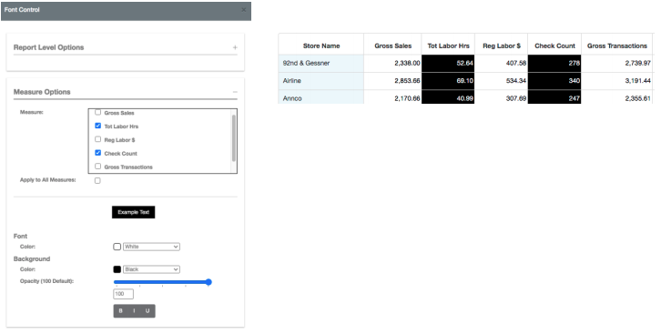
Additional information for measures in font control
A check box allows you to clearly indicate which measure is being selected.
The original measure name also now appears.
Notes:
There are a few changes we made to Font Control in 2020.
Font control is a large initiative we have been working on for a while. It is part of our attempt to give you more control over the look and feel of your reports.
This enhancement added a radio button to explicitly indicate which measures you are working with on the report
We also made it easier to see the original measure name in cases where a label has been applied.
You can see an example of the settings for a report, and how it changes to look of the report.
Today, font control is only available for measures, and not dimensions, but we will give you an update on what to expect in 2021 later in the presentation.
But, it's not the only enhancement on font control….
Next slide
.

Slide 10
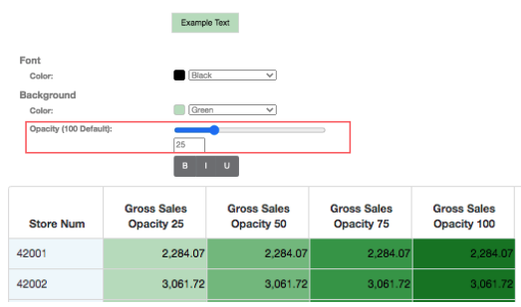
Opacity was also added to font control for the background color. (6.7.0)
Notes:
You may have noticed a new scale on the previous slide.
This scale is used to control opacity, so you can make your data as lightly or darkly colored as you like.
If you prefer using numbers instead of sliding the scale, you can also type in a value between 0 and 100 to control opacity.
The sample report here shows you four levels of opacity with a green background.
Next slide

Slide 11
You can now edit address book contact names in Site Admin. (6.6.1)
Notes:
Moving beyond font control, we made an enhancement for site administrators to allow them to edit address books directly from the Site Admin screen.
Site Administration is a section of Enterprise that will change significantly as we progress towards our mission to make Enterprise a Single Page Application.
That means improved performance for you, and for us it makes it easier to add or change features.
Next slide…

Slide 12
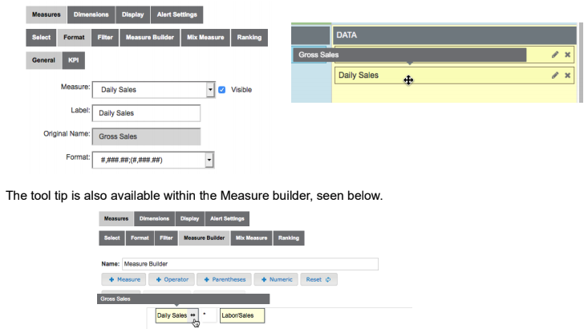
Tool tips have been added to measures in edit pages to help you see the original name of the measure after it’s been changed. (6.6.2)
Notes:
A feature that goes back to the earliest versions of Enterprise is the ability to rename a measure on a report. So, if Gross Sales is not the right label for a given report because you know it will be detailed by Day, you can rename it to Daily sales.
In the past, once you renamed a measure with a label, it was a challenge to understand the base measures being used in a report.
So, we now expose the original measure name whenever your cursor flies over a measure name in the Edit Pages.
Here we see two examples of the flyover, one in the report layout section, and another on the Measure Builder tab.
Next slide….

Slide 13
We achieved one of our 2020 goals of updating to the latest version of Angular for the Report List. What does that mean for you? More features and functionality and a more modern look and feel. (6.6.3)
Notes:
Each year we invest some of our time in upgrades to the software we use to build Enterprise. These updates are not always visible, but they are essential to maintain our ability to add new features quickly.
We use Angular to build the screens you use to build and display reports. It is one of our core technologies.
The investment in this upgrade gives us access to new features and capabilities within the Angular architecture.
Next slide….

Slide 14
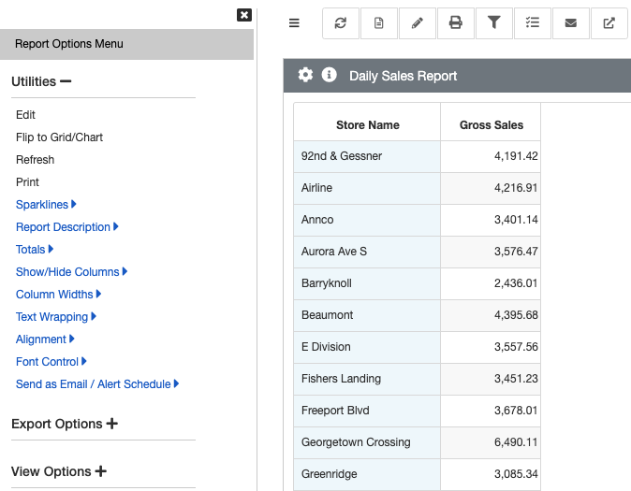
Report options now open in the left panel. This allows you to view the report and the report options at the same time. (6.7.0)
New Location Report Display
Dashboard View
Notes:
As I mentioned earlier, one of our long term objectives is to move all of the functionality from the Edit Pages out to the Dashboard and Report Display.
We started this journey several years ago and at some point, we started adding features to the Options (Gear) icon.
You can see here in the Old Location the screen we have used to add new features as we moved them from the Edit pages. We knew at the start that this page would not live long-term, and last year was when we exposed the new model for organizing features on the Dashboard and Report Display.
The Gear icon is still used to expose the features you can use while viewing a Dashboard or a Report.
What’s different is the panel that pops up on the left side of the screen. On Dashboards, the Options will replace the list of Dashboards. In the Report Viewer, the panel appears on the left side of the screen.
We have also taken advantage of this design to organize the features into groupings, so now you will see Utilities, Export Options, and Chart Options.

Slide 15
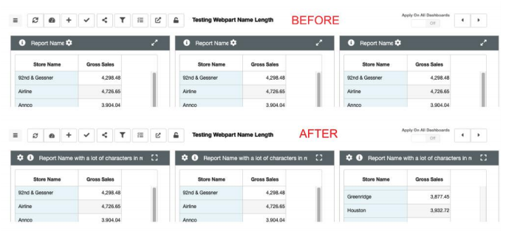
We’ve increased the character limit for the display of report names on Dashboards. (6.7.2)
Notes:
Our user interface is almost always changing slightly. Here is an example of a change that isn’t revolutionary, but it makes a lot of sense.
On Dashboards, each Webpart has a header that is used to display the name of the report and to provide links to several features.
The old way of organizing the icons created a limit on the number of characters you could see in the webpart header.
By rearranging the icons, you are now able to see longer report names on the webpart header.
Next slide

Slide 16
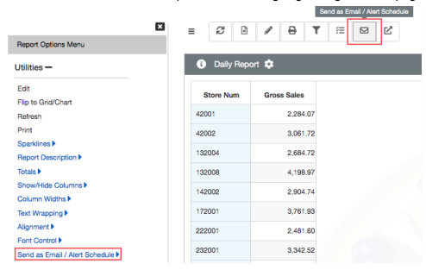
The alert scheduler has been moved to the report options. (6.7.0)
Notes:
One of the newest features to be moved to the Options menu is the Alert Scheduler.
Before, you had to have access to the edit pages to create an Alert. For those of you who are new to Mirus, an Alert is simply a report that has a Schedule for execution, as well as how the report will be delivered – Excel, PDF, or csv
Now you can access the Alert Schedule screen from either the Options menu, or through the Email icon on the toolbar.
Create or modify schedules while you look at the report.
Next slide

Slide 17
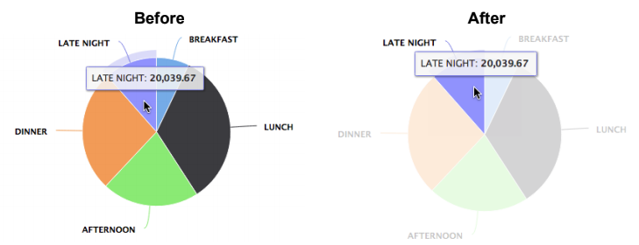
The chart library got an update. Now, when you hover over a section of a chart the unselected sections will be faded. (6.6.3)
Notes:
The Charting engine was updated to take advantage of new features.
Now, when you look at any chart, as you fly over elements of the chart, the other elements will be faded. This allows you to easily isolate a portion of the chart for closer examination.
If you do not use charts often, there is a growing list of features you can invoke while looking at a chart.
For example, drilling has been available on charts for a while now. I will show you an example of this when we are in the demo system.
Next slide

Slide 18
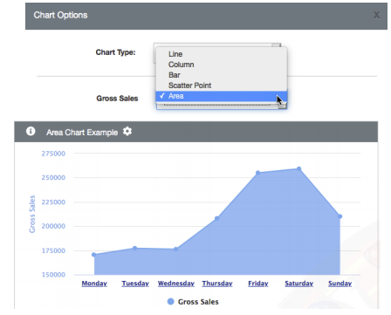
We also released a new chart type- Area charts! They can be found under the chart type options. (6.6.4)
Notes:
The charting engine we use has over 100 chart types we can activate. Today, we probably expose about ten of them. So, as always, if you need a chart type that is not yet available, please let Account Management know. Some chart types are easily added, but others are more involved and require adjustments to the back end to create the result used by that chart.
In 2020 we exposed an Area Chart. I will show you an example in the demo system.
Several years ago we modified the system to allow each user to decide how they want to see a report. We consider it a personalization. You can turn this capability on or off, but the intent is to allow a single report to be shared with lots of people, and each person can adjust the visualization so they see it the way that is best for them. The person building the report doesn’t have to worry about 5 unique versions, one for each visualization.
Next slide

Slide 19
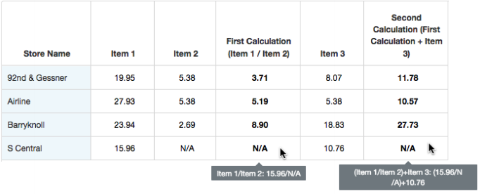
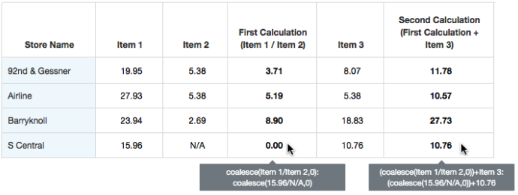
My favorite new word - Coalesce
The measure builder got a new feature requested by clients: coalesce. This improvement allows users to replace null or N/A values in a calculation with a value of 0. (COALESCE/ 6.6.5)
Notes:
I have been waiting for this slide so I can use my new favorite word, Coalesce.
What does it mean? Beats me, but apparently it means something in the world of mathematics.
I will show you an example of this when we go into the demo system.
The short story for Coalesce is that it allows calculations to be completed that would have failed in the past. In this example, we have two calculations. The first divides one measure by another, creating a result. That result is then used in a second calculation.
You can see on the left side that the calculations resulted in N/A, and on the right side the same calculations were completed by substituting zero for a null or invalid result.
More on this in the demo.
Next slide

Slide 20
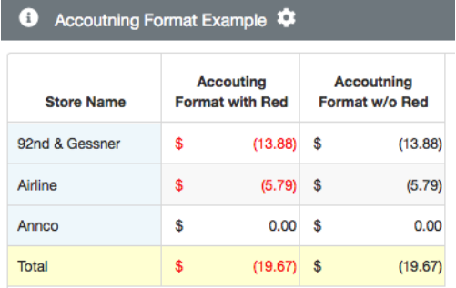
We introduced the Accounting format.
puts a dollar sign at the left side of the cell,
sets two decimal places,
adds a thousand separator, and
negative numbers are shown in parenthesis.
This format flows through when reports are exported to XLS and PDF. (6.6.6)
Notes:
Measure formats have been part of Enterprise since the beginning. It allows you to display the numbers the way you want, similar to a spreadsheet.
We have dozens of formats defined, and due to the way Enterprise is designed, we can easily define new format types to fit specific needs.
In 2020 we added an Accounting format. This format left justifies the dollar sign, sets two decimal places, adds a separator for thousands and millions, and there is an option to display negative values in RED.
The settings for the Accounting format are passed on in exports to excel and pdf.
If you want your reports to display numbers in particular ways, let us know. There is a good chance the format you want already exists, and if not, we can work with you to get one built.
Next slide

Slide 21
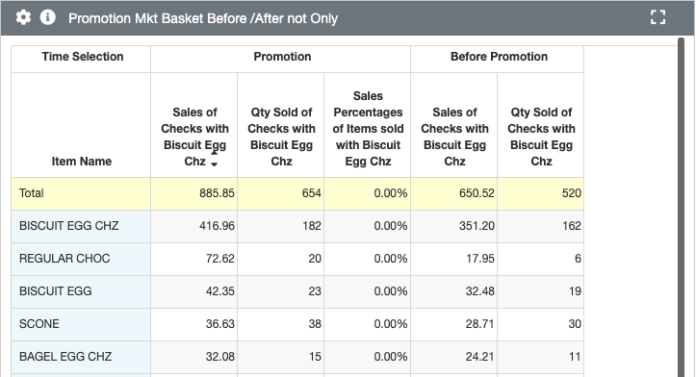
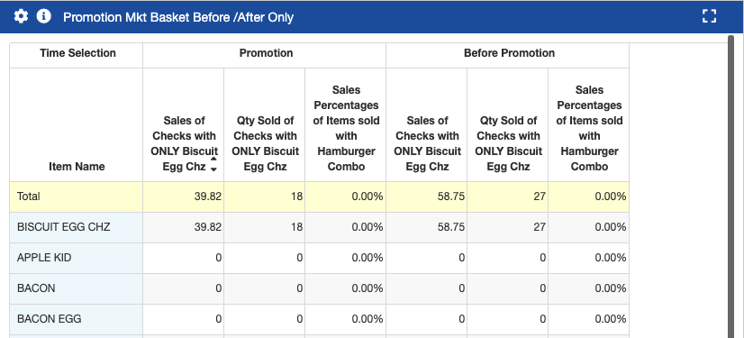
We added an ONLY feature to NSTEP.
You can now create reports that will show checks that ONLY have certain items on them. (6.6.7/8)
Notes:
Finally, the last slide for Enhancements. We are about to go into the demo system, but before we do, I want to discuss a new feature to NSTEP.
In the way of background, NSTEP is a type of Filter in Enterprise. It is different from other filters that work on individual rows of data, because NSTEP allows you to examine the contents of individual guest checks and filter for specific conditions.
For example, with NSTEP, you can filter all of the checks for a Day or Week, or even Year for specific conditions like: “Show me all of the checks that included a sandwich but no drink that was sold online from 2pm to 5pm and a gift card was used for payment.”
I know, that is a ridiculous example, but I wanted to give you the larger sense of this filter’s capabilities.
In 2020 we added the ONLY feature to NSTEP. With Only, you can select checks that contain ONLY the items you specify or checks that were tendered to ONLY the tender types you specify. In the report on the top, you see all of the items sold on checks that contain the Biscuit Egg Chz. The report on the bottom is the same report, but with the ONLY feature applied. So, the result includes only those checks that contain the Biscuit Egg Chz only – no other items.
I will touch on this when we are in the demo system.
Next slide

Slide 22
Demo Time
Notes:
We will jump over to the demo system at this time.
If you have any questions, please use the Chat feature to send them to Leslie, and we will cover all of the questions at the end.

Slide 23
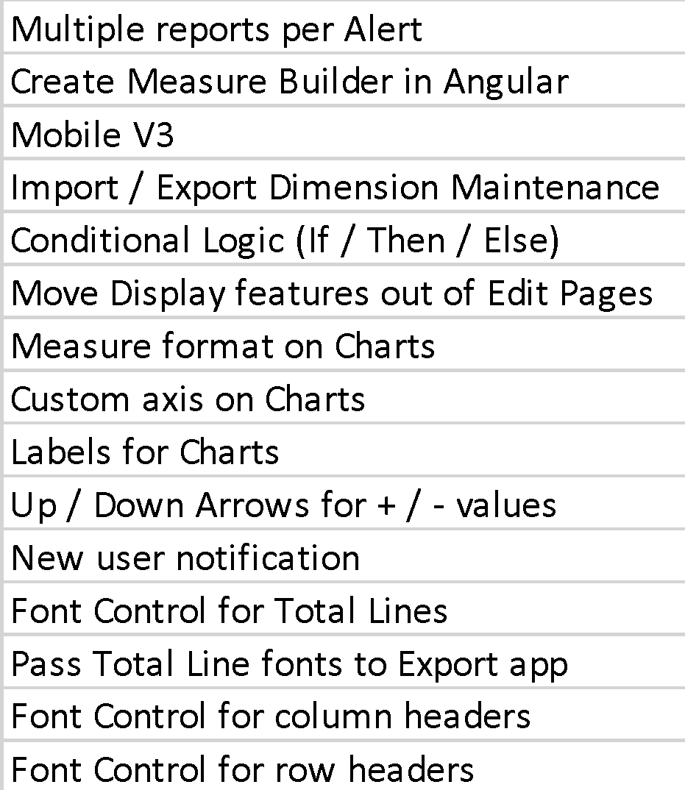
Planned Updates
2021 Development
Alerts with multiple reports
New measure builder
Mobile v3
Boolean logic
Charting enhancements
More font control
Notes:
For 2021 we plan to deliver a lot. Some of the work behind these deliverables has been proceeding for a while, and we hope to deliver these features as soon as possible.
An example of a popular feature that has had some work completed is the ability to designate multiple reports to be delivered as an Alert. The back end logic is in place for some of this, but we continue to work on the screens you will use to designate which reports to include in an Alert.
Measure Builder is one of the next features to move from the Edit Pages to the report display and Dashboards.
We also intend on moving the remaining Display functions – Top Bottom, General & Advanced – out to report display and Dashboards.
Development of V3 of our Mobile app is on the list this year. We will be looking for clients to work with us on the design of this version.
Then, we will continue to work on enhancements for Charting, and with Font Control.
This list represents a lot of work, and you will start seeing some of these in the next couple of builds.
Next slide

Slide 24
Q&A
Notes:
Now, let’s see if Leslie has any questions to address…..

