Slide 1
What is Flourishing?
Human Flourishing and the Common Good

Slide 2
Pre-Assessment
What does it mean to flourish? Do you know? Share what you think.
What do you need to flourish? Is it the same as other people?
What is the common good?
How does your personal “good” relate to the “good” of others?
Notes:
The teacher reminds students that in the unit pre-assessment they were asked to reflect on what it means to flourish and explains that today the class will explore the general concept of flourishing by taking a closer look at how different natural ecosystems function and what it takes for them to flourish.

Slide 3
Unit Introduction
In this Unit we will:
  Consider what human communities need to flourish.
  Learn about the concept of the common good and its critical attributes (characteristics).
  Apply the concept of the common good to real-world situations.
In order to do this…we first need to understand what communities are and what it means to flourish.
Lesson #1 will lay the groundwork by exploring environmental ecosystems and their flourishing.
Notes:
The teacher should take the opportunity to provide students with a basic outline of the unit before they start. This will allow students to know from the beginning what they are doing, why they are doing it, and where is expected of them by the end of the unit. The first three sub-bullet points provide the basic outline for Lessons #2 - #4. Then the teacher will want to inform students that in order for students to fully and correctly understand the concept of the common good, they require a basic understanding of human flourishing. If students do not understand what it means for an individual and a community to truly flourish, they will lack the foundational understanding needed for productive discussions about the common good.
Lesson #1 will lay the foundation for the coming lessons by allowing students to think about environmental ecosystems first. Thinking about environmental ecosystems and their flourishing will hopefully allow students to start with something they know and to enter into conversations about human ecosystems and human flourishing with fresh eyes.

Slide 4
Learning Objectives
What does it mean to flourish?
What are characteristics of flourishing environmental ecosystems?
How do humans influence the flourishing of environmental ecosystems?
What are the characteristics of flourishing human ecosystems?
How do humans influence the flourishing of human ecosystems?
Notes:
After giving students an overview of the unit, the teacher should introduce the learning objectives for Lesson #1. NB: These are a simplified version of the learning objectives for Lesson #1.

Slide 5
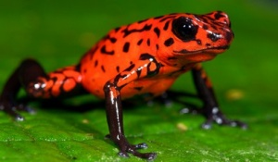
Poison Dart Frog
What does a poison dart frog need to flourish?
Notes:
The teacher should ask students to provide answers to the question “What does a poison dart frog need to flourish?”
Image: http://www.facts-about.info/poison-dart-frog/

Slide 6
Poison Dart Frog
Territory/habitat
Place to deposit eggs
Water/humid environment
Oxygen
Food: ants, centipedes, mites
Toxins from food
Male and female frogs
Notes:
This slide provides some of the answers students may give to what a poison dart frog needs to flourish. Poison dart frogs need a habitat or territory within which to live. In fact males and females are both territorial and will wrestle for their particular space. Within this territory, they need a place to leave their eggs which might be a pool of water or under the leaves on the forest floor. Because poison dart frogs are amphibians, they need water and a humid environment to survive. Their thin skin allows for oxygen to pass through but it also easily loses water. Hence, they need a constant supply of water to replenish what is lost. The poison dart frogs need food including ants, centipedes, and mites. Importantly, they need to eat the right food that will allow them to accumulate toxins from their food within their body. The secretion of these poisons (along with their bright colors) serves as a defense against predators. Male frogs need female frogs and vice versa in order to continue propagating their species.
Students may provide different or more answers than those found on this slide. These are just some examples of what a poison dart frog needs to flourish.
NOTE: The bright colors of a poison dart frog is not included in the list because the color of the frog is a characteristic of the frog not something external the frog needs. This is different than needing a particular diet in order to build up toxins within their body .
Image: http://www.facts-about.info/poison-dart-frog/

Slide 7
What are different types of ecosystems?
Notes:
The teacher should give students the opportunity to brainstorm about different types of ecosystems. Students may offer specific, subordinate examples such as a savannah, a rainforest, or a coral reel. Others may think more broadly and suggest examples such as marine, forest, or tundra. The teacher may ask students how their different examples relate to one another or may be grouped.
An ecosystem consists of all the living and nonliving things in a specific natural setting.

Slide 8
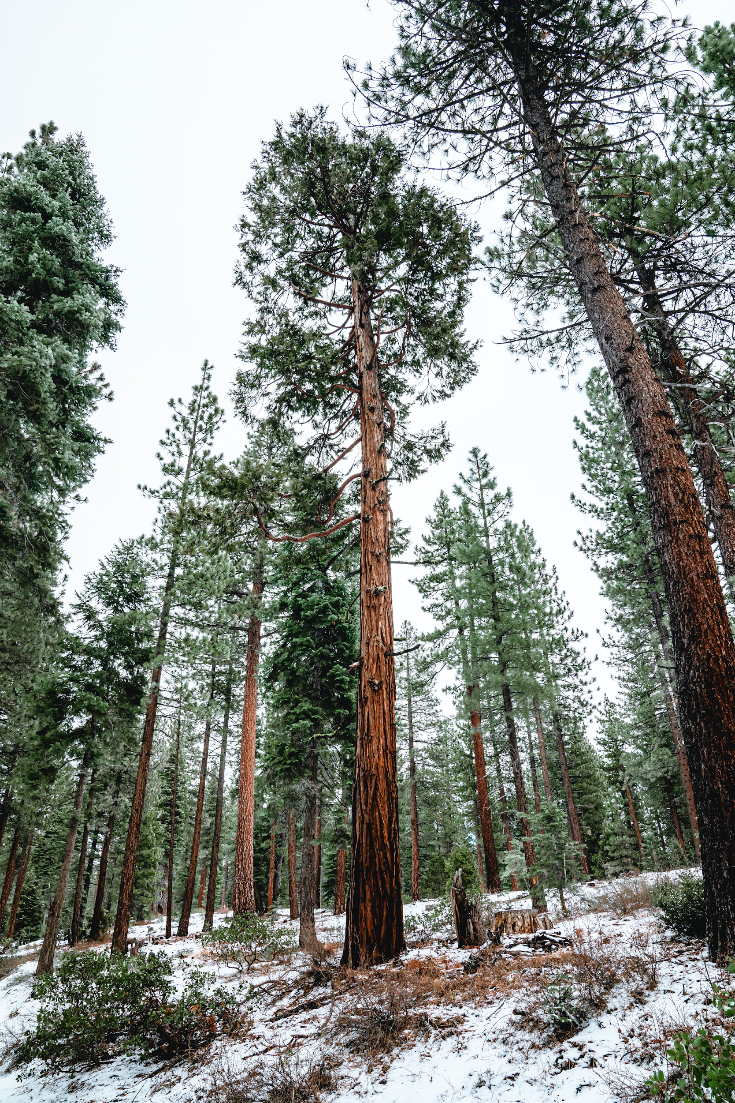
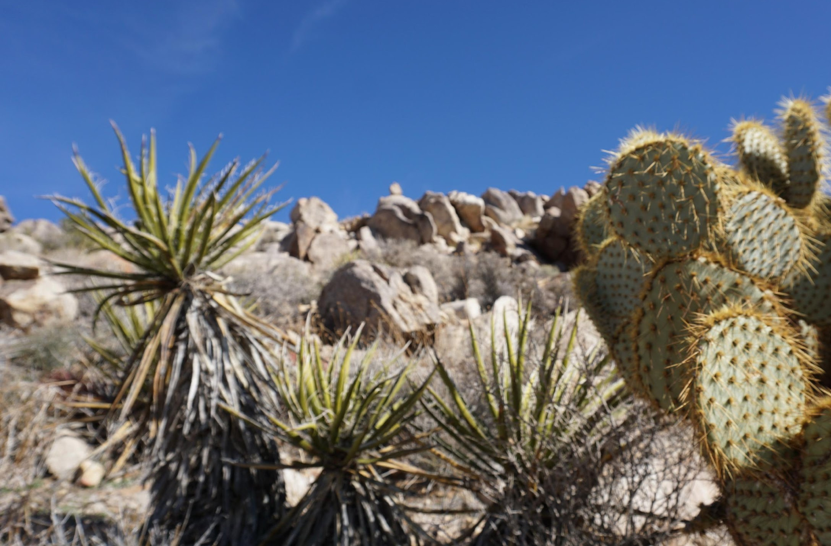
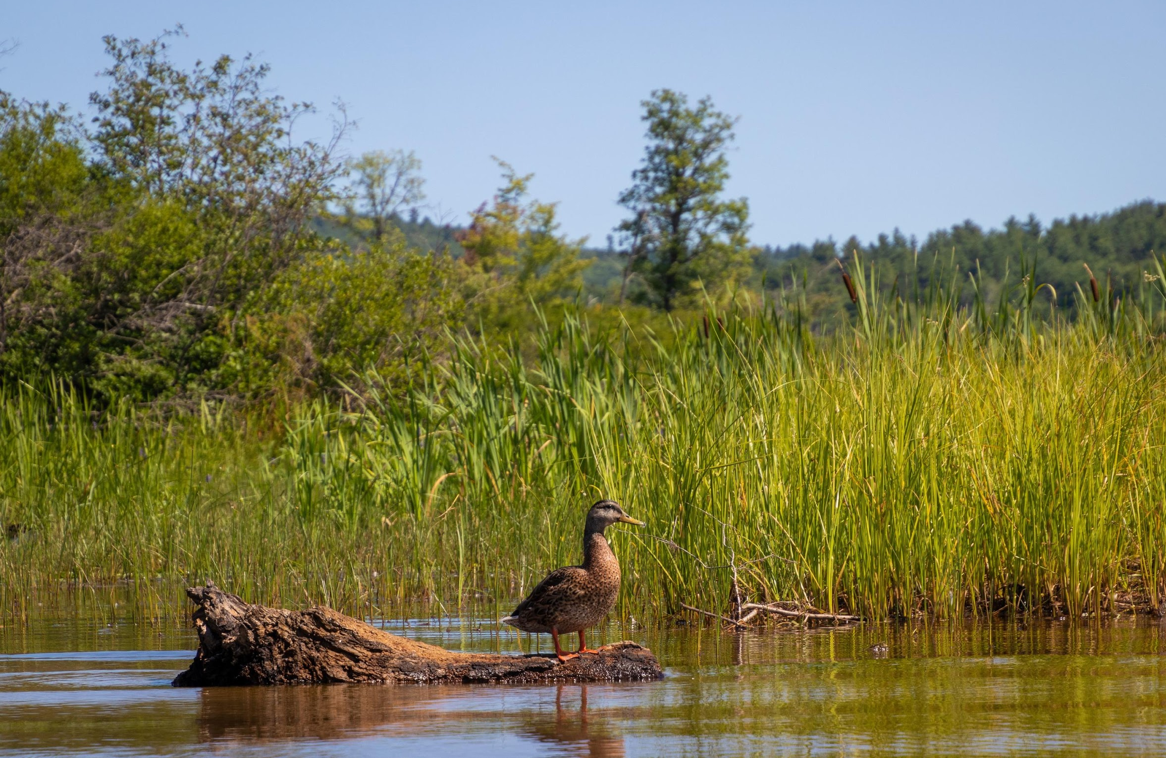
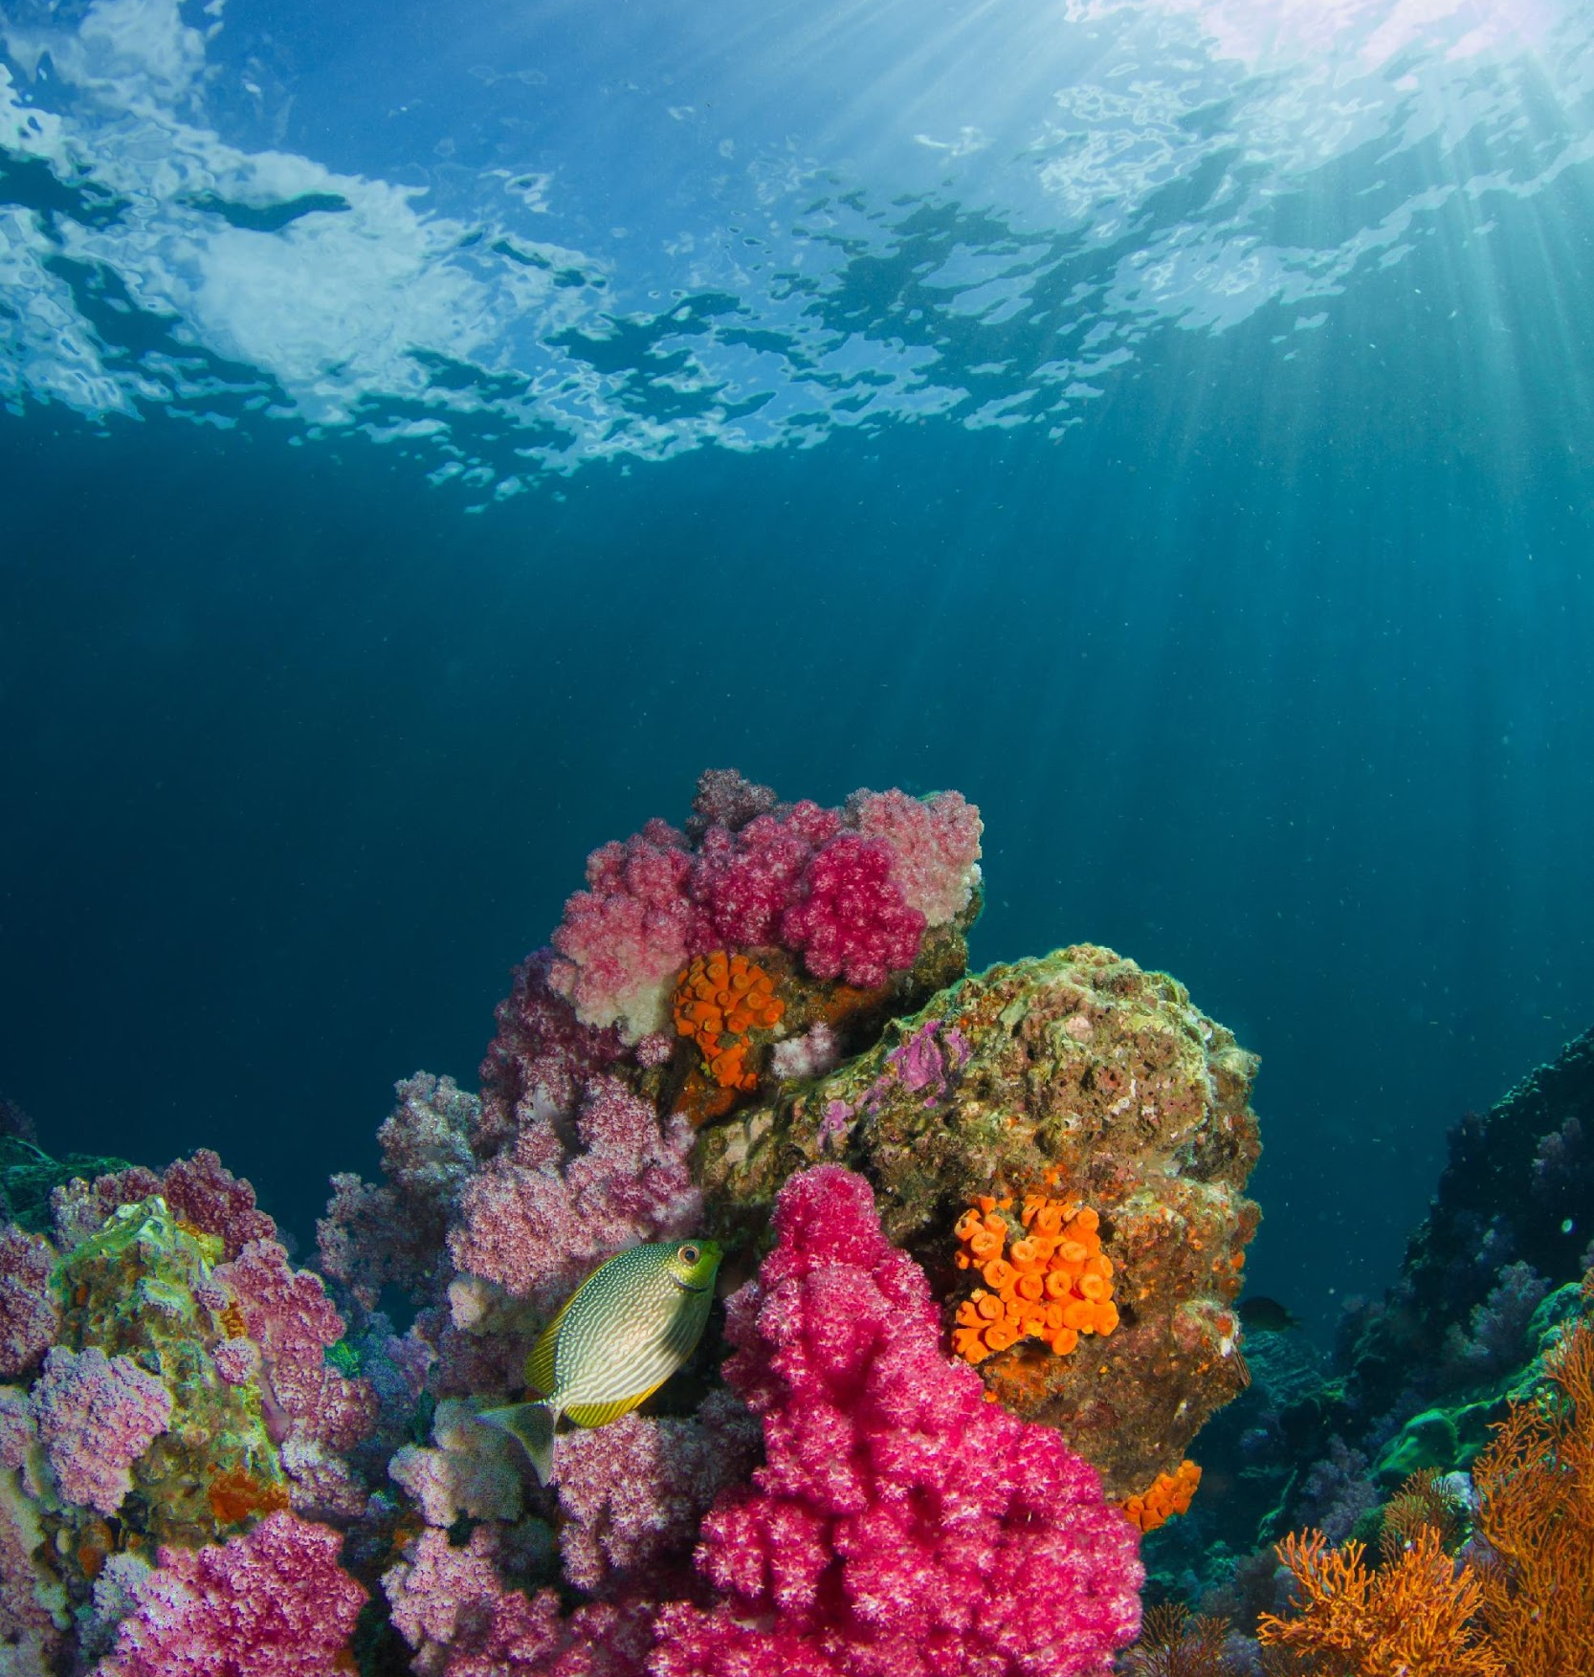
Ecosystems
Forest: Tropical Rainforest, Coniferous forest
Grassland: Prairies, Savannahs
Deserts: Hot, Cold
Tundra: Arctic, Alpine
Freshwater: Wetland, Stream, Lake
Marine: Coral Reef, Estuary, Ocean
Notes:
After the students have had a chance to suggest different ecosystems, the teacher can provide structure and organization to their examples using this slide.
For more information about the different ecosystems (https://sciencing.com/types-environmental-ecosystems-8640.html)
Published on January 25, 2021
Lake Tahoe, United States
Meritt Thomas
https://unsplash.com/photos/XdjRPTGe_CM
Tall redwood and pine trees in a snow covered Tahoe forest.
Joshua Tree, CA, USA
https://unsplash.com/photos/WzflGW7hqWo
Jaida Stewart
Published on May 2, 2020
https://unsplash.com/photos/CJmDwLcGkB8
Dan Hamill
Published on October 25, 2019
Milos Prelevic
https://unsplash.com/photos/2xuiab6o-qc
Ko Lipe, Thailand
Published on January 9, 2018

Slide 9
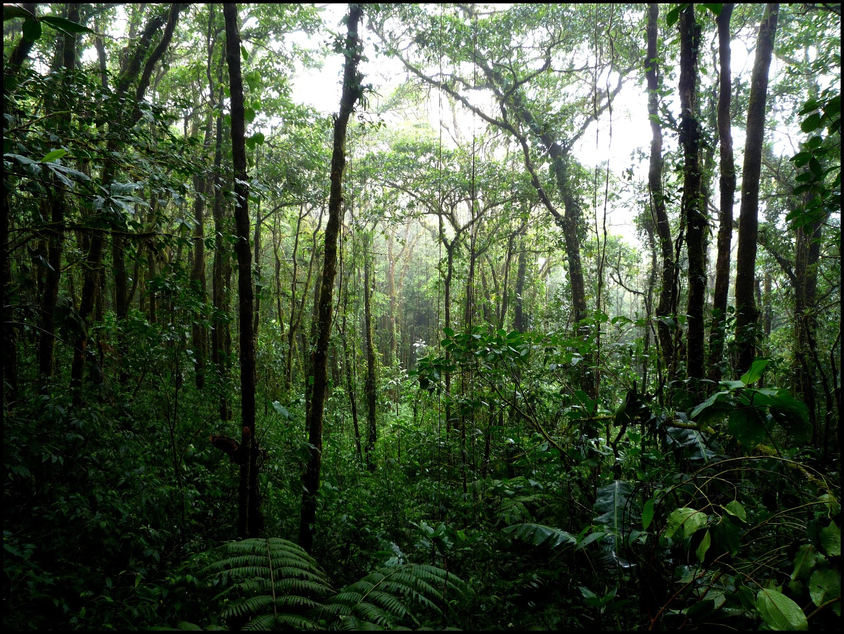
What type of ecosystem is this?
What are the various living/non-living entities? Imagine the animals that live in this ecosystem that you might not see in this image.
Why is each important? What does each contribute?
How are they interconnected?
How do you know if this ecosystem is flourishing?
Notes:
What type of ecosystem is this? Forest: Tropical Rainforest
What are the living/non-living entities? water, soil, orangutans, jaguars, butterflies, sloths, poison dart frogs, tree frogs, scarlet macaws, boa constrictor, spider monkey, forest floor (microbes, bacteria, fungi, decaying plant and animal matter), shrubs, small trees, broad-leafed evergreen trees, orchids
Why is each important? What does each contribute?
Microbes help break down plant and animal matter to release nutrients into the soil.
The large evergreen trees of the forest provide homes for orchids, mosses, liches, birds, mammals, reptiles, etc.
Each species is linked within a food web that if off-balance can disrupt many of the species within the forest.
Ants forage the forest floor and remove seeds, plant matter, and decaying animals
How are they interconnected?
An intricate food web (see above)
There exists an intricate balance of sunlight and water. Many of the plants living low to the ground require little sunlight as they are given shade from the canopy. Meanwhile some trees grow above the canopy layer and are well-adapted for the winds and hot temperatures while also protecting the canopy layer below.
How do you know if this ecosystem is flourishing?
Biodiversity - if there is a lack of biodiversity this could be a sign that something is off-balance and the rainforest isn’t flourishing.
If there are numerous animals or plants that have died there might be a problem with the flourishing of the ecosystem.
For more information: https://www.worldatlas.com/articles/tropical-rainforest-animals.html
https://www.flickr.com/photos/vkreay/4132244038/in/photolist-7i9QbS-z9dcL4-yREQFv-z8a7vo-yRAkum-za3vFc-z8b9hN-yRyFEA-z6Tgrw-yRyMtw-M1ub2d-23ZbdwJ-KtepRq-z9GbBY-zsa3ex-2jSZbo4-Vnvr6L-34wuiU-34rSKH-34rZqP-34rV8D-34rYkc-34s5rn-34wvkw-34wxcU-34s3D6-34rY4V-34wqwo-34rVzc-34ww85-ycaEeQ-ycaeVu-ycj9WH-yRErsM-za1oHZ-yca1Pj-yRyY13-depScV-yc9j4b-yRAr8W-7RfRGP-yRBHZ9-bp4K1f-7i5Ump-yRzyZE-7Rj96G-dy9dQY-z6SDz1-bdm86H-z9ZPca
Taken on November 27, 2008
“Rainforest”
Victoria Reay
Taken on November 27, 2008
Victoria Reay

Slide 10
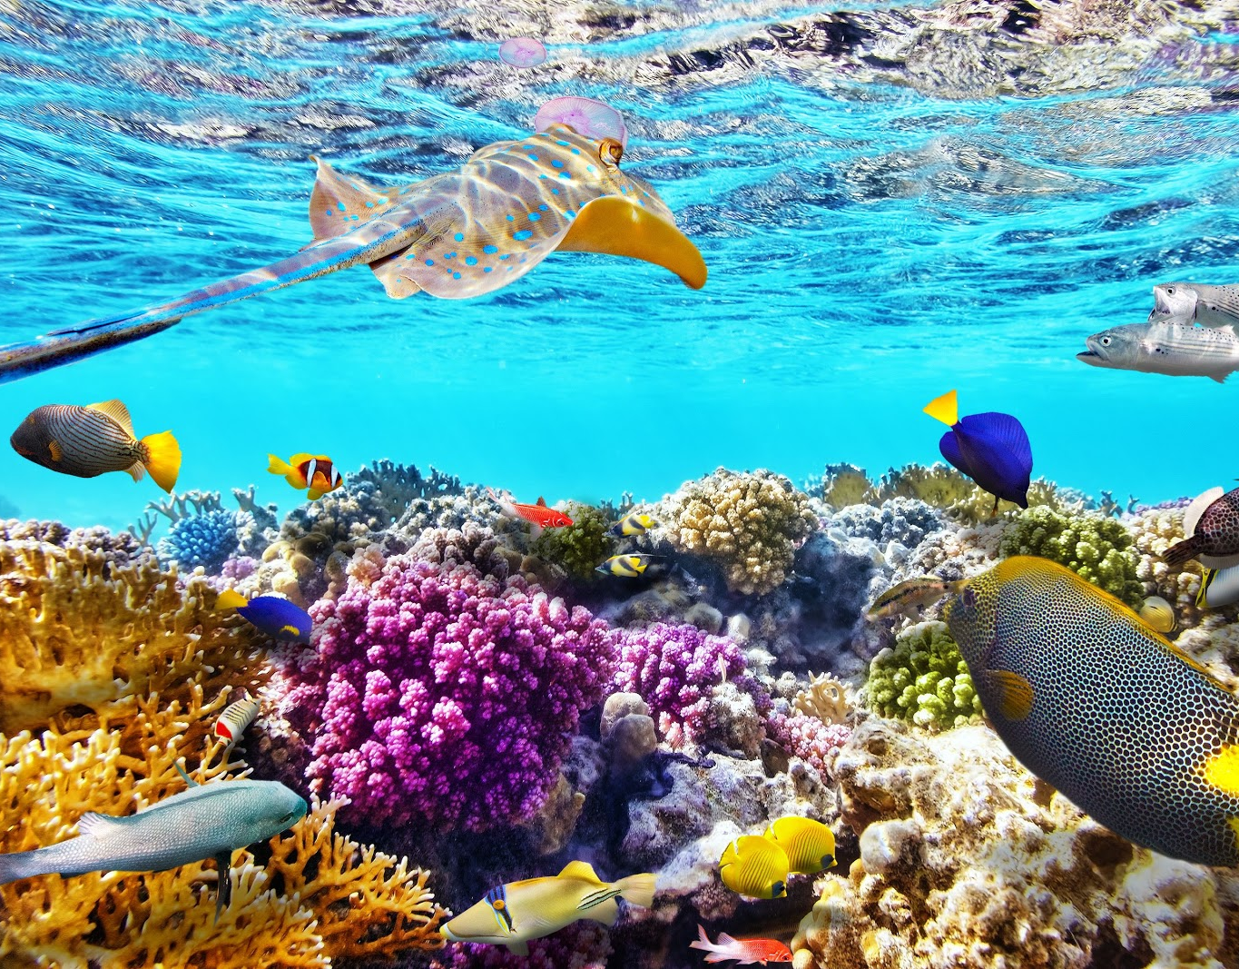
What type of ecosystem is this?
What are the various living/non-living entities? Imagine the animals that live in this ecosystem that you might not see in this image.
Why is each important? What does each contribute?
How are they interconnected?
How do you know if this ecosystem is flourishing?
Notes:
https://wallpaperaccess.com/great-barrier-reef

Slide 11
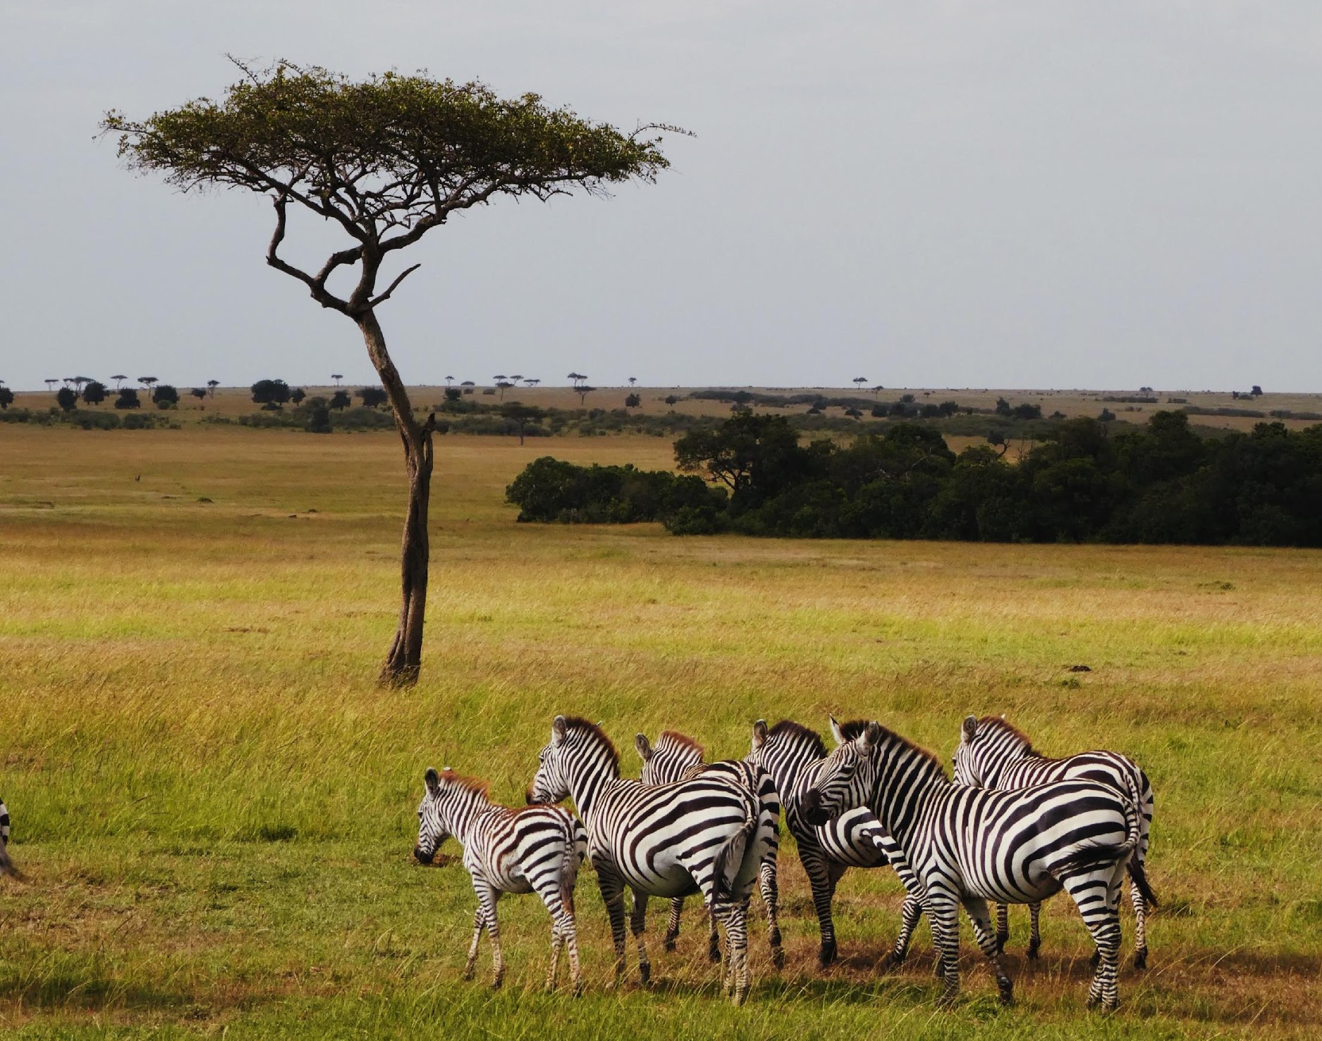
What type of ecosystem is this?
What are the various living/non-living entities? Imagine the animals that live in this ecosystem that you might not see in this image.
Why is each important? What does each contribute?
How are they interconnected?
How do you know if this ecosystem is flourishing?

Slide 12
Features of a Flourishing Ecosystem
Made of unique elements that contribute to the functioning of the ecosystem.
Living and nonliving things share certain necessary conditions for existence (e.g., balance, resources, etc.).
Living elements rely on other living elements and also non-living elements.
Living elements can influence other living elements and also non-living elements.
Elements are interdependent. The health of one element affects that of another and a balance is required for individual and ecosystem health.
What is good for one element or species is ultimately good for all (because it promotes this balance).
All of these features must be present!
Notes:
Ecosystems are made of unique elements (e.g., plants, animals, minerals, environmental conditions, etc.) with each element making a particular contribution to the functioning of the ecosystem.
For example in the tropical rainforest there are several species such that are found only in the tropical rainforest and nowhere else. The animals, microbes, plants, and decaying matter are all a part of a complex web of interactions that balance for the functioning of the entire ecosystem.
Living and nonliving things share certain necessary conditions for existence (e.g., balance, resources, etc.).
The tropical rainforest provides a great opportunity to talk about the shared condition of light. Little sunlight reaches the forest floor. For this reason, the plants that are low to the floor are adapted to need less sunlight. In addition, much of the forest floor is free of vegetation which allows larger animals such as the okapi and tapir to live in the forest. The canopy is home to many species within the tropical rainforest. The canopy is taller and able to obtain more sunlight that the trees need to grow. There are then even larger trees that grow above the canopy. These trees are adapted to harsh sunlight conditions and keep the rest of the rainforest protected from the heat and winds higher up.
Living elements in an ecosystem rely on other living elements and also non-living elements.
Plants and animals rely on sunlight, water, and other species for their food and survival.
Living elements have the ability to influence other living elements and also non-living elements.
Ants in the tropical rainforest are essential for clearing the forest floor of debris and decaying animals. Without the ants’ work, plant and animal matter would collect on the forest floor. This would impact other species who need to navigate across the forest floor including those large animals such as the okapi and tapir.
Elements in an ecosystem are interdependent. The health of one element affects that of another and a balance is required for individual and ecosystem health.
The plants and animals within a tropical rainforest are interconnected in a complex food web. This web provides a balance between the species such that all of the species can survive with enough food and space. If one species dies out this will impact the food supply of others who in turn may die out. If one species becomes too dominant then other species might be over-hunted by the dominant species, or run out of space or food.
What is good for one element or species is ultimately good for all (because it promotes this balance).

Slide 13
Human Interactions with Ecosystems
We affect an environment’s ability to flourish.
We can cause it to be out of balance (pollution)
We can cause it to collapse by introducing or removing something from it.
God empowers us with the ability to ruin, sustain, or repair an ecosystem.
Notes:
Here the teacher begins to introduce the idea that humans can impact the environment and hence ecosystems around us.

Slide 14
Human Interactions with Ecosystems
We affect an environment’s ability to flourish.
We can cause it to be out of balance (pollution).
We can cause it to collapse by introducing or removing something from it.
God empowers us with the ability to ruin, sustain, or repair an ecosystem.
Notes:
There are many ways that humans have caused the environment to be out of balance. These include: air pollution (cars and factories), water pollution (runoff from fertilizers and detergents, plastics in the ocean, oil spills) and more broadly global warming and subsequent climate changes. There are numerous examples students might offer or a teacher can discuss. The next slide gives more in-depth on one impact of humans on the balance of the environment.

Slide 15
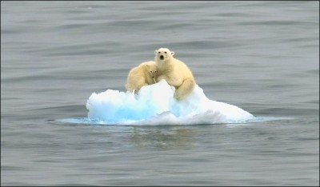
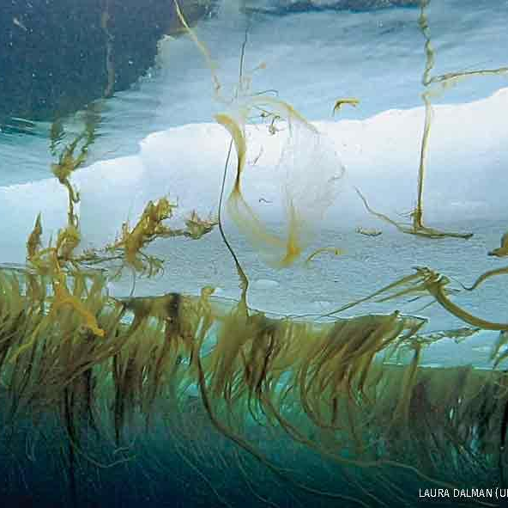
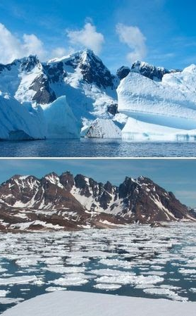
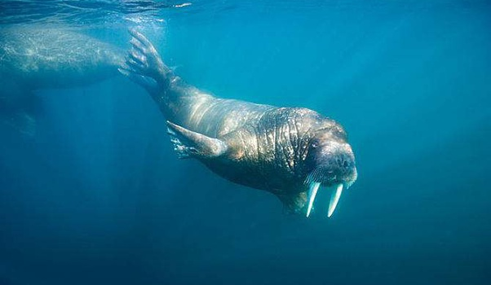
Melting of Glaciers
Notes:
On this slide, the teacher can talk about the melting of glaciers due to global warming.
Polar bears: Polar bears give birth and hunt on sea ice. They also need sea ice to travel from one region to another. With less sea ice, the female polar bears have less food. This means that mothers and cubs are less likely to survive in the spring and even prior to survival in the spring, less food means decreases the fat stores of females and impacts their ability to have healthy cubs in the spring.
Ice algae: Ice algae grow on the underside of sea ice. This algae is more nutritious that other forms of algae found in the sea an essential to the survival of krill, penguins, seals, polar bears, adn blue whales. In fact, 86% of a polar bear’s nutrition comes from a food chain that starts with ice algae.
Walrus: The walrus feeds off clam on the sea floor. The walrus dives from the ice edge down to the bottom of the sea. As the ice edge melts away continental shelves where walrus feed, they will no longer be able to access the sea floor or their clams. Walrus also travel on floating ice in order to access a wider range of area for feeding. This too is compromised by melting of ice.
https://www.thetravel.com/13-alarming-images-of-glaciers-melting-12-people-who-dont-care/
https://www.greenfacts.org/en/arctic-climate-change/l-2/5-arctic-animals.htm
https://www.nwf.org/Home/Magazines/National-Wildlife/2019/Feb-Mar/Animals/Sea-Ice-Algae
https://eportfolios.macaulay.cuny.edu/climatechange/effects-on-polar-bears/

Slide 16
Human Interactions with Ecosystems
We affect an environment’s ability to flourish.
We can cause it to be out of balance (pollution).
We can cause it to collapse by introducing or removing something from it.
God empowers us with the ability to ruin, sustain, or repair an ecosystem.

Slide 17
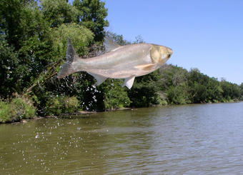
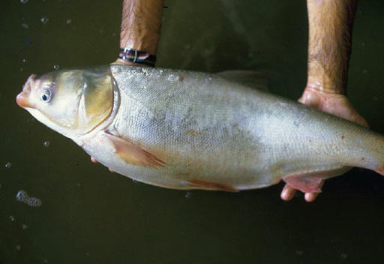
Asian Carp: An Invasive Species
Notes:
Asian carp are an example of an invasive species humans have introduced into ecosystems where they don’t naturally occur. These fish were brought to North American in the 1970s to eat algae in aquaculture ponds and have since escaped. They have been found in the Mississippi and Illinois River and are migrating towards Lake Michigan. These carp are voracious eaters and could easily overtake the natural ecosystem of Lake Michigan, eating the food supply of the native fish and crowding native fish out of their habitat. In addition, these fish can also harm boaters. Vibrations from boat propellers can cause the silver carp to jump as high as five feet out of the water. (https://www.michigan.gov/documents/dnr/asian_carp_brochure-smaller_388343_7.pdf)

Slide 18
Human Interactions with Ecosystems
We affect an environment’s ability to flourish.
We can cause it to be out of balance (pollution).
We can cause it to collapse by introducing or removing something from it.
God empowers us with the ability to ruin, sustain, or repair an ecosystem.

Slide 19
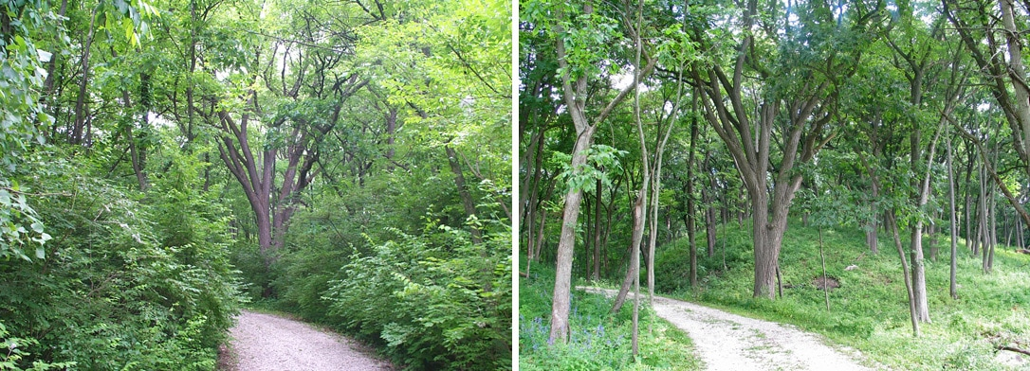
Honeysuckle: An Invasive Species
Notes:
On this slide the teacher can begin to introduce ways that humans can work to repair or sustain natural ecosystems. In this example, honeysuckle has overgrown a wooded area in northern Illinois. This invasive plant has overtaken the space and nutrients such that the native plants are not thriving. Humans came into this area to clear the invasive plant. As the students can see in the picture on the right, once the honeysuckle was removed, the native wildflowers and young trees are now able to grow again.
Photos courtesy of the Forest Preserve District of DuPage County.
https://www.ilhipp.org/stop-the-spread.html

Slide 20
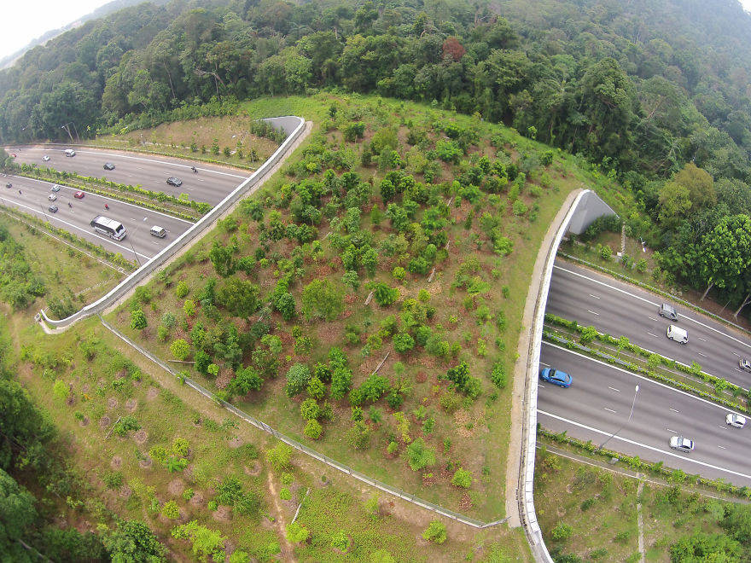
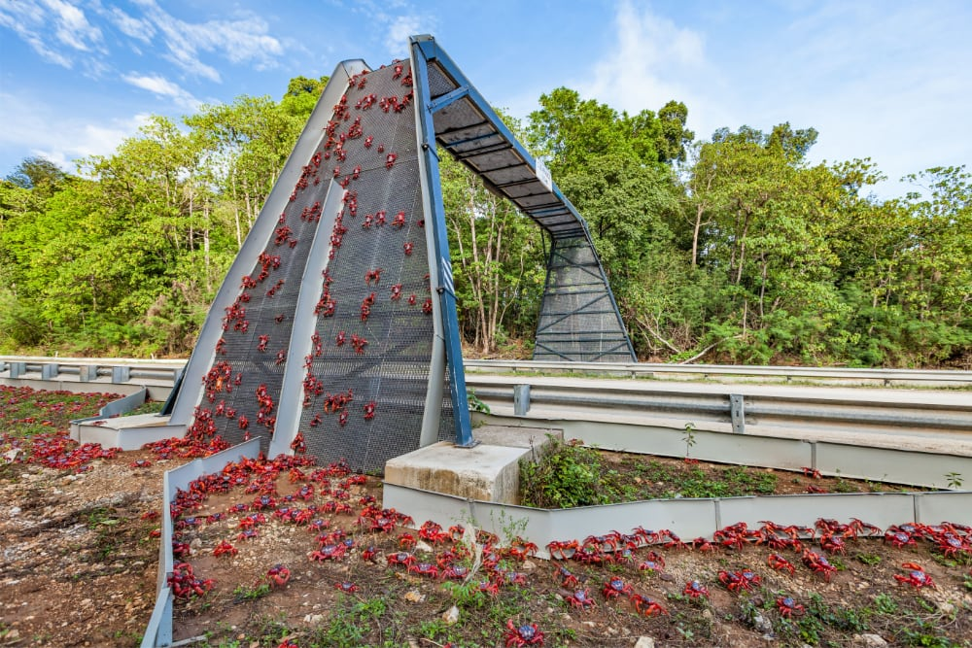
Bridges, Tunnels, and More
Notes:
On this slide, the teacher can provide some more examples of ways that humans are creatively sustaining ecosystems that have previously been disrupted by human behavior (e.g. building highways). The picture on the left is a natural bridge created in Singapore to allow the native animals to traverse their normal habitat. When humans build highways, cities, neighborhoods, etc. they segment the natural habitat of animals, cutting off populations from one another, decreasing biodiversity and even leading to the extinction of some species. Some species may lose genetic diversity when forced to mate within a smaller gene pool. Others may lose their source of food. Others may be killed when trying to cross busy highways or roads.
The picture on the right is from Christmas Island. Christmas Island is an Australian territory in the Indian Ocean. Sometime around the months of September to January, millions of red crabs migrate across the island to the ocean to mate. Human development on the island has disrupted this normal migration of the red crabs. In order to facilitate the migration of the red crabs, humans have created bridges, underground tunnels, and elaborate fencing systems to direct the crabs safely to the ocean.
Humans across the globe are creating these structures for antelope in Wyoming, deer and coyote in Washington, grizzly bears, elk, deer, moose, cougars, and black bears in Canada, elephants in Kenya, squirrels in Australia, etc.
https://allthatsinteresting.com/animal-bridges-wildlife-crossings
https://parksaustralia.gov.au/christmas/discover/highlights/red-crab-migration/
https://www.nationalgeographic.com/animals/article/wildlife-overpasses-underpasses-make-animals-people-safer?

Slide 21
Generalizations About Human Interactions
The actions outlast the person who causes them
The individual effects have a collective impact
Notes:
The teacher should point out to students that two generalizations about human interaction can be made based on the discussion about human influence on ecosystems.
Firstly, a person’s actions outlast him or her. Human actions have consequences and impacts that extend beyond the timeframe of the particular decision but can also extend beyond even the individual person’s lifetime. For example, consider those who are no longer living on the earth but have contributed to carbon emissions, the global warming of the planet, and the melting of glaciers.
Secondly, effects from individual decisions of the same person and/or effects from multiple different individuals have a collective impact on ecosystems. This can be seen in the example of the crab bridge (and other bridges and tunnels) around Christmas Island that allow the crabs to migrate to the ocean. Think of the numerous different individuals that would have been a part of identifying the problem for the crabs, brainstorming solutions, obtaining permits to create the structures, those who designed the structures, and those who built the structures all in order that the crabs can successfully migrate to the ocean without harm from human roads and traffic.
These generalizations about human interactions is not only true of human interactions with ecosystems but is also true of human interactions with other humans and within human communities. This is important to understand as the unit progresses but also for students to remember generally as they make decisions throughout their lifetime.

Slide 22
What does a flourishing human ecosystem (community) look like?
Notes:
Now the teacher should shift from a focus on natural ecosystems to human ecosystems or human communities. The teacher can use this question and the next slide to help students transition to thinking about human communities.

Slide 23
Natural Ecosystems / Human Communities
Natural Ecosystem | Human Community
Unique elements each make a particular contribution to the overall functioning. | Each individual person is unique and unrepeatable and makes his or her own contribution to the community
Living and nonliving things share certain necessary conditions for existence. | Persons in a community share the air, sun, water, library, school, laws (e.g. speed limits), etc.
Living elements rely on living and non-living elements. | Persons need food, water, oxygen, and friendships to survive
Living elements influence living and non-living elements. | Human communities are made of human persons
Elements are interdependent. The health of one affects the health of another and a balance is required for individual and ecosystem health. | Human persons are connected and can impact the well-being of one another. Someone not following the speed limit may cause a car crash.
What is good for one element or species is ultimately good for all (because it promotes this balance). | What is good for one individual person is good for the human community.
Notes:
The teacher can remind the students about the features of a flourishing natural ecosystem and challenge the students to consider how these features might be similar or different in a human community. Give the students plenty of time to make connections on their own as they begin to contemplate the complexities of flourishing in human communities.

Slide 24
Natural Ecosystems / Human Communities
Natural Ecosystem | Human Community
Unique elements each make a particular contribution to the overall functioning. | Each individual person is unique and unrepeatable and makes his or her own contribution to the community.
Living and nonliving things share certain necessary conditions for existence. | Persons in a community share the air, sun, water, library, school, laws (e.g. speed limits), etc.
Living elements rely on living and non-living elements. | Persons need food, water, oxygen, and friendships to survive.
Living elements influence living and non-living elements. | Persons influence one another and the environment.
Elements are interdependent. The health of one affects the health of another and a balance is required for individual and ecosystem health. | Human persons are connected and can impact the well-being of one another. Someone not following the speed limit may cause a car crash.
What is good for one element or species is ultimately good for all (because it promotes this balance). | What is good for one individual person is good for the human community.
Notes:
The table has suggestions for what students might say about the human community as related to a natural ecosystem. The students don’t have to have proficient knowledge of a human community at this point. The teacher can remind them that this is what they will be exploring over the next few lessons.
Note that the first entry for the human community references the uniqueness of each individual person. This is related to the concept of human dignity. Each individual person is an unrepeatable gift from God, made in the image and likeness of God, and should be treated with the utmost love and respect. The last entry for the human community may be the most difficult for students to comprehend at this time. As students continue to learn about the common good, this concept of the interrelatedness of individual good and group good will be reinforced.

Slide 25
Human Flourishing
Humans are a unique creation!
Capacity to reflect on actions and make correction
Union of body and soul
  Material needs: food, water, shelter
  Nonmaterial needs: loving and just relationships, pursuit of meaning and truth, acknowledgement of dignity
Capacity to reflect on the meaning of order and how a well ordered and just community ought to function
Notes:
Humans not only have the ability to impact natural ecosystems but also have the capacity to reflect on their actions and make corrections. The teacher will want to point out that humans are a unique type of animal, characterized by unity of body and soul This means that we have both material needs that must be met -- food, water, shelter, etc., -- and also non-material needs -- loving and just relationships, the pursuit of meaning and truth, an acknowledgment of dignity, etc. -- that must be met in order to flourish. Unlike other animals, even animals who order their environment in highly complex ways, human beings, human beings not only order our communities, but we can also reflect on the meaning of order itself and on how a well ordered and just community ought to function.

Slide 26
Upcoming Lesson
Explore how communities and every person in a community flourishes—common good
3-2-1 Exit ticket
  3 new things you learned today
  2 things reinforced today
  1 question about flourishing or the common good
Notes:
The teacher can use this slide to wrap up the lesson. In the next lesson students will begin to learn about the critical attributes of the common good through pairs of examples. At the end of the lesson students should complete a 3-2-1 exit ticket as explained on the slide.

Slide 27
References
References
Facts About Animals – Wildlife Society. Poison Dart Frog [digital image]. Retrieved from http://www.facts-about.info/poison-dart-frog/
Thomas, Meritt. (2021, January 25). Tall Redwood and Pine Trees in a Snow Covered Tahoe Forest [digital image]. Retrieved from https://unsplash.com/photos/XdjRPTGe_CM
Stewart, Jaida. (2020, May 2). Cacti [digital image]. Retrieved from https://unsplash.com/photos/WzflGW7hqWo
Hamill, Dan. (2019, October 25). Duck [digital image]. Retrieved from https://unsplash.com/photos/CJmDwLcGkB8
Prelevic, Milos. (2018, January 9). Coral [digital image]. Retrieved from https://unsplash.com/photos/2xuiab6o-qc
Ray, Victoria. (2008, November 27). Rainforest. Retrieved from https://bit.ly/37bSMlE
WallPaper Access. Great Barrier Reef [digital image]. Retrieved from https://wallpaperaccess.com/great-barrier-reef
Izumi, Aliya. (2019, September, 8). Zebra [digital image]. Retrieved from https://unsplash.com/photos/eeACe__y3LA
Hoffman, Shelby. (2019, November 20). 13 Alarming Images of Glaciers Melting. Retrieved from https://www.thetravel.com/13-alarming-images-of-glaciers-melting-12-people-who-dont-care/
Quora. The male walrus has very long teeth, what are they used for? Retrieved from https://www.quora.com/The-male-walrus-has-very-long-teeth-what-are-they-used-for
Hyman, Randall (2019, February 1). The Secret Lives of Ice Algae. Retrieved from https://www.nwf.org/Home/Magazines/National-Wildlife/2019/Feb-Mar/Animals/Sea-Ice-Algae
(2021). The Effect of Climate Change on Polar Wildlife. Retrieved from https://eportfolios.macaulay.cuny.edu/climatechange/effects-on-polar-bears/
Fuller, Jennifer. (2017, August 2). Scientists Trying to Discover Why Asian Carp Crossed Lake Michigan Barrier. Great Lakes Today. Retrieved from https://www.wmuk.org/post/scientists-trying-discover-why-asian-carp-crossed-lake-michigan-barrier#stream/0
Department of the Interior, U.S. Geological Survey. (2017, April 26). Asian Carp Would Have Adequate Food to Survive in Lake Michigan. Retrieved from https://www.usgs.gov/news/asian-carp-would-have-adequate-food-survive-lake-michigan
Forest Preserve District of DuPage County. (2018, March 7). Stop the Spread! Plant Natives Instead. Headwaters Invasive Plan Partnership. Retrieved from https://www.ilhipp.org/stop-the-spread.html
Kelly, Erin. (2019, May 27). 25 Animal Bridges That Are Keeping Wildlife Safe From Humans And Their Cars. All That’s Interesting. Retrieved from https://allthatsinteresting.com/animal-bridges-wildlife-crossings
Wondrous World Images. (2013-2021). Red Crab Migration. Parks Australia. Retrieved from https://parksaustralia.gov.au/christmas/discover/highlights/red-crab-migration/
Notes:
Silence

Slide 28
Copyright © 2019 McGrath Institute for Church Life, University of Notre Dame.
.

Slide 29
