Slide 1
Transforming the Contact Center Experience in Banking with Automation
January 25th, 2022

Slide 2



Thank you for joining us today!
This session is being recorded and will be sent to all participants after the webinar.
Listen-only mode during the presentation
Please submit questions via the chat. We will have a Q&A session at the end of the webinar.

Slide 3


Our Experts
David Burnie, Principal & Founder at Burnie Group
David founded Burnie Group in 2011 to help organizations dramatically improve their operations. It has since become one of the fastest-growing management consulting firms in Canada
Eli Federman, Omnichannel & Contact Center Practice Leader at Burnie Group
Eli is a strategic customer service and sales leader who works with global clients from various industries to optimize customer operations, generate revenue opportunities and build a differentiated customer experience.
* Current target – date may change

Slide 4



Our Experts
Amit Kumar, VP, Financial Services at UiPath
Amit Kumar leads financial services Go to Market (GTM) strategy and business value engineering, specifically for large banking and capital markets clients.
Brad Beumer, CX and Contact Center Lead, Americas at UiPath
Brad leads UiPath’s customer experience and contact center practice for the Americas. He evangelizes UiPath’s platform for customer experience and contact center automation.
* Current target – date may change

Slide 5
Agenda
  Insights from Burnie Group’s contact center benchmarking work
  Why contact center automation is so powerful
  UiPath for Contact Centers
  Q&A

Slide 6



Our Approach to Contact Center Benchmarking
What We Deliver: A Simplified, Impactful and Repeatable Benchmark
A customized contact center benchmark
A uniquely defined set of quantifiable data
A standardized data gathering process
A comparable set of high value inputs
Pre-built reports crystallizing outputs and findings
A repeatable process and framework
Quarterly refresh of all data gathered
Self-serve capability (banks can query themselves)
A defined cadence for data gathering, analysis and report sharing
A comparative thought-provoking analysis & assessment
Synthesized outputs / findings for all KPI benchmarks
Validation for which KPIs to start / continue measuring
Suggestions for optimizing contact center operations
Global, outside-in industry reference

Slide 7
Insights from Burnie Group’s Banking Contact Center Benchmark
95%
80%
60-90 sec
Of Canadians use the phone as their channel of choice to reach their bank
Of frontline employees working remotely today
Hold time, depending on the line of business
5-20%
37- 47 NPS
Quarterly external attrition for frontline employees
Range of net promoter scores (NPS)

Slide 8












12 Benefits of Contact Center Automation
1. Reduce or eliminate time spent on high volume, time-consuming task
2. Automate customer validation
3. Optimize FAQ access
4. Automate after-call work
5. Reduce and eliminate switching between screens and systems
6. Increase the speed of retrieving information
7. Provide a 360-degree view of the customer
8. Seamlessly integrate between systems
9. Fully automate specific call types
10. Route calls more effectively
11. Eliminate errors
12. Accelerate and improve decision making

Slide 9
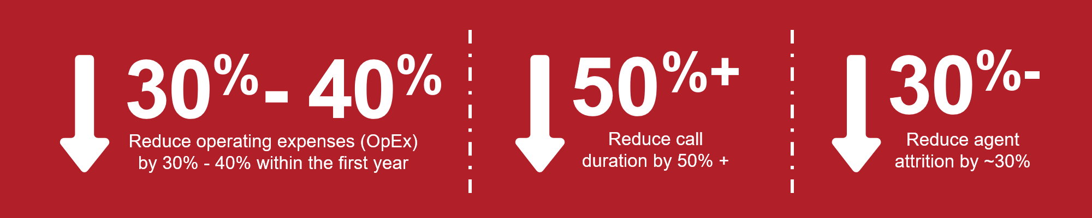
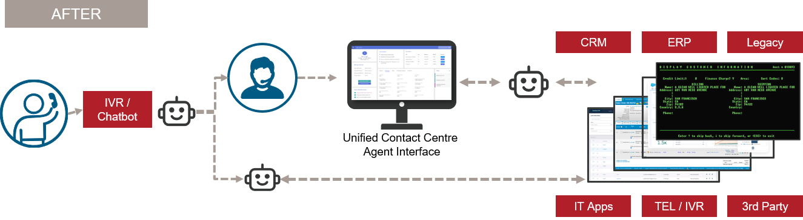
Why Contact Center Automation is Powerful
United Frontline Employee Interface

Slide 10



Automation Supports Top Customer Experience Improvement Priorities
Improve self-service options
Assist agents and boost productivity
Reduce costs and improve operational efficiency
Increase customer and employee satisfaction
“Customers will love a company when the employees love it first”
  Simon Sinek

Slide 11
Improve Self-Service
Options

Slide 12
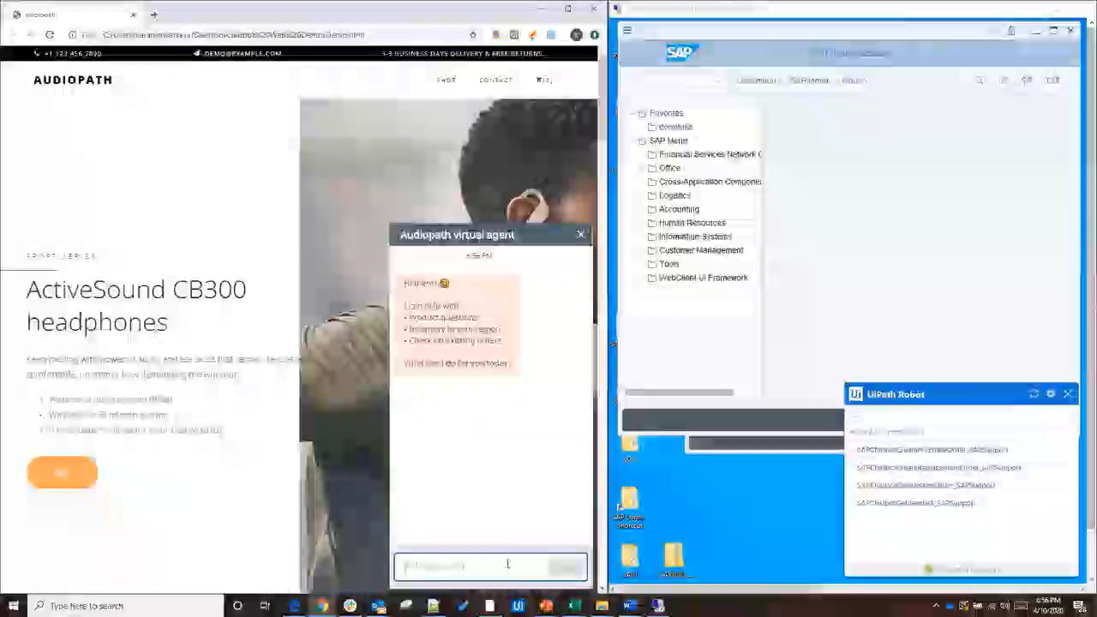

UiPath and Chatbots
Your Customer Web Portal and Chatbot
Your Backend Systems

Slide 13

Build Once, Deploy Across All Channels for a Consistent Customer Experience
Your Channels
UiPath Omnichannel Orchestration
Your Systems
Chat
Ask us about our Smart Email solution
CRM
Account Unlock
IVR
(phone)
Core
Banking
Connect & Triage
New Applications
Data Extraction
Email
Fraud & Security
Social
Other Interaction Types
Data Extraction
NLP/U
APIs
Web, Mobile, Fax
External Systems
Improve call deflection rates by 20-40%
Reduces customer wait times and provide 24x7x365 service
Improve NPS by 10% or more
Legend
Your Ecosystem
UiPath

Slide 14








Smart Email Automation – US Banking Client
The Challenge
Top US bank performs high amounts of manual effort to process over 700 million inbound customer emails across 10,000+ inboxes annually
The bank was in search of an end-to-end solution that leveraged AI to classify and extract data from emails to streamline processing and provide analytics
The Solution
Detect intent to organize and route emails to different departments
Prioritize urgent high value emails based on sentiment and business needs
Extract entities & execute business rules for escalations and data entry
Realize impact of AI, business processes & automation using Insights dashboard
The Results
$20 Million
Estimated annual savings
  1-2 Minutes
  saved per email
  Initial phase targeted top 10% of email types e.g., complaints, address changes, etc
  UiPath ML models used: text classification, sentiment analysis & named entity recognition (NER)

Slide 15
Improve Agent
Productivity

Slide 16
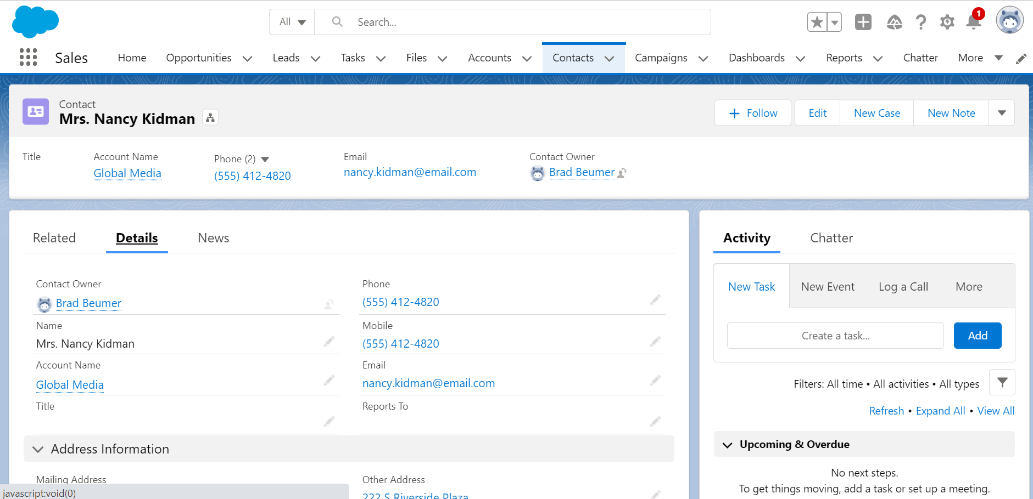
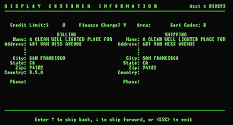
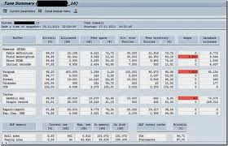
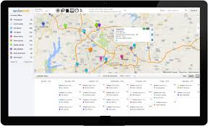
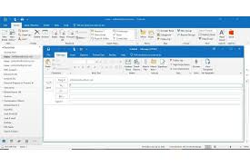
Challenge: System Functionality Gaps Cause Agents to Transverse Multiple Systems While Trying to Focus on the Customer
Key Challenges
Too many apps, screens, keystrokes, and commands to learn
Redundant data, copy and paste, and similar issues lead to errors (virtual swivel chair)
Pressure to reduce wait times and resolve requests on the first call (FCR)
Focus on soft skills to improve NPS, perform cross and upsell, and win back cancellations
Frontline employee
CRM
Core Banking
Fraud & Security
External
Systems
Emails, live chats, social, fax, written mail, and other requests

Slide 17
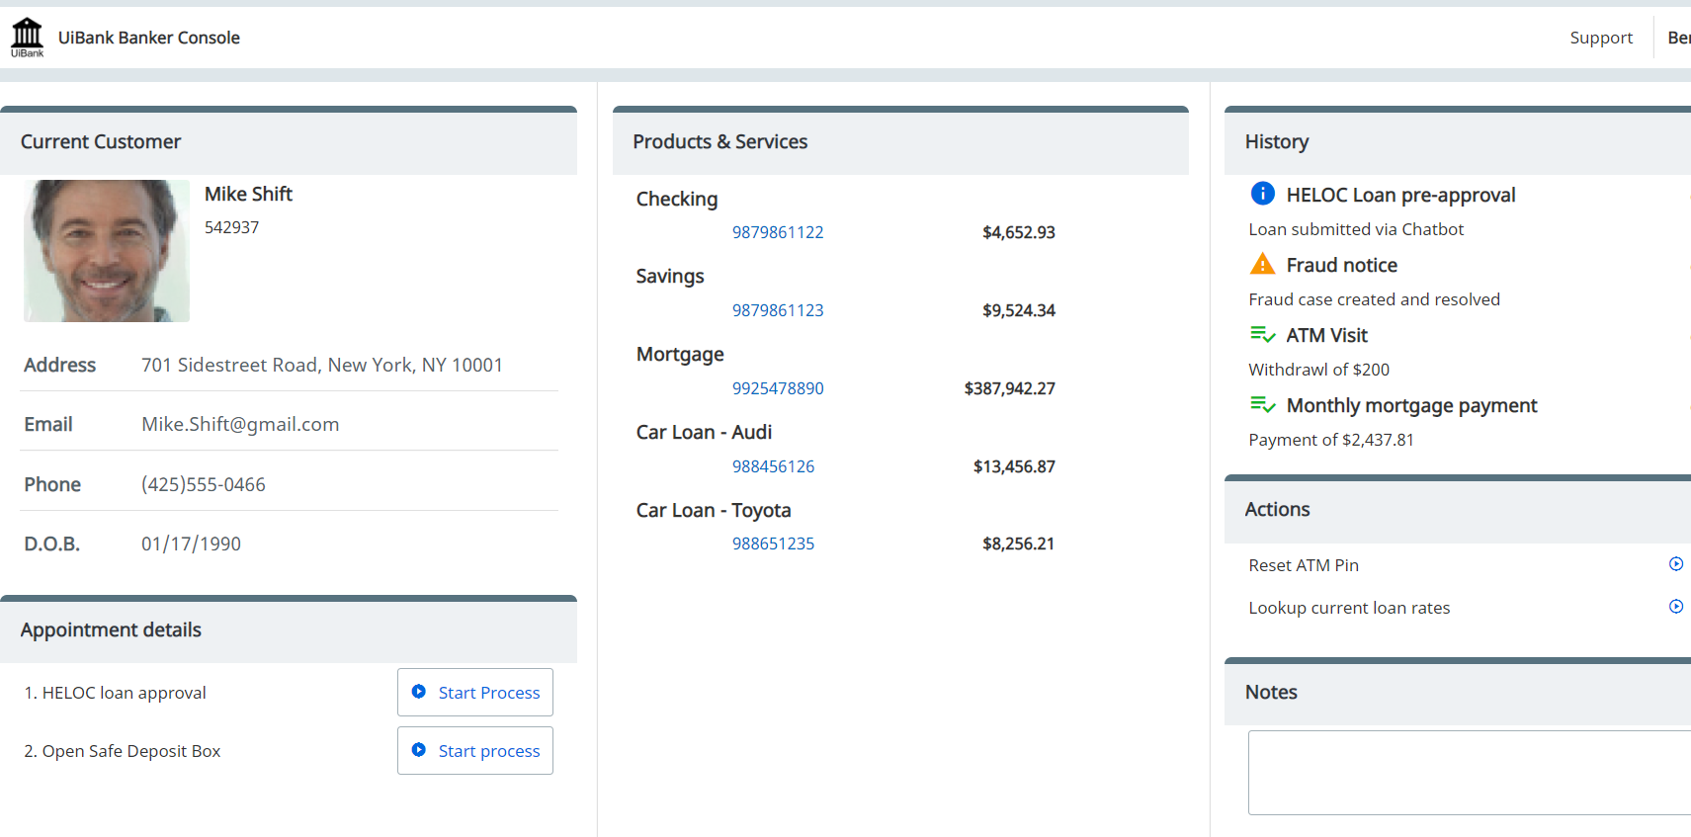

Solution: Guided Automation Allows Agents to Focus on the Customer Experience
1
Agent is provided real time guidance, suggestions, and next best actions
Solution Benefits
Improve NPS by 10%
Improve first call resolution, reduce wait times and average handle time by 40%
Reduce training time by over 20%
Increase upsell conversion rates by over 1%
Reduce errors and handle and increase consistency
Frontline employee
UiPath Agent Assisted Automation
2
Robots are triggered based on agent actions (e.g., button click) or keyword utterances (e.g., account number, order number, phone number, etc.)
3
Robots interact with all the required systems, removing the need for the agent to interact with any process or system

Slide 18





Getting Started with Automation and AI in the Contact Center
Start My Day
Start My Call
Guide My Call
End My Call
End My Day
Log the banker (agent) into WFM, phone, CRM, and other systems
3 or more times a day with breaks
Benefit: 2 mins per agent/day
Trigger the robot using the softphone or screen pop. Automate caller validation, data retrieval, and provide indicators in a single view
Benefit: 30-60 secs per call
Guide the agent through the call; robot eliminates swiveling, awkward silence, and executes NBAs
Benefit: 15-60 secs per call
Enter call wrap-up notes, generate emails, and automate handoffs
Benefit: 10-20% of AHT
Log the agent out of all systems and update the agent’s status in WFM
Benefit: Security and compliance

Slide 19
Improve Operational Efficiency

Slide 20
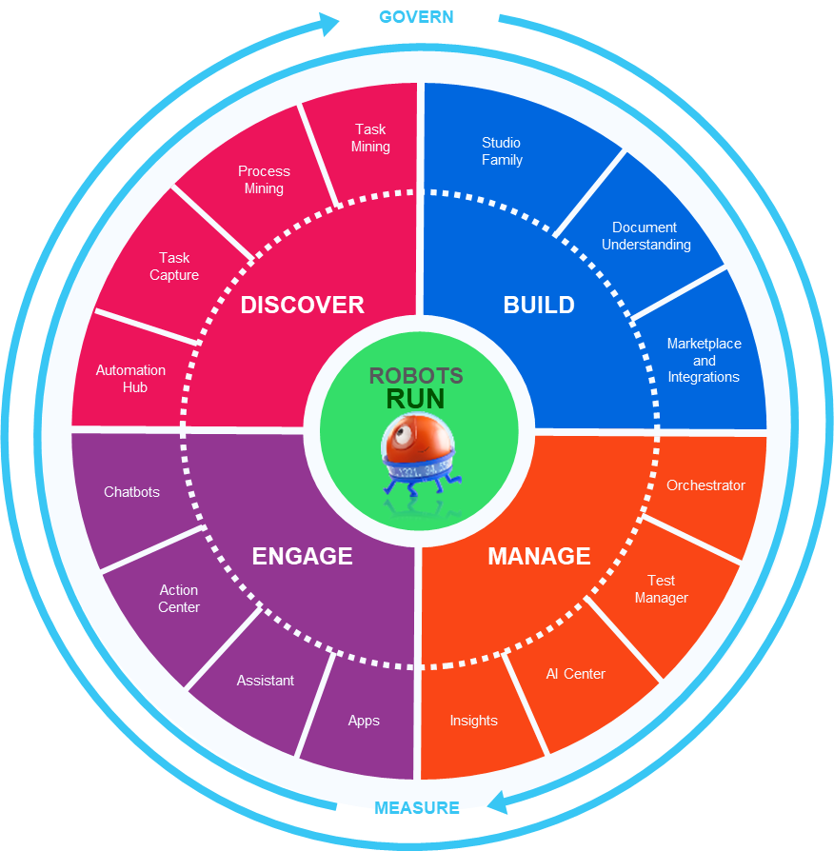
The UiPath Platform for Customer Experience Automation
Automate time and motion studies to gain insights
Discover what your best agents do differently
Document standard operating procedures and training guides
Analyze customer journeys to proactively identify customer pain points
Automate legacy channels like postal mail and fax
Configure automations based on processes documented by SMEs
Rapidly develop automations with connectors for Amazon Connect (AWS), Twilio, Genesys, Salesforce.com, kore.ai, boost.ai, Humley, and more
Leverage AI with automation for forms, email, ACW notes, post call analytics, and many more use cases
Advanced Citrix integration for WFH agents
Automate IVR and conversational AI testing
Create a single view of the customer with low-code + automation
Provide agents a digital assistant that doesn’t take over the keyboard
Allow customers to start in self-service and bring an agent into the loop
Boost your chatbot experience and usage metrics

Slide 21
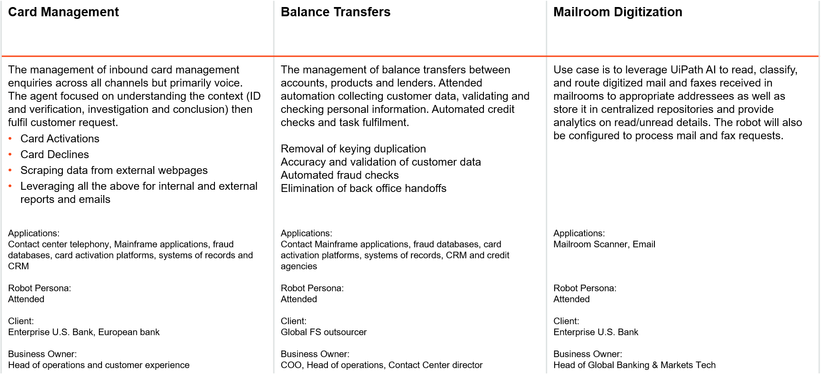
CX and Contact Center Case Studies
Enterprise Banks

Slide 22

Questions?
To ask our speakers a question,
type your question into the chat located in the bottom right portion of the screen.

Slide 23

What’s Next
Schedule a one-on-one consultation with our team
Read our article on the 12 benefits of contact center automation
Try our calculator to calculate the value you could realize through contact center automation

Slide 24

title
Thank you for joining us today
David Burnie
Burnie Group
david.burnie@burniegroup.com
Eli Federman
Burnie Group
eli.federman@burniegroup.com

