Slide 1
Gantrade Corporation + Tiarco-RST:
Creating Customer Benefits Serving the Emulsion Polymerization, Paint & Coatings, Adhesives & Sealants, Inks and Related Markets 2020

Slide 2
Gantrade + Tiarco-RST: Creating Customer Benefits
With 45 years in the global chemicals business, Gantrade is an experienced and responsible worldwide marketer of a broad range of Monomers, Intermediates & Polymers. Our goal is to provide value and innovation to help our customers succeed and grow.
With over four decades in the Rheology & Surfactants industry, Tiarco-RST offers a wealth of experience, capabilities and leading-edge products that can help to create products with distinctive performance advantages.
Together, Gantrade and Tiarco RST offer a broad portfolio monomers, intermediates, polymers crosslinking chemistries, surfactants, rheology modifiers, dispersants and related products that help to advance performance dimensions in emulsion-based paint & coatings, adhesives & sealant, inks and related products.
Our flexibility, customer focus, professional support services and environmental consciousness make doing business with us easy. Our combination allows us to better help our customers achieve the right solution for your specific formulations.
Whatever your specialty requirements, we welcome the opportunity to work with you

Slide 3
The Gantrade Value Proposition
Gantrade proudly serves industries spanning coatings, adhesives, sealants and elastomers (CASE);, emulsions and polymers; water soluble polymers, plastics and resins, urethane intermediates, construction, packaging, automotive, and textiles materials.
We have built a diversified global supply base, founded on responsible relationships with major global producers, and maintaining the principles of integrity, quality, safety and stewardship . The diversity of our supply chain mitigates risks for our customers. Above all else, we are committed to the highest standards of customer service and operational excellence.
Gantrade’s global footprint enables us to serve our customers efficiently and deliver more cost-effective chemical building blocks for their market applications. Our partners depend on us to keep them informed and ready to meet any challenges or opportunities.
Our highest business priority is to foster successful collaborations with our customers and suppliers to solve problems and create competitive advantages.
Gantrade is a Premier Marketer of Monomers, Intermediates, and Polymers Worldwide.

Slide 4
The Tiarco-RST Value Proposition
Tiarco-RST’s portfolio of Surfactants and Rheology Modifiers (Thickeners) has a product for every formulator’s need. You will find Tiarco’s multitude of rheology modifiers and surfactants in a wide range of applications in the emulsion polymerization, paint & coatings, adhesives & sealants, inks and related applications.
Prior associations with HB Fuller, Royal Adhesive, Para-Chem and now Textile Rubber provide a strong foundation for progressive research and product development, and technical service. Tiarco draws from a wealth of resources to deliver quality solutions. Their experience and technology spans over four decades.
The emulsion and rheology experts and chemists at Tiarco-RST are always available to assist you with any of your formulation challenges and new product development needs. Combining technologies from across their leading-edge chemistry portfolios can offer products with distinctive performance properties
With their highly flexible manufacturing processes and equipment, and advanced manufacturing technologies, Tiarco can custom synthesize or blend a wide variety of unique formulations to meet your special requirements, within strict quality limits. Production capacities span small and large quantities.
We excel in finding unique solutions for customers

Slide 5
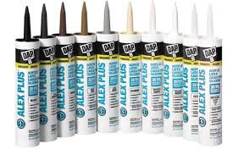
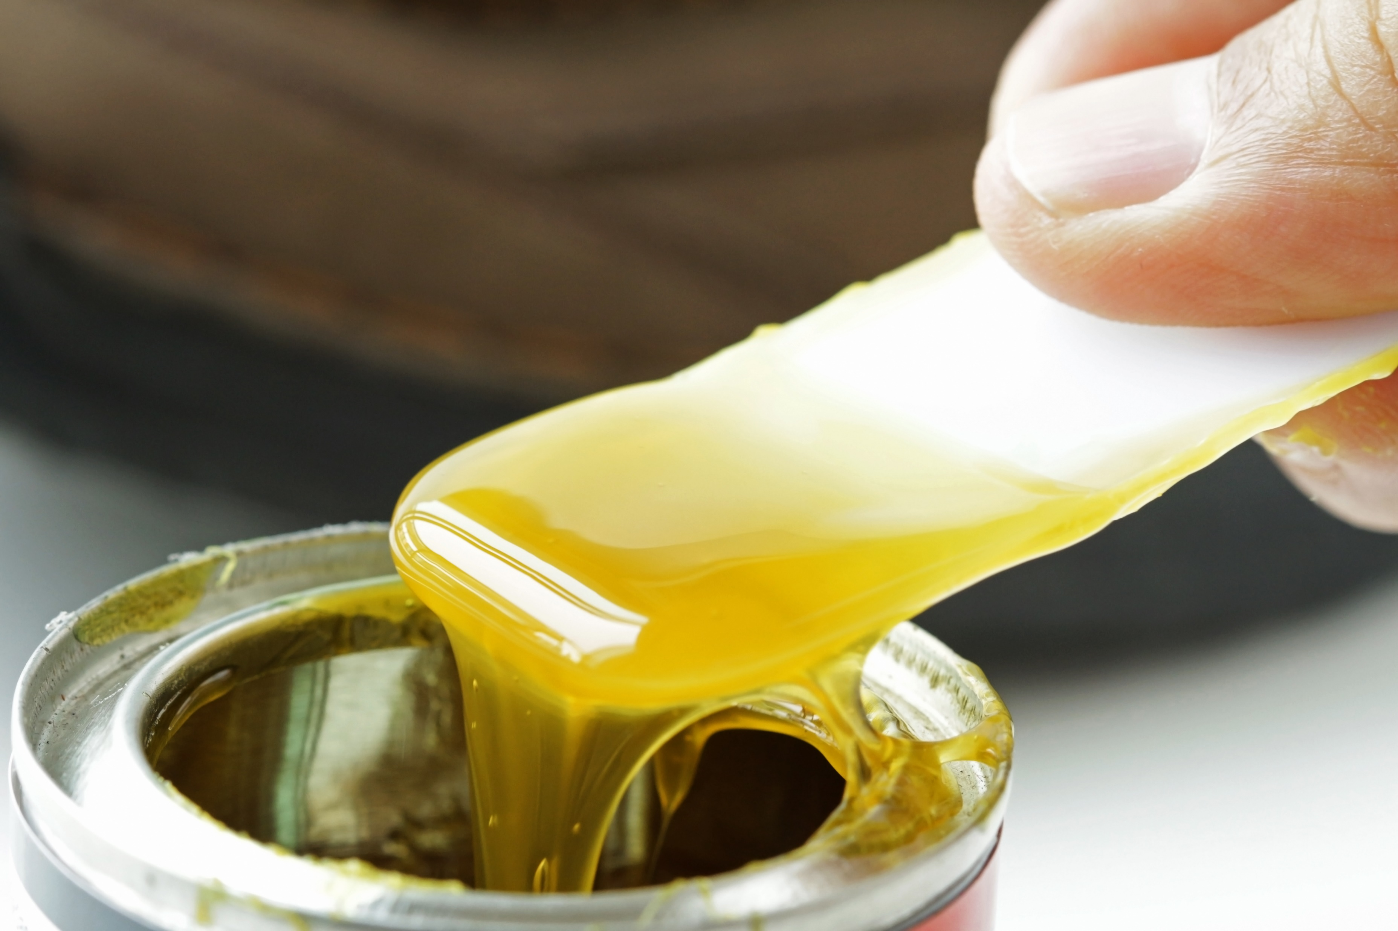
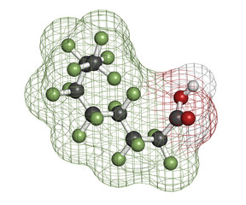
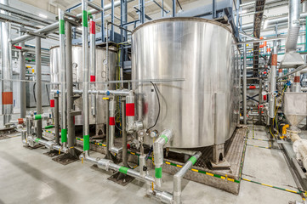
Tiarco-RST: Markets Served
Rheology Modifiers/Thickeners………..
….………….Surfactants, Emulsion Polymerization

Slide 6
Gantrade’s Vinyl and Acrylic Monomers
OUR MONOMERS INCLUDE:
Butyl Acrylate (BA)
Butyl Methacrylate (BMA)
Diacetone Acrylamide (DAAM) – crosslinking monomer with our ADH
Ethyl Acrylate (EA)
2-Ethylhexyl Acrylate (2-EHA)
Glacial Acrylic Acid (GAA)
Methyl Acrylate (MA)
Methacrylic Acid (MAA)
Methyl Methacrylate (MMA)
Vinyl Acetate Monomer (VAM)
Vinyl Neodecanoate (Shivena 10)

Slide 7
Sodium Polyacrylate Gum Thickeners
Product | Active | FDA Clearances | Application Information
Paragum T-111 | 15 | 175.105, 175.320, 175.300, 176.170 | Thickening of coatings, adhesives, sizes, and dispersions used in upholstery, drapery, carpet, paper, paint, wallpaper, printing, and textile.
Paragum 184 | 13 | 175.105, 175.300, 175.320, 176.170, 173.340, 176.200 | Thickening of specialty formulations including defoamers, textiles and paper coatings.
Paragum 241 | 13 |  | Thickening of suspensions, slurries, dispersions of inorganic color pigments, mineral fillers, and clays.
Paragum 341 (APEO-free) | 13 | 175.105, 175.320, 175.300, 176.170 | Thickening of liquid products applied by spraying, including defoamers and cleaning products.
Paragum 247 | 13 | 175.105, 176,180 | Secondary thickening agents used to impart unique rheology properties to a formulation.
Paragum 288 | 10.5 |  | Particle coatings and temporary coating vehicles removable by water rinse.
Paragum 390 (APEO-free) | 14.5 | 175.105, 175.320, 175.300, 176.170 | Superior thickening efficiency in carpet compounds.
Paragum 277 | 12.5 | 176.18 | Specially-formulated to incorporate the performance attributes of the products above with the added benefit of built-in added thickening efficiency for EVA (VAE) lattices.
T-Gum 104 | 13.5 | 176.170. 176-180, 176.200 | Superior thickening in defoamers or other coatings
SODIUM POLYACRYLATE THICKENERS
Sodium polyacrylate thickeners are versatile, aqueous polymer solutions designed to provide thickening, suspending, coating, and unique rheological properties for a host of applications. Uses include primary and secondary thickening of coatings, adhesives, grouts, dispersions, suspensions; thickening of liquid solutions applied by spray application; and as protective colloids and particle coatings in specialty products.
The broad product selection provides the formulator with a high degree of flexibility in determining the best choice for each application. Sodium polyacrylate thickeners are neutralized, viscous solutions. Paragum thickeners are used in the thickening of natural and synthetic latexes for a wide variety of applications. These product may be used to thicken styrene-butadiene, acrylonitrile, butadiene, acrylic, neoprene, vinyl acetate, and ethylene-vinyl acetate latex compounds. They are a great thickener for latexes that have an alkaline reaction.

Slide 8
Polyacrylate Rheology Modifiers: ASE (Alkali Soluble (Swellable) Emulsions) and HASE (Hydrophobically Modified)
POLYACRYLATE RHEOLOGY MODIFIERS
ASE thickeners contain a balance of methacrylic acid and acrylate ester. They are supplied in liquid form. Thickening is triggered by a change from low to high pH with bases such as ammonium hydroxide or caustic. ASE Rheology Modifiers are supplied at low pH and a low viscosity. When subject to a pH >8 in the coating formulation, ASE copolymers solubilize, swell and thicken the formulated coating through volume exclusion. ASE thickeners are steeply shear thinning and well suited to high-viscosity, thick-film applications such as caulks, mastics, finishes, sealers, paints, coatings and adhesives..
HASE rheology modifiers retain the pH dependent behavior and easy handling advantages of their ASE counterparts, but in addition to absorbing water, HASE rheology modifiers also thicken via hydrophobe association. Associative thickening, offers performance properties over a wider range of shear levels and facilitates a wider range of rheology profiles than is possible with thickeners such as ASE and cellulosic offerings. They are compatible with multiple binder chemistries,, where they offer a range of key performance properties, including flow and leveling, sag resistance and film build.
Product | Active | FDA Clearances | Application Information
Paragum 500 | 35 | 175.105 | Excellent all-purpose in situ acid type thickener, short rheology, clear gel. Workhorse acrylic coatings thickener used in defoamers.
Paragum 511 | 20 | 175.105 | Superior all-purpose in situ acid type thickener, stringy rheology, clear gel. Used in conjunction with Paragum 500 to achieve the exact blend of rheological properties.
Paragum 109 | 35 | 175.105, 176.170, 176.180, 176.200, 173.34 | Intermediate rheology in situ type thickener. Gentle thickening action.
Paragum 525 (HASE) | 30 | 175.105, 176.170,176.18 | Associative in situ acid type thickener. High-efficiency and effective in diverse applications including carpet, wood, and tile adhesives.
Paragum 530 (HASE) | 35 | 175.105, 176.170, 176.18 | Associative in situ acid type thickener. High-efficiency and effective in diverse applications including carpet, wood, and tile adhesives.
Paragum 600 (APEO-free) | 35 | 175.105, 176.170, 176.18 | Used as an in situ thickener by adding directly to the material. Performs effectively in a broad range of lattices, coatings, adhesives, dispersions, and solutions. Ease of handling and processing, safety, thickening, efficiency, and consistency, combined with its short, smooth flow characteristics, give the formulator latitude and flexibility in product design.
Paragum 601 (APEO-free) | 20 | 175.105, 176.170, 176.180, 176.200, 173.34 | Used as an in situ thickener by adding directly to the material. Performs effectively in a broad range of lattices, coatings, adhesives, dispersions, and solutions. Ease of handling and processing, safety, thickening, efficiency, and consistency, combined with its unique stringy or viscoelastic flow characteristics, give the formulator latitude and flexibility in product design.
Paragum 630 (HASE) | 30 | 175.105, 176.170,176.180, 175.300,175.32 | APEO-free. Hydrophobically modified anionic thickener designed to give high- efficiency and pseudoplastic rheological behavior. Used in tile adhesives, mastics, paint, water treatment and most textile applications.

Slide 9
Anionic Surfactants Quick Reference
Product | Active | Chemical Name | Applications
Stanfax 969 (3 mole) | 60 | Ammonium Laureth Sulfate | Emulsion Polymerization, Paints & Coatings, Adhesives, Sealants & Related Products .
Stanfax 1012 (12 mole) | 30
Stanfax 1026 (3 mole) | 27
Stanfax 1045 (2 mole) | 25
Stanfax 1094 (11 mole) | 30
Stanfax 238 | 27.5 | Ammonium Lauryl Sulfate | ditto
Stanfax 998 HV
Stanfax 998
Stanfax 1061 | 30 | Ammonium Decyl Sulfate | ditto and penetrants.
Stanfax 1033 (2 mole) | 32 | Ammonium Octyl/Decyl | ditto and high foaming ether sulfate agent.
Stanfax 967 | 30 | Sodium Decyl Sulfate | ditto and Emulsifier dispersant, wetting agent

Slide 10
Anionic Surfactants Quick Reference
Product | Active | Chemical Name | Applications
Stanfax 1024 HV | 25 | Sodium Laureth Sulfate | High Viscosity
Stanfax 1024 (1 mole) |  |  | Emulsion Polymerization, Paints & Coatings, Adhesives, Sealants & Related Products
Stanfax 1022 (2 mole) | 25.5 |  | ditto
Stanfax 1022 UM (2 mole) |  |  | ditto
 |  |  | ditto
Stanfax 1023 (3 mole) | 28.5
Stanfax 1015 (3 mole) | 60 |  | ditto
Stanfax 1066 (12 mole) | 30 |  | ditto
Stanfax 234 | 29.5 | Sodium Lauryl Sulfate | ditto
Stanfax 234 LCP |  |  | ditto
Stanfax 1025 |  |  | ditto
Stanfax 1007 | 33 | Sodium Octyl Sulfate | Ditto and wetting agent and dispersants
Stanfax 1089 | 32 | Ammonium Nonyl Phenolethoxy Sulfate | ditto
Stanfax 972 | 40 | Triethanolamine Lauryl Sulfate | ditto
Stanfax 560 | 22 | Sodium Dodecyl Benzenesulfonate | ditto and anionic wetting agent

Slide 11
Specialty Surfactant Blends Tiarco-RST
Product | Active | CFTA/Chemical Name | Typical Applications
Stanfax 525 | 33 | Proprietary Blend of Surfactants and Dispersants | High-efficiency foamer, which provides excellent foam stabilization properties, viscosity builder. Enhances froth viscosity and rheological properties.
Stanfax 167-M | 35 | Proprietary Blend of Surfactants and Dispersants | Premium foaming efficiency, combined with high level of foam stabilizer properties, viscosity builder. Enhances froth viscosity and rheological properties.
Stanfax 509 | 31 | Proprietary Blend of Surfactants and Dispersants | Moderate foaming efficiency, very high level of foam stabilization properties.
Stanfax 561 | 26 | Proprietary Blend of Surfactants and Dispersants | Enhanced foaming properties designed for commercial coating applications where bundle penetration is desired.
Stanfax 565 | 29 | Proprietary Blend of Surfactants and Dispersants | High-efficiency foamer, which provides excellent foam stabilization properties, viscosity builder. Enhances froth viscosity and rheological properties.
SPECIALTY BLENDS
Surfactant blends, specially formulated to meet the diverse coating needs of a broad range of latex applications, are effective with SBR, VAE, EVA, Acrylics, Vinyl Acrylics, SBR-X (carboxylated), and many other aqueous latex dispersions. These blends are compatible with most fillers, thickeners, and auxiliaries. Designed to be both cost-effective and efficient at low usage levels, these products provide the formulator with a full range of coating capabilities.

Slide 12
Thickeners Cross-References Tiarco-RST
GUM TYPE
Chemistry | Tiarco-RST | Cady | SCT | ChemTex | AkzoNobel
Methyl Acrylate-Sodium Acrylate Copolymer | O |  | SCT (KA)-114 |  | Alcogum 296W
Methyl Acrylate-Sodium Acrylate Copolymer | O | Acrypol 16
Ethyl Acrylate-Sodium Acrylate Copolymer | O | Acrypol 172 |  | CT-102
Ethyl Acrylate-Sodium Acrylate Copolymer | O | Acrypol 171 | SCT (KA)-78
Ethyl Acrylate-Sodium Acrylate Copolymer, APE free | O | Acrypol 17 |  | CT-202 | Alcogum AN-10
Ethyl Acrylate-Sodium Acrylate Copolymer, APE free | O | Acrypol 171 MP |  |  | Alcogum HPT
Borated Methyl Acrylate-Sodium Acrylate Copolymer | O | Acrypol 171V |  | CT-1015, 104
Borated Ethyl Acrylate-Sodium Acrylate Copolymer, APE free | O | Acrypol A70 |  | CT-2015
Injection Thickener – Ethyl Acrylate-Sodium Acrylate Copolymer Based | O | Acrypol 171 MP | SCT 5257
SODIUM POLYACRYLATE THICKENERS
Gum thickeners are supplied fully hydrolyzed
and pre-solubilized at medium to high as-is
viscosities. They allow for immediate thickening
without having to wait for polymer equilibration.
These new generation thickeners contain a
balance of acrylic acid and acrylate ester as
indicated in the Chemistry column.
Borated thickeners exhibit higher efficiencies.
Tiarco-RST offers numerous product grades
Within each set of Chemistries.
APE – Alkyl Phenol Ethoxylate Free. O Denotes an Equivalent Tiarco Product Grade

Slide 13
Thickeners Cross-References Tiarco-RST
ALKALI SOLUBLE TYPE (ASE & HASE)
Chemistry | Tiarco-RST | Cady | Rohm Haas | Dow | AkzoNobel
Alkali Soluble Emulsion (ASE) | O | Acrypol I304 | Acusol 810, 830 | ASE 60, 75 | Alcogum L-58, L-15, L-68
Alkali Soluble Emulsion (ASE) | O
Hydrophobically Modified HASE | O | Acrypol HMI 430 | Acusol 823, 805S | TT-935 | Alcogum SL78, SL70, SL251
ASE-APE free | O | Acrypol I305 |  | DR-5500
ASE-Redox type | O |  | Acusol 842 | ASE 95NP
ASE Redox- APE free | O
HASE- APE free, high shear rheology | O |  | Acusol 820 | TT-615
ASE thickeners contain a balance
of methacrylic acid and ethyl acrylate
ester. They are supplied in liquid
form. Thickening is triggered by a
change from low to high pH with
bases such as ammonium hydroxide
or caustic.
HASE are hydrophobically
modified on a molecular level
allowing thicken by association
and by absorbing water.
Tiarco-RST offers numerous product
grades within each set of Chemistries.
APE – Alkyl Phenol Ethoxylate Free. O Denotes an Equivalent Tiarco Product Grade

Slide 14
Surfactants Cross-Reference
 |  | TIARCO-RST |  | STEPAN | PILOT | LUBRIZOL (Chemron) | SOLVAY (Rhodia) | BASF(Cognis)
Sodium Lauryl Sulfate
 | SLS | Stanfax | O | Stepanol WAC | Calfoam SLS-30 | Sulfochem SLS | Rhodapon SB | Standapol WA
 |  | Stanfax | O | Polystep B-5 | Calimulse SLS |  | Rhodapon UB
 |  | Stanfax | O | Stepanol LCP |  | Sulfochem SLS-LCX | Rhodapon LCP | Standapol WA-LC
 |  | Stanfax | O
Sodium Lauryl Ether Sulfate
 | SLES (1) | Stanfax | O | Steol CS-130 | Calfoam ES 301 | Sulfochem ES-1 | Rhodapex ESY | Standapol ES-1
 | SLES (2) | Stanfax | O | Steol CS-230 | Calfoam ES 302 | Sulfochem ES-2 | Rhodapex ES-2 | Standapol ES-2
 | SLES (3) | Stanfax | O | Steol CS-330 | Calfoam ES 303 | Sulfochem ES-3 | Rhodapex ES | Standapol ES-3
 | SLES (3) - 60 | Stanfax | O | Steol CS-460 | Calfoam ES 603 | Sulfochem ES-60 | Rhodapex PS 603 | Standapol SL-60
 | SLES (12) | Stanfax | O | Polystep B-23
Ammonium Lauryl Sulfate
 | ALS | Stanfax | O | Stepanol AM | Calfoam ALS-30 | Sulfochem ALS | Rhodapon L-22 | Standapol A
 |  | Stanfax | O | Stepanol AM-V |  |  |  | Standapol A-HV
Ammonium Lauryl Ether Sulfate
 | ALES (2) | Stanfax | O | Steol CA-230 | Calfoam EA 302 | Sulfochem EA-2 | Rhodapex EA-2 | Standapol EA-2
 | ALES (3) | Stanfax | O | Steol CA-330 | Calfoam EA 303 | Sulfochem EA-3 |  | Standapol EA-3
 | ALES (3) - 60 | Stanfax | O | Steol CA-460 | Calfoam EA 603 | Sulfochem EA-60 | Rhodapex PA 603 | Standapol AL-60
 | ALES (11) | Stanfax | O |  |  |  | Abex JKB
 | ALES (12) | Stanfax | O | Polystep B-22
 |  |  | O denotes an Equivalent Tiarco Product Grade

Slide 15
Surfactants Cross-Reference
 |  | TIARCO-RST |  | STEPAN | PILOT | LUBRIZOL (Chemron) | SOLVAY (Rhodia) | BASF(Cognis)
Triethanol Amine Lauryl Sulfate
 | (TEALS) | Stanfax | O | Stepanol WAT | Calfoam TLS-40 | Sulfochem TLS | Rhodapon TLS | Standapol T
Cocamidopropyl Betaine (CAPB) |  | Stanfax | O | Amphosol CG | Caltaine C35 | Chembetaine C | Mirataine CB | Velvetex BA-35
Lauryl Amine Oxide (LAO) |  | Stanfax | O | Ammonyx LO | Caloxamine LO | Chemoxide LO | Rhodamox LO
Myristal Amine Oxide |  | Stanfax | O | Ammonyx MO | Macat AO-14 | Chemoxide MO
Cocamide DEA |  | Paramide | O | Ninol 40-CO | Calamide C | Amidex CE | Alkamide CD | Standamide SD
Cocamide DEA (2:1) |  | Paramide | O | Ninol 11-CM | Calamide CW-100 |  | Alkamide DC-212 | Standamide PD
Laramide DEA |  | Paramide | O | Ninol 30-LL | Calamide LL | Amidex LD | Alkamide LE | Standamide LD
Alpha Olefin Sulfonate (AOS) |  | Stanfax | O | Bio-Terge AS-40 | Calsoft AOS-40 |  | Rhodacal LSS
Sodium Octyl Sulfate |  | Stanfax | O | Polystep B-29
Sodium Decyl Sulfate (SDS) |  | Stanfax | O | Polystep B-25
Sodium 810-2 Sulfate |  | Stanfax | O
Ammonium Decyl Sulfate |  | Stanfax | O
Ammonium Nonyl Phenol |  | Stanfax | O |  |  |  | Abex EP-110
Ether (9) Sulfate
Sodium Trideceth (3) Sulfate |  | Stanfax | O | Cedepal TD-403 |  |  | Rhodpex EST-30
Sodium Dodecyl Benzene Sulfonate
NaDDBSA (Branched) |  | Stanfax | O | Polystep A16-22 | Calimulse EM-22 |  | Rhodacal DS-4
O denotes an Equivalent Tiarco Product Grade

Slide 16
The Gantrade + Tiarco-RST Value Proposition
Together, Gantrade and Tiarco RST offer a broad portfolio monomers, intermediates, polymers, crosslinking chemistries, surfactants, rheology modifiers, dispersants and related products that help to advance performance dimensions in emulsion-based paint & coatings, adhesives & sealant, inks and related products.
Our flexibility, customer focus, professional support services and range of manufacturing assets make doing business with us easy. Our combination allows us to better help our customers to meet challenges & opportunities and to achieve the right solution for your specific applications.
Tiarco-RST’s portfolio of Surfactants and Rheology Modifiers has a product for every formulators needs.
Our combined capabilities are always available to assist customers with formulation challenges and to tailor new products that can offer distinctive performance advantages.
Whatever your specialty requirements, we welcome the opportunity to work jointly to enhance the performance of your products

